Slide 1
JSON Data and API Calling
By Yashank

Slide 2
What is JSON?
JSON - JavaScript Object Notation
Advantages of JSON
Language Independent
Self Describing
Data interchange Format

Slide 3
JSON Syntax
Basic JSON Data
"name“ : “Yashank“
“rollnumber” : 1810991050
“male” : True
“MSPLevel” : “Beta”
“Status” : “Blocking all TikTokers”

Slide 4
JSON Syntax
{
"name“ : “Yashank“
“rollnumber” : 1810991050
“male” : True
“MSPLevel” : “Beta”
“Status” : “Blocking all TikTokers”
}

Slide 5
JSON Syntax with JS
<script>
var myObj;
myObj = { "name": “yashank", "age": 20, "city": “Hissar" };
myObj["name"] = “Yashank";
document.getElementById("demo").innerHTML = myObj.name;
</script>

Slide 6
JSON Data Types
There are basically 8 types for JSON data types
1. Number
2. String
3. Boolean
4. Array
5. Value
6. Object
7. Whitespace
8. Null

Slide 7
JSON - Numbers
var subject_marks = {
maths: 91,
chemistry: 97,
physics: 86,
biology: 78
};
var subject_marks = {
“maths” : 91,
“Chemistry” : 97,
“physics” : 86,
“biology” : 78
};

Slide 8
JSON - Strings
var subject_grade = {
maths: "A",
chemistry: "A",
physics: "B",
biology: "C“
};
var subject_grade = {
“maths” : “A”,
“Chemistry” :”A”,
“physics” : “B”,
“biology” : “C”
};

Slide 9
JSON - Boolean
var subject_grade = {
maths: true,
chemistry: true,
physics: false,
biology: true
};
var subject_grade = {
“maths” : true,
“Chemistry” :false,
“physics” : false,
“biology” : true
};

Slide 10
JSON - Array
"student": [
{
"rollnumber": 1810991050,
"subject": "Java Programming",
"name": “Yashank",
"course": "BTech",
"university": "International University"
},
]

Slide 11
JSON - Null
"student": [
{
"rollnumber": 1810991050,
"subject": null
"name": “Yashank",
"course": "BTech",
"university": "International University"
},
]

Slide 12
JSON - Value
var subject_grade = {maths: "A", chemistry: "A", physics: "B", biology: "C"};
var subject_marks = {maths: 91, chemistry: 97, physics: 86, biology: 78};
var subject_pass = {maths: true, chemistry: true, physics: true, biology: false};

Slide 13
Different types of Nested JSON data

Slide 14
JSON – Object inside Object
var subject_marks = {
maths: {
“Grades”:”A”,
“Marks”:90
},
chemistry: 97,
physics: 86,
biology: 78
};

Slide 15
JSON – Array inside Object
myObj = { "name":“Yashank", "age":20, "cars": [ { "name":“BMW"}, { “Model":“X5”} ] }

Slide 16
JSON – Complex Nested Array
myObj = { "name":“Yashank", "age":20, "cars": [ { "name":"Ford", "models":[ "Fiesta", "Focus", "Mustang" ] }, { "name":"BMW", "models":[ "320", "X3", "X5" ] }, { "name":"Fiat", "models":[ "500", "Panda" ] }
] }

Slide 17
API

Slide 18
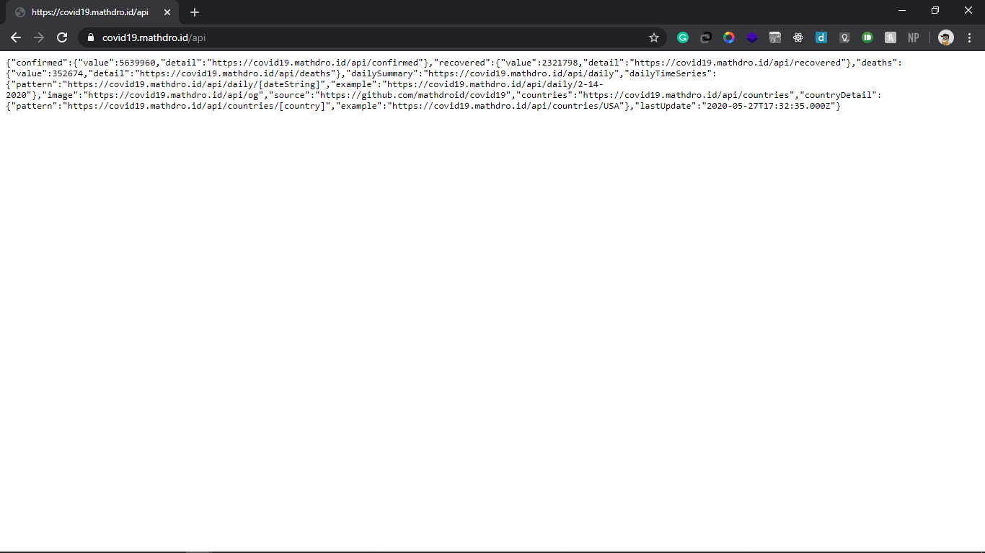
Example JSON API
https://covid19.mathdro.id/api

Slide 19
Ways to fetch data from API using JS

Slide 20
Ways to Call API
There are 4 possible Ways to call an API
XMLHttpRequest
Fetch
Axios
jQuery

Slide 21
XMLHttpRequest
let request = new XMLHttpRequest();
request.open(“GET”, “https://covid19.mathdro.id/api”);
request.send( );
request.onload = ( ) => {
console.log( request );
if ( request.status === 200){
console.log(JSON.parse(request.response));
}
else {
console.log(`error ${request.status} ${request.statusText}`)
}
}

Slide 22
Axios
<script src=“https://unpkg.com/axios/dist/axios.min.js></script>
<script>
axios.get(‘https://covid19.mathdro.id/api’)
.then(response => {
cosole.log(response.data);
})
.catch (error => console.error(error));
</script>

Slide 23
jQuery
<script>
$(document).ready(function () {
$.ajax( {
url: “https://covid19.mathdro.id/api”,
type: “GET”
success: function (result) {
console.log(result);
},
error: function (error) {
console.log(error);
}
})
})
</script>

Slide 24
Fetch
<script type="text/javascript">
function click(){
console.log("yes");
getData();
}
async function getData(){
let response = await fetch('https://covid19.mathdro.id/api');
let data = await response.json()
return data;
}
getData().then(data=> console.log(data.confirmed.value));
</script>

