Slide 1
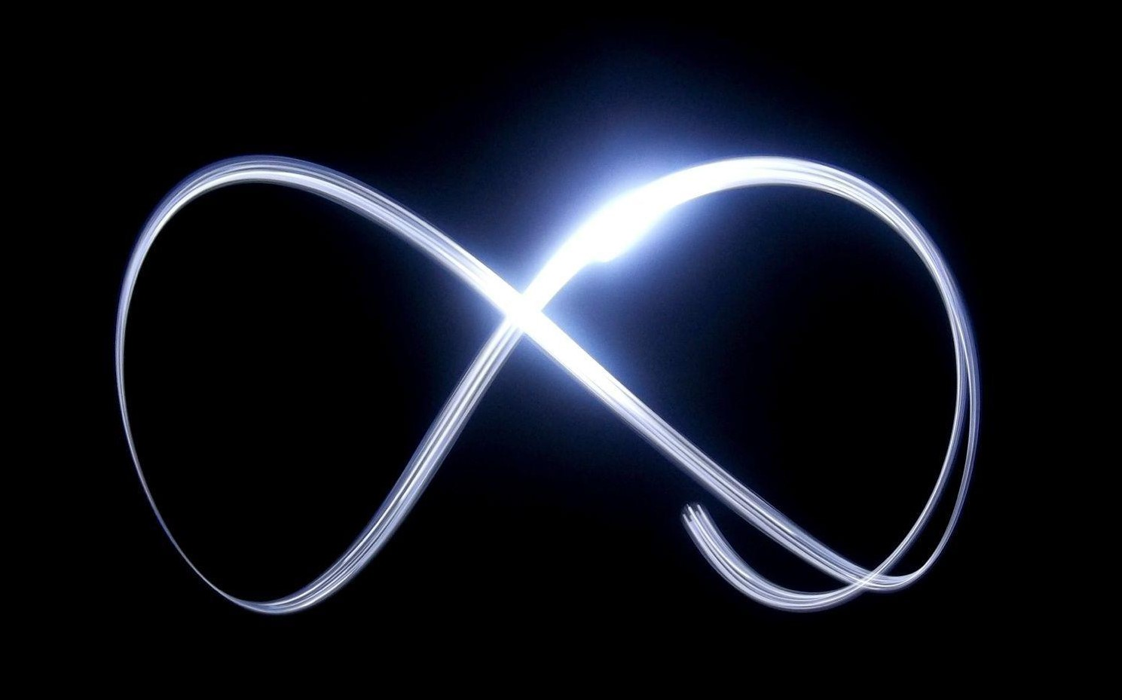
InPHYnity
Let it GO (Without a Bang)
By: Yashas.P

Slide 2
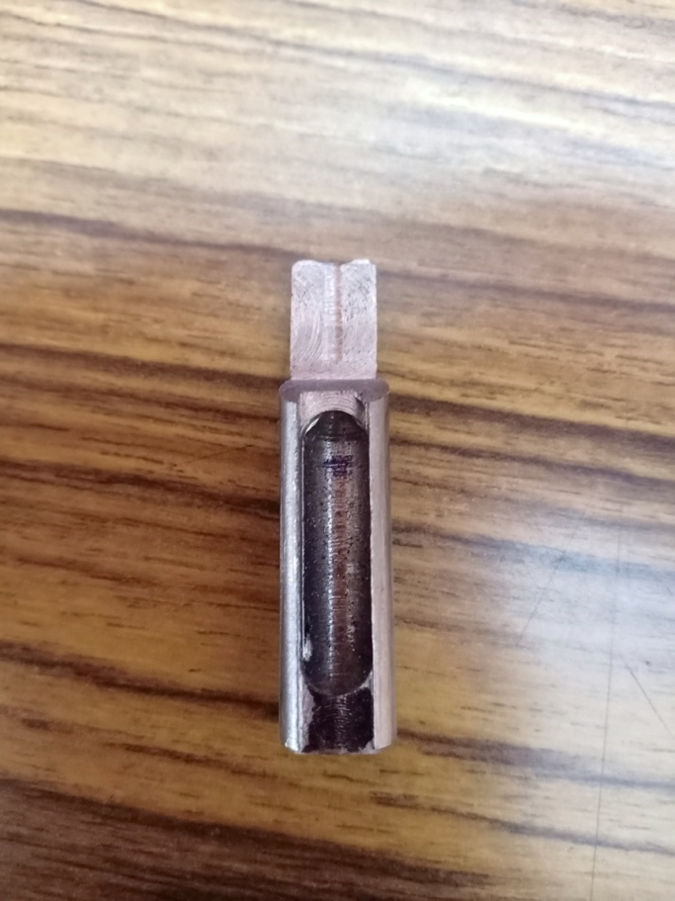
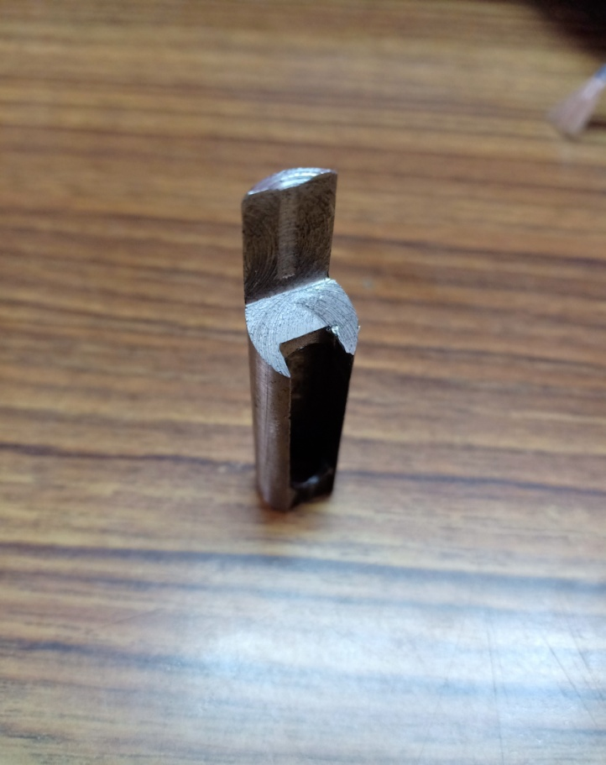
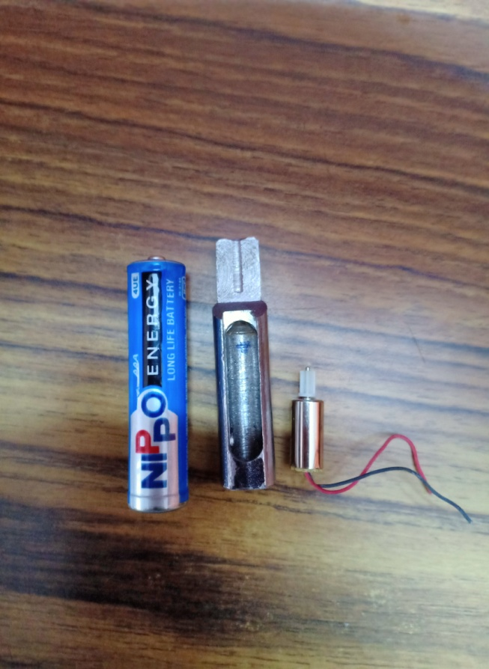
We youths have got an opportunity to tackle with a real life problem; to make a device that cuts the reefing line or a device that can have smooth detachment of two or more parts.

Slide 3
Usage of X-plosives?
Using explosives can cause at the top (or near the top) of the satellite can cause one of these problems:
High torque at he tip whit might affect the trajectory(if odd number of explosives are placed).
Can produce a huge amount of shockwaves that might ruin the internal systems that are crucial for the flight.(if the system is not insulated properly).
Explosives can’t be tested before flight (we can only hope that it works fine at the approached time).

Slide 4
My inspiration : THE WEDGE
I’m a mechanics student, using good amount of day-to-day phenomenons to make interesting things is my job.
I used a simple mechanical tool (wedge) that can detach the reefing line smoothly with the help of the stress created by the reefing line at the time of the expansion of parachute to reduce the failure of the mechanism.

Slide 5
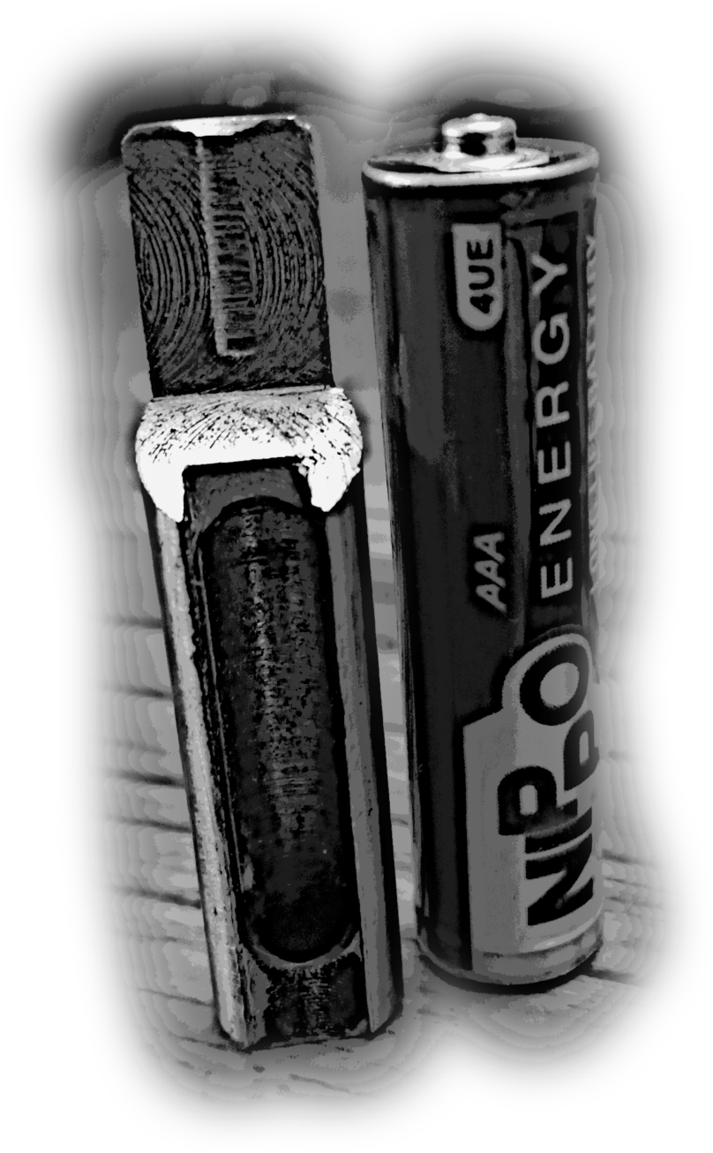
What is that I’ve made?
This steel artifact is no bigger than a regular AAA battery.
It might be tiny, but this can handle a lot of stress without bending.
Like ,it can handle more than 4000 newtons of force.
This can detach a reefing line which is about 5mm thick with a spring shot.

Slide 6
For the tech X-perts
Let us take the G experienced when the rocket is launched and when the parachute is released=>4 {4*9.8=approx. 40}
Calculation of force [ F=ma]
F is given to be 4000N
4000N=m*40
m=100Kg
So the mechanism should handle 100Kg or 0.220kips of weight/load.

Slide 7
Test for compression
Stress = load/area
=0.220/2.65= 8.3*10⁻³ ksi
Mild steel’s stress= 36ksi > 8.3*10⁻³ ksi
Test for Buckling
Euler’s_{buckling} = ℼ²EI/l²
= 9.8596*27000*3.3*10⁻⁸/1.25
= 0.719kips
Buckling load : 0.719 kips > 0.220kips

Slide 8
Motor specification and pulley?
I’ve used pulley and a micro core-less motor for this project.
Core-less motor is the best fit for this project which has small space.
Voltage consumption = 3.7V
Current consumption = 0.15A
Operating temperature = -10ºC to 50ºC
[Don’t worry, I’ve got m-seal insulation ;so it can handle -40ºC to 220ºC.]

Slide 9
Conclusion
My project idea was a humor in my friends’ circle.
JOKE: My friend told that I could keep a person with the scissors in the rocket to cut the reefing line when the time approaches ^_^.
Anyways , I had a very challenging and interesting time to make this project.

