Slide 1
ETTBLOG

Slide 2


A microblog is a social media site which allows users to exchange small elements of content such as images, videos, short sentences, etc.
Twitter and Sina Weibo are two of the most popular microblog platforms available.
The emerging trend of microblogs usually point towards an upcoming issue. These issues may be an emergency like an earthquake or a terrorist attack.
Tracking such emerging topics is beneficial for related organizations to draw up countermeasures earlier and understanding what subjects are drawing public attention.

Slide 3
Challenges of Topic Tracking
Detecting emerging topic as early as possible.
Tracking emerging topic evolution.
Presenting topic with coherent words.
The Probabilistic Topic Model is good at generating coherent latent topics and the Emerging Feature based Clustering Methods excels at identifying emerging words or phrases.
The advantages of the these two methods can be combined to tackle the above challenges.
With this motivation, the Emerging Topic Tracking (ETT) method was proposed.

Slide 4
2. Topic Detection and Tracking
Topic detection and tracking has great significance due to its applications in emergency detection, political election outcomes prediction, etc.
2.1 Probabilistic topic model
Probabilistic topic models have been proposed to understand semantic structure of topics and present a topic as a group of words with probability distribution.
Topic models such as LDA have been studied with variants such as addressing topic sparsity in short texts, automatically inferring topic numbers, generating more coherent topics by employing biterms or knowledge. These topics usually perform well on generating coherent topics from text corpus such as twitter feeds, amazon reviews and news articles.

Slide 5
2.2 Topic evolution tracking
Topic evolution tracking can be classified based on tracking methods. One type of methods employ probabilistic topic model with considering temporal information to
Online LDA is a temporal model which is able to identify bursty topics by inferring the current topic-term distribution with past information. It is a temporal topic model that works on detecting emerging topic at the same time.
2.3 Emerging Topic Detection
The Emerging Topic Detection can be classified into three categories:
2.3.1 Topic Model Based
In this method, the emerging topic is represented as a distribution over a vocabulary.
An emerging topic can be detected by solving an optimization problem over this distribution.
An example optimization would be to minimize the square error between the observed and expected values of word acceleration.
In the implementation, we have used a biconvex optimizer using ADMM method.

Slide 6
2.3.2 Emerging Feature Clustering
This type of emerging topic detection detects bursty features such as words, sements, etc. and cluster them into topics.
Emerging/bursty features are selected via an analysis of frequency based term signal, frequency expectation of a segment(feature) over a time window, etc.
Then, clustering algorithms such as KNN, SVM are employed to gather selected features into bursty topics followed by a post-processing of filtering noisy topics.
2.3.3 Document Clustering
In this type of method, documents are grouped together according to their similarity and a topic is presented as cluster of relevant documents.
An example study is first story detection in which Locality Sensitive Hashing was employed to search for the most similar neighbors for each new incoming text and assigning this text to the cluster containing this nearest neighbor.

Slide 7
3. Preliminaries
3.1.High quality microblog stream
A microblog stream is a temporal sequence of microblog feeds M= {M₁ ,M₂ ,...,M_{l} ,...} where each feed M_{l} in the stream contains some attributes like Textual content,URLs,Fwd and review,Text length,Posting time
The stream is divided into slices, where each slice collects all the feeds published in the same time interval (e.g., one hour or one day).
In the case of twitter, nearly 36% of the rated tweets are worth reading, 25% are not, and 39% are middling;36% of feeds contain URLs.
A high quality microblog stream is the subset of the raw stream that is composed of meaningful microblog feeds and can represent the raw stream in a global manner.

Slide 8
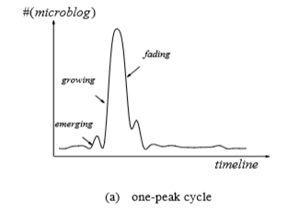
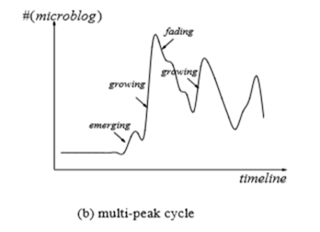
3.2. Topics evolution operations
●In this study, a topic is considered significant if it is discussed with over η percent (η is set to 5% in our dataset) of feeds.
● A topic in a time slice is called an emerging topic if it never appeared in previous slice and triggers a significant number of feeds in current slice. Thus, an emerging topic should be a novel topic that has a high level of novelty and low level of fading.

Slide 9
● A topic in a time slice is called an emerging topic if it never appeared in previous slice and triggers a significant number of feeds in current slice. Thus, an emerging topic should be a novel topic that has a high level of novelty and low level of fading.
● The given figure shows two types of topic life cycles, one-peak cycle and multi-peak cycle. In a topic life cycle, apart from emerging states, the other two evolutionary states are also worth noting, which we call growing and fading respectively.
● A topic shows a growing trend if it has appeared before and attracts more feeds in current slice. Usually, a growing trend has a higher value of novelty than fading although it has appeared in previous slice.
● A topic shows a fading trend if it has appeared before but attracts fewer feeds in current slice. Usually, a fading trend has a lower value of novelty than fading.

Slide 10
3.3. A brief Overview
●The three primary research challenges in this study are
(I) how to detect an emerging topic as early and accurately as possible;
(II) how to capture the topic evolution;
(III) how to generate coherent and meaningful topic.
● (1)We propose a novel emerging topic tracking method, named ETT, to track what topics are emerging in microblog streams and how they evolve over time.
● (1)Novelty is used to measure the freshness of a word/topic, whereas fading is used to measure the staleness of a word/topic.
● (1)A method, based on local weighted linear regression (LWLR) is designed to predict the frequency for each of the words in current stream.

Slide 11
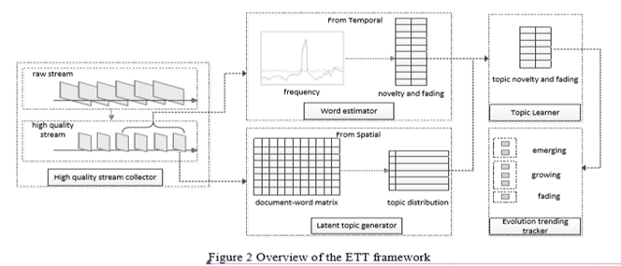
●(2) Three topic evolution operations are defined to track emerging topics and their evolution over time,as discussed in the earlier segment
● (3)A probabilistic topic model is employed to generate latent topics in the stream from spatial perspective. Finally, an optimization problem is formulated and solved to estimate the novelty and fading probabilities for all the latent topics.

Slide 12
4. Emerging Topic Tracking in Microblog Streams
4.1 Term novelty and fading
In a microblog stream, an emerging topic usually consists of terms whose frequencies have sharp increments in current time slice compared to the previous one.
A primary metric for determining term novelty is to measure the difference between a term’s expected frequency vs it’s actual frequency.
The expected frequency is usually an average frequency in a historical time window.
A Challenge: In some cases, terms show significant improvements(high actual frequency) despite their relevant topic having appeared before. This signifies a growing trend i.e. the topic is still getting more attention. The predicted frequencies of such terms will be low and their novelty values may be overvalued.
One way to solve the above problem is to use Local Weight Linear Regression(LWLR) to modify the frequency prediction function.

Slide 13
4.2 Topic Modelling
One of the most significant topic models is LDA in which a document is modeled as a mixture of multiple topics.
In the implementation, LDA is used to generate topics from a microblog stream inferring a topic-term distribution matrix Φ and a topic significance probability vector θ by inputting the number of latent topics K.
A topic model is preferred against designing a clustering method to gather emerging terms into topics. A topic model presents a topic as a word probability distribution which displays the significance of a topic and the importance of a term to a topic.

Slide 14
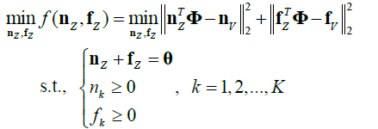
4.3 Topic Novelty and Fading
The parameters that have been inferred from the topic model (LDA) are significance probabilities θk and term probabilities distributions Φk for K latent topics Z={z1, z2..., zK }.
The main goal of this section is to find the novelty probability nk=p(n,zk) and fading probability fk=p(f,zk) for each topic zk.
We obtain a biconvex optimization problem with optimization function as:
An Alternating Direction Method of Multipliers(ADMM) is used to optimize the above function over the parameters nz and fz.

Slide 15
4.4 Topic evolution operations
Each topic z_{k} can be evaluated by a triplet (n_{k} ,f_{k} ,θ_{k} ) and a word probability distribution,Based on topic novelty and fading probabilities.
A higher value of θ_{k} indicates greater significance of the topic and a higher value of n_{k}/f_{k} means more freshness of the topic.
We define the topic evolution operations according to existing indicators about a topic as :
Emerging: A topic z_{k} is emerging in current time slice iff n_{k}/f_{k} >ς , (ς >1) and there is no topic in previous slice such that KLD(z_{k}^{i} ,z_{l}^{i-1} ) < ξ .
Growing: For a latent topic z_{k} in current time slice, iff n_{k}/f_{k} >1 and there exists a topic ,z_{l}^{i-1} in previous slice such that KLD(z_{k}^{i} ,z_{l}^{i-1} ) < ξ , then topic z_{k} is called a growing trend of its most similar topic z_{l}^{i-1} .
Fading : For a latent topic z_{k} in current time slice, iff n_{k}/f_{k} <1 and there exists a topic ,z_{l}^{i-1} in previous slice such that KLD(z_{k}^{i} ,z_{l}^{i-1} ) < ξ , then topic z_{k} is called a fading trend of its most similar topic z_{l}^{i-1} .
Noisy: A topic z_{k} is noisy in current time slice iff n_{k}/f_{k} <ς , (ς >1) and there is no topic in previous slice such that KLD(z_{k}^{i} ,z_{l}^{i-1} ) < ξ .

Slide 16
DATASET
The dataset was obtained by fetching tweets from Twitter ( a microblog site that has a limit on number of characters in a tweet) in the year of 2012 about various events that happened in that year.
The tweets collected are then cleared of duplicates,removed of unnecessary data and arranged according to their time stamp.
The tweets are divided into time slices of 1 day duration.

Slide 17
IMPLEMENTATION
After dividing dataset into time slices, the First step is to implement LDA for latent topic extraction using mallet toolkit.
We compute the novelty and fading probabilities of each key word which constitute a timeslice.
After extracting the latent topics, ADMM is applied to get the novelty and fading probabilities of each topic.
Then KL Divergence is used to compare the novelty and fading probabilities of each topic in present and previous timeslices.
Then The topics are categorized into Growing, Emerging, Fading and Noise.

Slide 18
Observations
The increase threshold we set for novelty/fading ratio for classifying a topic tends to classify a topic as noise rather than emerging.
Increasing the maximum deviance criteria for detecting similar topics would tend to classify topics as growing or fading.
The number of time slices and number of topics under consideration has an effect on how topics are classified
E.g, an increase in number of topics tends to classify noises as emerging. On the contrary, decrease in number of time slices tends to classify emerging topics as noises.

Slide 19
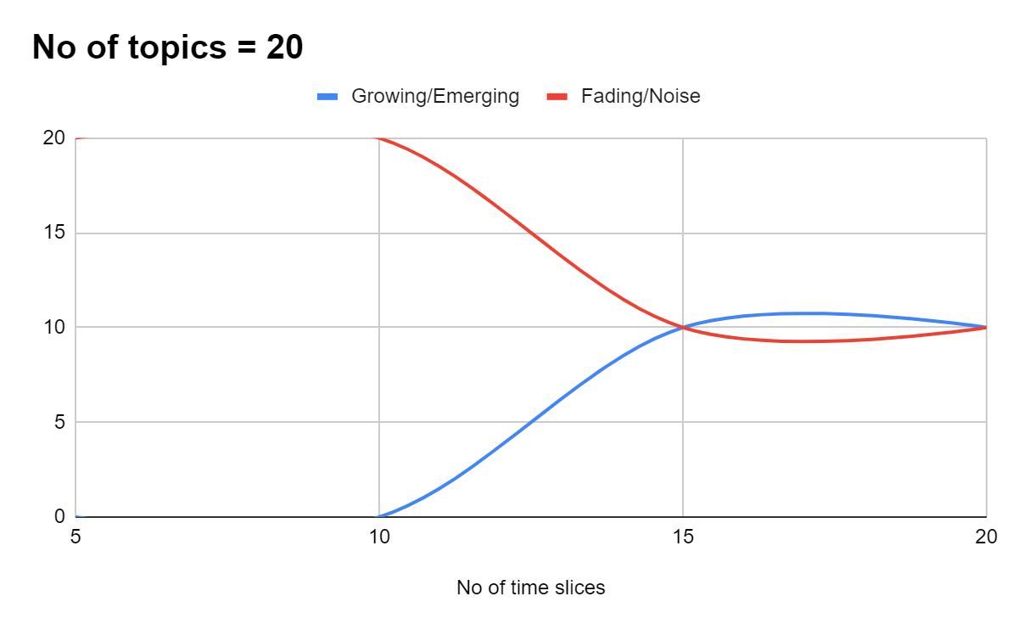
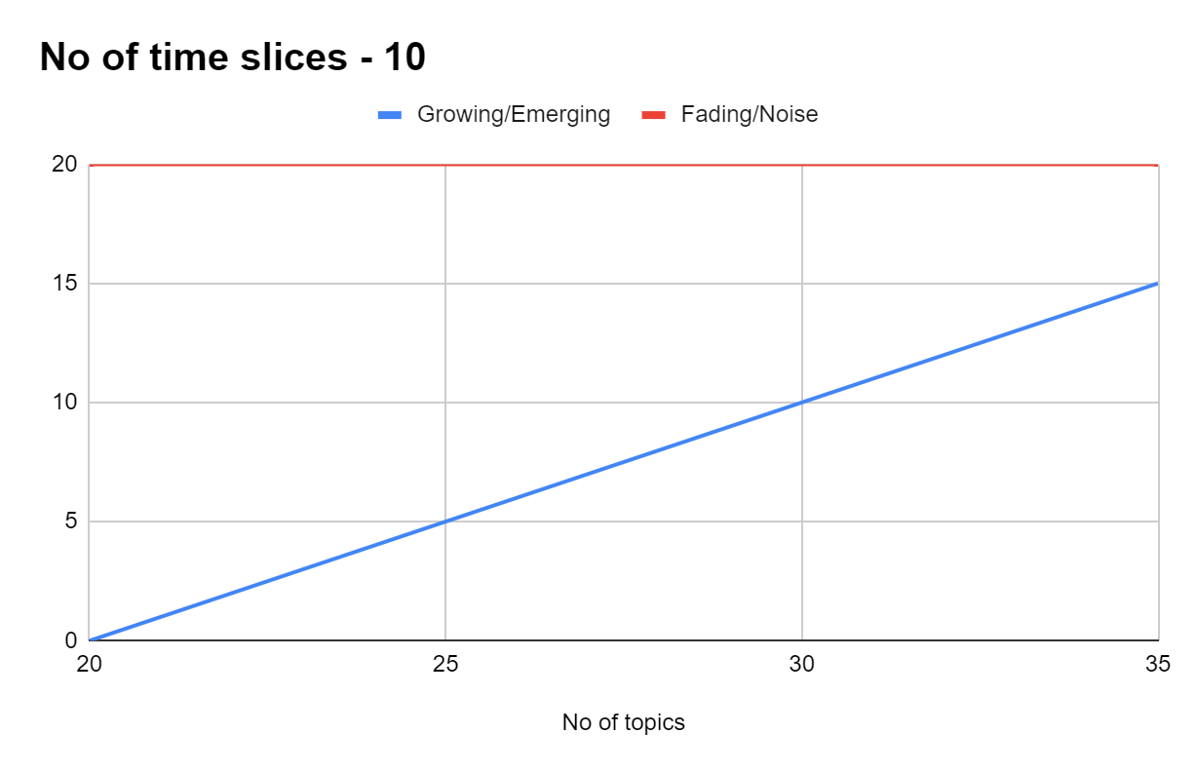
Dependency graphs

