Slide 1
🏭
₹120 Cr
🛸
PLI Scheme for Drone Mfg (2021)
Drones in
Modern GIS
🛸
327K+
Villages drone-surveyed (SVAMITVA)
From Pixels to Intelligence
📅
2030
India's target: Global Drone Hub
4th & 6th Sem Engineering • Civil

Slide 2
Today's Agenda
01
🚁
Introduction to Drones
→
What • Why • Where • Types
02
🛰️
Satellite vs Drone
→
Resolution • Cost • Coverage • Weather
03
🌍
Applications
→
Agriculture, Infrastructure, Disaster & more
04
🇮🇳
Indian Case Studies
→
SVAMITVA • Namo Drone Didi • PM Gati Shakti
05
📡
Drone Data Outputs
→
Point Cloud • DSM • DTM • NDVI • Orthomosaic

Slide 3
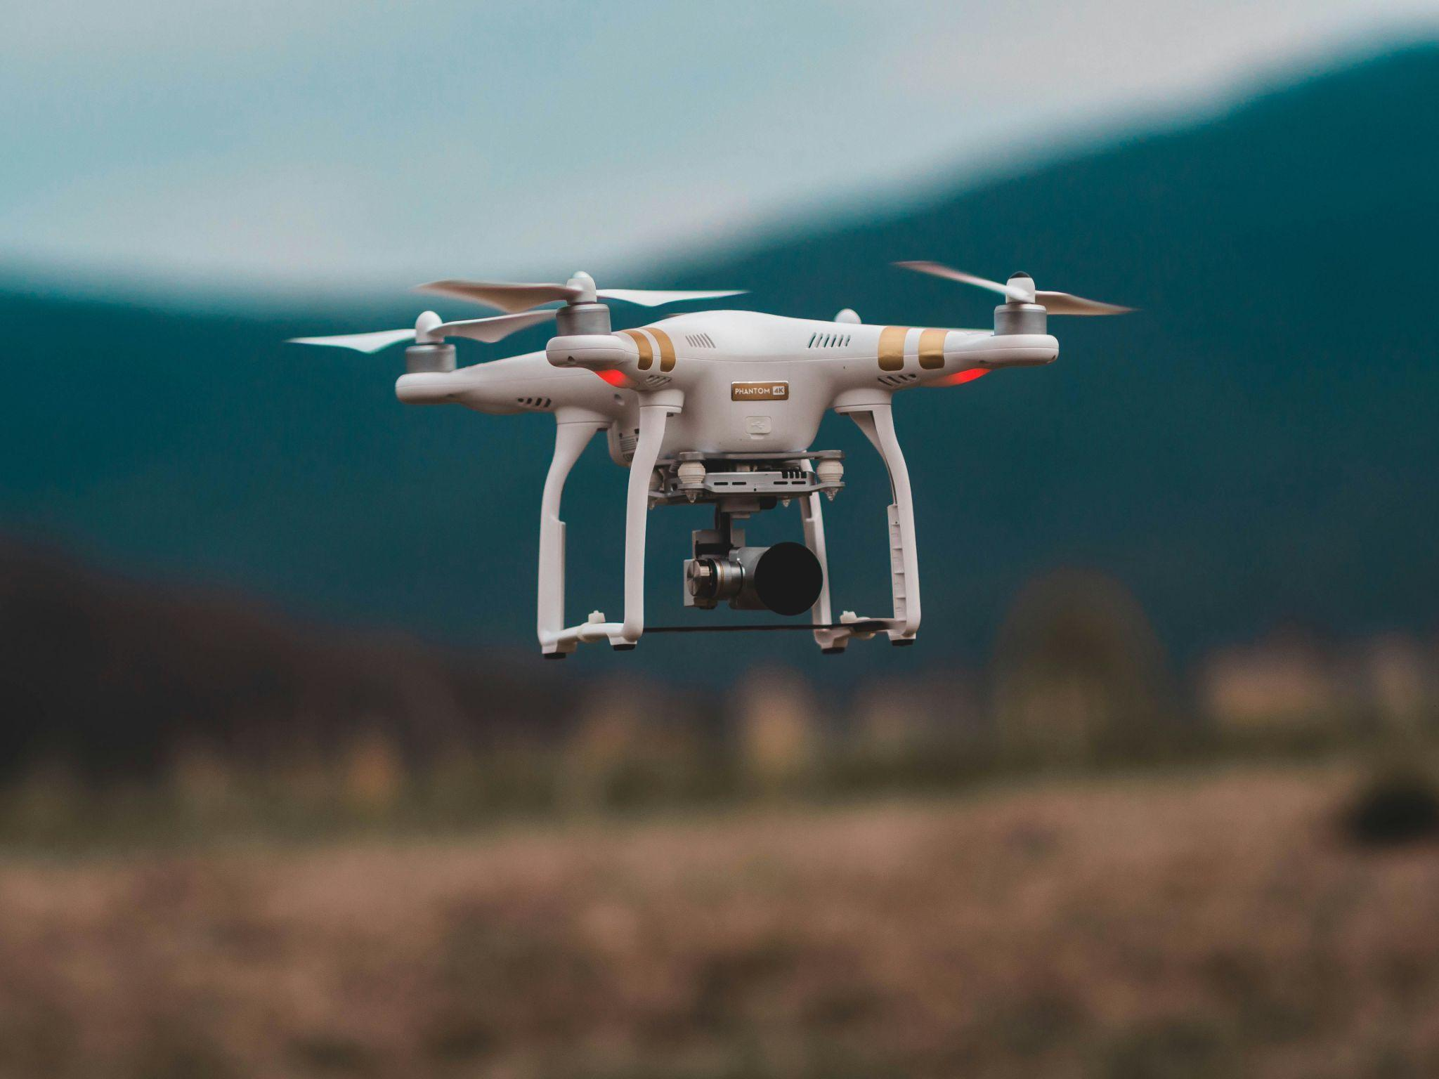
What is a Drone?

Slide 4
SECTION 01 • INTRODUCTION
What is a Drone?
UAV = Unmanned Aerial Vehicle • No pilot on-board • Remotely or autonomously operated
PLATFORM
PAYLOAD
• Fixed Wing
• RGB Camera
• Multirotor
• LiDAR Sensor
• Hybrid VTOL
• Multispectral

Slide 5
SECTION 01 • INTRODUCTION
Types of Drones
🚁
Multirotor
✈️
Fixed Wing
DJI Phantom / Mavic
Ideal for survey & photo
senseFly eBee
Long range, large areas
Most common type
Agriculture & mapping
🤏
Nano / Mini
🔀
Hybrid VTOL
DJI Mini 4 Pro
Consumer grade, light
Best of both worlds
Vertical takeoff + speed
Urban photography
Military & delivery

Slide 6
SECTION 01 • INTRODUCTION
Why Drones? Where in India?
⚡
💰
🗺️ Where Drones Fly in India
10×
60%
🌾
Farmlands — Punjab wheat, AP rice paddies
Faster than ground survey
Cost saving vs traditional methods
🏙️
Smart Cities — Bengaluru, Hyderabad, GIFT City
🎯
🔒
⛰️
Remote Terrain — Himachal valleys, NE forest zones
2–5 cm
SAFE
🏗️
Construction — Mumbai Metro, Navi Mumbai Airport
Accuracy with RTK GPS
No human in hazardous zones
🌊
Coastlines — Kerala, Odisha flood mapping
⛏️
Mining Zones — iron ore, mines

Slide 7
SECTION 02
🛰️ vs 🚁
Satellite vs Drone

Slide 8
SECTION 02 • SATELLITE vs DRONE
Head-to-Head Comparison
PARAMETER
🛰️ SATELLITE
🚁 DRONE
📐 Resolution
30 cm – 5 m
(WorldView-3: ~30 cm)
1–5 cm
(RTK equipped)
✓
💰 Cost (per km²)
Varies widely
(licensed archive data)
₹200–₹800
(operational cost)
✓
📡 Coverage Area
Hundreds of km² per pass
5–50 km² per flight
⛅ Weather Dep.
Cloud-free needed
Delay: days to weeks
Wind < 15 m/s needed
Flexible scheduling
✓
⏱️ Revisit Time
1–16 days (orbit cycle)
On-demand, same day
✓
✓ = Drone advantage in this parameter

Slide 9
SECTION 02 • SATELLITE vs DRONE
Resolution: The Game Changer
Same field. Three different sensors. Three very different stories.
Google Maps Satellite
Satellite (e.g. WorldView-3)
Drone (RTK Camera)
⬛⬛⬛⬛
⬛⬜⬜⬛
⬛⬜⬜⬛
⬛⬛⬛⬛
🟦🟦🟦🟦🟦
🟦⬜⬜⬜🟦
🟦⬜⬜⬜🟦
🟦🟦🟦🟦🟦
🟩🟩🟩🟩🟩🟩🟩
🟩⬜⬜⬜⬜⬜🟩
🟩⬜🟫🟫⬜⬜🟩
🟩⬜⬜⬜⬜⬜🟩
🟩🟩🟩🟩🟩🟩🟩
GSD: ~50–100 cm/pixel
GSD: ~30 cm/pixel
GSD: 1–5 cm/pixel
Useful for navigation
and basic city planning
Building outlines & field
boundaries visible
Individual plants, cracks
in concrete — centimeter detail
Low Resolution
Medium Resolution
Ultra High Resolution
🗺️
🛰️
🚁

Slide 10
SECTION 03
Applications
Where Drones Transform India 🌍
🌾 Agriculture
🏗️ Infrastructure
🏘️ Urban Planning
⛑️ Disaster Mgmt
⛏️ Mining
🌳 Environment

Slide 11
SECTION 03 • APPLICATIONS
6 Key Fields in India
🌾
Agriculture
🏗️
Infrastructure
🏘️
Urban Planning
Crop health mapping, fertilizer spraying, yield estimation. 452,000+ farmers demonstrated ICAR drone tech (2023–25)
Road & bridge inspection, railway alignment. PM Gati Shakti platform uses drone LiDAR across ministries
3D city models, land records. Used in Bengaluru & Ahmedabad Smart City surveys for GIS planning
⛑️
Disaster Mgmt
⛏️
Mining
🌳
Environment
Flood & cyclone mapping. NDRF uses drones for search-rescue in Kerala, Odisha, Assam floods
Volume calculations, stockpile monitoring. NMDC Panna diamond mines (MP) use drone DSM+orthomosaic
Forest canopy assessment, carbon stock mapping. Western Ghats survey using multispectral sensors

Slide 12
SECTION 04
🇮🇳
Real World
Indian Case Studies
Government of India • Proven • Operational • Impactful
3.27 Lakh
₹1,261 Cr
452K+
Villages drone-surveyed*
Namo Drone Didi budget
Farmers shown drone demo
*SVAMITVA scheme, as of January 2024 (PIB)

Slide 13
CASE STUDY 01 • LAND RECORDS
SVAMITVA Scheme
🏡
Survey of Villages Abadi & Mapping with Improvised Technology in Village Areas
Launched
Ministry
Agency
April 2020
Panchayati Raj
Survey of India
Key Stats
3.27 Lakh
1
🛸
Drones fly at 120 m altitude to capture high-resolution aerial imagery of every village abadi (inhabited) area
Villages surveyed
1.75 Cr
2
📍
CORS (Continuous Operating Reference System) + GCPs placed for 5 cm centimeter-level accuracy
Property cards prepared
31
3
🗺️
Orthomosaic maps are generated — base for property cards (Adhikar Patra) issued to households
States & UTs with MoU
5 cm
4
📱
Property cards delivered via DigiLocker; 1.75 crore cards prepared in 1.09 lakh villages (Jan 2024)
Drone accuracy
Source: PIB, Jan 2024

Slide 14
CASE STUDIES 02 & 03
More Indian Government Initiatives
🌾 Namo Drone Didi Scheme
🛤️ PM Gati Shakti NMP
Empowering women farmers with drones
National Master Plan — Unified GIS platform
📅 Approved 2023, operational 2024–26
📅 Launched October 2021 by PM Modi
💰 Budget: ₹1,261 crore
🛰️ LiDAR drone surveys used across states (e.g. Arunachal Pradesh confirmed)
👩 15,000 women SHGs get drones at 80% subsidy (up to ₹8 lakh)
🏛️ 16 Central Ministries share spatial data on one platform
🚜 Used for pesticide & fertilizer spraying on farmers' fields
🗺️ Orthomaps & 3D terrain used for highway alignment, forest clearances
🎓 15-day free training as certified drone pilots
🔗 Reduces project delays via real-time geospatial monitoring
📊 452,000+ farmers already shown ICAR drone demos (SMAM)
🏗️ Roads, railways, ports, pipelines — all mapped in one view

Slide 15
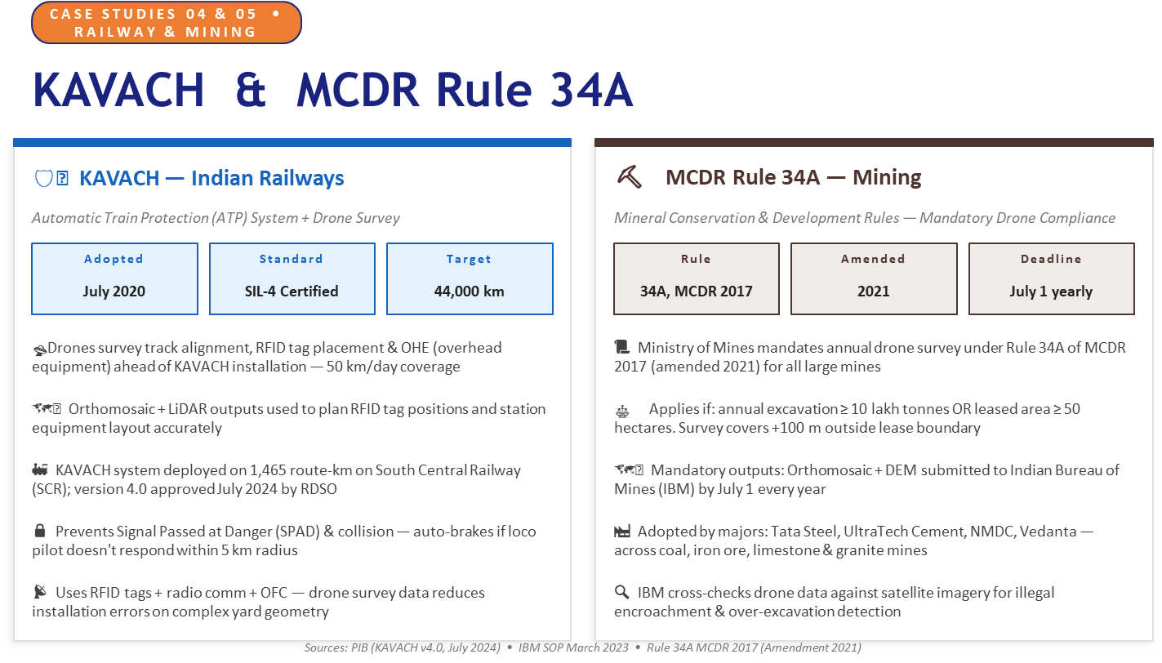

Slide 16
SECTION 05
Drone Data Outputs
Raw images → Photogrammetry / LiDAR → Actionable Geospatial Intelligence
📸 Raw Images
➜
⚙️ Processing
➜
🗺️ Data Products
📦 Point Cloud
🏔️ DSM
⛰️ DTM
🛰️ Orthomosaic
🌿 NDVI

Slide 17
SECTION 05 • DATA OUTPUTS
📦 Point Cloud
🛰️ Orthomosaic
🔵 🟣 🟡 🔵 🟢 🟡 🔴
🟢 🔵 🟣 🟡 🔵 🟢 🟣
🟡 🟢 🔵 🔴 🟣 🟡 🔵
🔵 🟣 🟡 🟢 🔵 🟣 🟢
Millions of 3D coordinates (X, Y, Z)
Georeferenced 2D aerial map
▸ Generated by LiDAR or photogrammetry processing
▸ Hundreds of images stitched into one seamless map
▸ Each point has X, Y, Z coordinates + colour (RGB)
▸ Geometrically corrected — measurable like a survey map
▸ Used to build 3D models of terrain & structures
▸ GSD = Ground Sampling Distance (pixel size on ground)
▸ Software: CloudCompare, Pix4D, DJI Terra
▸ Used in SVAMITVA for village property boundary maps
▸ View in QGIS, ArcGIS, Google Earth Pro

Slide 18
SECTION 05 • DATA OUTPUTS
DSM
DTM
NDVI
Digital Surface Model
Digital Terrain Model
Normalised Difference Vegetation Index
🏙️
⛰️
🌿
Captures elevation of ALL surfaces — buildings, trees, and terrain included.
Bare-earth only — vegetation, buildings and objects are removed from the surface.
Plant health indicator using multispectral camera data. Range: –1 (no vegetation) to +1 (healthy crop).
📍 India Use Case
📍 India Use Case
📍 India Use Case
Flood risk modelling, shadow analysis, urban 3D city models. Used in Bengaluru & Ahmedabad smart city planning.
Contour lines, watershed analysis, road & railway design. Critical for highway planning in hilly terrain.
Crop stress, pest detection, forest health. AP & Telangana rice fields; Kisan Drone programme.
🛠️ Agisoft Metashape, Pix4D
🛠️ Global Mapper, ERDAS IMAGINE

Slide 19
🎯 Quiz Time!
Raise your hand — fastest correct answer wins! 🏆
Q1: As of Jan 2024, drone survey was completed in
how many villages under SVAMITVA?
A) 50,000 villages
B) 1.09 lakh villages
C) 2.93 lakh villages ✓
D) 6.2 lakh villages
Q2: Namo Drone Didi scheme has a budget of?
A) ₹120 crore
B) ₹900 crore
C) ₹1,261 crore ✓
D) ₹5,000 crore
Q3: Which output removes buildings & trees
to show only bare-earth elevation?
A) Orthomosaic
B) DSM
C) Point Cloud
D) DTM ✓

Slide 20
🛸
Fly High. Map Everything.
The future of Indian infrastructure runs on drone data.
You're the engineers who'll build it.
Explore Further
🌐
DGCA Drone Rules
📡
SVAMITVA Dashboard
dgca.gov.in/digigov-site
svamitva.nic.in
🛰️
Bhuvan ISRO
🏗️
PM Gati Shakti NMP
bhuvan.nrsc.gov.in
pmgatishakti.gov.in
Workshop for 4th & 6th Sem Engineering • Bengaluru, Karnataka • All facts sourced from GoI/PIB official releases

