Slide 1
Near-optimal dynamic trajectory generation and control of an omnidirectional vehicle ENPM667 Control of Robotic System
Yashas Shetty(UID:119376348)
Neha Madhekar(UID: 119374436)

Slide 2
Abstract
Usually, optimal control leads to computationally costly solutions. Whereas a cheap solution may lead to an unstable control. There are many applications in which precise optimal control is not necessary and rather computational speed is required. This paper presents a novel technique to calculate a control input which generates a near optimal trajectory for an omni-directional vehicle-based system. This control input is generated at a significantly lower cost.
The complex non-linear system has been linearized by restricting the admissible controls. By applying a simple constraint on the control input, a near optimal trajectory is generated. As the computational cost of this strategy is low, a beneficial trade off between cost and optimality is achieved.

Slide 3
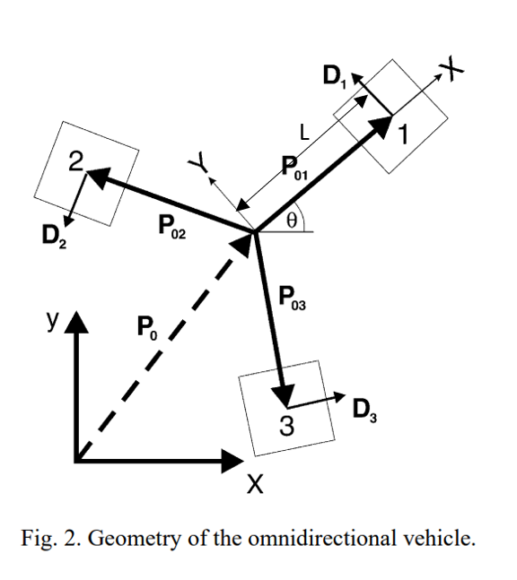
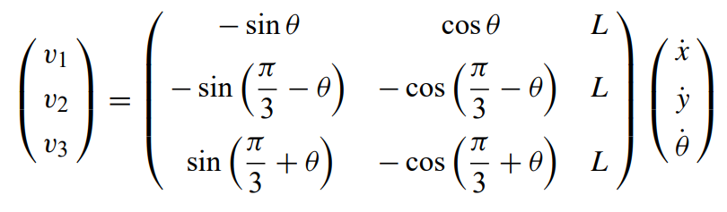
Kinematic modeling of omnidirectional vehicle
The omnidirectional vehicle has 3 planar DOFs (2 translational and 1 rotational)
The velocities of each wheel are given as:

Slide 4
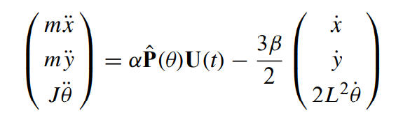
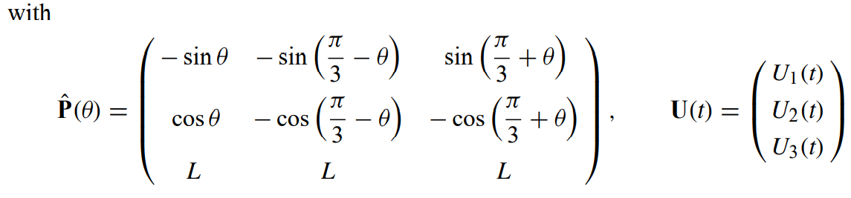
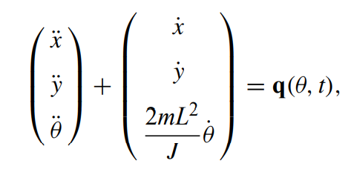
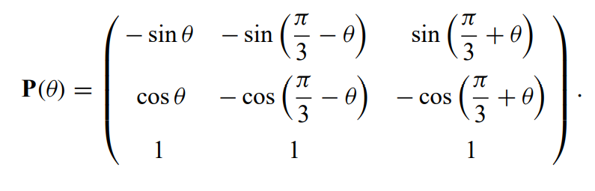
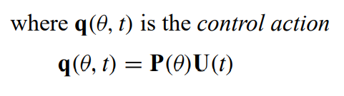
Dynamic modeling of omnidirectional vehicle
The system of differential equations can be represented as
Non-dimensionalized equations of motion are given by

Slide 5

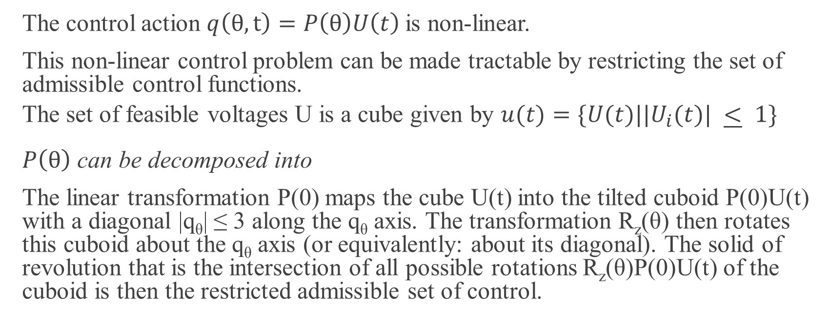
Restricting admissible controls
The control action $q\left(θ,t\right)=P\left(θ\right)U\left(t\right)$is non-linear.
This non-linear control problem can be made tractable by restricting the set of admissible control functions.
The set of feasible voltages U is a cube given by $u(t)=\{U(t)||U_{i}(t)| \underline{<} 1\}$
$P\left(θ\right)$ can be decomposed into
The linear transformation P(0) maps the cube U(t) into the tilted cuboid P(0)U(t) with a diagonal |q_{θ}| ≤ 3 along the q_{θ} axis. The transformation R_{z}(θ) then rotates this cuboid about the q_{θ} axis (or equivalently: about its diagonal). The solid of revolution that is the intersection of all possible rotations R_{z}(θ)P(0)U(t) of the cuboid is then the restricted admissible set of control.

Slide 6
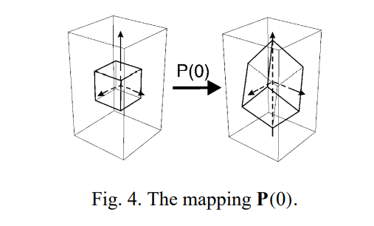
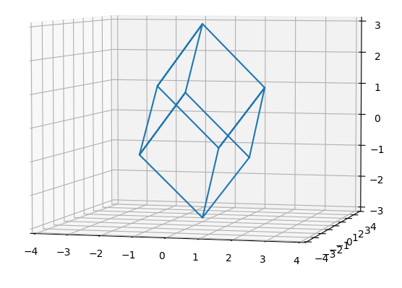
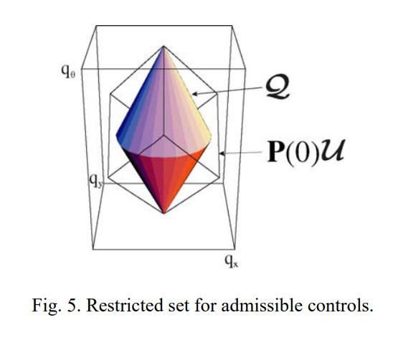
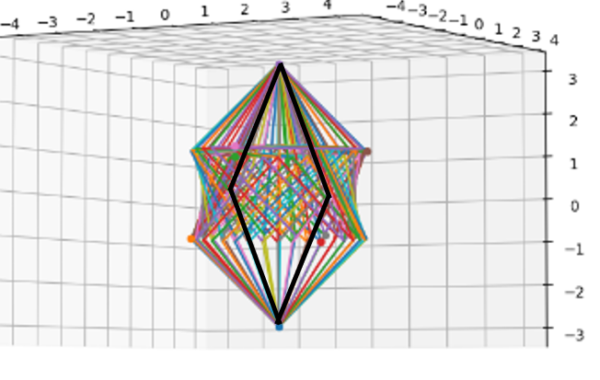
Restricting admissible controls

Slide 7
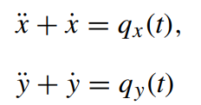

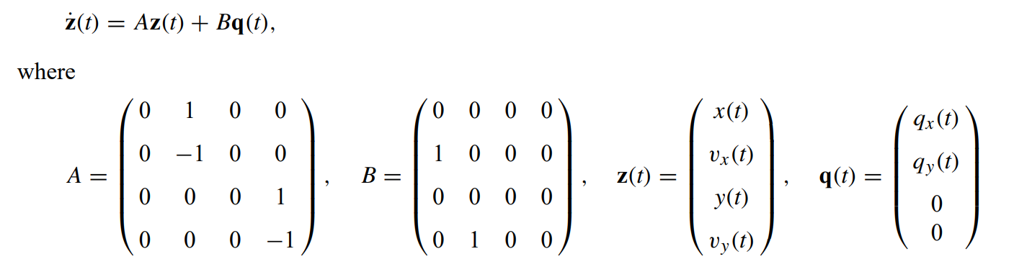
Trajectory Generation
As translational and rotational DOFs are independent of each other,
The constraint on the control inputs is given by
The system can also be written as

Slide 8

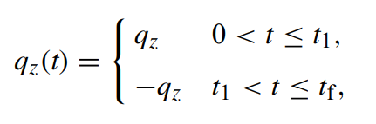
Trajectory Generation
For minimum time of trajectory,
For Near-optimal control, following strategy is used.

Slide 9
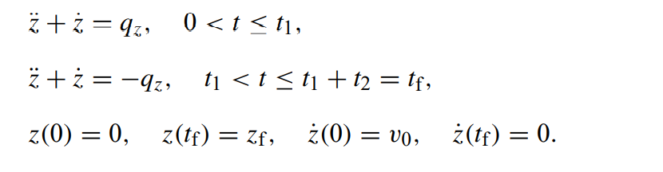
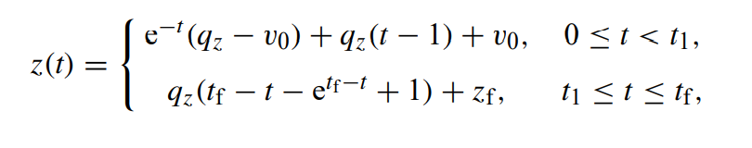
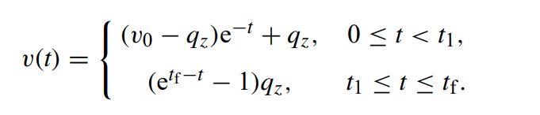
Bang–bang trajectory
We know that
where z= x, y
Solving the above two differential equations and applying the boundary conditions, we get

Slide 10


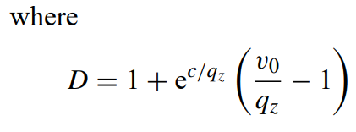



Bang–bang trajectory
For calculating t₁,t₂,q_{z} and t_{fmin}:

Slide 11




Trajectory synchronization
As per proposition 1
We know that
We denote t_{f} using q_{z} with the following notation
For trajectory synchronization:

Slide 12
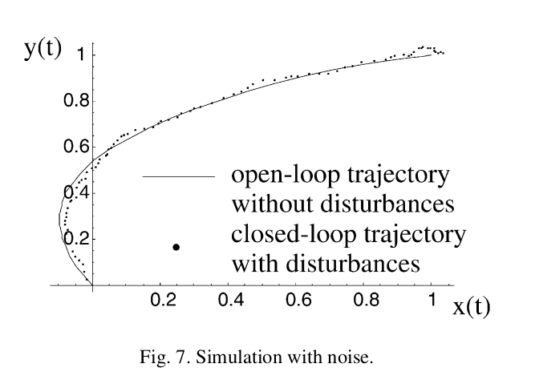
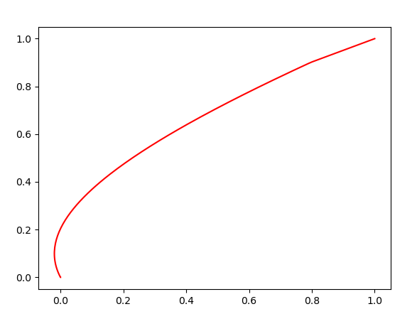
Simulation and Results
Trajectory shown in research paper
Trajectory plotted by us

Slide 13
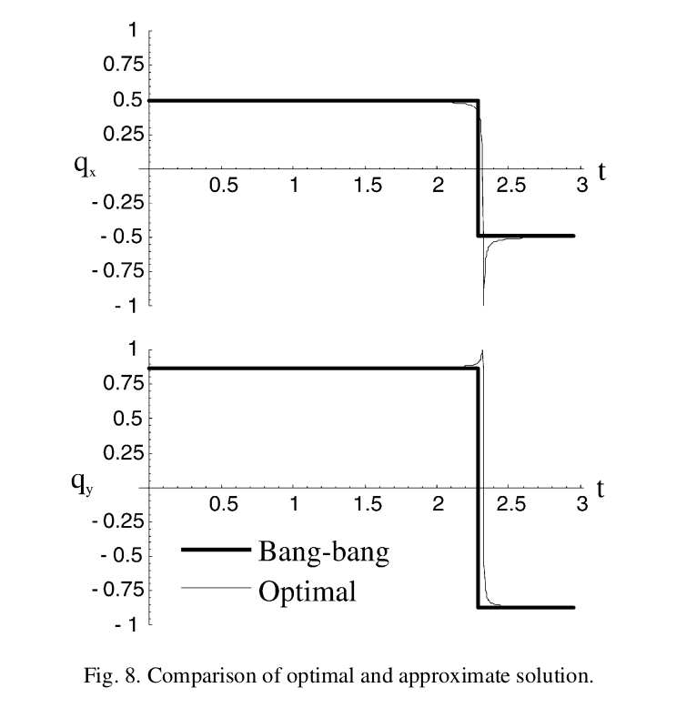
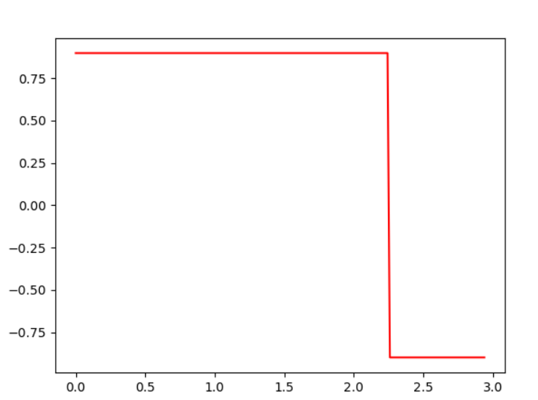
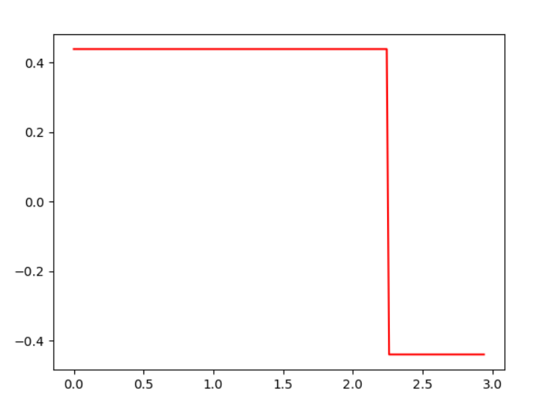
Simulation and Results
Plots of qx and qy from paper
Plots of qx and qy by us

Slide 14
Conclusion
As translational degrees of freedom of an omnidirectional vehicle can be made independent of its rotational degrees of freedom, restricting admissible control has been used to greatly simplify the complex nonlinear control problem.
The proposed control strategy is very simple yet effective. Even though it does not provide the "optimal" trajectory, it provides a near optimal trajectory, in a much more computationally effective way.
Considering the benefits of computational efficiency, the difference in the two trajectories is quite acceptable. Thus, the proposed strategy can prove to be useful in many scenarios where low cost of computation is required with a significant tolerance to the output error. For example, this strategy would be very efficient for field mapping applications

Slide 15
Learning Outcomes
Linearization of the non-linear system can be achieved by restricting admissible control.
The control of translational DOFs and rotational DOF of the omnidirectional vehicle can be assumed independent of each other.
A very simple and efficient bang-bang control can be used to generate near optimal trajectory instead of complex and computationally costly optimal control.

