Slide 1
CNNs: Classification and Verification
Recitation 5
Jinhyung Park

Slide 2
Today we will talk about
Problem Statement for Part 2
Classification and Verification
Transfer Learning
Model Architectures
Types of Losses
Dataset and custom Dataloader for PyTorch(in the Notebook)

Slide 3
Problem Statement
Face Classification:
Classifying the person(ID) based on the image of the person’s face
Face Verification:
How would you use the same network you trained for Classification to do face verification, Ideas??
You identify the most important features in the image which capture the identity of the face
The extracted features will be represented by a fixed length vector, known as an embedding
In order to do verification, we need to identify if a given embedding is similar to a reference embedding of that person using a distance metric like the Cosine Distance

Slide 4
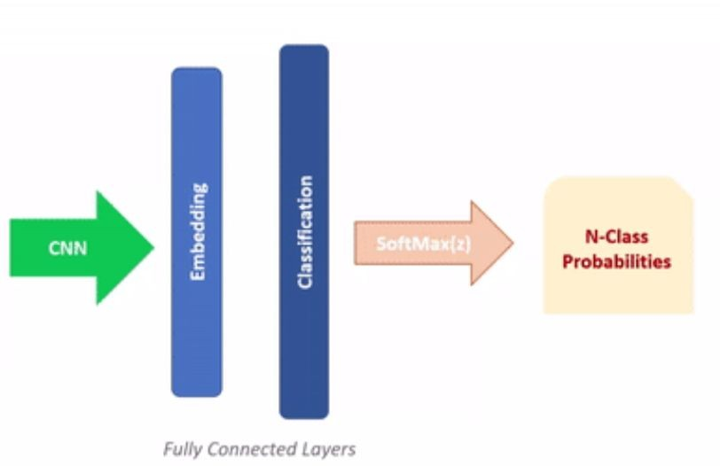

Classification vs Verification
Classification
An N way classification task, predicting from a fixed set of possible output classes
Verification
It is a matching operation, where you match the given sample to the closest sample from a reference of N other samples
Can also be a 1 to 1 task, where we want to verify if the two embeddings are similar (belong to the same class)
N way classification using cross entropy loss

Slide 5
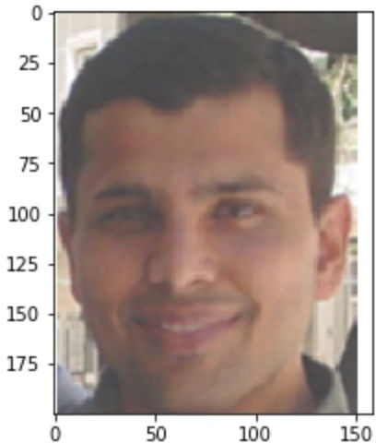
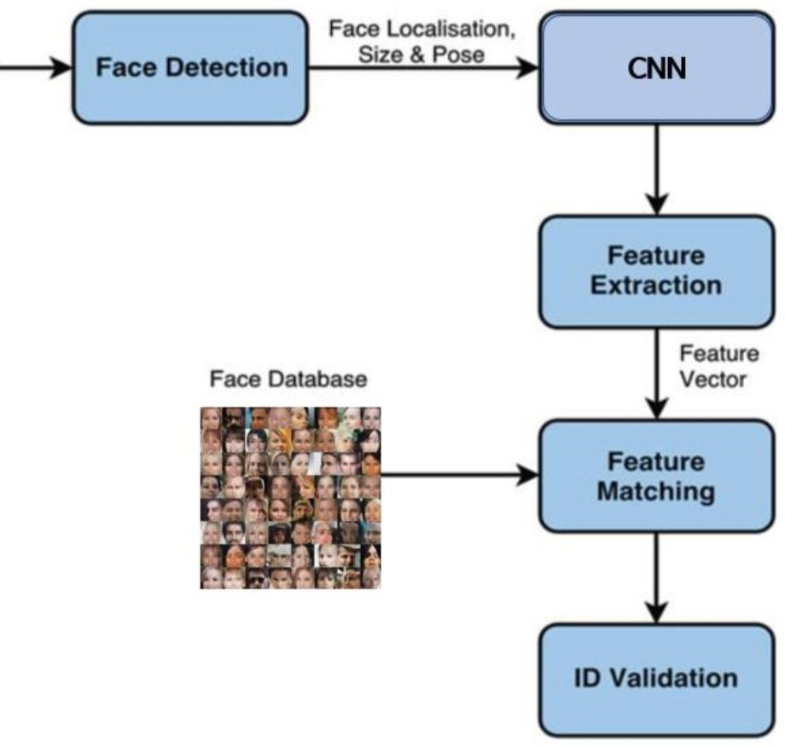
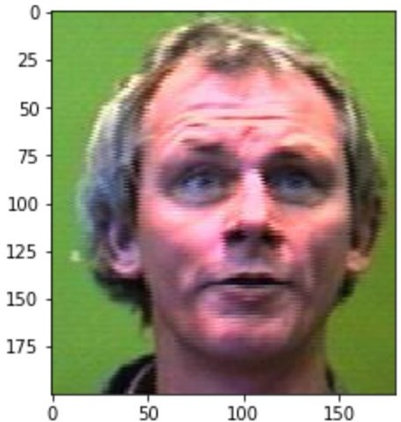
Verification

Slide 6
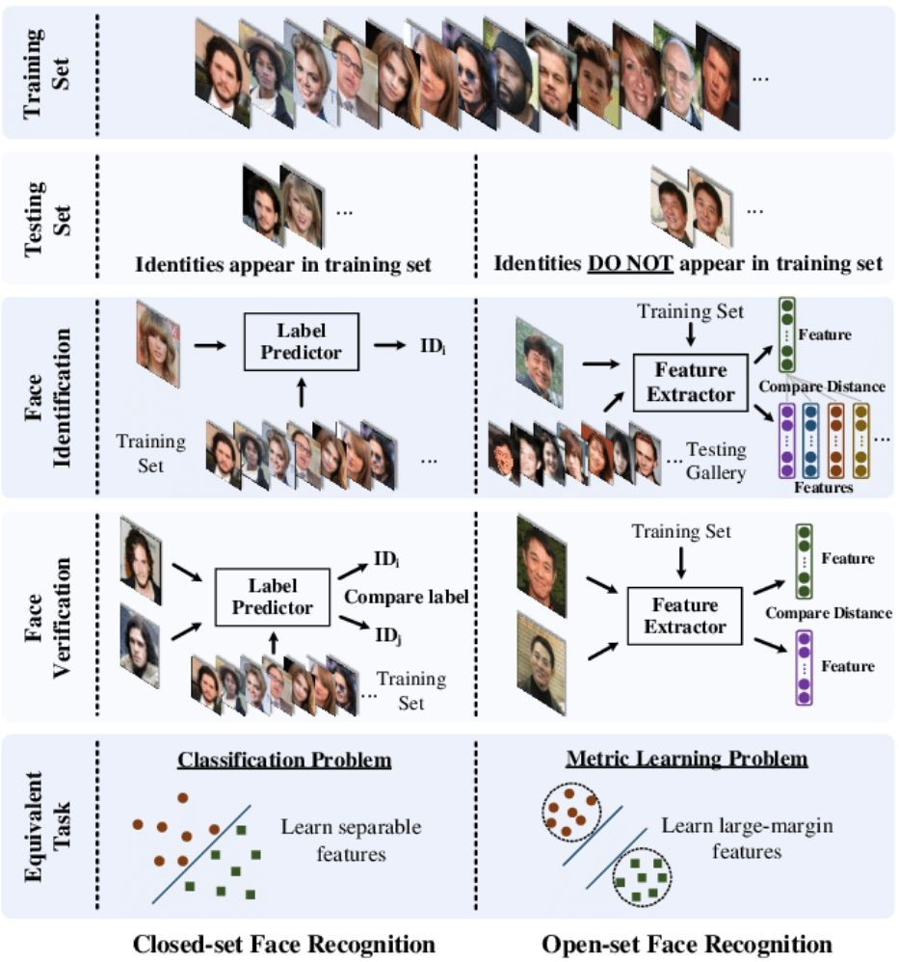
Open set vs Closed Set
Classification versus Verification & Open versus Closed set for the facial recognition problem.

Slide 7
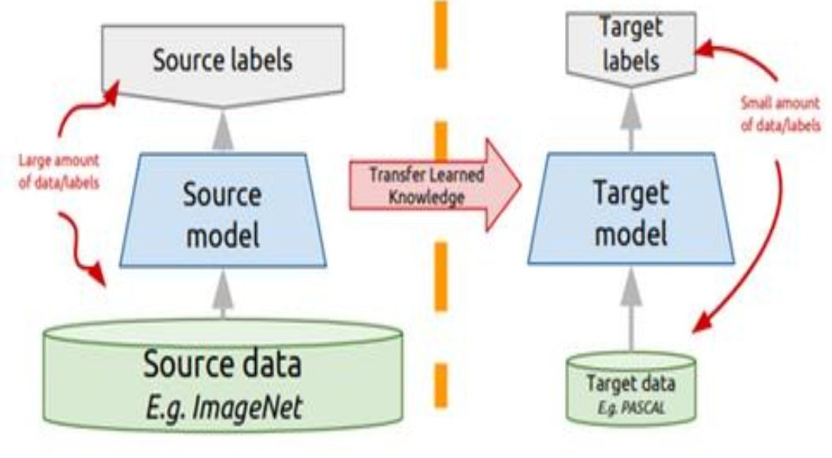
Transfer Learning
Transfer Learning is a method where a model developed for a task is reused as the starting point for a model on another task
Two ways to do Transfer Learning
Use trained model weights to initialize the network and train the entire network again
Freeze the weights of the network and fine tune the last few layers on the target dataset

Slide 8
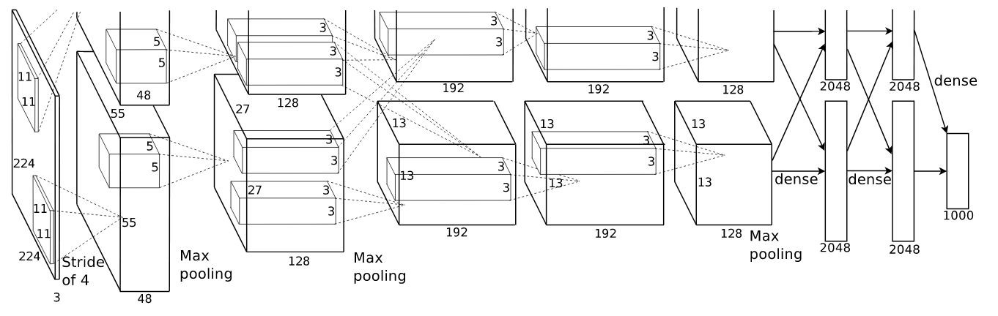
CNN Architectures: AlexNet
Published in 2012 and was the winner of the Imagenet LSVRC-2012
Uses ReLU as it makes training faster
Implements dropout between layers
Uses data augmentation methods (Random Crop, Random Flip in PyTorch)
The network is trained using SGD with momentum
https://papers.nips.cc/paper/4824-imagenet-classification-with-deep-convolutional-neural-networks.pdf

Slide 9
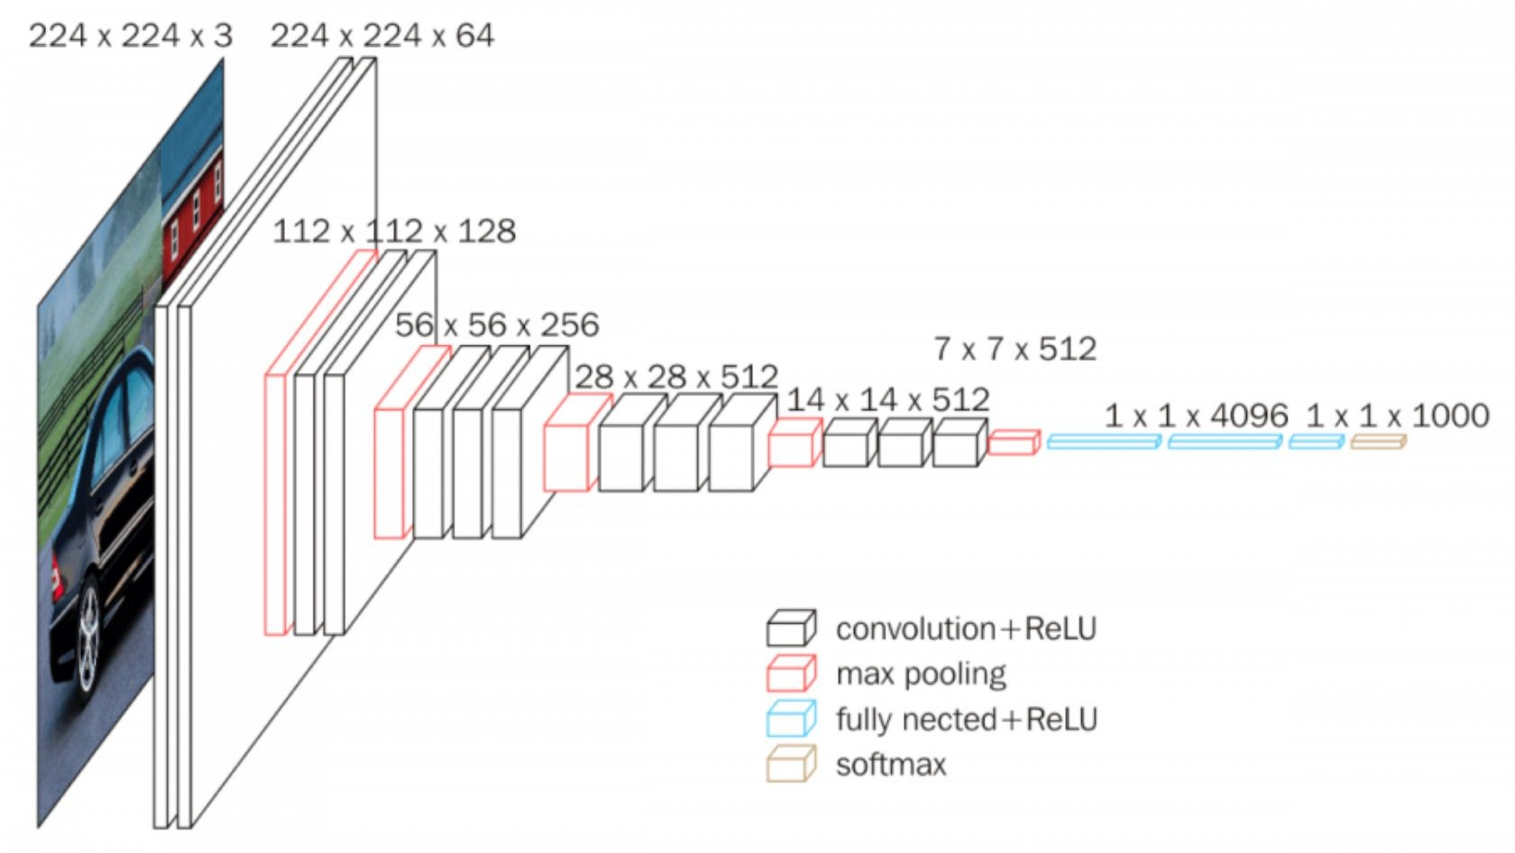
VGG Net
VGG (2014) architecture reduces the size of each layer yet increases the overall depth of it. reinforces the idea that CNNs must be deep in order to work well on visual data.
Conv filters (3*3)
Max Pool (2*2)
https://arxiv.org/pdf/1409.1556.pdf

Slide 10
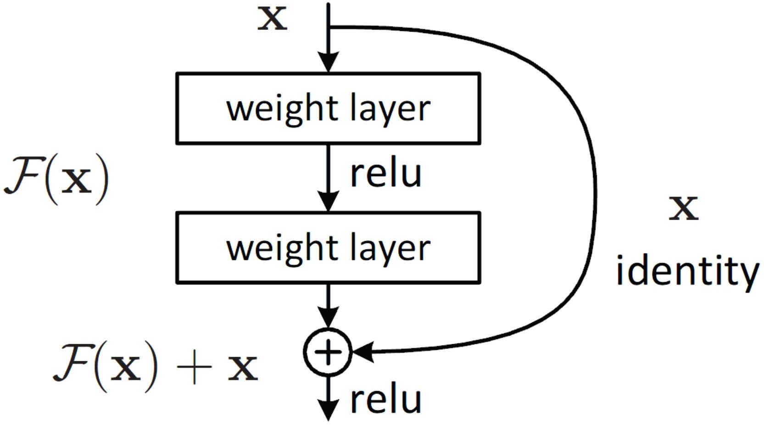
ResNet
Introduced in 2015, utilizes bottleneck architectures efficiently and learns them as residual functions
Easier to optimize and can gain accuracy from increased depth due to skip connections
https://arxiv.org/pdf/1512.03385.pdf

Slide 11
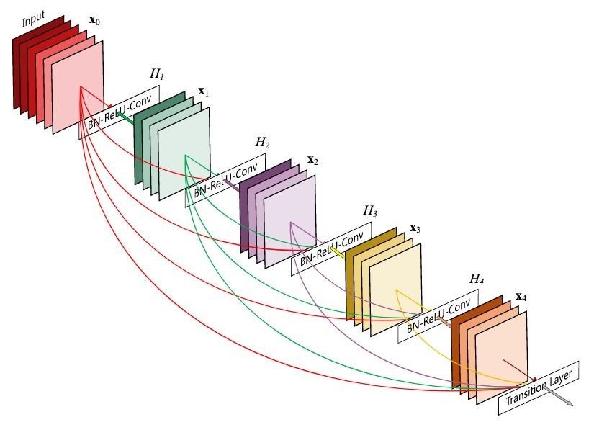
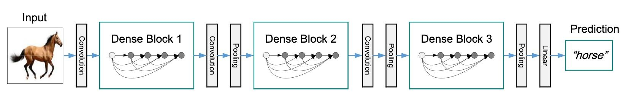
Dense Nets
It includes a stack of dense blocks followed by a transition layers
Strengthen feature propagation, encourage feature reuse and decrease the number of parameters
https://arxiv.org/pdf/1608.06993.pdf
https://arxiv.org/pdf/1608.06993.pdf

Slide 12
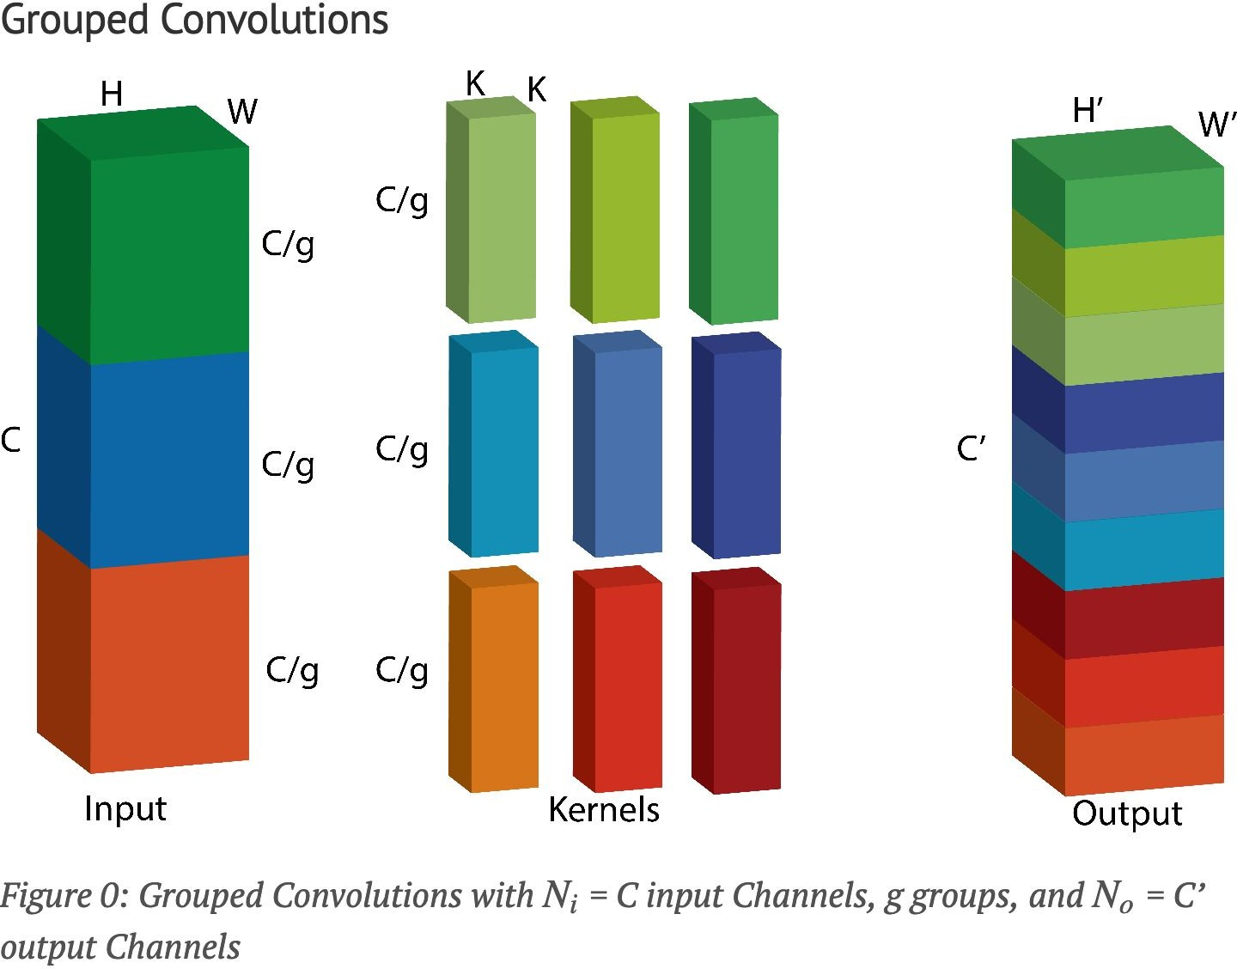

Slide 13
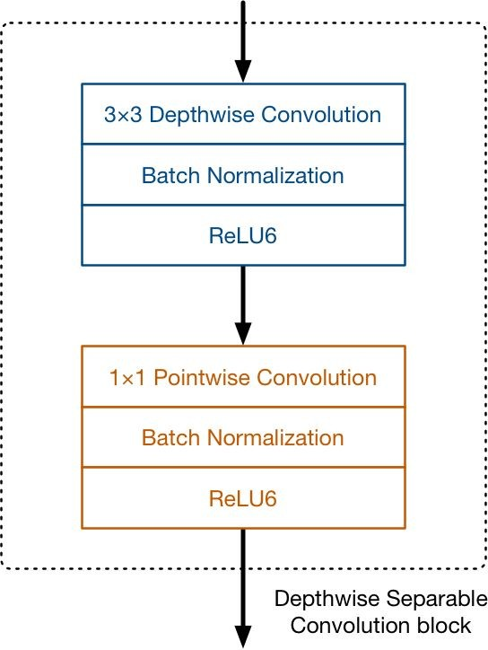
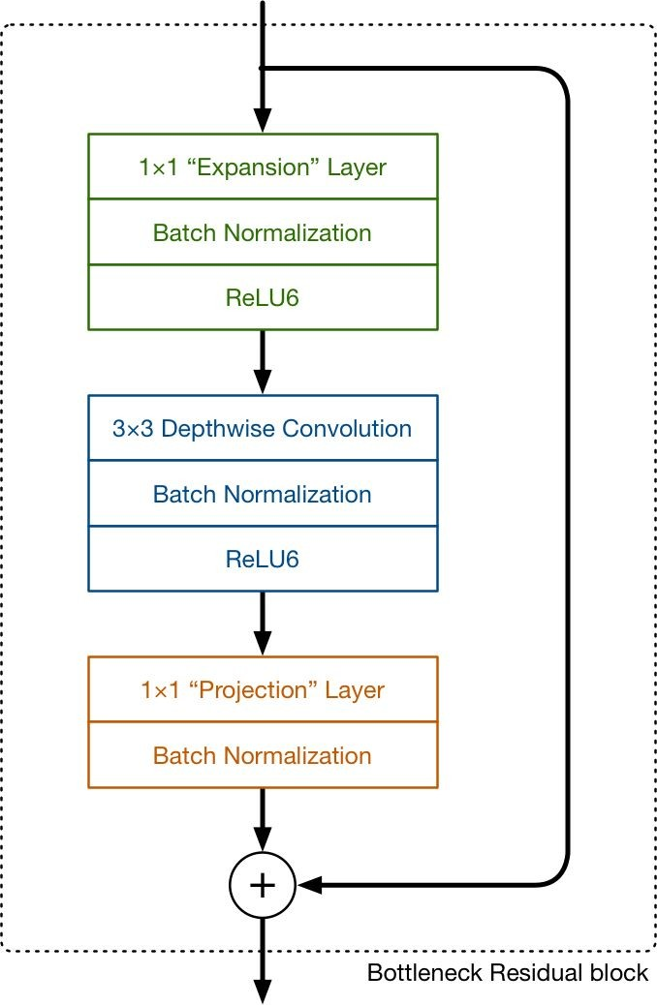
MobileNet
Introduced in 2017, intended to run neural networks efficiently on mobile devices
V1 introduces Depth wise separable convolution
V2 introduces Inverted Residual block
https://arxiv.org/pdf/1704.04861.pdf

Slide 14
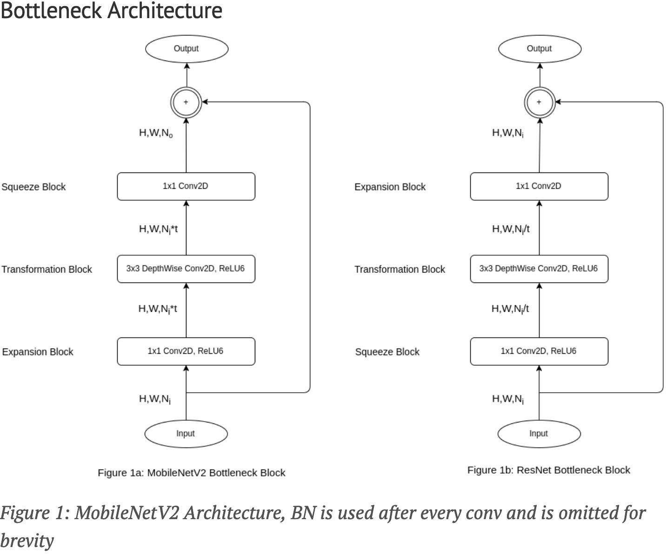
Residual and Inverted Residual block

Slide 15
Other Interesting Papers
ResNeXt (2016)
https://arxiv.org/pdf/1611.05431.pdf
Generally a strict improvement to ResNet, but slower. It’s like 3 lines of code changed.
SENet (2017)
https://arxiv.org/pdf/1709.01507.pdf
Channel-wise attention in CNNs. It’s like 20 lines of code.
EfficientNet (2019)
https://arxiv.org/pdf/1905.11946.pdf
Optimized model scaling. Probably can hard code this with some effort.
RegNet (2020)
https://arxiv.org/pdf/2003.13678.pdf
ResNet with optimized layer sizes. It’s probably… 10 lines changed?
ResNeSt (2020)
https://arxiv.org/pdf/2004.08955.pdf
ResNeXt on steroids + attention. I (we?) will be really impressed ☺
NFNet (2021, SOTA)
https://arxiv.org/pdf/2102.06171v1.pdf
Quite doable actually

Slide 16
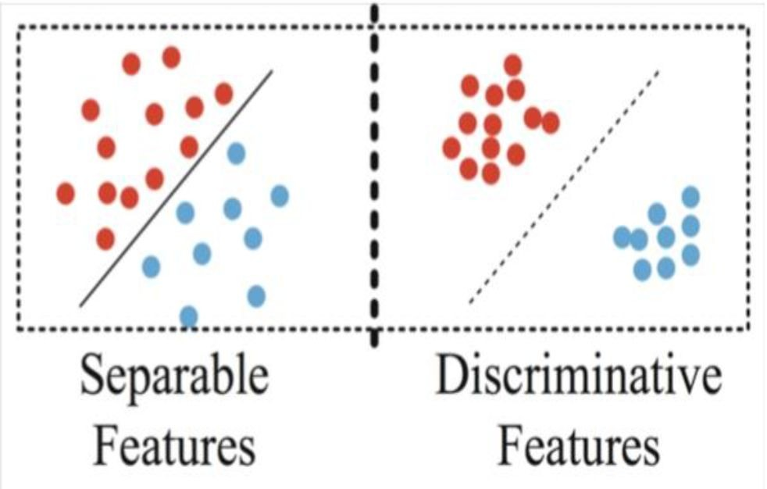
Discriminative Features
Classification optimizes learning separable features
Optimally we wish to learn discriminative features
Maximum inter class distance
Minimum intra class distance

Slide 17
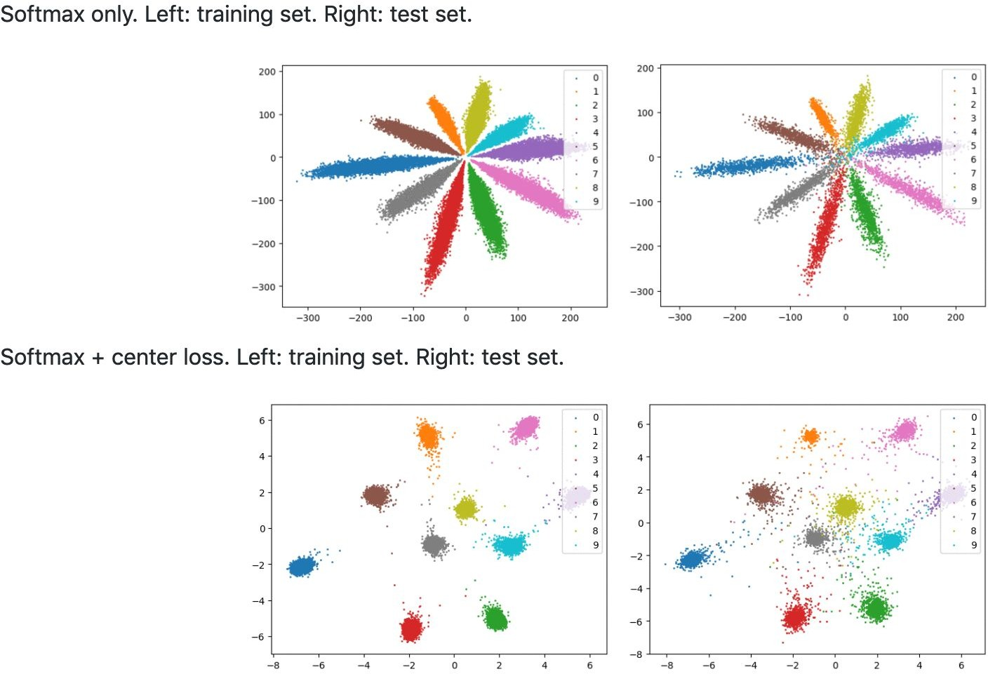
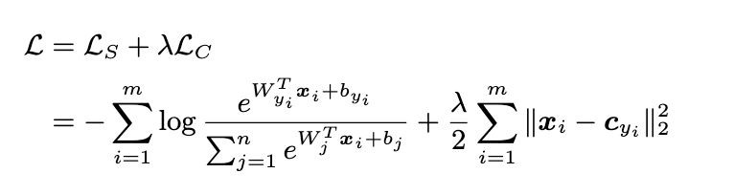
Center Loss
Tries to minimize the intra class distance by adding a euclidean distance loss term
If you use this, YOU MUST USE CENTER LOSS FROM THE BEGINNING OF TRAINING CLASSIFICATION!
Every semester we get around 50 questions about this.

Slide 18
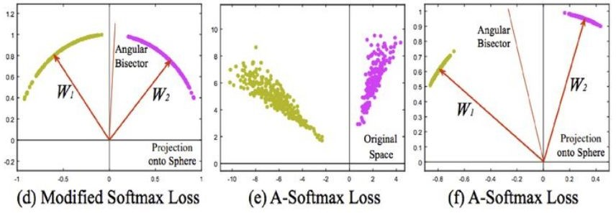
Other types of Losses
Contrastive Loss (maintain margin between classes)
Triplet Loss (motivated from nearest neighbour classification)
Pair Wise Loss (separate distributions of similarity scores)
Angular Softmax Loss

Slide 19
References
https://arxiv.org/pdf/1512.03385.pdf
https://arxiv.org/pdf/1608.06993v3.pdf
https://arxiv.org/pdf/1409.1556.pdf
https://arxiv.org/pdf/1704.08063.pdf
https://arxiv.org/pdf/1503.03832v3.pdf
http://ydwen.github.io/papers/WenECCV16.pdf
https://www.cs.cmu.edu/~rsalakhu/papers/oneshot1.pdf
https://towardsdatascience.com/densenet-2810936aeebb
http://yann.lecun.com/exdb/publis/pdf/hadsell-chopra-lecun-06.pdf
https://papers.nips.cc/paper/4824-imagenet-classification-with-deep-convoluti onal-neural-networks.pdf

