Slide 1



|| Jai Sri Gurudev ||
BGSKH Education Trust® – A unit of Sri Adichunchanagiri Shikshana Trust®
BGS College of Engineering and Technology
Mahalakshmipuram, West of Chord Road, Bengaluru – 560086 | www.bgscet.ac.in
(Approved by AICTE, New Delhi and Affiliated to VTU, Belagavi)
Department of Information Science and Engineering
Title: Samaritan
Ms.Poojitha K
Asst.Professor
ISE, BGSCET
1MP24IS037 Prathik K U
1MP24IS038 Rahul C Pujar
1MP24IS061 Yashash Gowda M
1MP24IS062 Yashwanth P
Dept. of ISE
AY: 2026-27
1

Slide 2
Table of Content
BGSCET
  Introduction
  Problem Statement
  Objectives
  Proposed System
  Expected Results
  Applications
Dept. of ISE
AY: 2026-27
2

Slide 3
Introduction
BGSCET
Instant messaging is now a primary mode of communication, but most messaging applications assume that users can type and read comfortably at all times. This leaves out visually impaired users, people with motor difficulties, and anyone whose hands or eyes are busy, such as while driving or working. At the same time, messages often carry personal or confidential information, which makes security a basic requirement rather than an add-on.
Samaritan is a secure messaging system in which users can dictate messages by speaking, have incoming messages read aloud, or use plain text chat
Dept. of ISE
AY: 2026-27
3

Slide 4
Problem Statement
BGSCET
→ Most applications today have either text or voice messaging
→ Many apps that offer voice transcription send audio to
third-party cloud servers
→ Transcription and speech synthesis delays break the flow
of conversation
There is a need for a single, secure, efficient messaging system that integrates voice input and output while keeping user data private and offering a polished user experience.
Dept. of ISE
AY: 2026-27
6

Slide 5
Objectives
BGSCET
→ Design a messaging system supporting real-time text
communication.
→ Integrate STT so users can compose messages by voice and
integrate TTS so users can listen to received messages.
→ Keep latency low enough for natural conversation.
→ Provide a premium, responsive and accessible GUI.
Dept. of ISE
AY: 2026-27
7

Slide 6
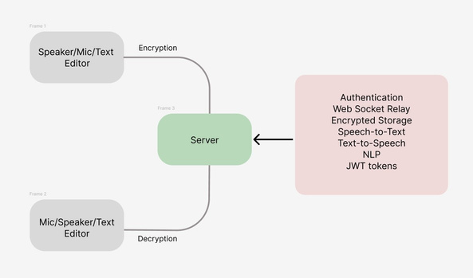
Proposed System
BGSCET
Schematic
Representation
Modules:
  User Management Registration, login, password hashing
  Messaging Engine Real-time delivery over WebSockets,
message history, delivery status
  STT & TTS Vosk, Whisper, browser Web Speech API
  Security TLS transport, input validation, EK
  GUI Chat screen, mic and play controls,
themes, animations, accessibility
options
Dept. of ISE
AY: 2026-27
8

Slide 7
Expected Result
BGSCET
  User logs in and a secure session is established.
  Encryption keys are exchanged between the two users.
  The sender types or speaks. Model converts speech to text, and the user confirms it.
  The message is encrypted on the sender’s device and sent to the server.
  The server forwards the ciphertext to the receiver.
  The receiver’s device decrypts the message and displays it.
  The receiver can tap play, or enable auto-read, to hear the message through TTS.
Dept. of ISE
AY: 2026-27
9

Slide 8
Applications
BGSCET
  Accessibility: assists visually impaired users (hear messages) and users with motor or typing difficulties(dictate messages).
  Hands-free communication: drivers, field workers, factory and lab staff.
  Elderly users: simpler interaction for people who find typing hard.
  Education: language learning with pronunciation practice, and support for students with dyslexia or other learning difficulties.
  Multilingual communication: can be extended to Indian languages (Kannada, Hindi and others) for regional accessibility.
Dept. of ISE
AY: 2026-27
10

Slide 9
BGSCET
Thank You
Dept. of ISE
AY: 2026-27
11

