Slide 1
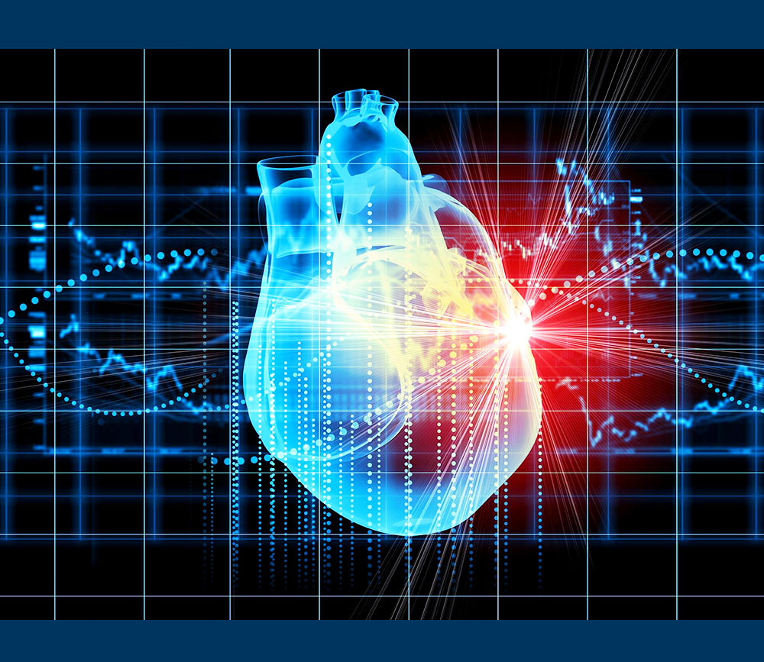
Heart Disease Prediction using Deep Learning..
Team Members: Yashashwini Devineni
Sai Venkata Anil Thota

Slide 2
Outline:
Objective
Motivation
Limitations of existing models
Proposed Model
Methodology
Feature Engineering
Model Implementation
Outputs Achieved
References
Conclusion
Dataset

Slide 3

Objective
This project aims to predict heart disease using decision trees and random forests. The objective is to evaluate the performance of various models and determine the most effective approach.
Our main goal is to create a model to detect heart disease using deep learning techniques that can predict whether a person is prone to heart attack or not which will help healthcare professionals make informed decisions.

Slide 4

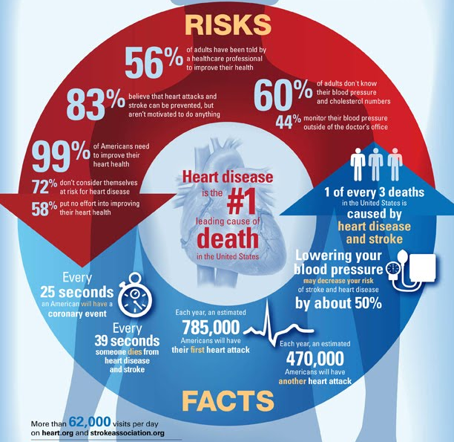

Slide 5

Limitations of existing models:
Simplistic Models: Linear models may not fully capture the complex, non-linear relationships in medical data.
Manual Interpretation: Clinical risk scores involve manual calculations, which can be error-prone and inefficient.
Limited Feature Interaction: Traditional methods may overlook important interactions between multiple risk factors.

Slide 6
Proposed Solution:
After a proper research we came to a conclusion that random forest is the most robust model for heart disease prediction.
The random forest algorithm takes multiple decision trees as input and gives a single result which enable healthcare professionals make informed decisions.
Decision trees can model complex relationships and provide clear, interpretable decision rules, making them particularly suitable for medical applications.
Our approach involves data preprocessing, model training, evaluation, and optimization to ensure robust and accurate predictions.

Slide 7
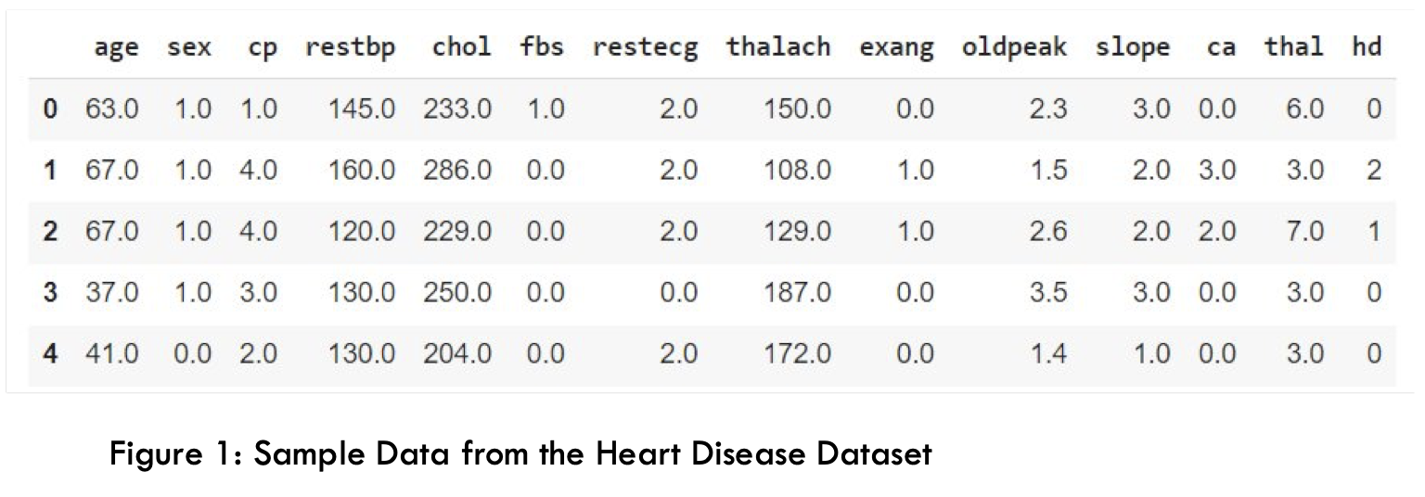
DATASET DESCRIPTION
We have taken Cleveland Heart Disease Data from UCI ML repository that contains 14 variables from 303 patients.
The dataset used for this project contains patient data with various medical attributes. The target variable is whether the patient has heart disease (1) or not (0). Key features include age, sex, chest pain type, resting blood pressure, cholesterol level, and more.

Slide 8
Methodology:
Data Collection
Data Preprocessing
Model Training
Model Evaluation
Model Pruning
Model Deployment

Slide 9
FEATURE ENGINEERING
Handling
Handling missing values.
Encoding
Encoding categorical variables.
Normalizing/Scaling
Normalizing/Scaling numerical features.
Creating
Creating new features based on domain knowledge.

Slide 10
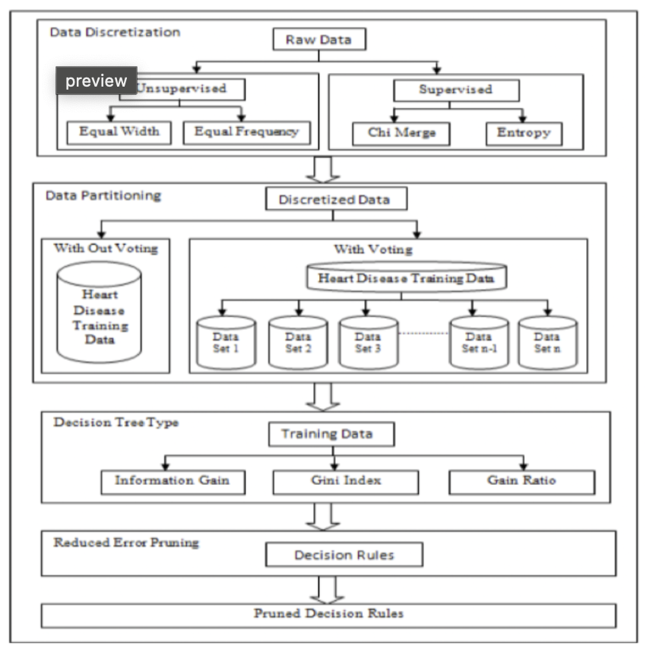
Flow Diagram

Slide 11
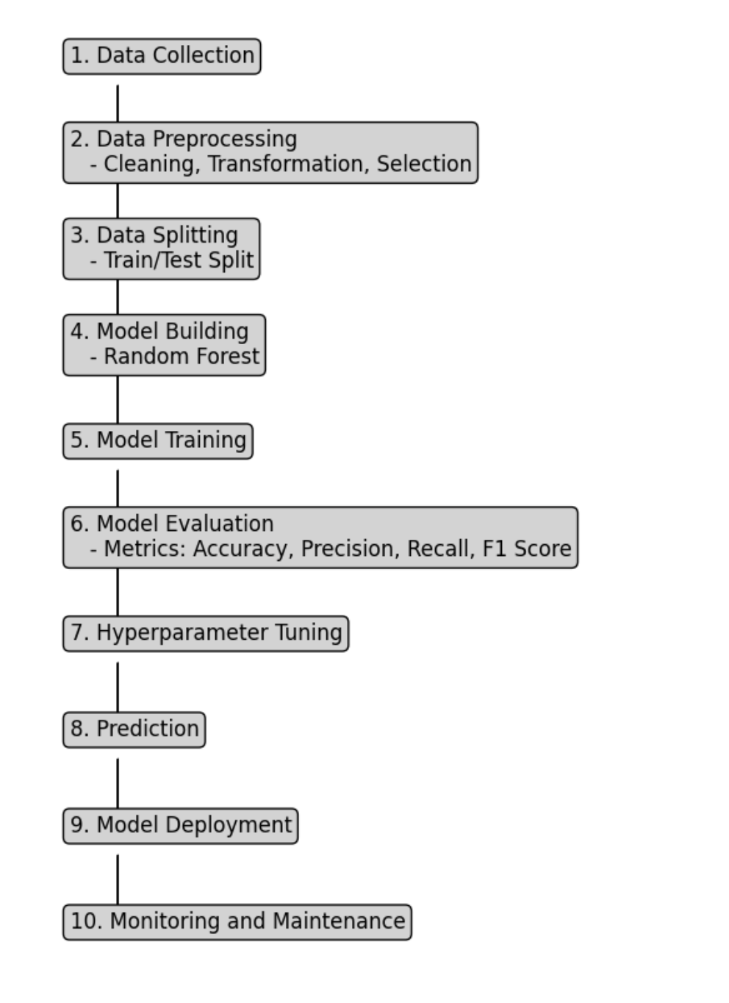
Flow Diagram

Slide 12
Implementation:
Training and testing unpruned and pruned decision tree
Plotting unpruned and pruned decision tree
Obtaining confusion matrix
Obtaining Accuracy
Building model using random forest
Comparing the models developed using decision trees with best parameters and random forest
Comparision using performance metrics such as Accuracy, Precision, Recall, F1score.
Comparing confusion matrix for both the models

Slide 13
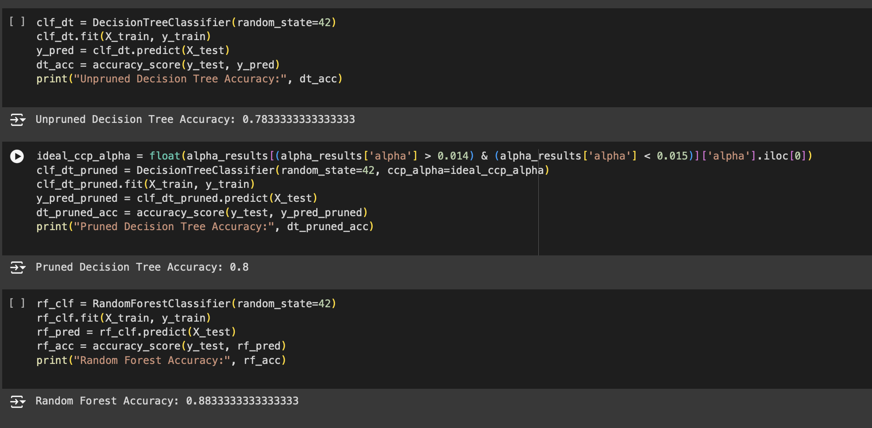
Outputs:

Slide 14
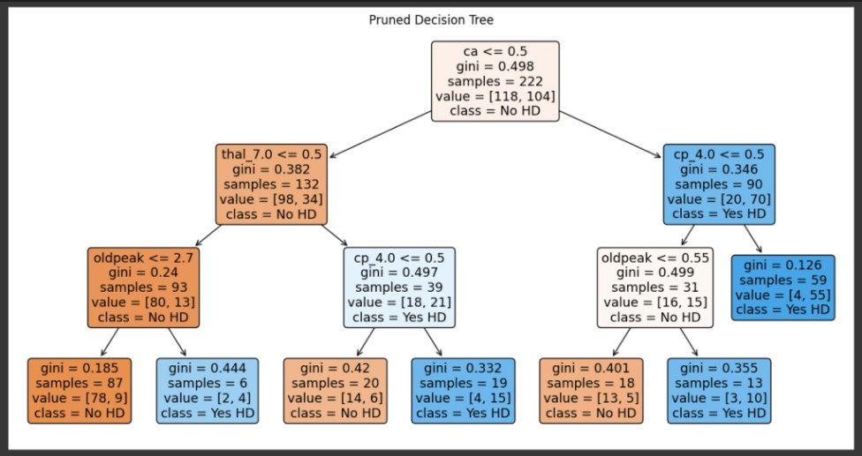
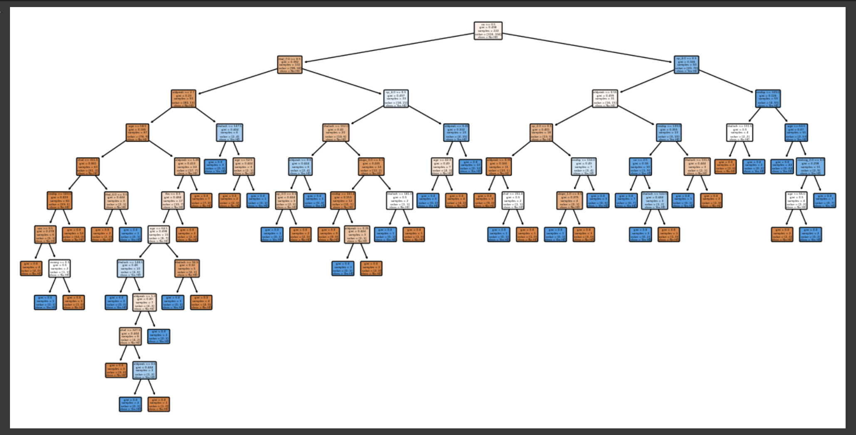
Pruned Decision Tree:
Unpruned Decision Tree:

Slide 15
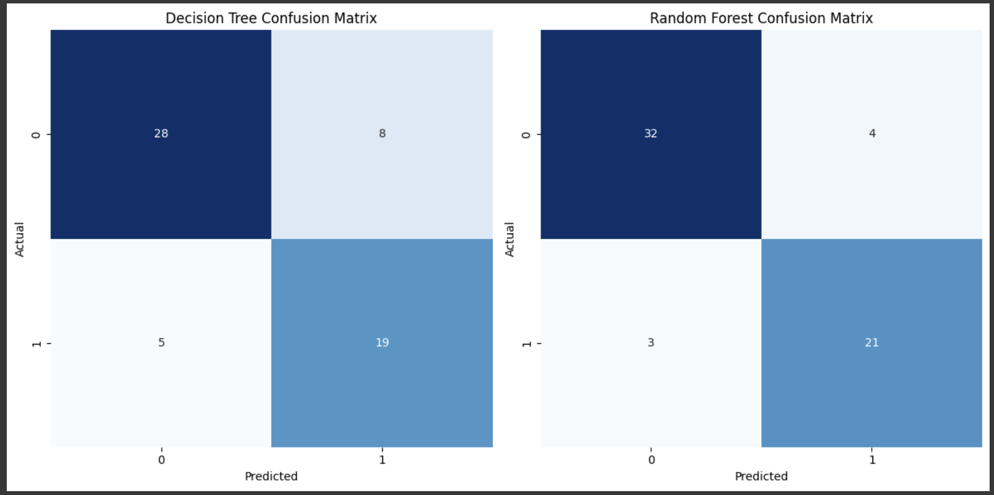

Slide 16
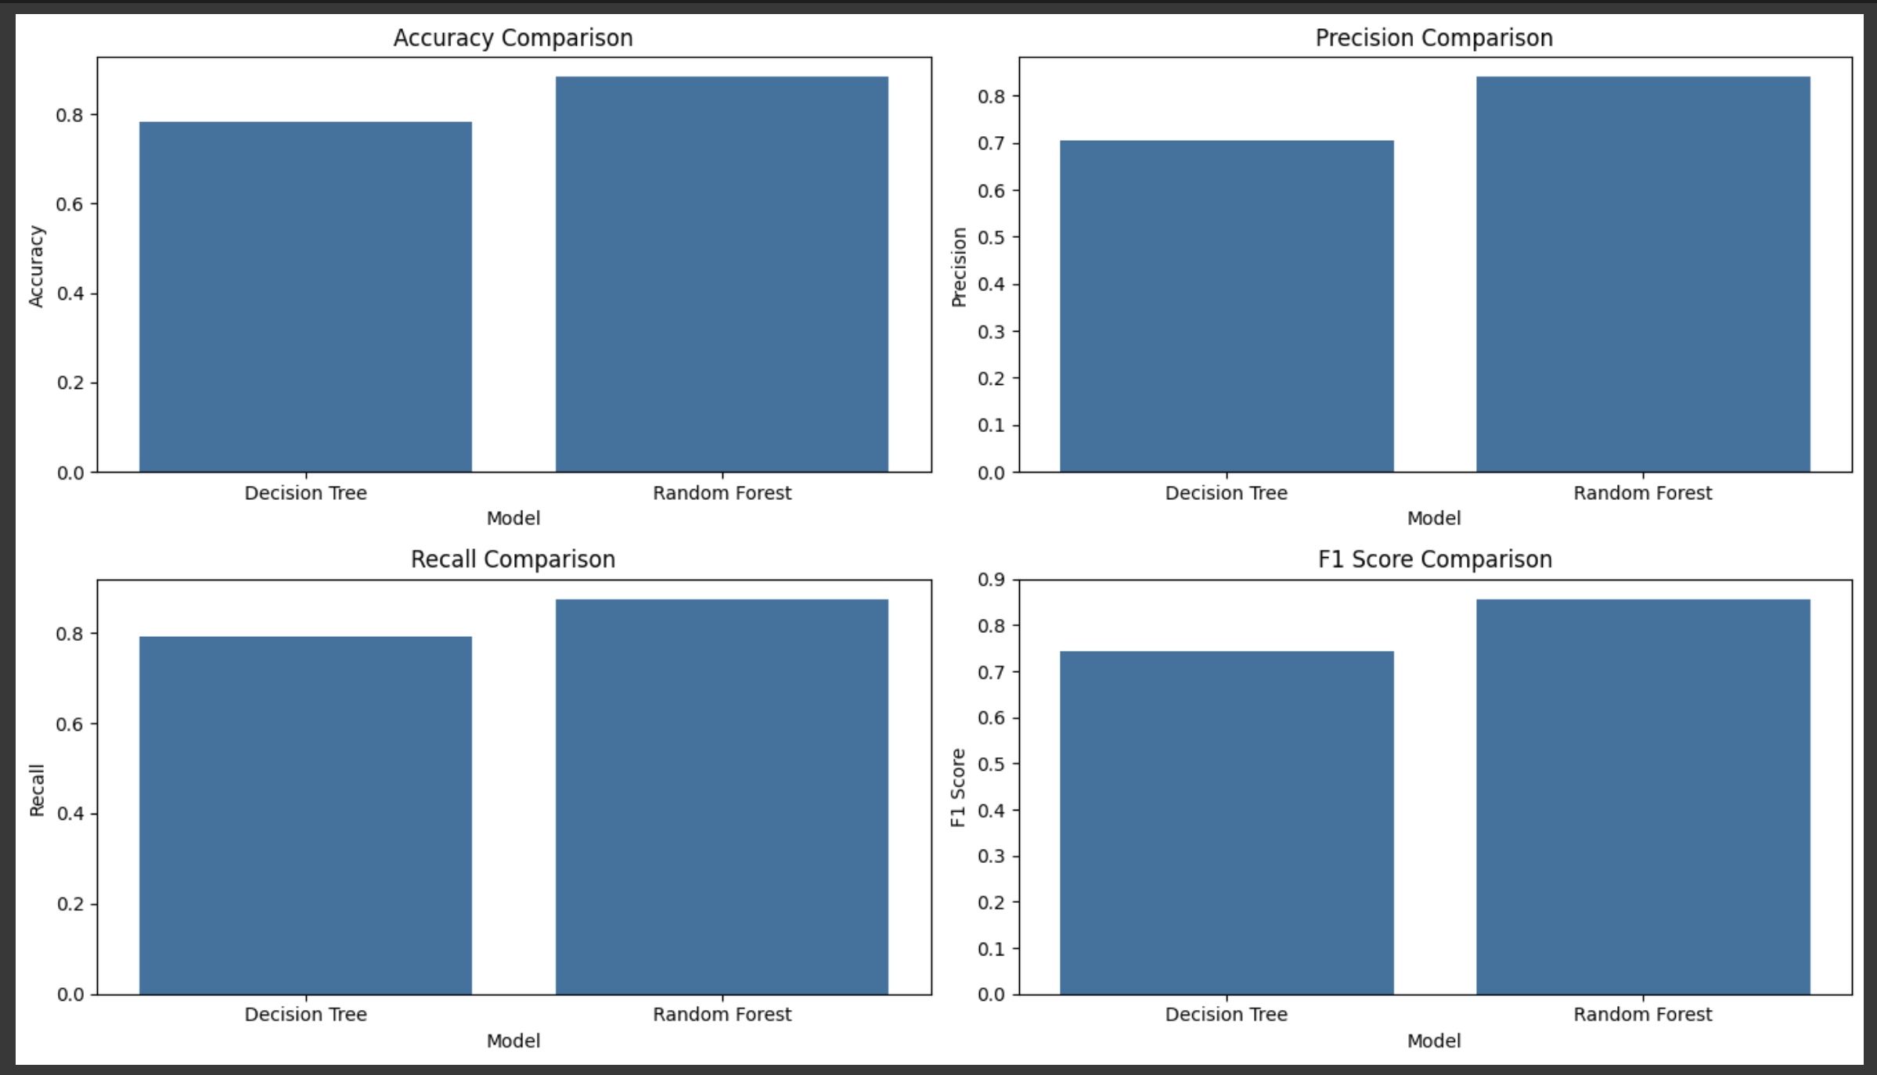

Slide 17
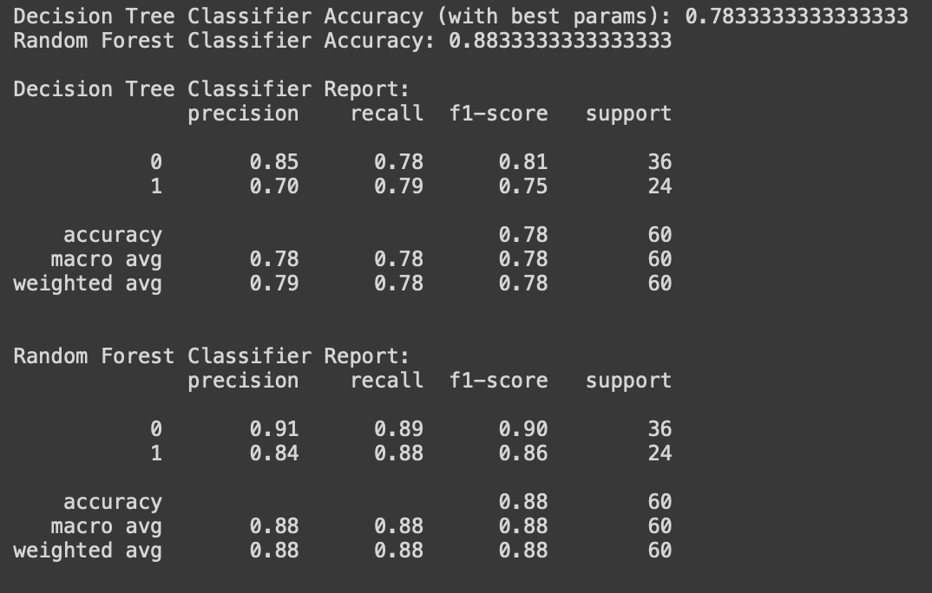

Slide 18

Conclusion:
Heart disease prediction using machine learning, specifically decision tree classifiers, offers a powerful tool for early detection and management of heart disease.
By leveraging the capabilities of decision trees, we can model complex relationships in medical data and provide interpretable predictions that assist healthcare professionals in making informed decisions.
This project aims to develop a robust and accurate heart disease prediction model that contributes to better patient outcomes and advances in medical data science.

Slide 19
References:
1. Smith, J., & Lee, K. (2023). Machine Learning in Cardiovascular Disease Prediction: A Review. *Journal of Medical Informatics*. 2. Brown, T., & Green, P. (2024). Decision Tree Algorithms for Medical Applications. *IEEE Transactions on Biomedical Engineering*. 3. Wang, X., & Chen, L. (2023). Predicting Heart Disease with Decision Trees: A Case Study. *ACM Transactions on Healthcare Informatics*. 4. Davis, R., & White, J. (2022). Implementing Machine Learning for Heart Disease Prediction: Challenges and Solutions. *International Journal of Medical Data Science*. 5. Liu, S., & Li, M. (2023). Machine Learning for Cardiovascular Disease: An Industrial Case Study. *Journal of Healthcare Research*. 6. Wilson, E., & Robinson, T. (2024). Real-time Heart Disease Prediction using Machine Learning. *IEEE Transactions on Industrial Informatics*. 7. Zhang, Y., & Zhao, Q. (2022). A Survey on Machine Learning for Heart Disease Prediction. *Data Mining and Knowledge Discovery*. 8. Brown, A., & Davis, M. (2023). Deep Learning for Cardiovascular Disease Prediction. *Journal of Machine Learning Research*.

Slide 20

Any Queries?!

