Slide 1
AI-Powered Resume Screening and Job Matching: A Data-Driven Approach to Career Success
Team: ResumeMate
Yashashwini Devineni
Sravani Kudumula
Vrunda Teeleru
Sai Venkata Anil Thota

Slide 2

Contents:
Introduction
Problem statement
motivation
Existing limitations
Proposed Work
Implementation
System architecture
Data Preparation
Preprocessing steps
Features
Experiments
Comparison of existing vs proposed model
Evaluation Metrics
Performance and Efficiency
Challenges and Future Work
Conclusion
References

Slide 3
Problem Statement
Difficulties interacting with ATS systems
Over 75% resumes rejected before human review
Resume tools lack AI-generated personalized feedback
Currently, no software exists that can accurately suggest the most suitable job to an applicant based on their skills.
There is no existing model capable of matching a job seeker’s resume to that of a successfully selected candidate and recommending appropriate job opportunities accordingly.

Slide 4
Motivation
Demand for automated recruitment practices
Need for tools that generate actionable feedback
Bridge job seekers and recruiters dynamically

Slide 5
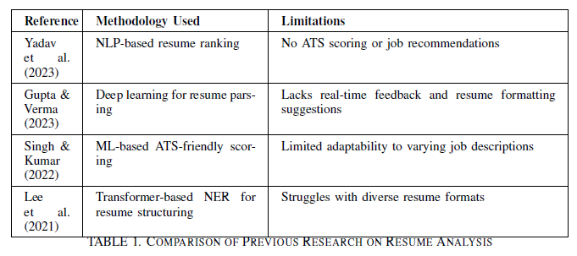
Existing Limitations
- Most tools only offer formatting and keyword tracking
- No real-time feedback or personalization
- Poor job matching accuracy

Slide 6
Proposed Solution Overview
AI-powered Resume Parsing and Feedback.
Real-time ATS scoring system.
Job matching via candidate similarity clustering

Slide 7
System Architecture
Resume Parsing and preprocessing using spaCy + Regex
→ Hybrid Embedding with bert and TF-IDF for ATS Scoring
→ ATS feedback generation using rule-based+GPT technique
→ Job role matching using cosine similarity with the selected candidate
resumes

Slide 8
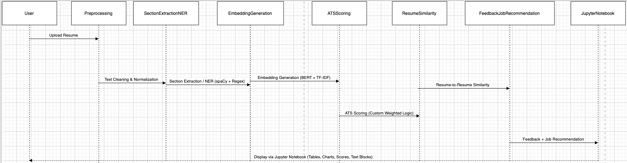
Architecture:

Slide 9
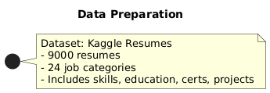
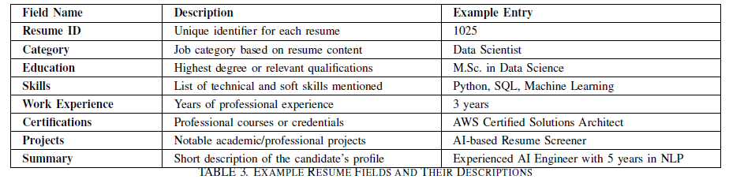
Data Preparation
- Kaggle Resume Dataset (9,000 resumes, 24 categories)
- Includes education, skills, certifications, projects
- Diverse industry coverage

Slide 10
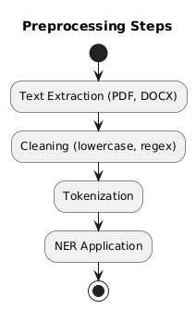
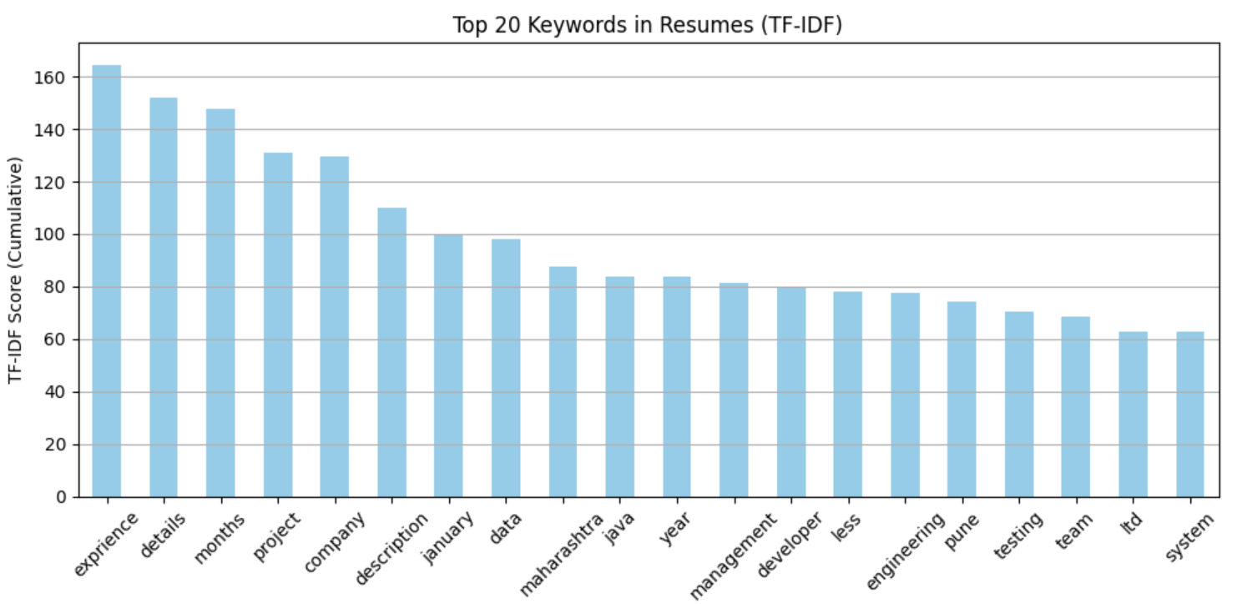
Preprocessing Steps
Text extraction: PyMuPDF, pdfplumber, python-docx
Cleaning: lowercase, stop-word removal, regex
Tokenization & Named Entity Recognition (NER)

Slide 11
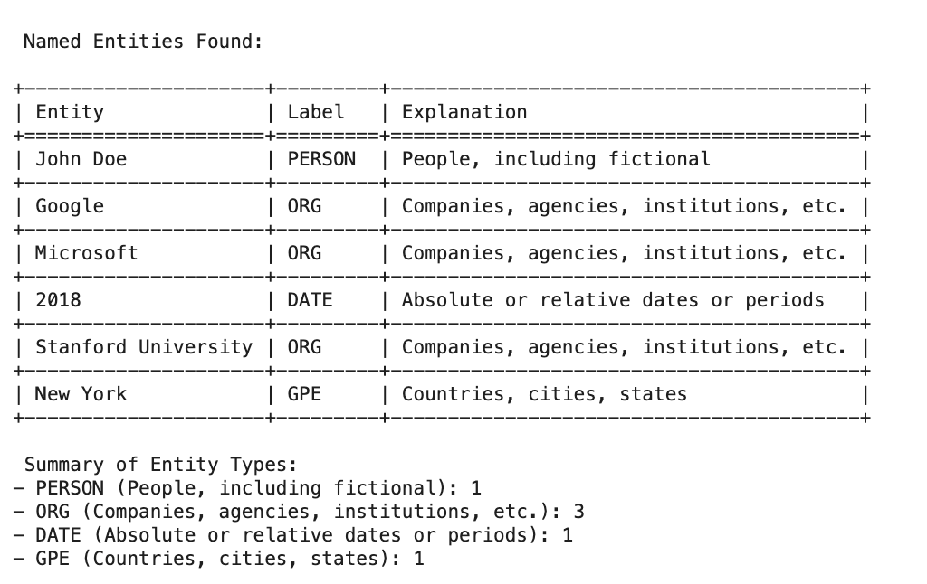
Resume Parsing & NER
Education: BERT-based NER
Experience: SpaCy
Skills: GPT
Certifications: TF-IDF

Slide 12
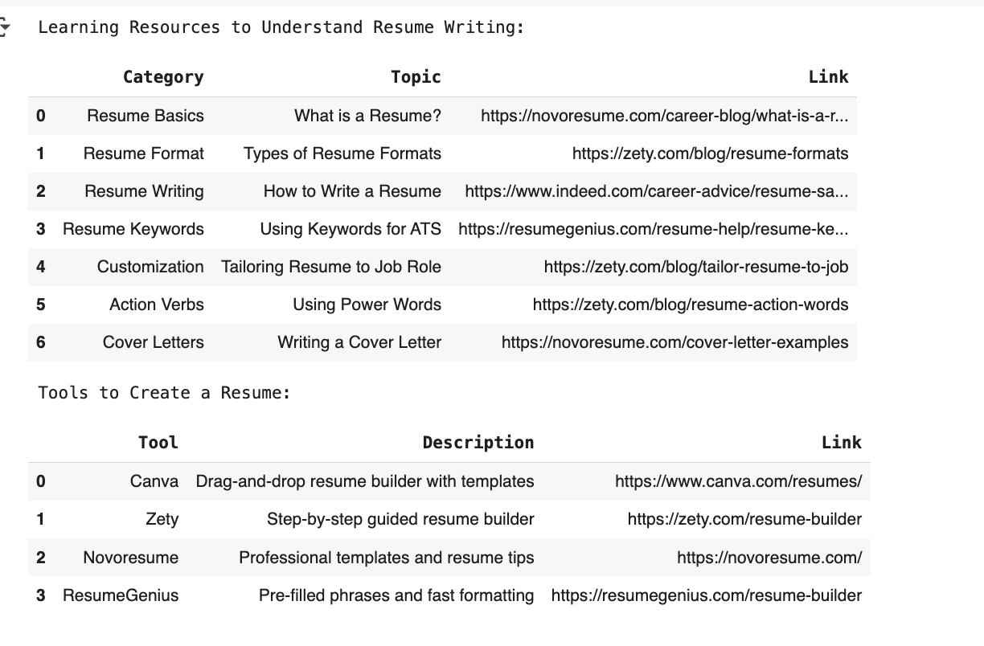
Learning Resources for resume making

Slide 13
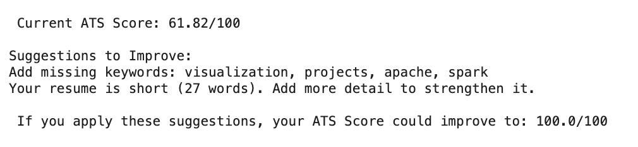
ATS Scoring Mechanism
Formula: 0.4×Keyword + 0.3×Formatting + 0.3×Action Verbs
Generates a numerical resume score
Identifies improvement areas

Slide 14
AI Resume FeedbacK
GPT-generated structural improvement tips
Rephrasing and formatting suggestions
Personalized resume enhancement

Slide 15
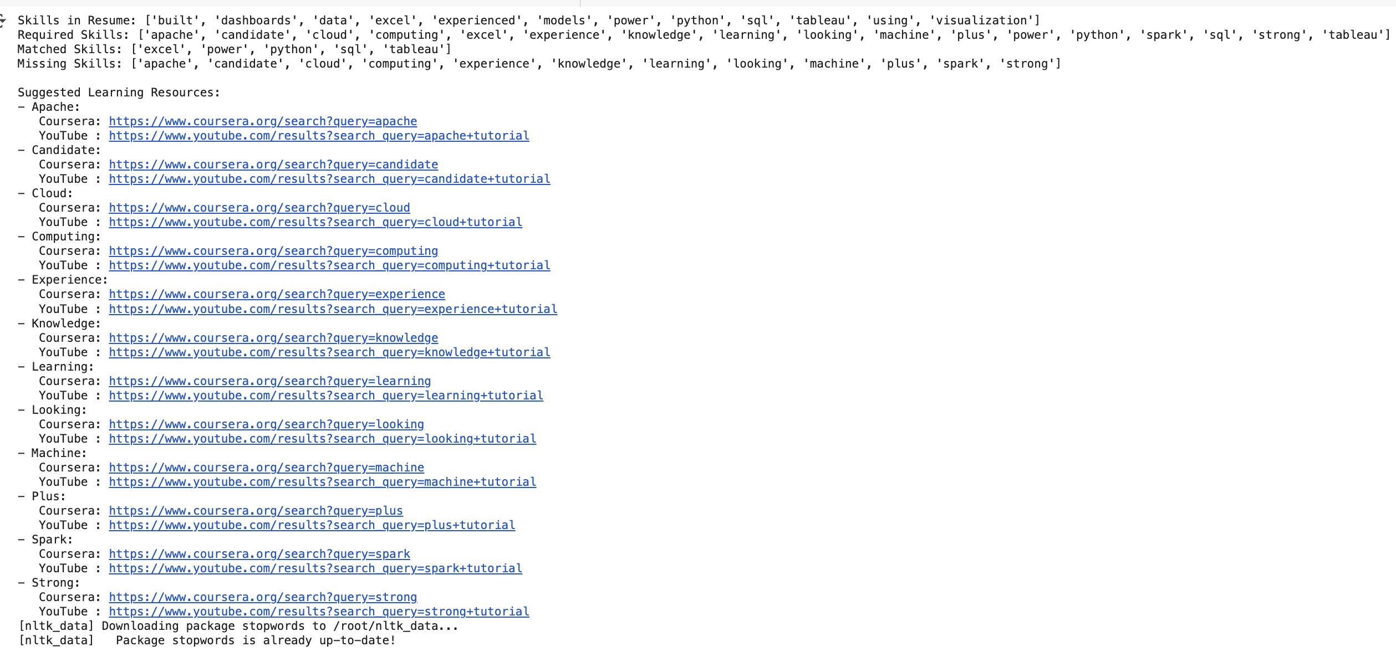
Skill gap analysis

Slide 16
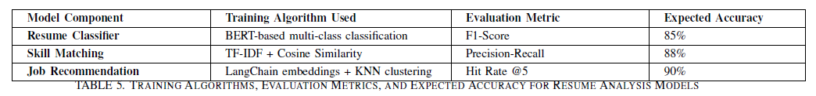
Job Recommendation Engine
- LangChain embeddings + clustering
- Matches profiles with successful candidates
- Provides job suggestions based on similarity

Slide 17

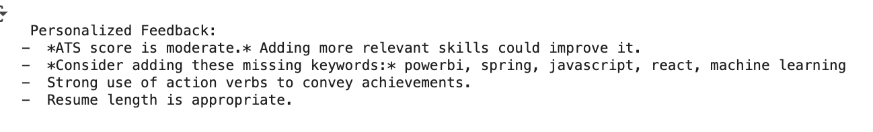
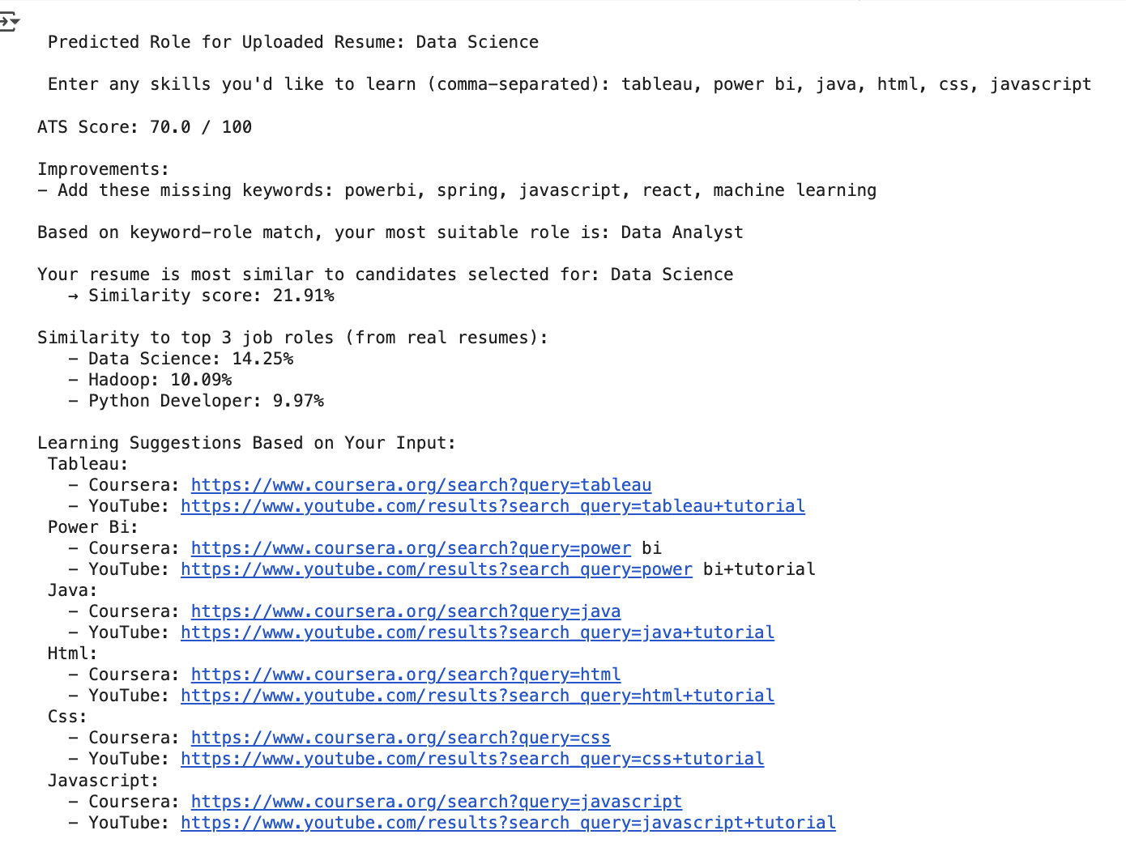
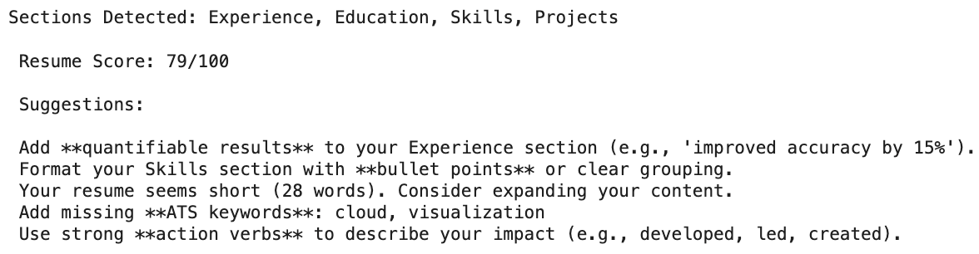
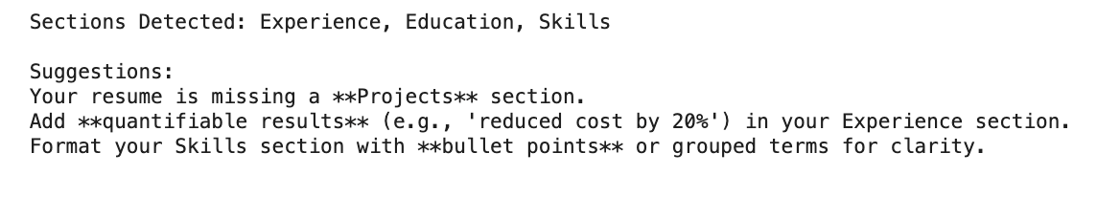
Feedback System:
Section-wise analysis:
Job Recommendation System

Slide 18
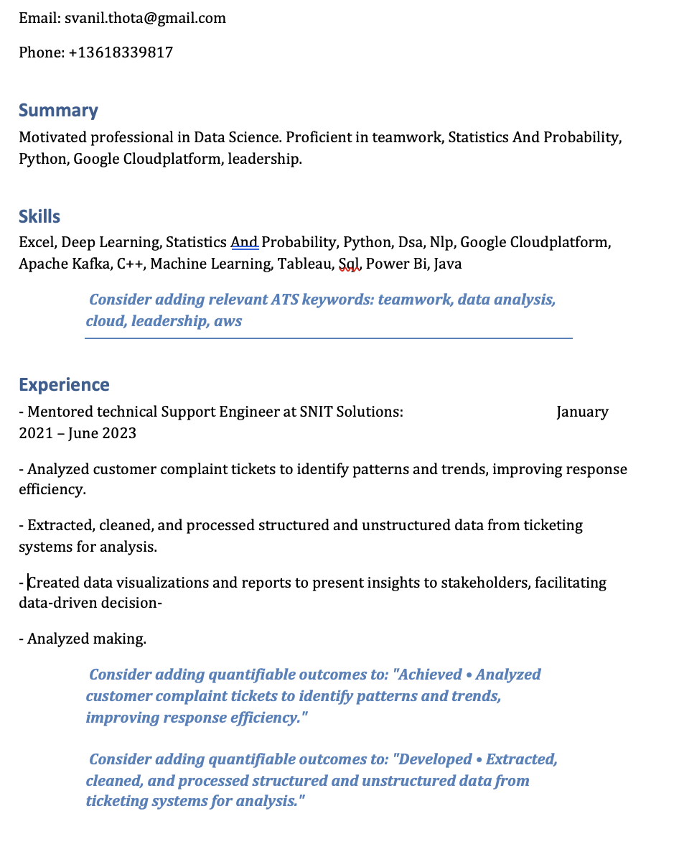
Improved resume generation after adding the suggestions:
Sample screenshot of generated resume:

Slide 19
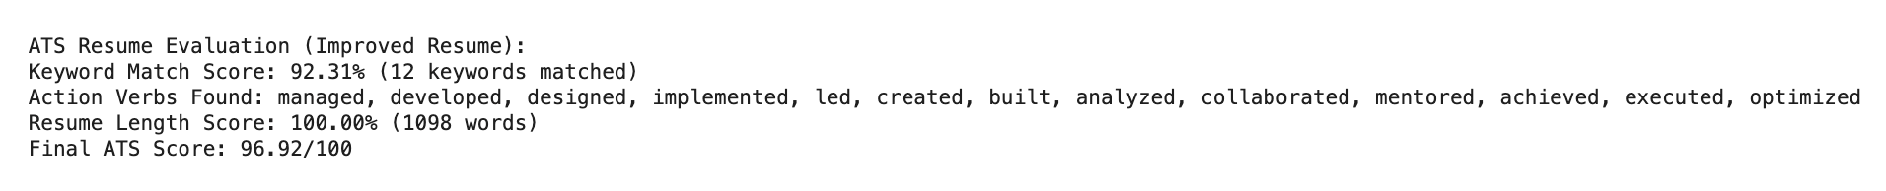
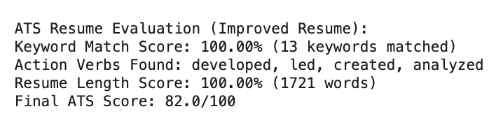
Evaluation of generated improved resume:

Slide 20
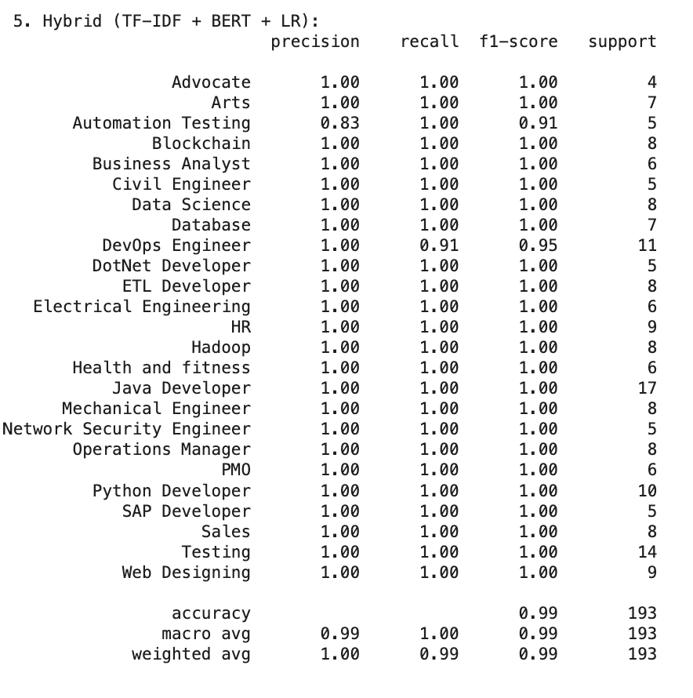
Evaluation Metrics
- Resume classifier: F1-Score (85%)
- Skill matching: Precision-Recall (88%)
- Job recommendations: Hit Rate@5 (90%)

Slide 21
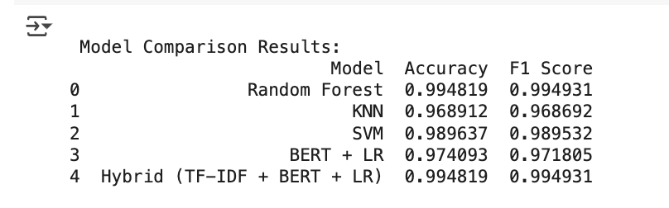
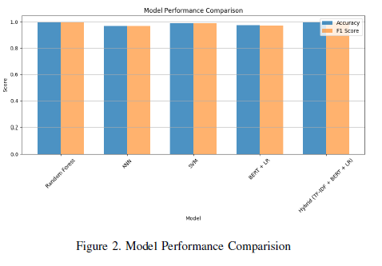
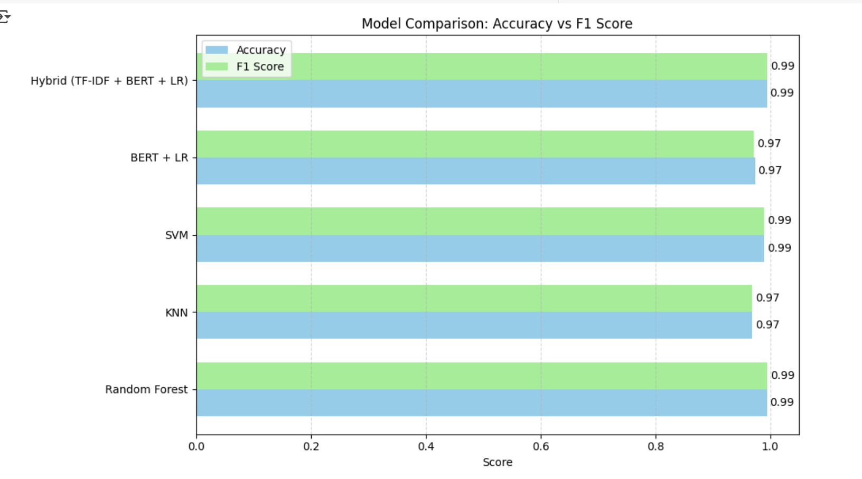
Comparison of all the models:

Slide 22
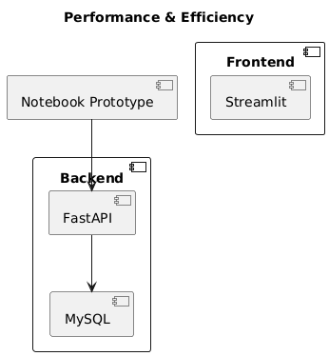
Performance & Efficiency
Prototype in Jupyter Notebook
Backend: FastAPI + MySQL
Needs optimization for scalability and speed

Slide 23
Challenges & Future Work
UI integration ongoing
Potential bias in recommendations
Adaptation to global resume standards planned
Streamlit dashboard (planned)
Real-time ATS score and job match display

Slide 24
Conclusion
-Combines LLMs, NLP & ML for smart resume analysis
-Real-time ATS scoring, feedback, job suggestions
-Bridges the gap between traditional hiring tools and modern AI-based solutions.
-Future updates to include global resume formats and industry-specific adaptations.

Slide 25
References
Singh & Kumar, 2022 – ML for ATS-Friendly Resume Scoring
Thompson et al., 2024 – Harnessing GPT-4 for Automated Resume Summarization
Zhou et al., 2023 – Job Recommendation Using LangChain and Transformer-Based Embeddings

Slide 26
THANK YOU

