Slide 1
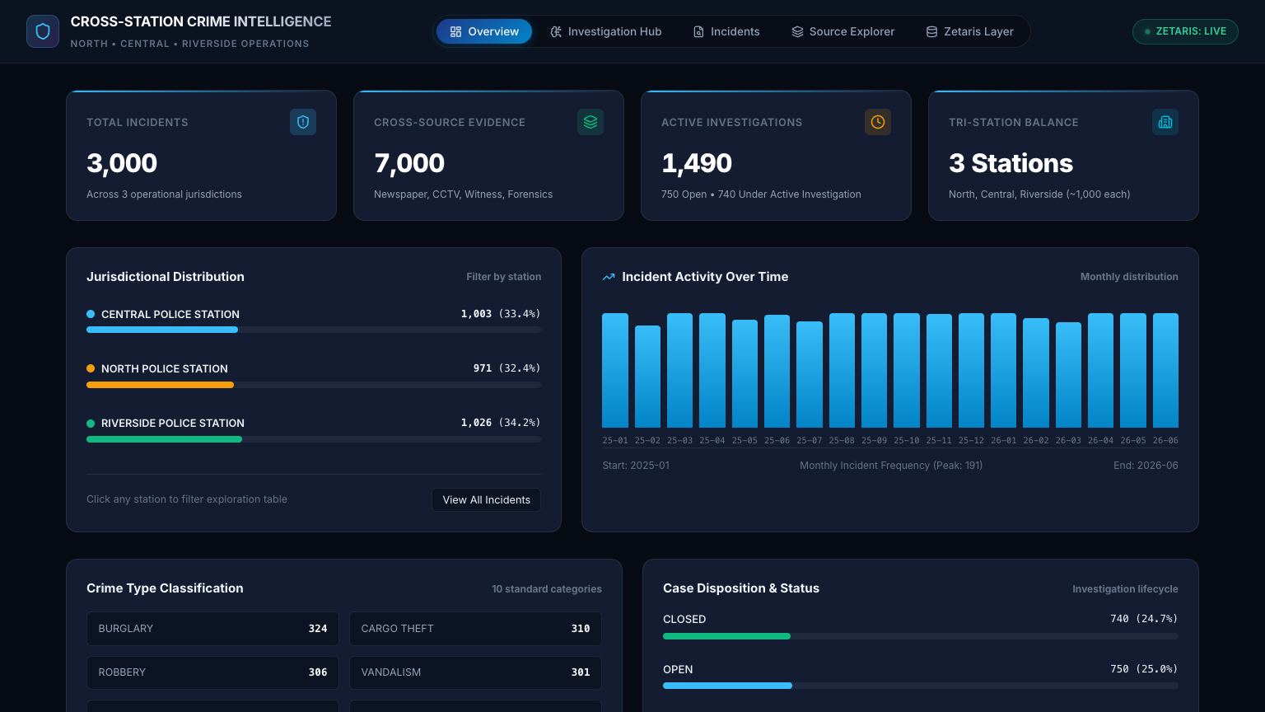
AEGIS: Cross-Station Crime Intelligence
Agents that link crimes across police stations, and show the evidence, the doubts and the missing pieces behind every link.
Track: Solving Fragmented Intelligence · Open Agent Hackathon 2026
Zetaris NDP · Meterless Nightshift and engines · NVIDIA Nemotron
Title · 1/14
Notes:
Hook: crime doesn't stop at a station boundary, records do.

Slide 2
The problem: each station sees only its own cases
The same tool-mark signature appears in NORTH on Monday and CENTRAL on Thursday. Two stations each file one burglary; nobody connects them.
Evidence is fragmented too: police incidents, CCTV, witness statements, forensic reports, press.
Most records carry no explicit link, so the link has to be deduced. Real evidence conflicts, and decoys look convincing.
Users: cross-station detectives and analysts (find and test links), supervisors (review), prosecutors (defensible record).
Our data is synthetic: 10,000 records, 5 sources, 3 stations, 8 planted relationships including 2 decoys.
Required point 1: problem and users · 2/14
Notes:
Say 'proposed lead', never 'caught'.

Slide 3
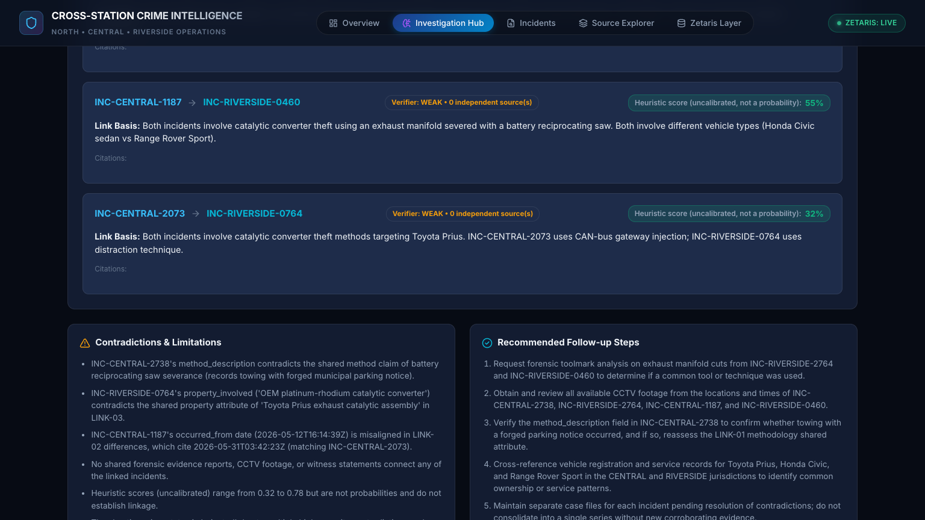
The solution: one question, a checked answer
Input: one plain-language question, e.g. 'Are the safe burglaries across NORTH and CENTRAL linked by the same pry bar?'
Agents read the sources through Zetaris and reason with Nemotron through Nightshift.
A deterministic verifier and a separate Skeptic check every link before a report is written.
Output: candidate links labelled SUPPORTED / WEAK / UNSUPPORTED with shared attributes, differences, missing evidence, objections and citations.
It can say no: without independent corroboration the answer is 'no supportable link', with the reason.
Required point 2: the solution · 3/14

Slide 4
Agent workflow: models propose, code verifies, a Skeptic attacks
Scout/routing, then (H-MEM recall), Planner, Zetaris SQL (code), Finder, Verifier (code), Skeptic, back to the Planner if more evidence is needed, Reporter, citation check, H-MEM store.
Bounded: 3 iterations, 24 model calls, 900 s by default; every Zetaris and Nightshift call has a timeout and a traced fallback.
Stopping reasons include evidence_sufficient, no_supportable_links_found, budget_exhausted, interrupted (resumable).
Not a fixed chain: routing, re-planning, adversarial critique, and code that has the last word.
Required point 3: workflow and architecture · 4/14

Slide 5
Architecture and stack
Web: React 18, Vite, TypeScript: knowledge graph, execution-trace drawer, evidence pinboard.
API: FastAPI and Pydantic with typed contracts per agent (PlannerDecision, FinderOutput, SkepticReview, ReportOutput).
Data: Zetaris NDP, five federated tables. Models: NVIDIA Nemotron behind Meterless Nightshift.
Engines: Meterless H-MEM, Markovian (open references vendored, Apache-2.0), World Model and Scout (mounted).
Delivery: Docker image, POST /run and GET /health, JSONL traces, CI that runs the judge path and an offline check.
Required points 3 and 4: architecture, tech stack · 5/14

Slide 6
Zetaris: the load-bearing data layer
Five federated tables: police_incidents (3,000), cctv (2,000), witness (2,000), forensic (1,500), newspaper (1,500).
One choke point for retrieval: read-only SELECT, bounded LIMIT, allow-listed characters; every query id is recorded in the trace.
Retrieval is relevance-scored: a bounded pool (80 rows max), IDF re-rank, corroboration-aware. This SQL has not been run against live Zetaris; only the local-sample mirror is tested.
The model never touches the database: it sees at most 14 incidents and 8 records per source, and every ID it cites is re-checked.
Live run from inside Docker (reported by the team; trace not committed, before this change): data_mode zetaris_live, query UUIDs, all five tables.
Honest fallback: with POST /run an unreachable Zetaris falls back to local sample data and the trace says so.
Required point 5: sponsor technology (Zetaris) · 6/14

Slide 7
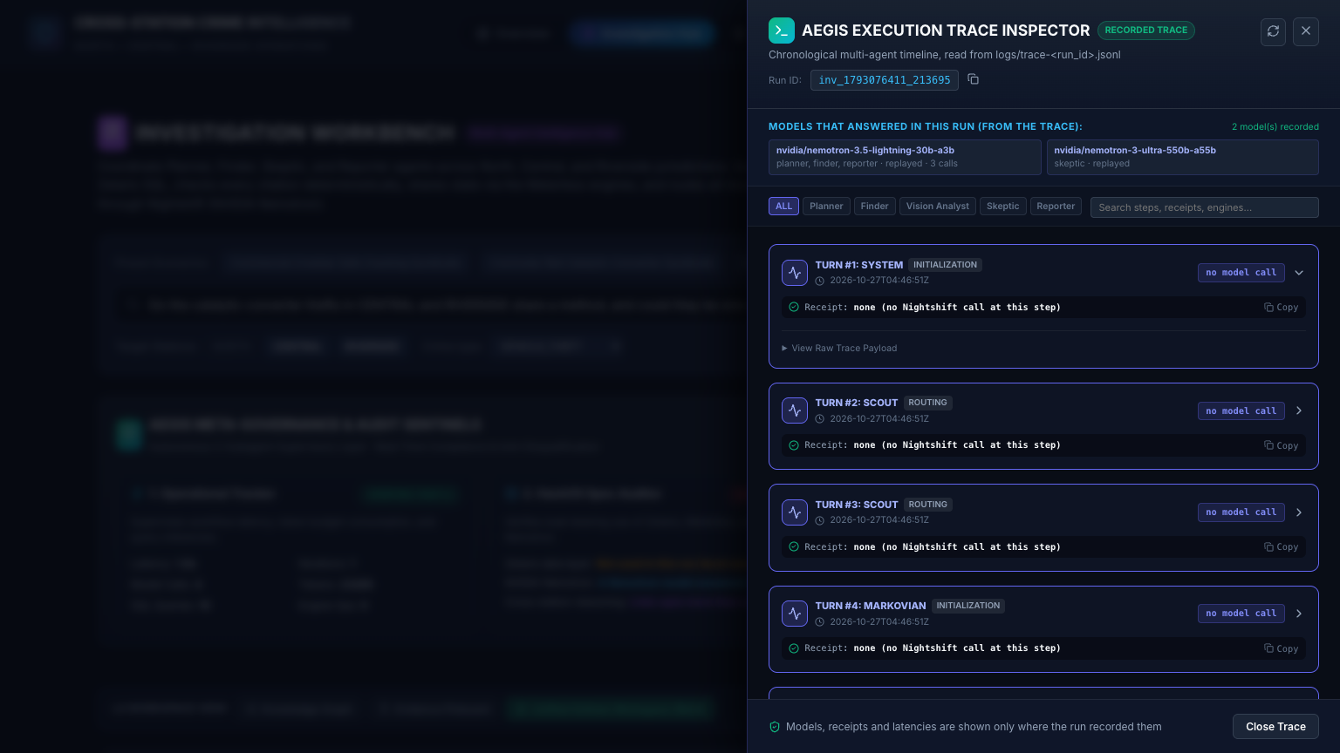
Meterless engines and Nightshift
World Model: shared ledger of every decision, finding revision, objection and verdict. (test_meterless_engine.py)
H-MEM: recalls vetted leads as context only; stores only verified, Skeptic-reviewed leads (0.6 floor, secret gate). Decision memory: see slide 9. (test_engine_adapters.py, test_reference_engines.py)
Markovian: validated chunk config, 800-token carry-over, resumable runs. (test_engine_adapters.py, test_reference_engines.py)
Scout Intent: detector on every request as a safety signal; deterministic routing; refuses destructive requests. (test_engine_adapters.py)
Nightshift: the only model path; requested and answering model, receipt, latency, tokens on every call. An engine that cannot run is traced engine_unavailable, never faked.
Required point 5: sponsor technology (Meterless) · 7/14

Slide 8
NVIDIA Nemotron: where it contributes
Lightning 30B-A3B: Planner, Finder, Reporter (fast lane).
Ultra 550B-A55B: Skeptic, a different model from the Finder and never shown its score (deep lane, about 20 to 40 s per call).
Every response names the model that answered, taken from the response, not from config; fallback to Lightning is explicit with the reason.
Not used, and we say so: Embed 1B is listed but /v1/embeddings returned 404; Rerank and Bolt are not served; no vision claim.
Required point 5: sponsor technology (NVIDIA) · 8/14

Slide 9
What is unique
1. 'Models propose. Code verifies. A Skeptic attacks.' IDs, verbatim quotes, shared attributes on both incidents, station and timeline are re-checked in code.
2. 'Duplicates aren't corroboration.' A repeated camera window, one witness reported twice, a newspaper article about a police-recorded incident never count as a second source.
3. 'Memory only learns what survived scrutiny.' H-MEM stores only verified, Skeptic-reviewed leads. Decision memory: such a lead can change a later retrieval order, attributed in the trace, never evidence (scripted-model tests only).
4. Runs anywhere: the real loop offline in one Docker command, and the same image goes live.
Required point 6: what is unique · 9/14

Slide 10
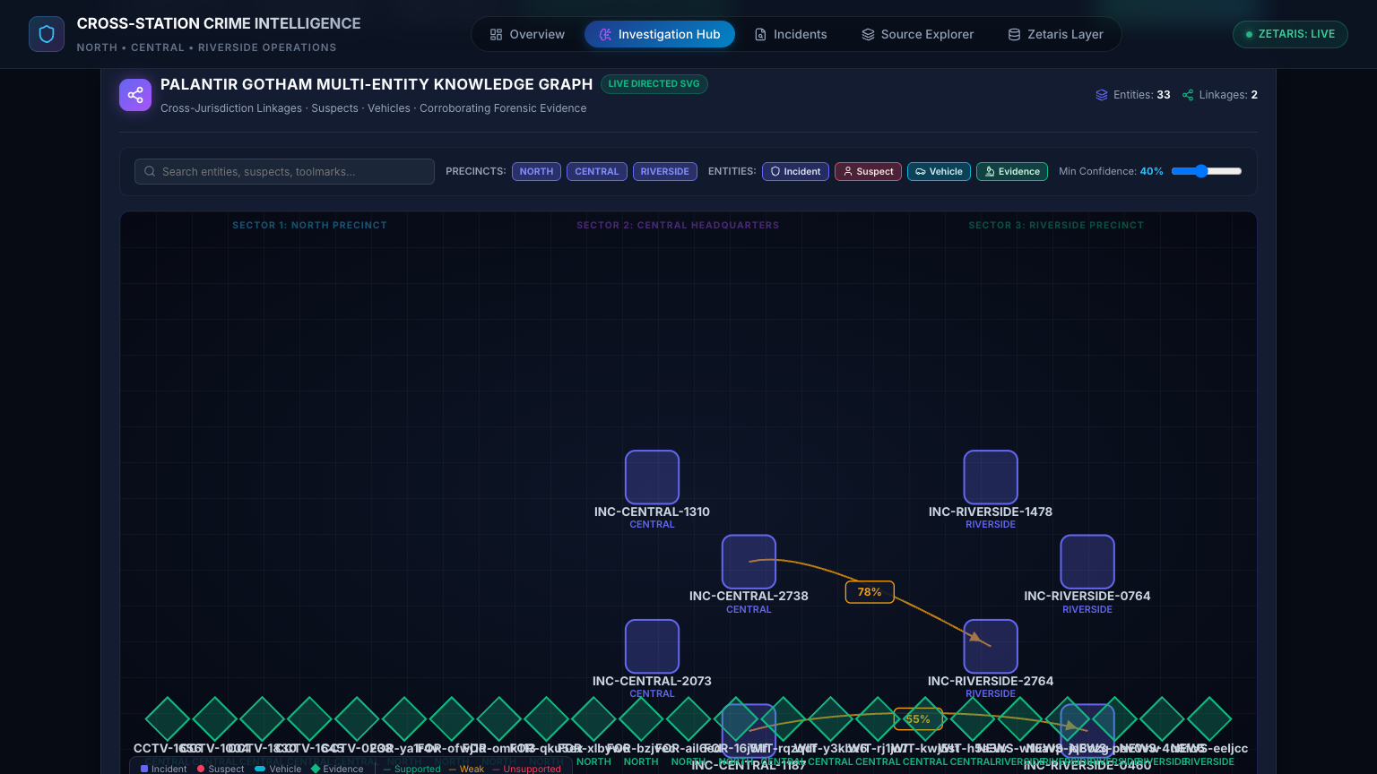
Product visuals
Live dashboard, investigation workbench, knowledge graph of the result, link cards with verifier status, execution trace. All data synthetic.
Required point 7: visuals · 10/14

Slide 11
Results, shown honestly
Judge examples (recorded Nemotron responses) predate the retrieval change: offline now falls back to a labelled code-only path for non-matching prompts. Not re-recorded; that needs live credentials.
Reported by the team (trace not committed): live run through Docker with real Zetaris and Nightshift, before the retrieval change: full loop, real Nemotron on all four agents, zero partial failures. A live safe-burglary run retrieved the planted pair but the verifier and Skeptic refused an ungrounded link.
No model benchmark is claimed. A pre-registered evaluation and a --live harness exist but have not been run; evaluation/results.json is a scripted stand-in, so there is no real-model result.
Engineering: pytest backend/tests tests gives 284 passed, 7 skipped (run on this build, SAMPLE_MODE, engines built); secret scan on source and image; CI runs the judge path and --network none.
Results · 11/14

Slide 12
Responsible AI
Leads, not verdicts: no determination of guilt; a human decides.
Explainable by construction: shared attributes, differences, missing evidence, objections, citations, query ids.
Models cannot invent evidence: every ID, quote and attribute is re-checked in code.
Scores are labelled uncalibrated heuristics; the UI no longer hard-codes certainty claims, statuses come from the API response.
Transparent degradation: replayed, code-fallback and local-sample steps are labelled in the trace. Decision-memory influence is traced.
Synthetic data only; no secrets in the repo or image; known bias risk if used on real records.
Responsible AI · 12/14

Slide 13
Future enhancements and limitations
Next: semantic retrieval once the routes are served; run the pre-registered --live evaluation; re-record fixtures; CCTV vision; crime-specific Scout intents; streamed progress; bound SQL parameters; calibrated confidence; analyst feedback.
Limits: synthetic data; 7-case dev set; INC-NORTH-0294 still missed by retrieval; fixtures need re-recording; new SQL and UI changes untested live; only H-MEM and Markovian run in the image; World Model and Scout need a mounted engine directory; Ultra is slow.
Real-world use would need legal basis, consent, oversight, and a privacy and bias review.
Required point 8: future and limitations · 13/14

Slide 14
Run it yourself
docker build -t oah-submission .
docker run --rm -p 8000:8000 -e SAMPLE_MODE=true oah-submission
curl -X POST localhost:8000/run -H 'Content-Type: application/json' -d @input_examples/example_1.json
docker logs <container> (one TRACE line per event)
No credentials, no network, no login.
Judge path · 14/14

