Slide 1
Harnessing Deep Cross-lingual Word Embeddings to Infer Accurate Phylogenetic Trees
Authors:
Yashasvi Mantha, Diptesh Kanojia, Abhijeet Dubey,
Pushpak Bhattacharyya, and Malhar Kulkarni
Center for Indian Language Technology,
Indian Institute of Technology, Bombay

Slide 2
Phylogenitics
What is Phylogenetics:
Phylogenetics is mainly concerned with the relationships of an organism to other organisms according to evolutionary similarities and differences.
Where Phylogenetics is generally used:
Used in classification of new species, identifying the origin of pathogens etc.
How we used Phylogenetics:
1) We consider each language as taxon and establish relations between them using Phylogenetics.
2) We use various Phylogenetic algorithms to analyze these taxa.
3) We obtain conclusions with the resultant tree.

Slide 3
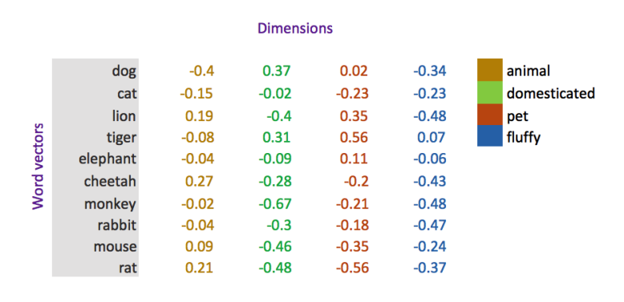
Motivation:
Lack of Context: Most of the previous literature focuses on construction of phylo-trees using n-grams and cognates based methods.
These methods do not focus on the semantics of a word. Which also means these methods do not take the meaning of a word into account
These Vectors were calculated for various Indian languages. Hence taking schematics(context, meaning) into account.
Not this but smaller and our own image.

Slide 4

Experiment
1) Acquiring and cleaning the IndoWordNet data:
Converting Script: Unicode offsetting (Anoop Kunchukuttan, 2013)
POS Removal etc.
2) Calculating Distance Matrix:
Baseline:
Weighted Lexical similarity.
Novel Approach:
Angular Cosine Disatance[2]
Synset wise.
3) Tree Construction:
UPGMA:
Where,
|A|, |B|: Average Clusters
d(x,y) : distance between pairs

Slide 5
WordNet Dataset
Large lexical database of a language.
Synsets, each expressing different concept.
All WordNets in the IndoWordNet have:
Parallel ids
5 Parts separated by semi-colon(“;”):
ID : Every line is given a unique ID.
Words : Separated by a comma(“,”)
Gloss
Definition
POS : Tagged Part-of-speech
Arranged in format:
(ID ; Words ; Gloss ; Definition ; POS )
Represent Context

Slide 6
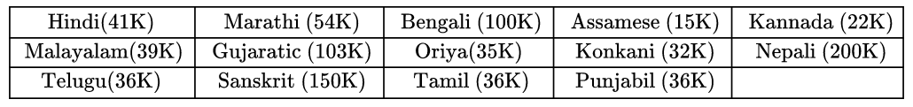
Statistics:
14 Different Indian Languages
Monolingual
Each ranging from 2 Lakh to 15 thousand unique lines
Same data was used as a part of bi-lingual dictionaries for producing vectors.
Brief stats:

Slide 7
Edit Distance
Minimum-weight series of edit operations that transforms a into b. Where a, b are strings.
Example:
A variant of Edit Distance(Levenshtein Distance) was used in the calculation of the weighted average distance in the baseline approach.
Here the distance would be 3.
1. kitten → sitten (substitute “s” for “k”)
2. sitten → sittin (substitute “i” for “e”)
3. sittin → sitting (insert “g” at the end)

Slide 8
Normalized Levenshtein Distance
When calculating Edit Distance, the result’s range cannot be predicted.
To make the resultant always in a range of [0,1], we normalize the edit distance.
To normalize we take the ratio of the edit cost and the length of the larger string.
Example:
Range = [1,6]
Word(1) | Word(2) | Edit Distance | Normalized
HELLO | MELLO | 1 | 1/5 = 0.2
DRINK | BLINK | 2 | 2/5 = 0.4
FOLLOW | ACCEPT | 6 | 6/6 = 1.0
Range = [0,1]

Slide 9
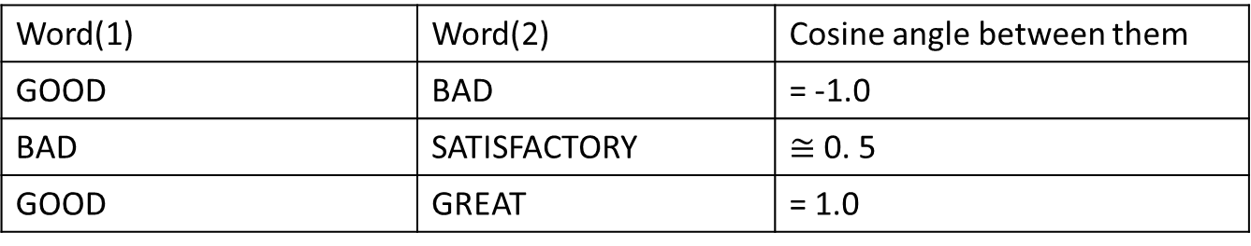
Angular Cosine Distance
Measures the similarity of two vectors.
Effectively used to measure the angle between two vectors(Straight Lines).
Example:
Opposite meaning words would have an angle of 180 between them
Word(1) | Word(2) | Cosine angle between them
GOOD | BAD | = -1.0
BAD | SATISFACTORY | $≅$ 0. 5
GOOD | GREAT | = 1.0
Similar meaning would have angle of 0 between them

Slide 10
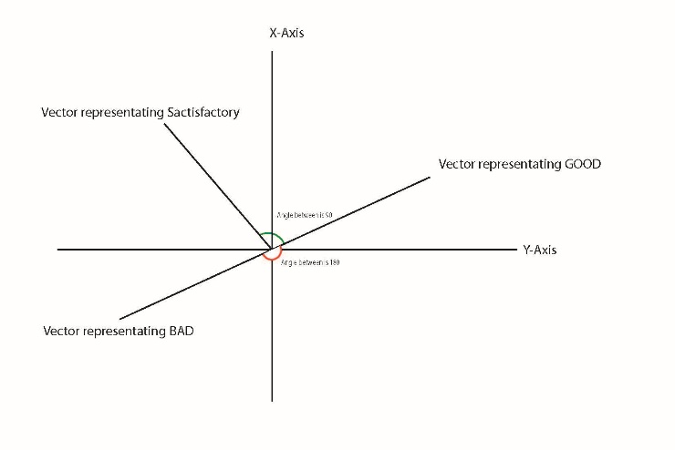
Cosine Distance Visually

Slide 11


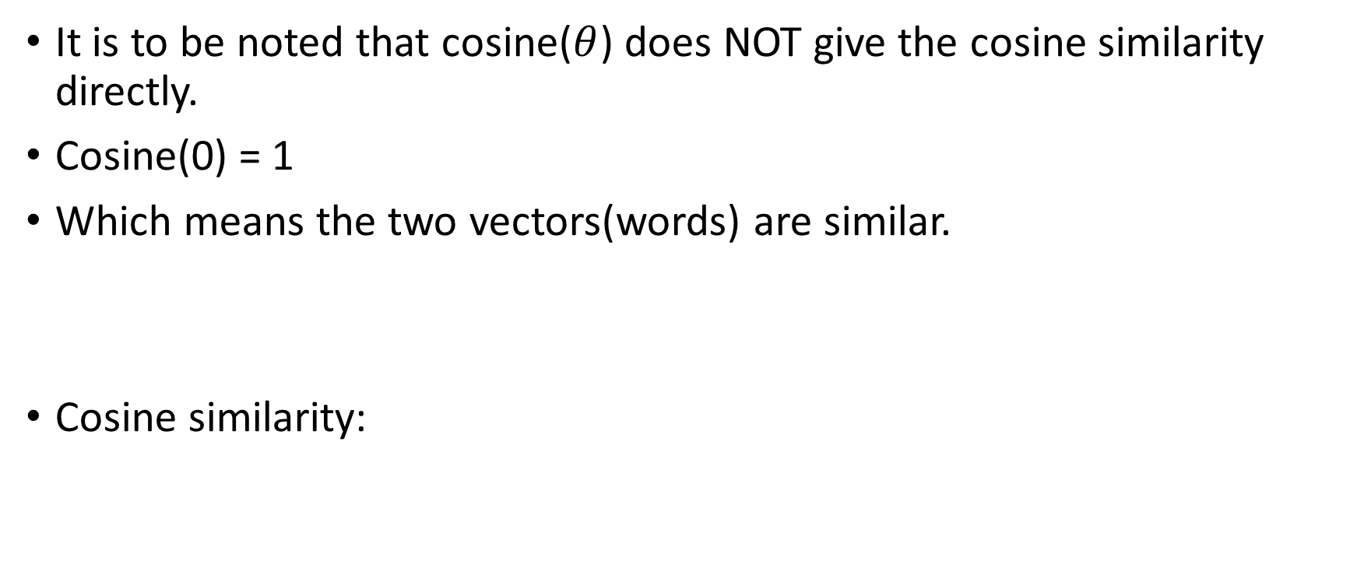
Cosine Similarity
It is to be noted that cosine($θ$) does NOT give the cosine similarity directly.
Cosine(0) = 1
Which means the two vectors(words) are similar.
Cosine similarity:

Slide 12
Word Embeddings
Efficient representation on words in a language.
Tomas Mikolov, et al. at Google in 2013 Word2Vec was taken as base and the improved varient ”Skip-Gram” from fastText was used.
Instead of feeding individual words into the Neural Network, fastText breaks words into several n-grams (sub-words).
The words were first tokenized, removing any unproductive words:
I am selling leather jackets → selling leather jackets
After Tokenization

Slide 13
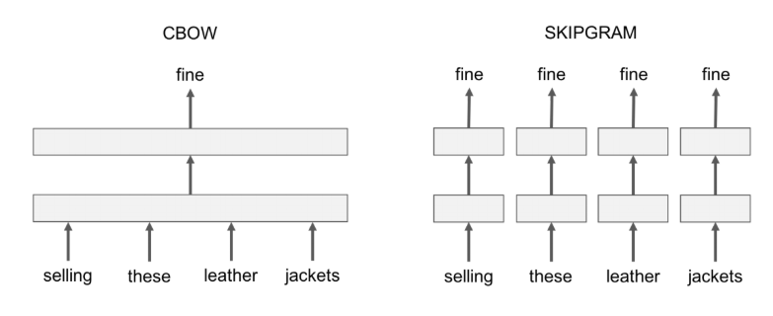
CBOW v/s SKIPGRAM

Slide 14
Mono-lingual Word Embeddings
Mikolovet al., 2013
Reduces data size as compared with the conventional one-hot encoding.
Vectors of dimension 50 were calculated.
vector(”King”) - vector(”Man”) + vector(”Woman”) (Our own example)
CBOW Model.
Baroni and Lenci, 2010

Slide 15
Cross-Lingual Word Embeddings
Bilingual dictionaries for training and evaluation methodology.
using a train bilingual dictionary, learn a mapping from the source to the target space using Procrustes alignment.
Dico train
Identical char
Conneau et al. (2017).

Slide 16
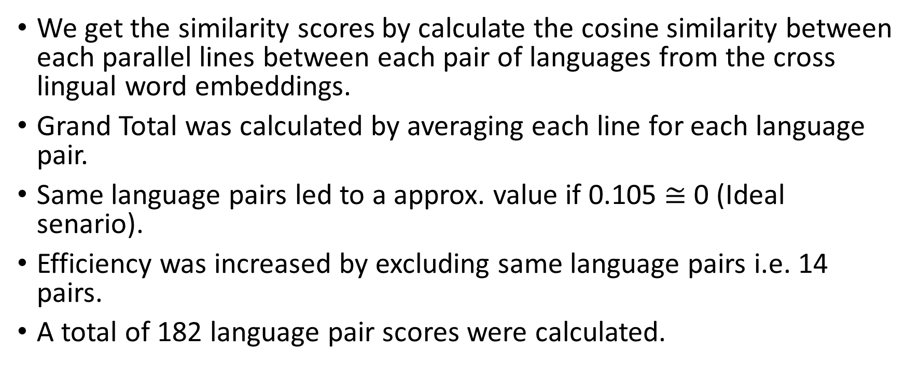
Similarity Scores
We get the similarity scores by calculate the cosine similarity between each parallel lines between each pair of languages from the cross lingual word embeddings.
Grand Total was calculated by averaging each line for each language pair.
Same language pairs led to a approx. value if 0.105 $≅$ 0 (Ideal senario).
Efficiency was increased by excluding same language pairs i.e. 14 pairs.
A total of 182 language pair scores were calculated.

Slide 17
Results Distance Matrix
Baseline Approach
Novel Approach
Language Pair | Distance
as – bn | 0.7885
as – ta | 0.9334
ta - te | 0.8973
pa – hi | 0.7993
sa – hi | 0.7706
Language Pair | Distance
as – bn | 0.4299
as – ta | 0.5722
ta - te | 0.4172
pa – hi | 0.4163
sa – hi | 0.5326
Language code as per ISO 639 Alpha

Slide 18

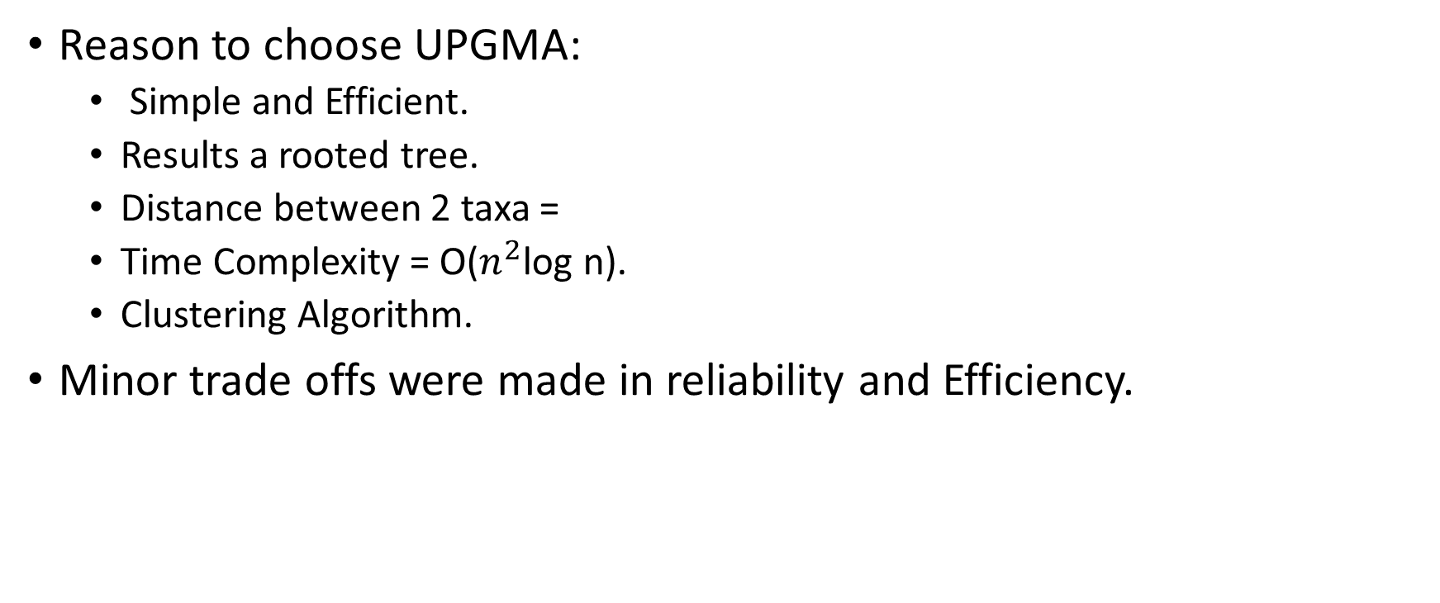
Plotting Trees (UPGMA)
Reason to choose UPGMA:
Simple and Efficient.
Results a rooted tree.
Distance between 2 taxa =
Time Complexity = O($n^{2}$log n).
Clustering Algorithm.
Minor trade offs were made in reliability and Efficiency.

Slide 19
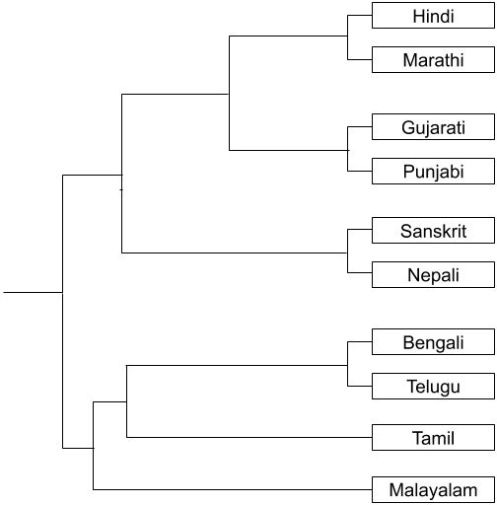
Result – Baseline Approach
TO BE CHANGED

Slide 20
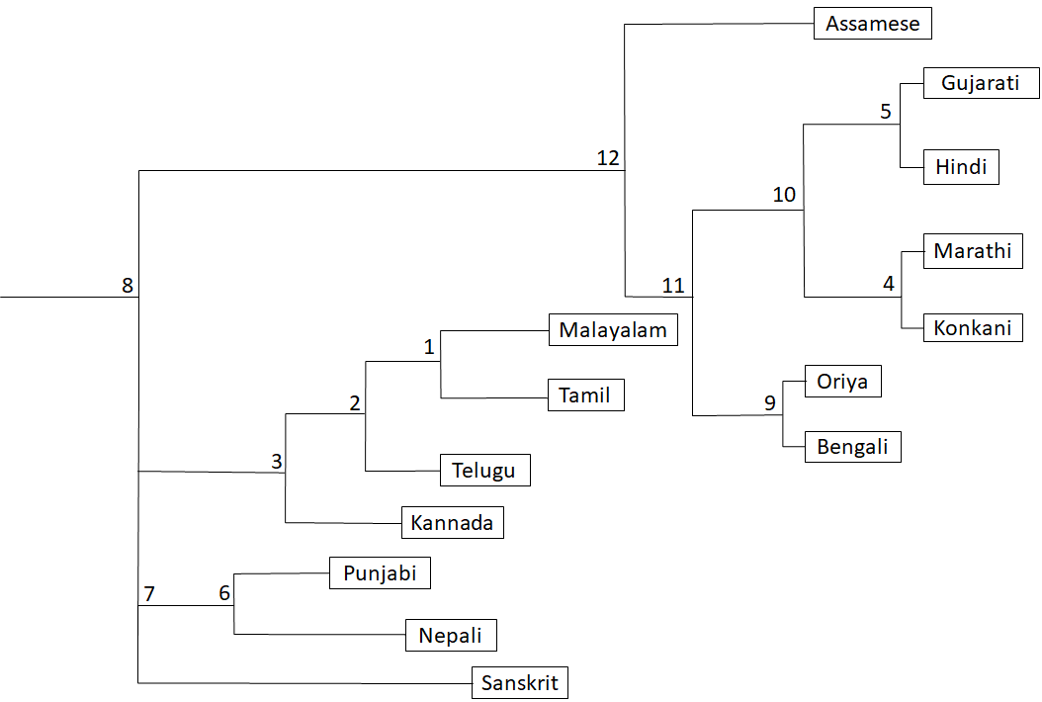
Result - Novel Approach

Slide 21
Conclusion
Trees were constructed using both:
Orthographic Similarity (Baseline Approach)
Deep Cross-Lingual Embeddings (Novel Approach)
We observe that:
The Cross-Lingual approach results in a depict closeness in the languages in a better way.

Slide 22
Future Work
Extend this work for several other Indian Languages(Excluding these 14).
Experiment inducing cognate data into this experiment and compare results.
Increase the size of corpora and run experiments.
Improve the embeddings model.

Slide 23
REFERENCES
Anoop Kunchukuttan, 2013, “Indic nlp library,” https://github.com/anoopkunchukuttan/indic_nlp_library
Daniel Cer, Yinfei Yang, Sheng-yi Kong, Nan Hua, Nicole Limtiaco, Rhomni St John, Noah Constant, Mario Guajardo-Cespedes, Steve Yuan, Chris Tar, et al 2018. Universal sentence encoder. arXiv preprint arXiv:1803.11175 (2018).
Baroni, Marco, and Alessandro Lenci, 2010, “Distributional memory: A general frame-work for corpus-based semantics,” Computational Linguistics 36, 673–721
Mikolov, Tomas, Kai Chen, Greg Corrado, and Jeffrey Dean, 2013, “Efficient estimationof word representations in vector space,” arXiv preprint arXiv:1301.3781
Conneau, Alexis, Guillaume Lample, Marc’Aurelio Ranzato, Ludovic Denoyer, and Herve J ́ egou, 2017, “Word translation without parallel data,” ́ arXiv preprint arXiv:1710.04087
Ilan Gronau and Shlomo Moran. 2007. Optimal implementations of UPGMA and other common clustering algorithms. Inform. Process. Lett. 104, 6 (2007), 205–210.

