Slide 1
LeakSense
INTEGRATING SUSTAINIBILTY AND HOUSEHOLDS.

Slide 2
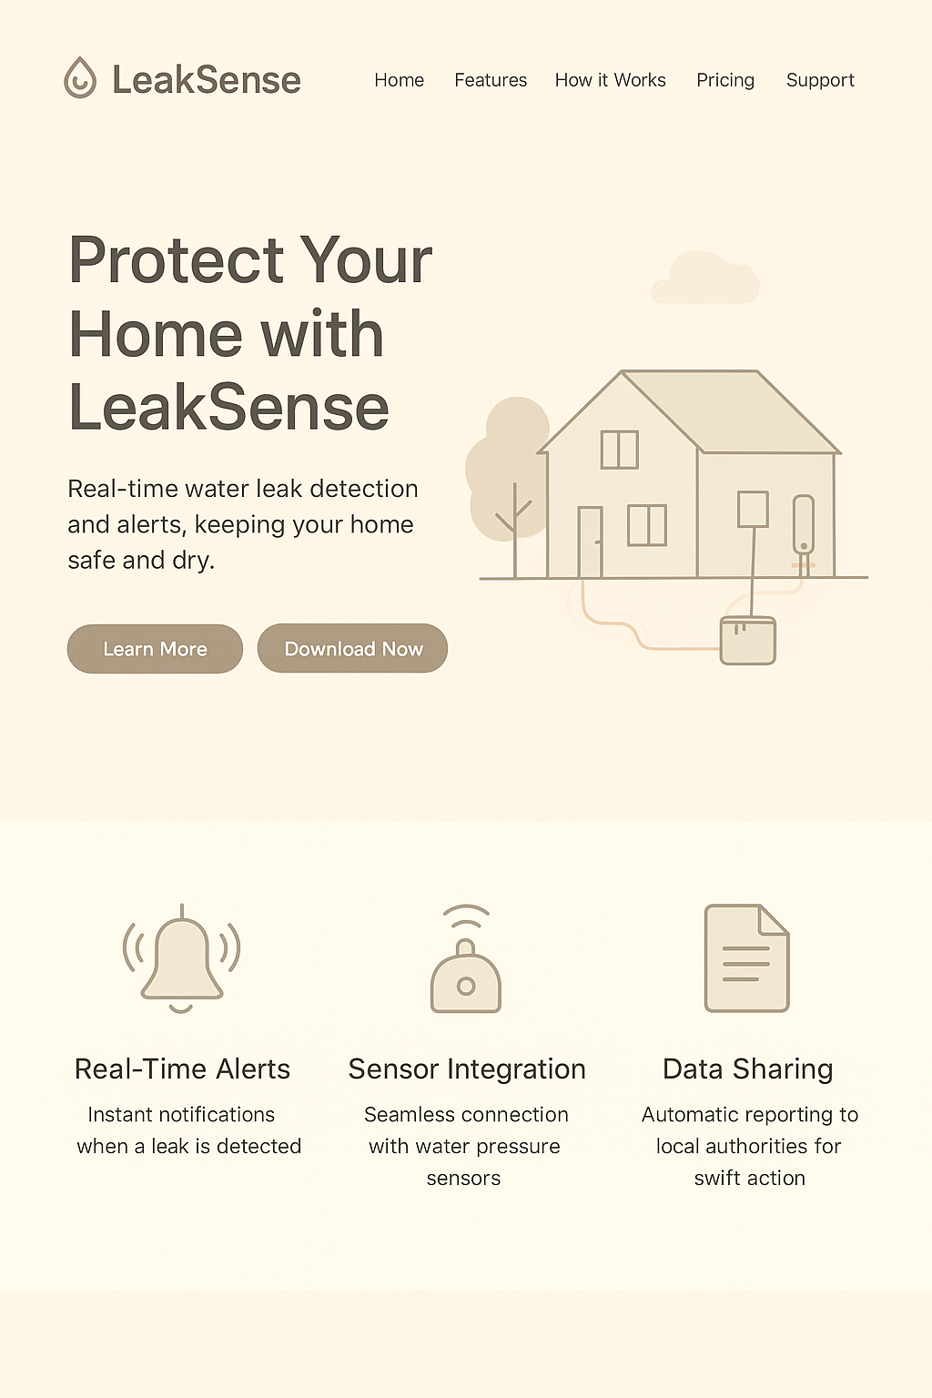
LEAKSENSE
The Problem
High water leakage burden on utilities: Significant treated water loss occurs due to aging networks.
Escalating costs: Resources are wasted on moving water that doesn't benefit users, increasing tariffs.
Asset damage and safety risks: Leaks lead to dampness, mold, hazards, and higher remediation expenses.
3

Slide 3
LEAKSENSE
MARKET SIZE AND
Target Market
Servicable Obtainable Market
Total Addressable Market
Serviceably addressable
market
Key factors:
geographic focus
marketing reach
operational capacity
Estimated growth (3-5 years): $50-100 million USD.
Focus Areas: Tier-1 cities.
Partnerships with insurance firms and real estate developers.
The global smart water leak detector market, valued at USD 1.4–2.43 billion in 2024
Expected to grow at 13.2% to reach USD 6.91 billion by 2033
Scope:
Households
Commercial buildings
Municipal water applications
Focus on the residential and small commercial sectors in smart leak detection
Estimated market value of USD 8007 million to USD 1.2 billion.
Target customers include:
Urban households with plumbing
Property managers and housing societies.
REFERENCE: DATALNELO
REFERENCE:GLOBAL GROWTH INSIGHTS
REFERENCE: VMR

Slide 4
LEAKSENSE
OUR SOLUTION
LEAKSENSE
Brainstorm
Issues
Modifications
Our Take
The initial plan included two sensors: one on the main water source pipe and another on divisions.
Sensors would collect real-time data and notify users about any abnormalities via an app.
Sensor recharging is needed.
Inconsistent pressure flows may lead to false predictions.
Lack of engagement in sustainability practices.
Solar panels will power external sensors; internal sensors will use low-power sources like LoRa and Bizbee.
Acoustic and pressure sensors will be combined to minimize misreading margins.
Moisture sensors will be automated in designated locations.
A community leaderboard, with the authorities being notified of the individuals with most quick responses to their issues.

Slide 5

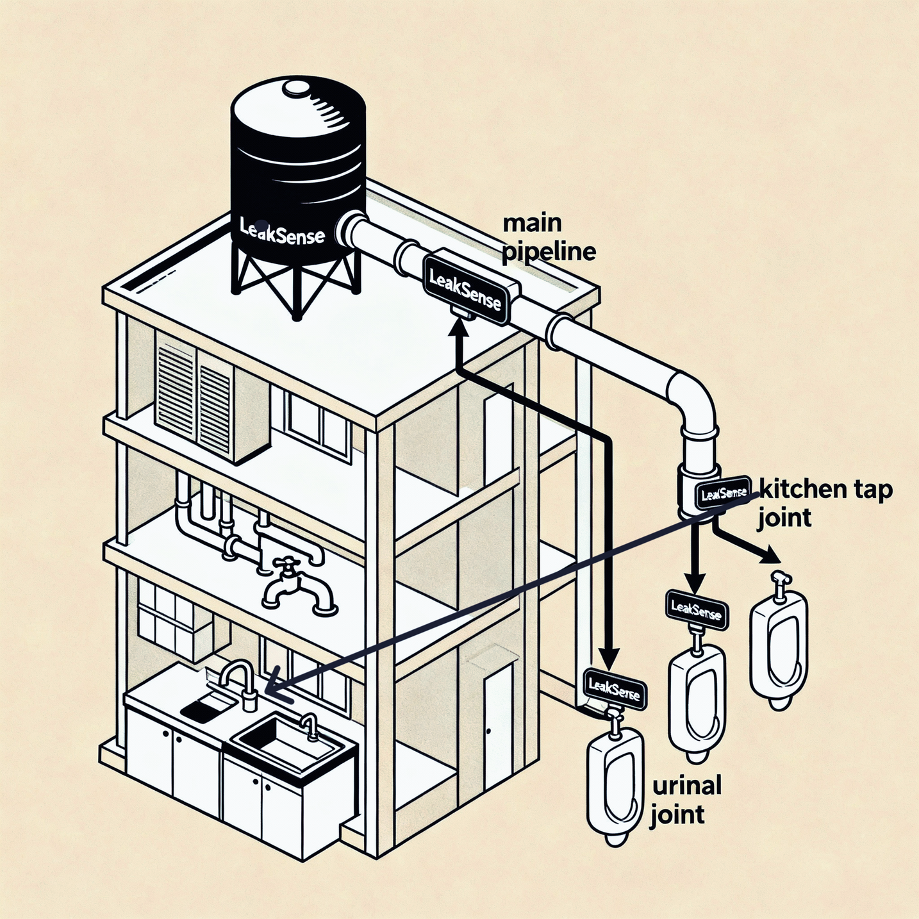
INTEGRATION STRATEGY
Merging sensor intelligence with cloud analytics:
Sensor Fusion: Uses Kalman filters & Bayesian networks for highly reliable detection.
Confidence Scoring: Assigns reliability scores to reduce false alerts.
Edge plus cloud architecture:
Local anomaly detection & temporary data buffering
Instant response, low energy & bandwidth consumption
Communication Layer:
LoRaWAN / NB-IoT for long-range, low-power communication (Wi-Fi fallback for dense areas)
Data Transmission:
Lightweight MQTT/CoAP protocols send only anomalies or summaries to cloud servers.

Slide 6
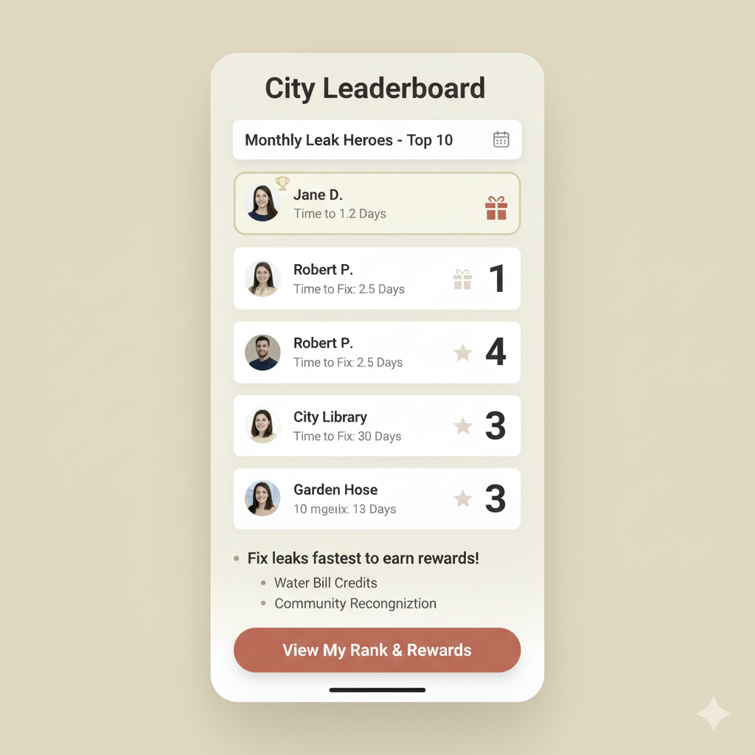

LEAKSENSE
Cloud Intelligence, Modular Sensors and Deployment Blueprint
Cloud & Analytics Layer
Cloud & Analytics Layer hosted on AWS IoT
Enables analytics, dashboards & predictive maintenance
InfluxDB : Lightweight, real-time local data
TimescaleDB : Scalable analytics
Secured with TLS encryption and role-based access control.
Modular Sensor Design
Plug-and-play pressure, acoustic, and moisture modules
easy installation and scalability.
Accuracy through sensor fusion Efficiency through computing Scalability through modular design

Slide 7
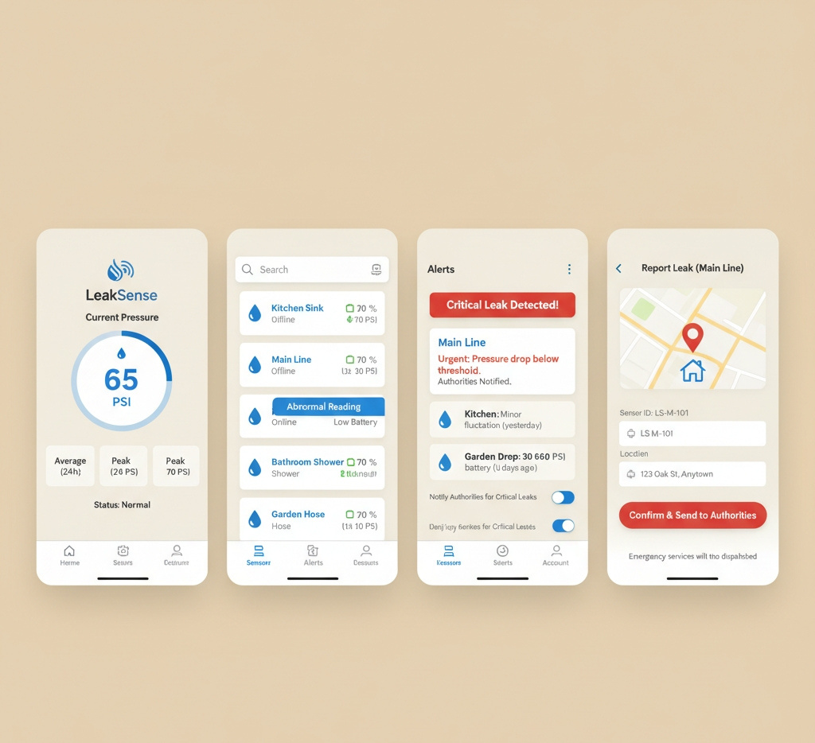
LEAKSENSE
n
o
o

Slide 8


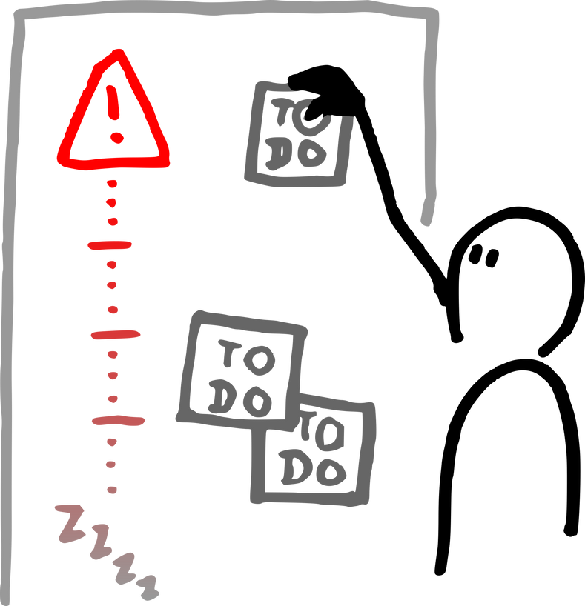

LEAKSENSE
Why LeakSense Will Work...
Pinpoint accuracy
Dual Sensor Technology
User friendly
Engagement
Pressure sensors enable real-time burst detection and transient analysis, for utilities to respond promptly.
Prevents potential damage, reduce financial strain, and extend asset lifespan.
First system to combine pressure,moisture and acoustic sensors to reduce misreading risks from inconsistent pressure levels.
Timed acoustic sensors and location specific moisture sensors effectively detect small cracks by reading vibrations.
By notifying users of damages through our app, we help prevent potential health issues easily
Interface suitable for mobile and desktop use..
Making sustainability engaging for the common- man.
Government incentives and rewards will boost engagement and support for sustainable activities.

Slide 9
LEAKSENSE
Revenue Model
STD. UNIT COST: 10,000INR
STD.CLOUD COST: 1700 INR/MONTH
GOVERNMENT AND MUNICIPAL INSTALLS
MAINTENANCE FEES FROM FLAT OWNERS
INSTALLATION FROM BUILDERS
RECURRING MAINTENANCE SUBSCRIPTION PER FLAT FOR MONITORING, UPDATES, ANALYTICS, AND 24/7 LEAK ALERTS
ONE-TIME FEES FOR DESIGN, HARDWARE, AND DEPLOYMENT COVER 12 MONTHS OF PREPAID MAINTENANCE, AFTER WHICH RESIDENT SUBSCRIPTIONS BEGIN.
B2G CONTRACTS FOR CITYWIDE OR PUBLIC HOUSING ROLLOUTS

Slide 10
LEAKSENSE
Competitive Analysis
Phyn
LeakBot
Honeywell lyric
Aqua
Less coverage area
Not cost efficient
Less user friendly interface
Limited acoustic coverage
Affordability and accessibility
Sustainability Integration
Positioned to be cost efficient (100-300ft)
easy to install due to being placed over outer nodes.
LeakSense’s tagline and mission align with growing consumer demand for eco-conscious solutions.
Differentiators
LEAKSENSE

Slide 11
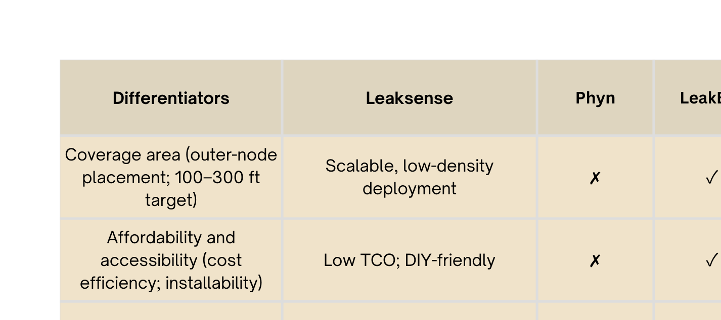
LEAKSENSE
What We Offer

Slide 12


Slide 13

LEAKSENSE

