Slide 1

TEXT SUMMARIZATION USING MACHINE LEARNING
Submitted by,
Krupa K R [MUB19041]
Yashaswini K [MUB19123]
Under the guidance of
Dr. Lavanya P G
IN THE PARTIAL FULFILLMENT OF THE REQUIREMENTS FOR THE AWARD OF THE DEGREE OF
BACHELOR OF COMPUTER APPLICATION
DEPARTMENT OF COMPUTER SCIENCE
MANDYA UNIVERSITY, MANDYA
2021 - 2022

Slide 2
Contents:
Introduction
Scope of work
Motivation
Literature review
Research gap
Proposed method
Dataset
Hardware and software requirements
Model
Evaluation metrices
Results
Conclusion
Reference

Slide 3
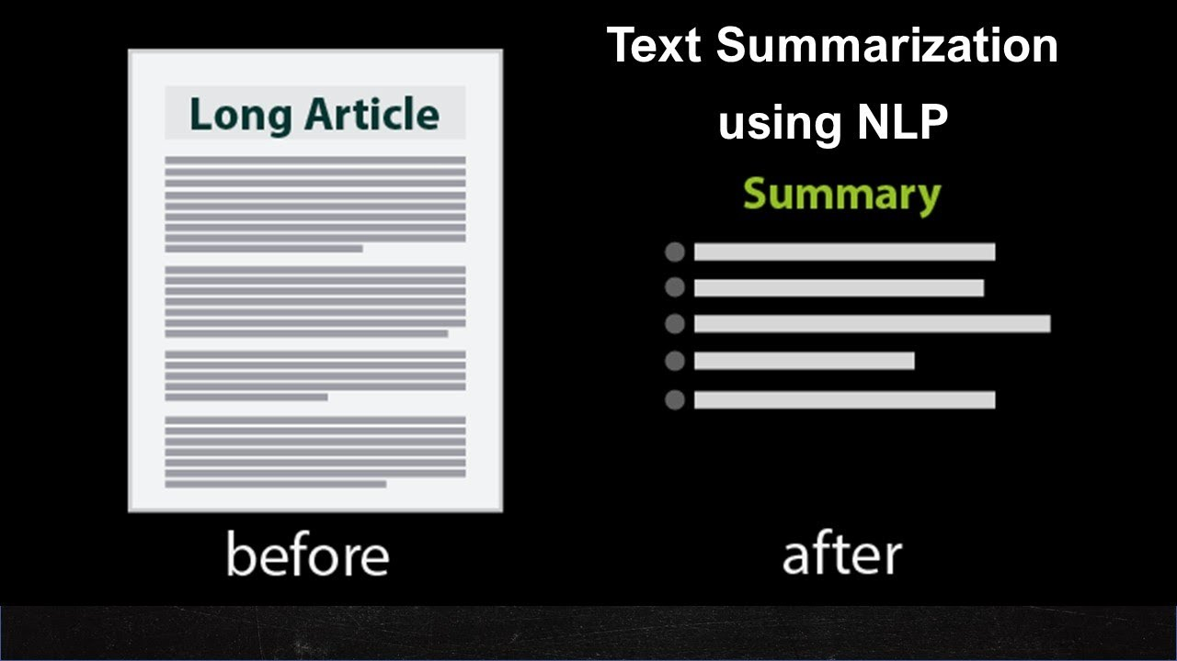
Introduction
Text summarization is the process of automatically generating natural language summaries from an input document while retaining the important points. It would help in easy and fast retrieval of information.
There are two important types of summarization.
Extractive summarization: In this method, summaries are formed by copying parts of the source text through some measures of an important and then combine those part or sentences together to render a summary. Importance of sentence is based on linguistic and statistical features.
Abstractive summarization: It form summaries by generate new phrases, possibly rephrasing or using words that were not in the original text.
Naturally abstractive approaches are harder than extractive.

Slide 4
Scope of work
Automating such a process can help parse through a lot of data and help humans better use their time to make crucial decisions.
Automatic Text Summarization, thus, is an exciting yet challenging frontier in Natural Language Processing(NLP) and Machine Learning(ML).
The current developments in Automatic text Summarization are owed to research into this field since the 1950s when Hans Peter Luhn’s paper titled “The automatic creation of literature abstracts” was published.
Text summarization is on the verge of becoming a ubiquitous tool to interact with information in the digital age.

Slide 5
Motivation
Despite highly developed tools to generate and evaluate summaries, challenges remain to find a reliable way for text summarizers to understand what is important and relevant.
Vector representation and similarity matrices attempt to find word associations, But, they do not have a reliable method to identify the most important sentences.
Language is not only composed of long sentences with adjectives and adverbs to describe something but also relative sentences, appositions, etc.
Such insights may add valuable information they do not help in establishing the main crux of information to be include into the summary.

Slide 6
Literature review
Sl.no | Paper Name | Author | Year | Methods | Result’s
1. | Extracting sentences segments for text summarization using ML | Wesley Chuang et. al | 2017 | Decision trees, Naïve Bayesian classier and Dist. Al | C4.5→a=72.6/p=39.0/r=54.6 Bayesian=69.0/p=55.0/r=52.3 Dist.Al→a=78.1/p=50.0/r=53.0
2. | Automatic text summarization using a machine learning approach | Joel Laroca Neto et.al | 2019 | Naive Bayes, TF-IDF, | TF-IDF→Pr-0.133,Re-0.249
3. | Hierarchical heterogeneous graph attention network for syntax-aware summarization | Zixing Song et.al | 2020 | Synapsum, LexpageRank, SE analysis | ROUGE-1/2/L=41.52/18.82/38.29
4. | PEGASUS:Pre-training with Extracted Gap-Sentences for Abstractive Summarization | Jingqing Zhang et.al | 2020 | Pegasus | ROUGE-1/2/L=32.48/10.59/23.86

Slide 7
Sl.no | Paper Name | Author | Year | Methods | Results
5. | Distillation knowledge applied on Pegasus for summarization | Lorenzo Niccolai et.al | 2020 | FFNNs, CNNs, RNNs, LSTMs Metric ROUGE | ROUGE-1/2/L=35.27/15.61/29.54
6. | Neural abstractive text summarization with sequence-to-sequence models | Tian Shi et.al | 2020 | CNN, RNN based seq-to-seq | ROUGE-1/2/L=39.4/22.72/35.90
7. | Qualitative analysis of text summarization techniques and its applications and its applications in health domain | Divakar Yadav et.al | 2022 | LexRank, TextRank, BertSum, TF-IDF | LexRank=Fm-0.19,Re-0.14,Pr-0.33 TextRank=Fm-0.13,Re-0.085,Pr-0.38 BertSum=Fm-0.226,Re-0.116,Pr-0.388
8. | Extractive text summarization using deep learning approach | Arun Kumar Yadav et.al | 2022 | Deep-Learning based models, | BLEU-0.4 ROUGE-0.6

Slide 8
Existing System
In existing system, researchers have been using a variety of models for text summarization. Most of the best performed models are based on machine learning. Accuracy would decrease when document is big.
Some of the deep learning algorithms are evolved by researches but it takes lots time to trin the model because of its complexity in layers and also it gives the low accuracy.
Research gap
Though, considerable research work has been carried out in the area of text summarization, natural language processing is always a challenge.
Extractive summarization techniques have been explored more compared to abstractive summarization techniques.

Slide 9
Proposed method
ORIGINAL DOCUMENT
DATA PREPROCESSING
(Null values)
SUMMARIZATION ALGORITHMS
ANALYSIS& VISUALIZATION
EVALUATION METRICS

Slide 10
Dataset
We have chosen the wikihowAll dataset that contains around 200,000 long sequence pairs of articles and their headlines. This dataset is one of the large-scale datasets available for summarization with the length of articles varying considerably. These articles are quite diverse in their writing style which makes the summarization problem more challenging and interesting.
This dataset consist of three column that is ‘headline’ ,‘title’ and ‘text’.
headline consist of summaries of the text.
text consist of a original text.
title consist of title of the text.

Slide 11
Hardware And Software Requirements
Hardware Requirements | Software requirements
Intel i3 processor | Windows 8,9 0r higher version OS
4GB RAM or higher | Python language
500GB hard disk or higher | Anaconda3(Spyder) Software

Slide 12
Models
1.Luhn’s summarization
Luhn’s algorithm is an approach based on TF-IDF. It selects only the words of higher importance as per their frequency. Higher weights are assigned to the words present at the beginning of the document.
The algorithm itself occurs in 2 phases:
Identifying significant words:-First remove the stopwords because they are words that tend to lack significant importance for conveying information. Then count word frequency.
Give a score:- This function calculates our score based upon how tightly the importance words are clustered inside the sentence.
i.e. score = (significant words)²
Total number of words

Slide 13
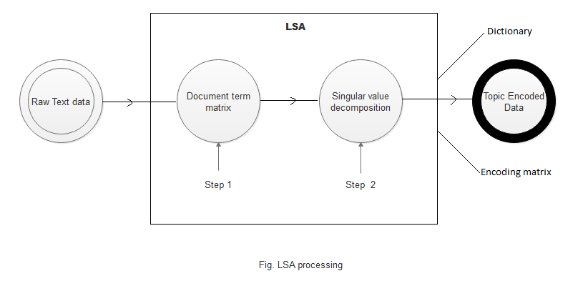
2.LSA summarization
LSA works by projecting the data into a lower dimensional space without any significant loss of information. One way to interpret this spatial decomposition operation is that singular vectors can capture and represent word combination patterns which are recurring in the corpus. The magnitude of the singular value indicates the importance of the pattern in a document.

Slide 14
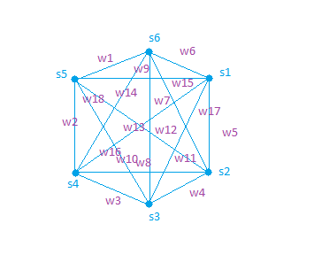
3.LexRank
LexRank is an unsupervised approach to text summarization based on scoring of sentences.
Based on Eigen Vector Centrality.
Sentences are placed at the vertexes of the Graphs
The weight on the Edges is calculated using cosine similarity metric.

Slide 15
4.TextRank
TextRank is an extractive and unsupervised text summarization technique.
First to concatenate all the text contained in the article, then split the text into individual sentences.
In the next step, the vector representation(word embeddings) for each and every sentences is formed.
Similarities between sentence vectors are then calculated and stored in a matrix.
The similarity matrix is then converted into a graph, with sentences as vertices and similarity scores as edges.

Slide 16
Evaluation Metrices
1.ROUGE:
ROUGE stands for Recall-Oriented Understudy for Gisting Evaluation. It is essentially of a set of metrics for evaluating automatic summarization of texts as well as machine translation. It works by comparing an automatically produced summary or translation against a set of reference summaries (typically human-produced).
Types:
ROUGE-N: Overlap of n-grams between the system and reference summaries.
ROUGE-1 refers to the overlap of unigram (each word) between the system and reference summaries.
ROUGE-2 refers to the overlap of bigrams between the system and reference summaries.
ROUGE-L: Longest Common Subsequence (LCS) based statistics. The longest common subsequence problem takes into account sentence-level structure similarity naturally and identifies longest co-occurring in sequence n-grams automatically.

Slide 17



The ROUGE contains mainly three elements i.e.:-Recall, Precision and F1 score
Recall: The recall counts the number of overlapping n-grams found in both the model output and reference — then divides this number by the total number of n-grams in the reference. It looks like this:
b) Precision:To avoid this we use the precision metric — which is calculated in almost the exact same way, but rather than dividing by the reference n-gram count, we divide by the model n-gram count.
c) F1-Score:It uses both the recall and precision values to calculate ROUGE F1 score

Slide 18
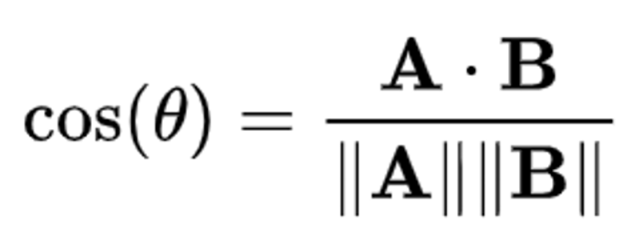
2.COSINE SIMILARITY:
Cosine similarity helps in measuring the cosine of the angles between two vectors. The value of cosine similarity always lies between the range -1 to +1. The value of +1 indicates that the vectors into consideration are perfectly similar. Whereas the value of -1 indicates that the vectors into consideration are perfectly dissimilar or opposite to each other.
The formula for calculating Cosine similarity is given by
In the above formula, A and B are two vectors. The numerator denotes the dot product or the scalar product of these vectors and the denominator denotes the magnitude of these vectors. When we divide the dot product by the magnitude, we get the Cosine of the angle between them.

Slide 19
Result:
 | P1 | PL | R1 | RL | Fm1 | FmL | cosine | Time
Luhn’s | 0.600 | 0.400 | 0.900 | 0.733 | 0.556 | 0.307 | 0.815 | 19.357
LSA | 0.600 | 0.400 | 0.684 | 0.556 | 0.562 | 0.303 | 0.781 | 15.335
LexRank | 0.600 | 0.400 | 0.875 | 0.687 | 0.560 | 0.338 | 0.784 | 18.608
TextRank | 0.600 | 0.400 | 0.900 | 0.785 | 0.542 | 0.376 | 0.802 | 23.475

Slide 20
Conclusion
The field of text summarization is experiencing rapid growth, and specialized tools are being developed to tackle more focused summarization tasks. With open-source software and word embedding packages becoming widely available, users are stretching the use case of this technology. Automatic text summarization is a tool that enables a quantum leap in human productivity by simplifying the sheer volume of information that humans interact with daily. This not only allows people to cut down on the reading necessary but also frees up time to read and understand otherwise overlooked written works. It is only a matter of time that such summarizers get integrated so well that they create summaries indistinguishable from those return by humans.
To improve the precision and recall score by using feature selection and feature extraction methods
To explore abstractive summarization techniques
Future enhancement

Slide 21
Reference:
[1] C. Wolf and A. Schnauber, “News consumption in the mobile era,” Digital Journalism, vol. 3, no. 5, pp. 759–776, 2015.
[2] W. S. El-Kassas, C. R. Salama, A. A. Rafea, and H. K. Mohamed, “Automatic text summarization: A comprehensive survey,” Expert Systems with Applications, vol. 165, p. 113679, 2021.
[3]Allahyari, M., Pouriyeh, S., Assefi, M., Safaei, S., Trippe, E. D., Gutierrez, J. B., & Kochut, K. (2017). Text summarization techniques: a brief survey. arXiv preprint arXiv:1707.02268.
[4]Nenkova, A., & McKeown, K. (2012). A survey of text summarization techniques. In Mining text data (pp. 43-76). Springer, Boston, MA.
[5]Yousefi-Azar, M., & Hamey, L. (2017). Text summarization using unsupervised deep learning. Expert Systems with Applications, 68, 93-105.
[6]Adhikari, S. (2020, March). Nlp based machine learning approaches for text summarization. In 2020 Fourth International Conference on Computing Methodologies and Communication (ICCMC) (pp. 535-538). IEEE

Slide 22
THANK YOU

