Slide 1
TLPGNN: A Two-Level Parallelism Paradigm for GNN Computation on GPU
Notes:
Hello everyone, myself athulitha yashaswini, I am here with my team members sahithi and chandramaika and today we are going to talk about TLPGNN which is two level parallelism paradigm for GNN computation on GPU

Slide 2
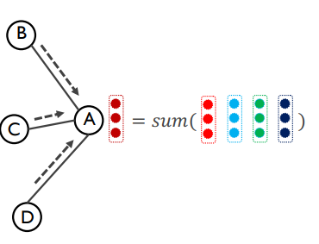
INTRODUCTION
Graph Neural Networks (GNNs) are integral to deep learning for graph data, finding applications in recommendation systems, drug discovery, and social network analysis.
GNN computation encompasses both regular neural network operations and general graph convolution operations, consuming the majority of computation time.
Notes:
As we all know, GNN is the present emerging topic which is used in various real life applications like recommendation systems , drug discovery , social network analysis and may more . So , in GNN computation involves regular neural network operations and general graph convolution operation .Dense neural network operations, such as matrix multiplication and ReLU activation, Graph convolutional layers operations like aggregation of feature vectors on neighbor nodes, integrate them with the vertex's own features, and produce updated features for the next input layer

Slide 3
Why TLPGNN?
TLPGNN offers improved efficiency in computing Graph Neural Networks (GNNs), reducing computation time by optimizing both regular neural network and graph convolution operations.
TLPGNN's lightweight two-level parallelism paradigm is specifically designed for GNN computation, utilizing insights from hardware resource analysis to optimize workload distribution and enhance efficiency.
This outperforms existing GNN computation systems like DGL, GNNAdvisor, and FeatGraph by significant margins, making it a highly effective choice for accelerating GNN computations.
Notes:
Why ar w using TLPGNN offers improved efficiency in GNN computation by reducing computation time and optimizing the GNN operations and it is specially designed a two level parallelism which utilizes the hardware resources to optimize workload distribution and enhance efficiency . And , in terms of performance , it outperformed DGL, GNNAdvisor and featGraph.

Slide 4
Limitations
GNNs differ significantly from traditional graph algorithms due to their large feature vectors, altering GPU runtime characteristics.
Existing optimization techniques lack understanding of their impact on GPU resource usage, hindering efficiency.
Challenges include heavy pre-processing, inefficient atomic operations, and unnecessary kernel launches, necessitating deeper understanding for more efficient GNN computation.
Notes:
Under state art approach;
So, from the traditional graph algorithms, GNN differ alot because in GNN, we have an extra dimension which is feature vector in vertex or edge in computation. The existing optimization techniques lack the deep understanding of GNN performance, for example, GNN advisor claims that huge feature size will impact the workload but they have not clearly stated the reason that why this is happening . So, some of challenges we are going to notice is the effect of , heavy preprocessing, impact of atomic operations and unnecessary more number of kernel launches.
This approach is currently justified on homogeneous graphs, but it have enough potential to extend until hetero geneous graphs for future exploration,

Slide 5
GPU profiling
Streaming multiprocessor (SM) utilization rate :It assesses the efficiency of GPU computing resources, including pipelining and issue queue, with low values indicating underutilization.
Achieved occupancy: This metric measures the ratio of number of active warps by maximum number of possible active warps, the higher the achieved occupancy, higher the balanced workload distribution among different warps .
Sector per request : This measures the average transactions issued per memory request, with lower values indicating more coalesced memory access.
Stall for long scoreboard : This represents the average cycles spent waiting for memory operations across all resident warps, with higher values indicating inefficient data retrieval.
Notes:
So, to understand the performance of GNN computation , they have GPU profiling with NVIDIA Nsight Compute offers detailed performance metrics and analysis for CUDA applications through an interactive interface and command-line tool .
SM untilization rate : This metric is going to describe the efficiency of GPU resources which includes pilelining and issue queuse, so , the lower the SM utilization rate indicates the underutilization
Achieved occupancy : This metric measures the ratio of number of active warps by maximum number of possible active warps, the higher the achieved occupancy, higher the balanced workload distribution among different warps
Setor per request :

Slide 6
Understanding performance of GNN
Following are the observations made in this paper:
Optimizations with atomic writing can drastically lower the performance because of the huge extra overhead
Coalesced memory access can lead to tremendous performance improvement if more threads within one warp are used to process one vertex for GNN workloads.
The graph convolution of GNNs should be implemented with as few kernels as possible for better performance.
Notes:
So,now we are going to talk about how are we going to understand the performance of GNN with the metrics introduced in GPU profiling. They have experimented on 3 things to understand GNN better, i.e; atomic operations, coaleseced memory access and kernel launches, now we are going to discuss about them in detail here

Slide 7
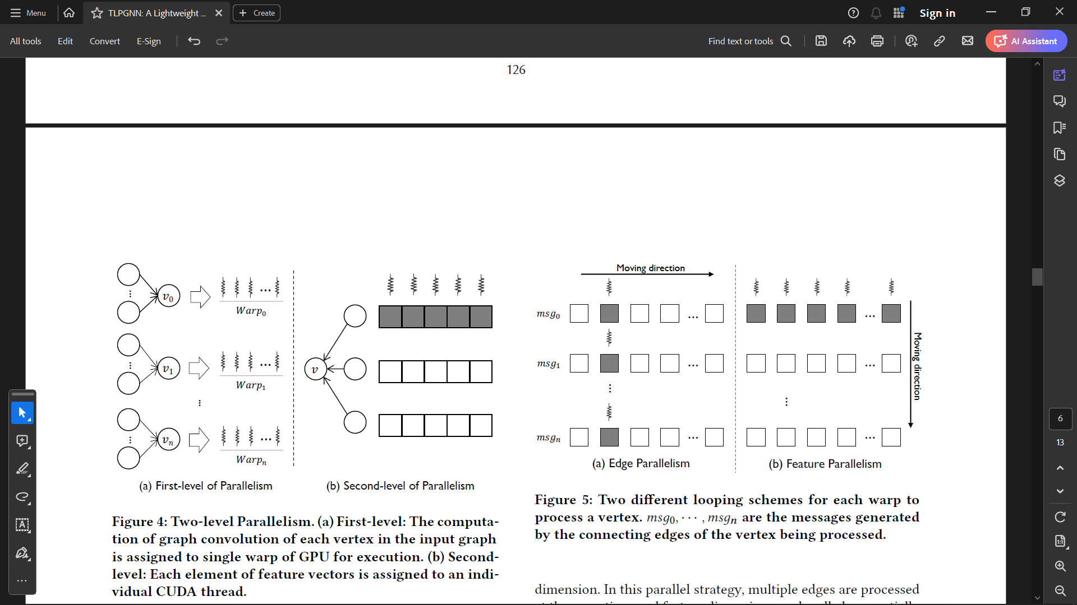
TWO LEVEL PARALLELISM
The computation in the graph convolution of GNN’s is divided into two levels:
In the first level, the granularity of computation is measured by the entities in the graph, i.e, vertex and edge.
In the second level, we focus on the concrete computation task of individual vertex or edge, the specific computation task for this vertex.

Slide 8
First Level: Vertex Parallelism
The first level parallelism comes from the fact that the workload associated with each vertex or edge can be processed independently from others.
There are two different types of parallelism: vertex parallelism and edge parallelism
In vertex parallelism, multiple vertices are processed in parallel and in edge parallelism processes multiple edges in parallel.
Although edge parallelism can avoid workload imbalance caused by uneven edge distributions in vertex parallelism, the huge overhead brought by atomic operations will dramatically hurt the performance.

Slide 9
First Level: Vertex Parallelism - Abstraction
Using one CUDA thread will lead to divergent execution within each warp due to uneven edge distribution of vertices.
Using one thread block introduces synchronization overhead into the kernels.
Assigning each vertex to a single warp means the workload running on one warp won’t interfere with each other. By this the synchronization overhead can be avoided
Since all the threads in a warp are working on the same vertex, they will follow same control path elimination the branch divergence.

Slide 10
Second Level: Feature Parallelism
The computation associated with each vertex could be parallelized internally and since we use one warp to process a vertex, thus we have 32 threads available that enables parallelism to process the features.
The computation within the vertex can be expressed as nested loop with two options for the looping order: edge-then-feature or feature-then-edge.
The former first iterates on each edge of the vertex being processed, and then for each index of the feature dimension axis. Each edge is processed parallely and the features are processed sequentially. The latter one uses reversed order.
Edge-then-feature is also referred as Edge Parallelism and Feature-then-Edge is also referred as Feature Parallelism.

Slide 11
First, in the edge parallelism scheme, all threads in a warp work on the same dimension of messages, requiring them to update the same element of the resulting feature. This introduces race conditions. In feature parallelism threads in a warp process different dimensions, allowing them to update different elements of the resulting feature. This eliminates the need for synchronization overhead caused by atomic operations.
In feature parallelism all the threads in a warp access the features of the same vertex, which results in coalesced memory access. It is uncoalesced memory access in Edge Parallelism.
Thus, feature parallelism is used in the paper

Slide 12
HYBRID WORKLOAD BALANCING
Hardware based assignment: GPU hardware will schedule the execution of the warps in dynamic mode, in which hardware resources will be released after one block is done and then be allocated to the next new one.
Since the minimum scheduling unit is block, there will be workload imbalance within one block if it has more than one warps.
As a result, the number of warps in each block becomes a tunable parameter for this implementation.
Fewer warps in a block mean a more balanced workload but higher hardware scheduling overhead, and more warps mean a more imbalanced workload but lower hardware scheduling overhead.
Software-based dynamic workload assignment can be understood as the task pool model. All the vertices needed to be processed are put into a task pool. Each warp takes a fixed number of tasks from the pool at a time and executes the computation on these vertices.
This implementation uses a fixed number of warps for all inputs at the beginning, which normally is the maximum warps all SM can run in parallel. All the hardware resources are allocated once, so there is no hardware scheduling overhead.

Slide 13
KERNEL FUSION AND REGISTER CACHING
In general, there are two types of basic kernels that could be considered as the building block for the computation in graph convolution: ApplyEdge, and ApplyVertex.
Using separate kernels means that the messages generated by the ApplyEdge kernel for all edges need to be written to the global memory. This could lead to significant computational and memory bottlenecks
To address this problem, the computation in the graph convolution of GNN models is fused into a single kernel in our design.
The fused kernel generates and aggregates the message of each edge collectively without explicitly storing the message.

Slide 14
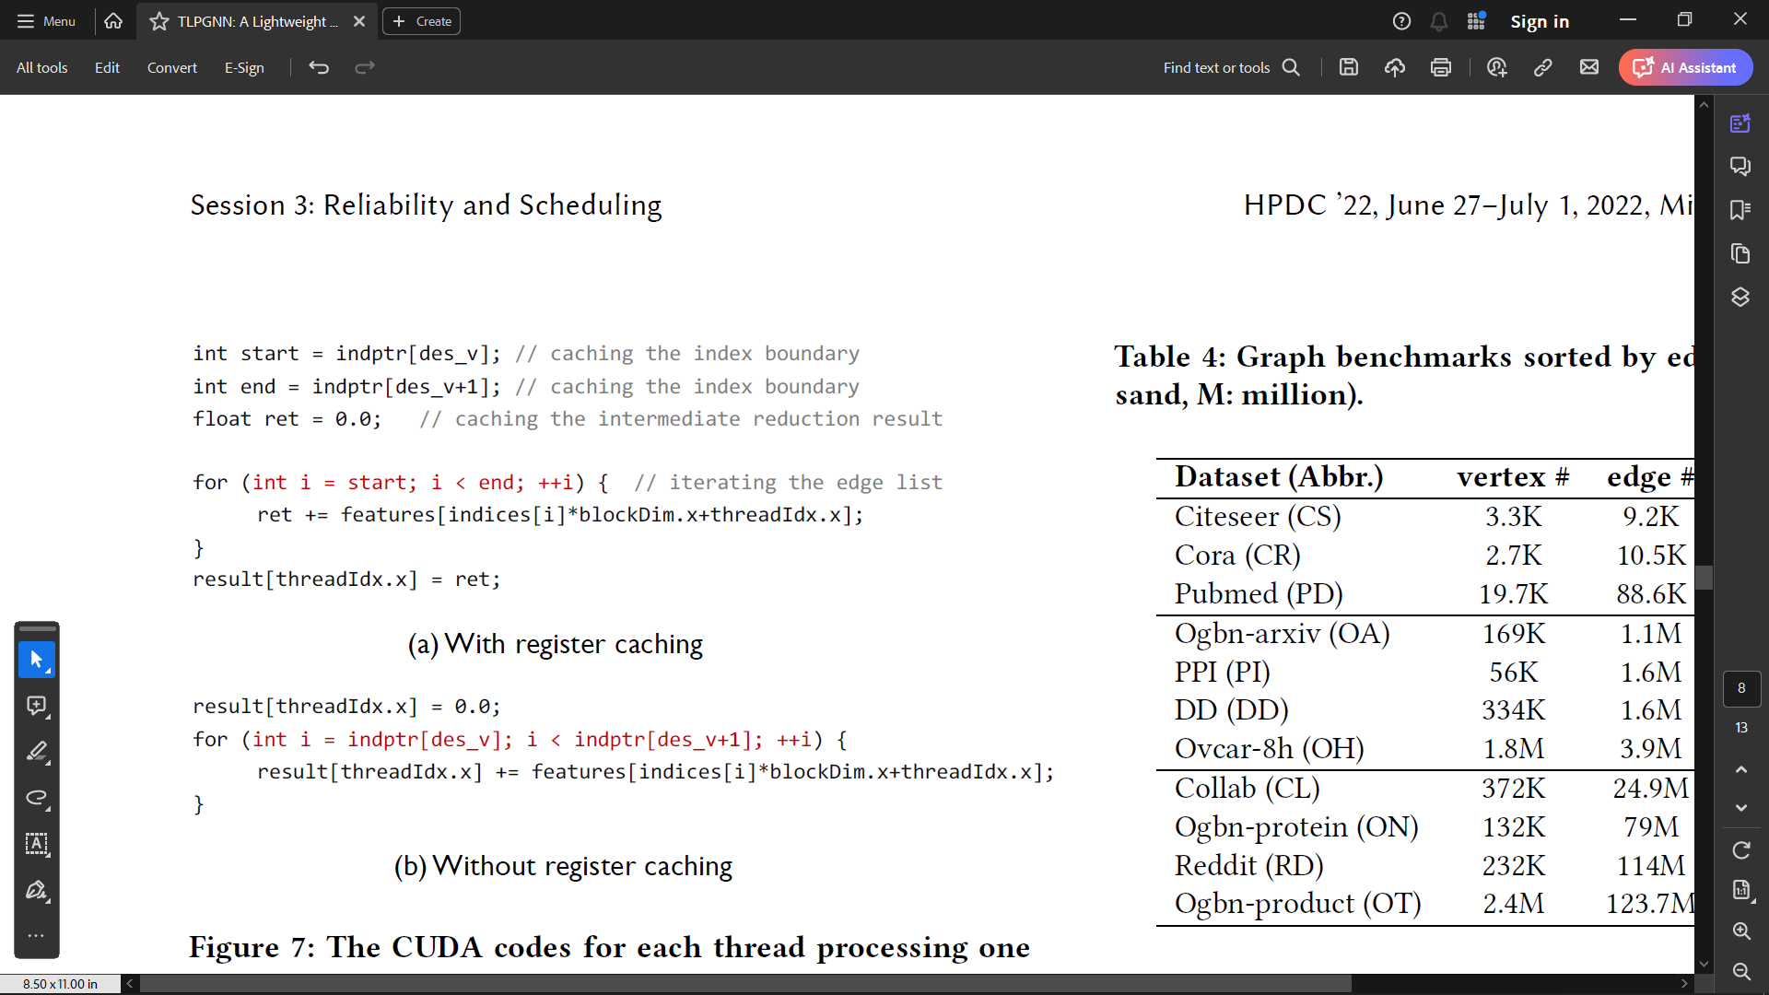
In our design, we find that using registers for two types of data objects can greatly improve the overall performance: index boundary and intermediate reduction result.
We frequently access the index boundary (start and end in CSR). So storing those two values in registers will reduce unnecessary global memory requests to a large extent.
GNN models use a reduction operation to aggregate the messages from all edges into a single resulting feature.
The intermediate reduction result in registers can reduce the access to the global memory; only one write operation is needed after the iteration over the edge list.

Slide 15
EXPERIMENT AND EVALUATION
GNN models
We use four representative GNN models for testing, including Graph Convolutional Network(GCN) , GraphSage, Graph Isomorphism Network (GIN), Graph Attention Network (GAT).
GCN has been used in many semi-supervised or unsupervised tasks, such as node embedding, graph classification, it applies a weighted sum operation for the neighbor’s features for each vertex in graph convolution.
GraphSage and GIN differ from GCN as to how they aggregate messages from neighbors during graph convolution.
GAT introduces the attention mechanism to learn the different weight coefficients of different neighbors.
We evaluate TLPGNN and compared works on a server with 24-Core Intel(R) Xeon(R) Gold 6126 2.6GHz CPU and a Nvidia Tesla V100 GPU (32GB DRAM).

Slide 16
PERFORMANCE COMPARISON
For the 3 recent GNN computation methods, we will measure the execution time of the single operation of graph convolution for each GNN model.
Deep Graph Library(DGL)
DGL’s implementations rely on general sparse-dense matrix multiplication (SpMM) kernels provided by the library cuSPARSE.
Following factors lead to the high number of kernel launches of DGL:
DGL needs extra kernels to manipulate the data formats of input in order to invoke the SpMM kernels.
For complex GNN models a single SpMM kernel is not enough to express the computation of the model’s graph convolution, so DGL uses more kernels to compose it.
DGL launches 6, 8, 10, and 18 GPU kernels for GCN, GIN, GraphSage, and GAT, respectively. The unnecessary kernel launches lead to sub-optimal performance of DGL.
It is to be noted that DGL outperforms TLPGNN for GCN, GIN, and GraphSage models over the OA dataset, due to the excellent performance of the SpMM kernel on the dataset according to our profiling.

Slide 17
GNNAdvisor
GNNAdvisor partitions each vertex neighbor list into multiple fix-sized groups and assign each group to one warp for processing.
As a result, each warp uses atomic operations to update the intermediate result into the final result of the vertex causing higher memory traffics of atomic writes.
In contrast, the two-level parallelism design allows TLPGNN to avoid any atomic operations, which brings the performance improvement over GNNAdvisor.
FeatGraph
FeatGraph makes use of TVM, a deep learning compiler framework, to generate efficient GPU kernels for GNN operations.
It outperforms the other two baselines for most experiment settings.
However, TVM’s Tensor Expression API is not flexible to manage the workload mapping between vertices and CUDA threads, leading to low hardware utilization and occupancy.
The average achieved occupancy of FeatGraph’s GCN implementation for all datasets is 41.2%, in comparison with TLPGNN’s average value of 68.2%

Slide 18
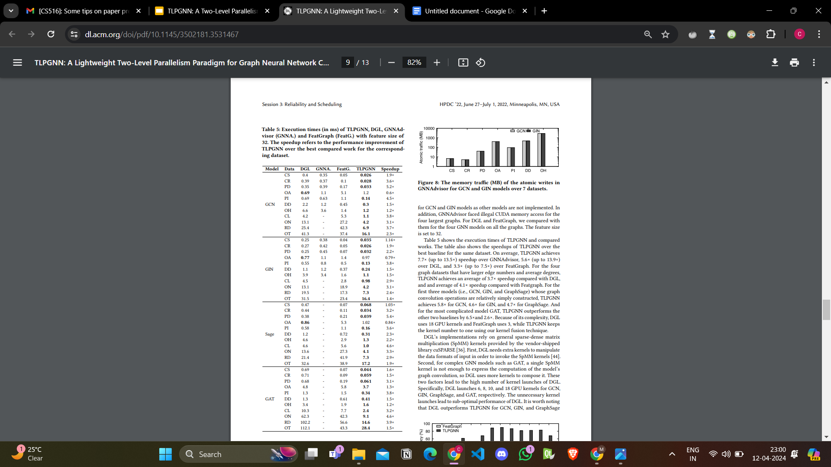

Slide 19
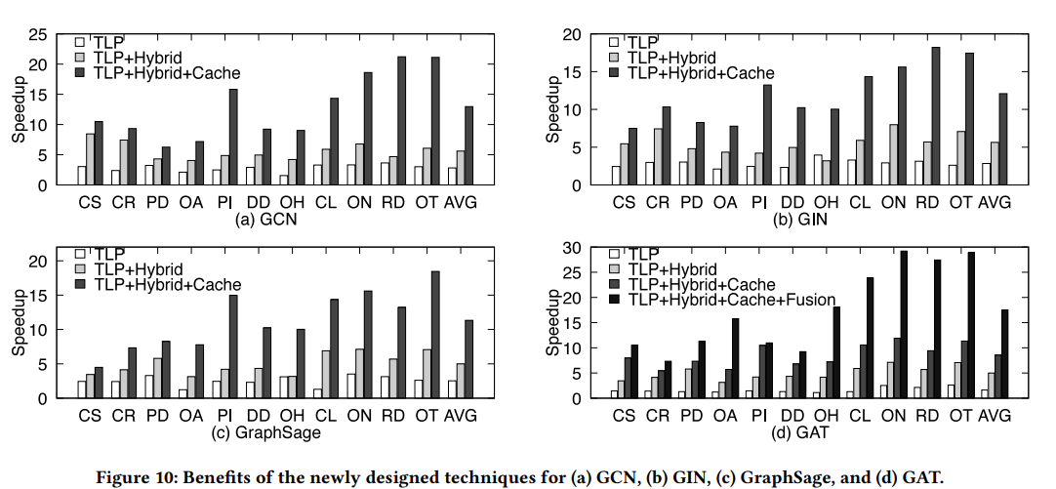
TECHNIQUE BENEFITS

Slide 20
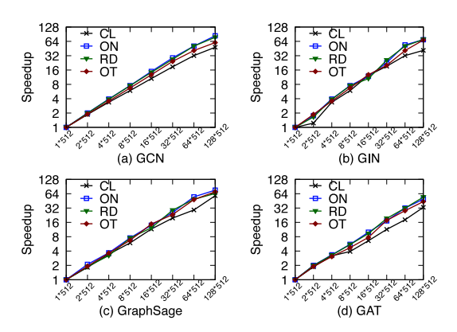
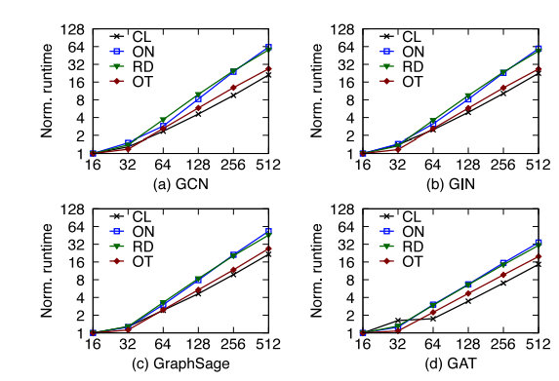
Scalability
Scalability of TLPGNN against the number of threads (shown in x-axis) for the four largest graphs (CL, ON, RD, OT)
Scalability (normalized runtime) of TLPGNN against feature sizes (shown in x-axis) for the four largest graphs (CL, ON, RD, OT).

Slide 21
CONCLUSION
TLPGNN is a high-performance two-level parallelism design for efficient GNN computation on GPU. It utilizes vertex-parallelism and feature-parallelism to avoid atomic operations, unnecessary memory traffic, and achieve coalesced memory access. TLPGNN also introduces a hybrid dynamic workload assignment to address workload imbalance. Experimental results show that TLPGNN achieves significant speedups compared to existing solutions for GNN computation.

Slide 22
THANK YOU

