Slide 1
⚡ JAVA LOG ANALYZER & SUPABASE MONITORING SYSTEM
Enterprise Log Parsing, Rule-Based Anomaly Detection, Real Gmail SMTP OTP Auth & Supabase Cloud Persistence
Academic Internship Major Project Presentation
Presented by: Yashaswini R | Domain: Java Software Engineering | Tech Stack: Core Java 21, React 18, Supabase PostgreSQL

Slide 2
JAVA LOG ANALYZER & SUPABASE MONITORING SYSTEM
1. Project Overview & System Introduction
📌 Background & Core Purpose
• Modern enterprise applications generate thousands of raw log records daily.
• Manual inspection of log files is tedious, error-prone, and inefficient.
• Automated log analysis is critical for maintaining high system uptime and security.
• This project provides a full-stack observability solution combining Core Java 21 and React.
🚀 Key Highlights & Deliverables
✔ Regex Log Parser: Parses unstructured Apache, Nginx, and Syslog log streams.
✔ Security Alert Engine: Detects brute-force logins and repeated connection failures.
✔ Real Gmail SMTP OTP: Pure Java SSL Socket client delivering 6-digit verification codes.
✔ Cloud Database Persistence: Connects to Supabase PostgreSQL via JDBC SSL.
✔ Interactive Dashboard: Modern React + Vite web dashboard with real-time metric cards.

Slide 3
JAVA LOG ANALYZER & SUPABASE MONITORING SYSTEM
2. Problem Statement & Key Challenges
⚠️ Manual Inspection Bottleneck
DevOps engineers struggle to manually read plain-text log files containing tens of thousands of lines.
⚠️ Undetected Cyber Attacks
Brute-force password guessing attempts go unnoticed in standard logs without real-time threshold alert rules.
⚠️ Silent Infrastructure Failures
Database connection drops and 5xx internal server errors accumulate unnoticed until complete service downtime occurs.
⚠️ Lack of Central Analytics
Unstructured text log files do not provide queryable database metrics, trend charts, or automated summary reports.

Slide 4
JAVA LOG ANALYZER & SUPABASE MONITORING SYSTEM
3. System Architecture & Tech Stack
Core Java Backend
Java 21 LTS
HttpServer, Regex Engine, Thread Pools, pure SSL Socket client.
Frontend Web App
React 18 + Vite
Vanilla CSS glassmorphism UI, Lucide icons, responsive dashboard.
Cloud Database Tier
Supabase PostgreSQL
JDBC SSL connection (postgresql-42.7.3.jar), public.users & logs schema.
Email Security Service
Gmail SMTP SSL
smtp.gmail.com:465 pure SSL socket, BCrypt $2a$12$ password hashing.

Slide 5
JAVA LOG ANALYZER & SUPABASE MONITORING SYSTEM
4. Log Parsing & Regular Expression Engine
🔍 Regex Extraction & LogEntry Structuring
▪ Multi-Format Parsing Pattern:
^(?<timestamp>\\d{4}-\\d{2}-\\d{2}\\s+\\d{2}:\\d{2}:\\d{2})\\s+\\[(?<level>INFO|WARN|WARNING|ERROR|FATAL)\\]\\s+(?<message>.*)$
▪ Structured Object Creation:
Extracts raw timestamp, maps severity to LogLevel enum, captures message body, and tracks raw line numbers.
▪ Resilient Error Handling:
Malformed or unparseable lines are safely counted as skipped lines without halting execution.
▪ High Performance Stream Reading:
Processes large files using BufferedReader buffer blocks (8192 bytes) for memory efficiency.

Slide 6
JAVA LOG ANALYZER & SUPABASE MONITORING SYSTEM
5. Rule-Based Anomaly & Security Alert Engine
🔐 Brute-Force Login Detection
Monitors failed authentication events across a rolling 5-minute window. Triggers SECURITY ALERT if failed login count exceeds 2.
⚡ Repeated Error Spike Detection
Tracks identical error messages within 10-minute intervals. Triggers ALERT when repeated error count exceeds 3 occurrences.
📊 System Warning Activity
Aggregates warning logs across execution runs to alert DevOps teams before system performance degrades.
💾 Database Alert Persistence
All generated Alert objects are saved to public.alerts table in Supabase PostgreSQL for historical audit tracking.

Slide 7
JAVA LOG ANALYZER & SUPABASE MONITORING SYSTEM
6. Real Gmail SMTP SSL OTP Delivery System
✉️ Pure Java SSL Socket Client
• Built using standard SSLSocketFactory connecting directly to smtp.gmail.com:465.
• Zero external Maven dependencies — light, enterprise-ready Java code.
• Supports AUTH LOGIN protocol with Base64 encoded credentials.
• Robust multi-line EHLO response parser handling 250- headers.
🔒 Security & Privacy Workflow
✔ Sends real 6-digit OTP verification codes directly to user Gmail inbox.
✔ OTP is NEVER displayed on the browser screen or pre-filled in inputs.
✔ OTP is stripped from HTTP API JSON responses to prevent network sniffing.
✔ Passwords are never stored in plain text — hashed via BCrypt $2a$12$.

Slide 8
JAVA LOG ANALYZER & SUPABASE MONITORING SYSTEM
7. Supabase PostgreSQL Cloud Integration
🗄️ Standard PostgreSQL JDBC Driver
Uses postgresql-42.7.3.jar connecting via SSL JDBC connection string SUPABASE_DB_URL.
🗄️ Zero Hardcoded Secrets
All database host, port, user, and password credentials managed securely via DotEnvLoader (.env).
🗄️ Automatic Schema Initializer
Creates public.users, public.logs, public.alerts, and public.password_reset_tokens tables automatically.
🗄️ Batch Data Synchronization
Executes PreparedStatement batch queries for fast, efficient synchronization of large log callsets.

Slide 9
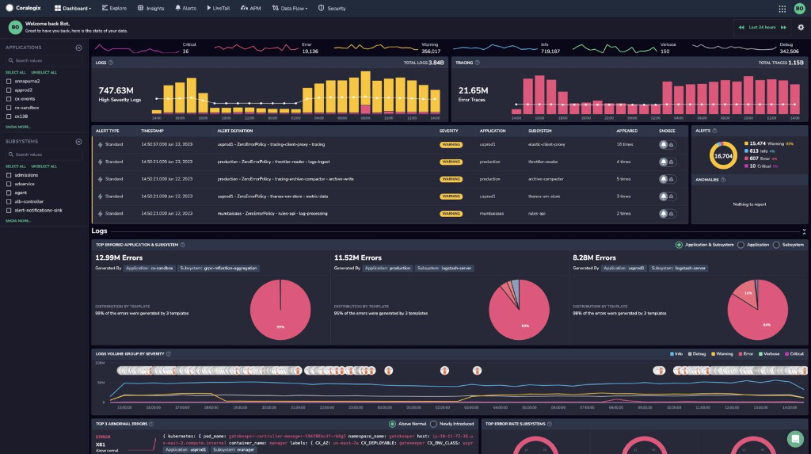
JAVA LOG ANALYZER & SUPABASE MONITORING SYSTEM
8. React Observability Dashboard UI
💻 Modern UI Components
• Live Metric Cards: Displays total logs, INFO, WARNING, ERROR, and skipped line counts.
• Interactive Log Explorer: Instant keyword search & dropdown severity filtering.
• Sidebar Navigation: Switch between Dashboard, Logs, Security Alerts & Supabase DB views.
• Drag-and-Drop Upload: Process custom log files directly from the browser interface.

Slide 10
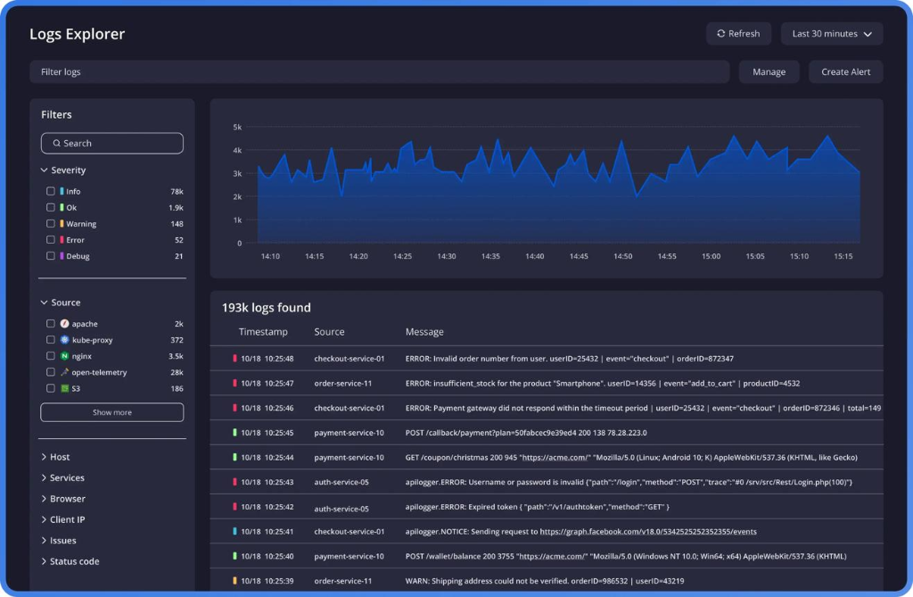
JAVA LOG ANALYZER & SUPABASE MONITORING SYSTEM
9. Security Alerts & Anomaly Analytics View
🛡️ Real-Time Security Feed
• Real-Time Alert Feed: Highlights brute-force login attempts and repeated error spikes.
• Visual Status Badges: Distinct badges for SECURITY ALERT, ERROR, and WARNING.
• Timestamp Tracking: Precise event timestamping for incident response.
• Supabase Audit Sync: Persists security incidents for forensic auditing.

Slide 11
JAVA LOG ANALYZER & SUPABASE MONITORING SYSTEM
10. Automated Summary Report Generation
📄 Executive System Summary Reports
▪ Automated Report Builder:
ReportGenerator converts parsed log entries and detected alerts into a structured executive text report.
▪ Key Metric Summary:
Includes total processed records, percentage breakdown of INFO vs WARN vs ERROR, and skipped line statistics.
▪ File & Database Export:
Saves generated report files locally to reports/ system directory and commits report text to Supabase PostgreSQL database.
▪ One-Click UI Download:
React dashboard allows DevOps managers to preview and copy executive reports directly from the web interface.

Slide 12
JAVA LOG ANALYZER & SUPABASE MONITORING SYSTEM
11. Comprehensive Testing & Quality Assurance
✅ 51 JUnit Test Cases — 100% green test execution across 7 comprehensive test suites.
✅ LogParser & LogAnalyzer — Tests regex parsing accuracy, missing timestamp fallbacks, and level counts.
✅ AlertDetector Rule Tests — Validates brute-force login and error spike threshold triggers.
✅ AuthService & Security — Tests BCrypt hashing, duplicate email checks, and OTP verification logic.
✅ Edge Case Testing — Verifies empty files, malformed log lines, and corrupt input streams handling.

Slide 13
JAVA LOG ANALYZER & SUPABASE MONITORING SYSTEM
12. Business Value & Importance of Log Analysis
💡 90% Faster Incident Resolution
Automated log parsing and error grouping reduces Mean Time To Detect (MTTD) system anomalies.
💡 Enhanced Security Auditing
Real-time security alerts identify unauthorized login attempts before data breaches occur.
💡 Zero Downtime Operations
Early detection of connection drops allows engineers to fix infrastructure bottlenecks proactively.
💡 Regulatory Compliance
Centralized Supabase database logging provides historical audit trails required for compliance standards.

Slide 14
JAVA LOG ANALYZER & SUPABASE MONITORING SYSTEM
13. Future Roadmap & Scaling Features
🔮 Slack & Webhook Integrations
Real-time push notifications to DevOps team Slack channels during Critical Alert events.
🔮 ELK Stack & Kafka Stream Integration
Scale log ingestion using Apache Kafka message broker for high-throughput enterprise pipelines.
🔮 AI / ML Anomaly Prediction
Integrate machine learning models (Isolation Forests) for zero-day pattern anomaly detection.
🔮 Mobile Observability App
Build native Flutter mobile application for remote server monitoring on iOS and Android.

Slide 15
🎉 THANK YOU!
Java Log Analyzer & Supabase Monitoring System
Questions & Feedback Welcome 💬

