Slide 1

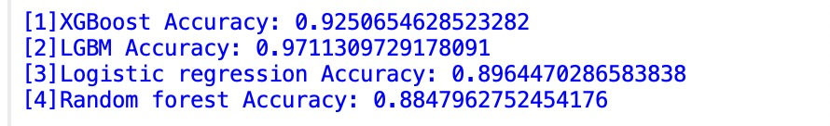
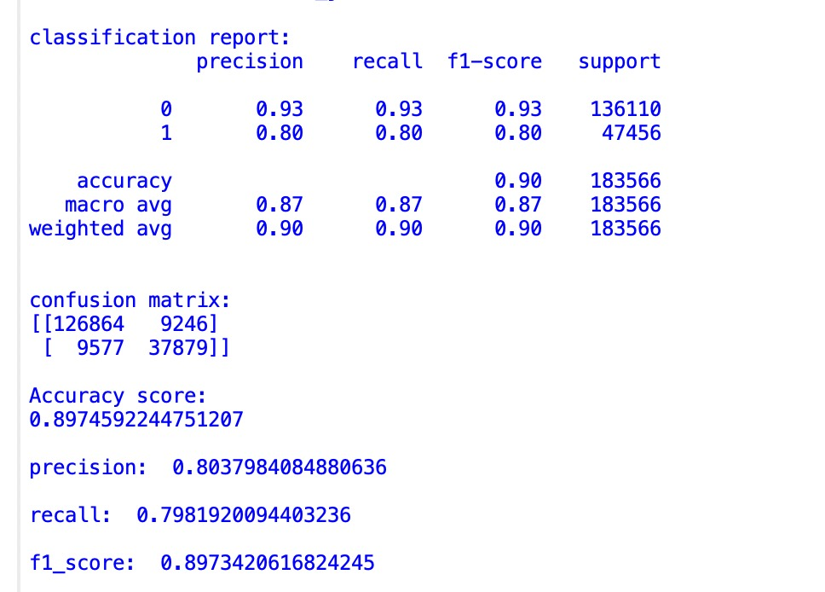
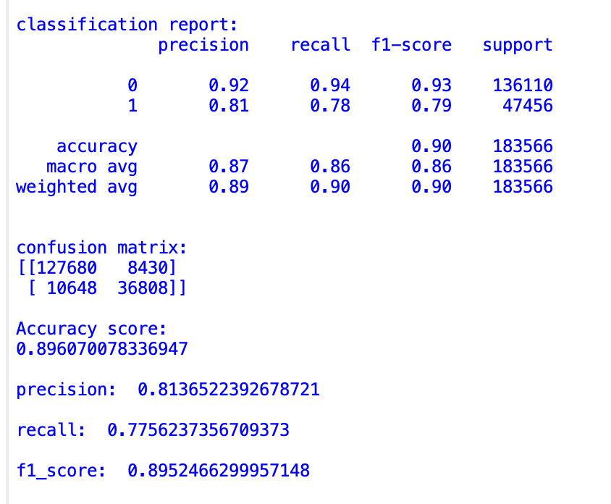
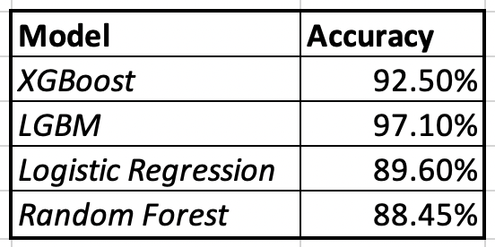
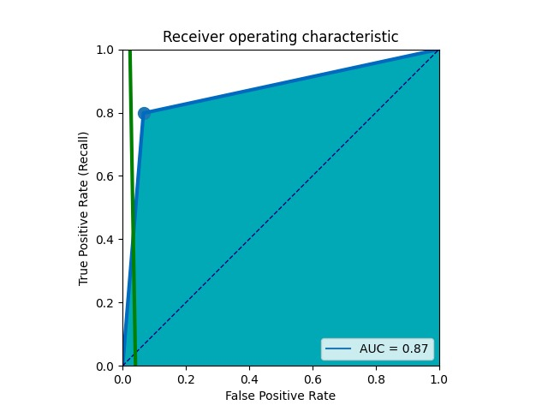
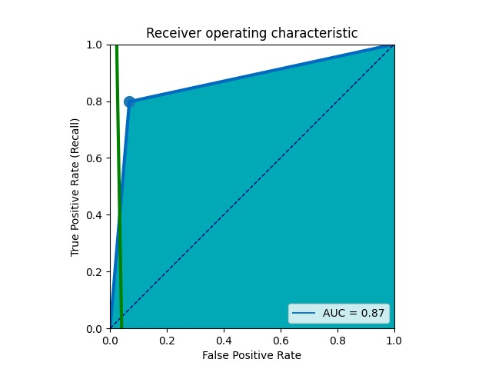
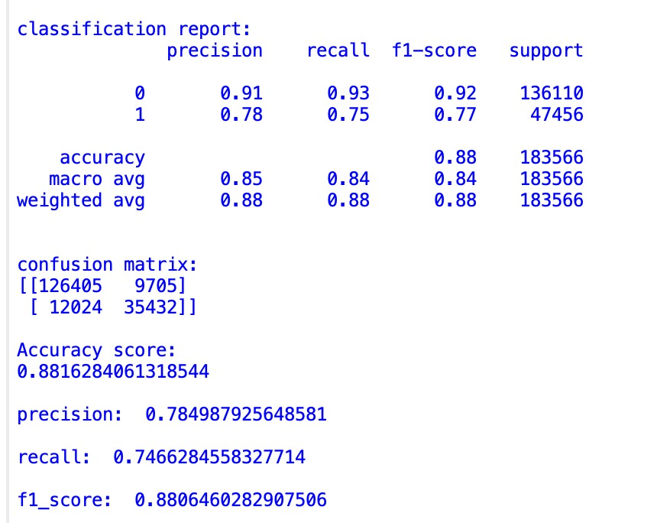
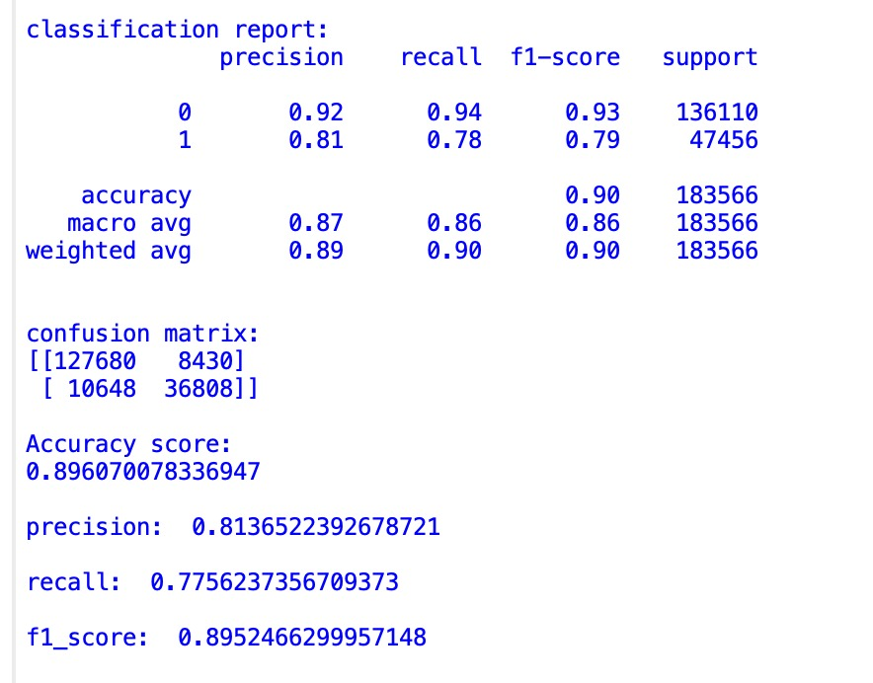
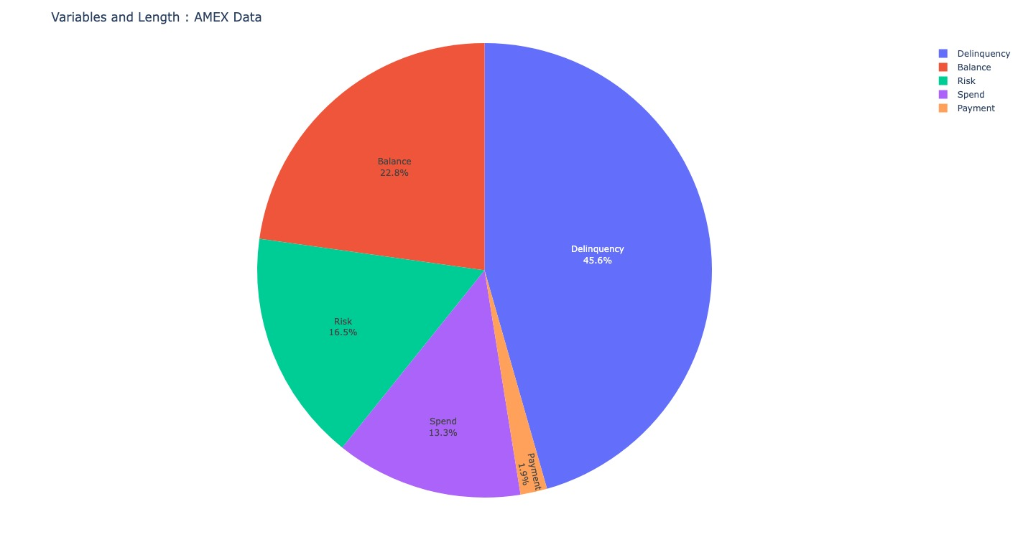
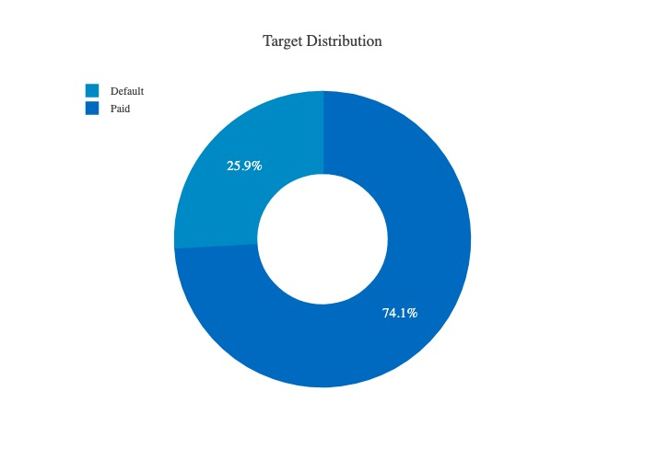
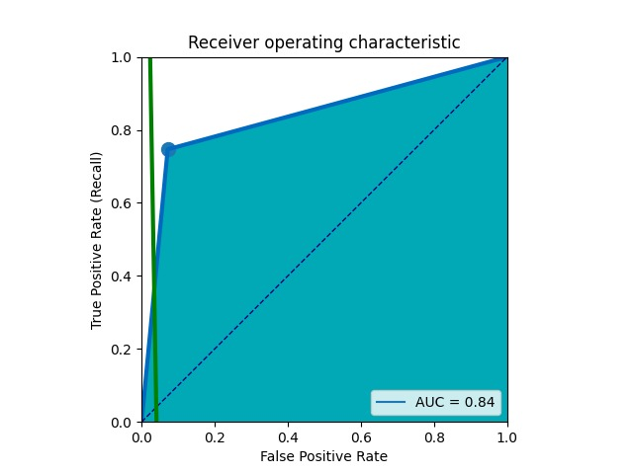
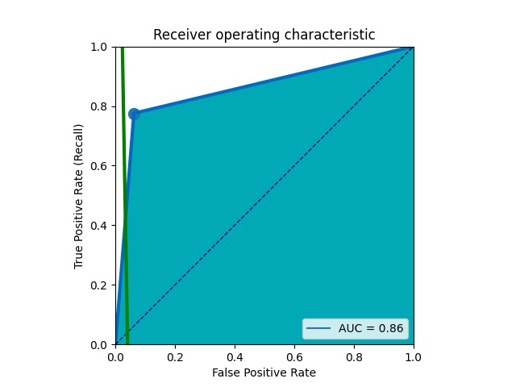
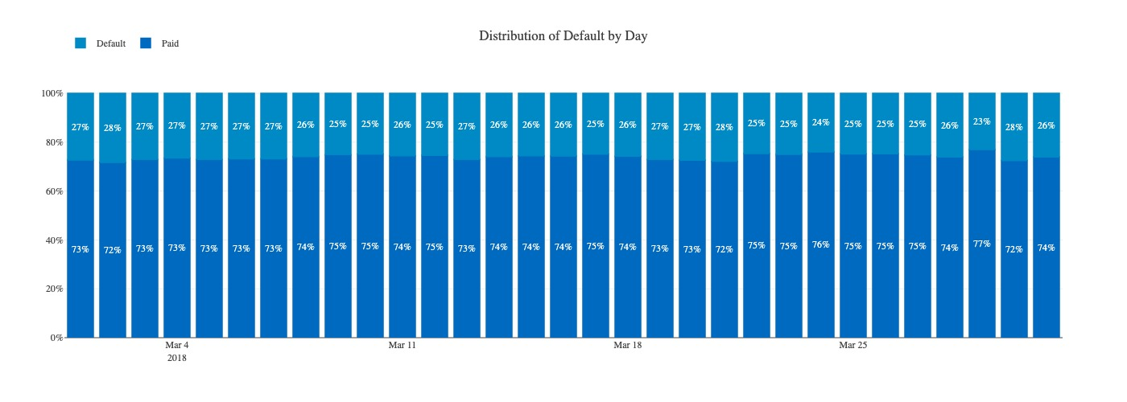
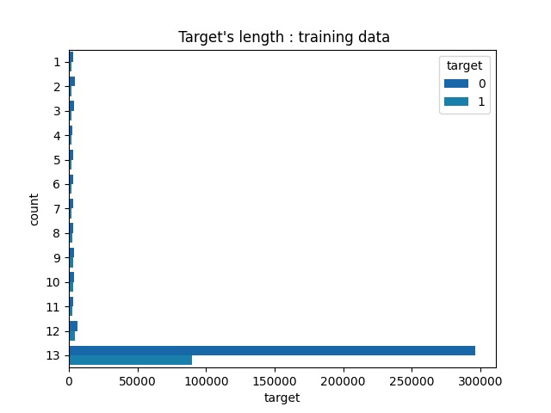
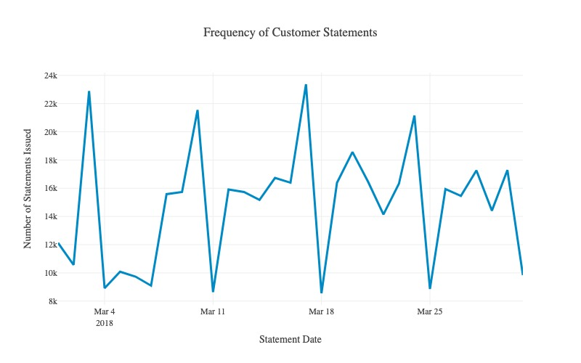
Credit Default Prediction
Aditya Chugh - 0718959 Yashaswini Reddy Terala - 0726670
INTRODUCTION
Methodology
In this Project we are predicting the credit defaulters for AMEX dataset. The main goal of this project is to figure out which algorithm is more accurate and works the best on the test dataset. Also, the algorithm with highest accuracy can be used by the banks for more accurate predictions for future.
The biggest challenge in this project was the dataset. But luckily AMEX provided with the feather dataset that is the converted 50GB of csv format data into text format and hence the data loading and code running time is optimized.
We are using XGBoost, LGBM, Logistic Regression and Random Forest classifier for our credit default prediction. XGBoost and LGBM are some of the most used industry models and are currently in use. When we compare it with logistic regression or even with Random Forest Classifier, we could be able to tell why companies like AMEX or VISA are sticking to these high accurate models rather than other models which doesn’t have a high accuracy. XGBoost and LGBM are the set industry standard models. Both models can work with sparse datasets and can handle the null values. On the other hand, models like random classifier and logistic regression requires the test data to be absolutely cleaned and pre-processed.
The accuracy of the XGBoost model is 92.50%. This means that we correctly predicted the output for 92.50% of the input instances in our dataset. The accuracy of the LGBM model is 97.11%, which is higher than XGBoost. This indicates that the LGBM model performed better in predicting the output for input instances in the dataset. The logistic regression model has an accuracy of 89.60%, which is lower than XGBoost and LGBM. This suggests that the model did a poor job of predicting the output for the input instances in the dataset. The random forest model has an accuracy of 88.45%, the lowest value among the models built. This indicates that the model was not as good as others at predicting the output for input instances in the dataset.
XGBoost
LGBM
DATASET DESCRIPTION
The objective of the dataset is to find the numbers of customer who will not pay back their credit card balance in the future based on their monthly customer profile. According to AMEX if the customer doesn’t payback in 120 days it would be considered as default event.
The Train data consist of 190 columns with over 450K rows, and the test data consists over 900k rows with 189 features and the total dataset sums to 50GB. The good part about this dataset is that AMEX has already provided training dataset and test dataset. The dataset contains following features for each customer.
D_*: Delinquency variables
S_*: Spend variables
P_*: Payment variables
B_*: Balance variables
R_*: Risk variables
Random Forest Classifier
Logistic Regression
The evaluation findings on the various metrics employed by this arrangement of machine learning models are summarized in the above images. There are 183,566 support data points in total for this test run, with 136,110 for class 0 and 47,456 for class 1 for all the models constructed. One metric for assessing classification model performance is accuracy. Accuracy is the percentage of forecasts that our models accurately predicted, to put it simply. A prediction accuracy of 97% demonstrates the model's outstanding performance. Precision is often the real percentage of accurate identifications. With a precision of 0.80, our XGBoost model predicts events with absolute certainty 80% of the time. Random forest models have the lowest precision (0.79), but logistic regression models have the best precision (0.81). The fact that both models have a low recall value when tested, however, indicates that models do not fare well with prediction. Overall, the accuracy, precision, and recall ratings of the LGBM model are respectable.
DISCUSSION
XGBoost and LGBM may provide better performance in credit default predictions than logistic regression and random forest, especially in cases where the data has complex non-linear relationships and imbalanced datasets. However, the best model choice ultimately depends on the specific characteristics of the data and the performance metrics of interest. In the dataset provided by the AMEX Random Forest classifier has the accuracy of 99% for 40% test size, but since the data went through a lot pre-processing it’s one of the reason for the accuracy to be this high. XGBoost is a gradient boosting algorithm that can capture complex non-linear relationships between the features and the target variable. It can handle missing data and feature interactions, which can be useful in credit default predictions. LGBM is another gradient boosting algorithm similar to XGBoost, but it can handle large datasets and can be faster to train. It can also handle missing data and feature interactions. LGBM can also handle imbalanced datasets, which is important in this context. Logistic regression can be a good baseline model for credit default predictions since it is simple and easy to interpret. However, it may not capture non-linear relationships between the features and the target variable. If the data has a non-linear relationship, logistic regression may not perform well like the other models.
CONCLUSION
On a binary classification task, the results demonstrate how well four different classification algorithms—XGB Classifier, LGBM, Logistic Regression, and Random Forest—perform. Starting with the accuracy ratings, we can see that XGB Classifier and LGBM both performed best, with XGB Classifier earning a score of 0.9251 and 0.9711 respectively. However, the accuracy scores for Logistic Regression and Random Forest were lower, at 0.8964 and 0.8852, respectively. Recall is the ratio of true positives to all of the model's positive predictions, whereas precision is the ratio of true positives to all of the dataset's actual positive samples. The harmonic mean of recall and precision is known as the F1-score. In terms of precision scores, Logistic Regression came in second with a precision of 0.8137, closely followed by XGB Classifier with a precision of 0.8088. Random Forest had the lowest precision (0.7880), whereas LGBM had the highest (0.8038). As we go on to recall scores, we can see that XGB Classifier and LGBM both received recall ratings of 0.7983, with LGBM having the highest recall of 0.7982. Random Forest has the lowest recall (0.7471), followed by Logistic Regression (0.7756). The f1-scores, which account for both precision and recall, can then be compared. The highest f1-score was recorded by LGBM (0.8973), followed by XGB Classifier (0.8989). Random Forest got the lowest f1-score (0.8819), while Logistic Regression had the highest at 0.8952. In conclusion, LGBM and XGB Classifier outperformed all other algorithms in terms of accuracy and f1-score, with LGBM having the highest recall score and Logistic Regression having the highest precision score. The worst results across all metrics were achieved by Random Forest. It is crucial to remember that any algorithm's performance can change based on the particular dataset and issue at hand. As a result, it is advised to test out several algorithms and evaluate their performance before selecting the best one for a particular problem.

