Slide 1





Team Details
Team Name:
{TEAM NAME}
SR. NO
ROLE
NAME
ACADEMIC YEAR
1
Team Leader
{NAME}
{YEAR}
2
Member 1
{NAME}
{YEAR}
3
Member 2
{NAME}
{YEAR}
4
Member 3
{NAME}
{YEAR}
A team can have up to 4 members including the team leader. Add rows if necessary.
COLLEGE NAME
{COLLEGE NAME}
TEAM LEADER CONTACT NUMBER
TEAM LEADER EMAIL ADDRESS
{+91 XXXXX XXXXX}
{email@example.com}

Slide 2


Problem Statement Addressed
PS-02 — Navigation-error recovery for wafer inspection
DESCRIPTION / DETAILS
A wafer-inspection tool must re-photograph the same microscopic site, but its stage lands roughly a micrometre off target.
Every die is a printed copy of the same design, so the wrong location looks identical to the right one — the images do not distinguish the candidates.
Given a reference at 1 nm/px and a search image at 10 nm/px, return the reference centre in search pixels; that offset times pixel size is the stage correction.
A periodic template on a periodic field yields a lattice of near-identical peaks. Recall is easy; choosing the right peak is the problem.

Slide 3



Proposed Solution - Describe your Idea/Solution/Prototype
Six stages, escalating: the cheap path runs first, and the expensive tiers are entered only when the evidence says it was not enough.
SOLUTION DETAILS
Pipeline: pose estimation → template construction → ZNCC matched filter (FFT) → peaks with NMS → disambiguation → sub-pixel refinement → calibrated confidence.
Uniqueness weighting is the core idea. Periodic regions match everywhere, aperiodic ones match in one place, so each tile is scored by its autocorrelation sidelobe — its ambiguity function — and the filter is weighted toward what can localise. +0.080.
Fourier–Mellin rotation estimation adds +0.086, the largest single gain, closing a 26-point gap on the most-rotated stratum to under two points.
Upsampled-DFT phase correlation refines to 0.035 px, an 11x error reduction.

Slide 4



Impact and Benefits
Measured on 324 held-out pairs the system had never seen, generated from a seed registered before development began.
Primary Impact
Quantifiable Outcomes
What It Gets Wrong
Turns a micrometre-scale navigation error into a sub-nanometre correction: 0.031 px (0.31 nm) median error on data the system has never seen.
Every answer carries a quality flag, so cases it cannot solve are reported rather than guessed.
Held-out set, 324 unseen pairs: 95.1% at 1 px, 96.3% at 2 px, 97.5% at 4 and 5 px.
Development set: 93.8% at 1 px against a plain-NCC baseline of 75.3%.
Median 382 ms per pair on one CPU core — no GPU, no trained model.
Accuracy generalised; our confidence measure did not. The holdout accepted two unflagged answers and both were wrong, by 1.49 and 1.66 px.
PSR cannot tell a correct peak from a confident one on a periodic lattice, so thresholds stay untuned.

Slide 5

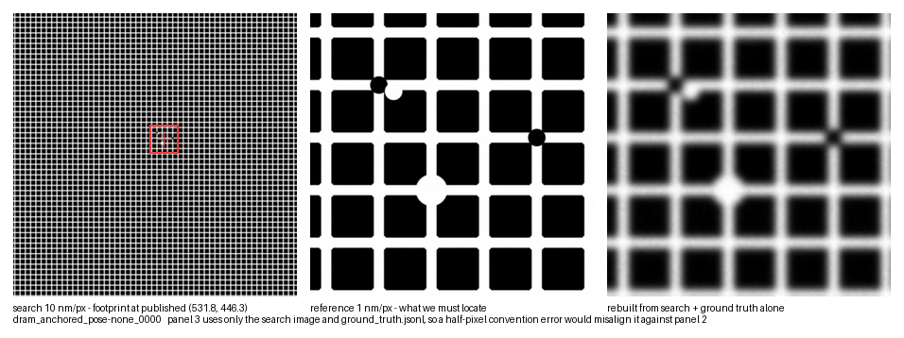



Technology & Feasibility/Methodology Used
Commodity-CPU Python, a physics-based synthetic dataset, and reproducibility checks that run from a clean unzip.
IMPLEMENTATION STRATEGY
Python 3.12 with NumPy, SciPy, OpenCV and scikit-image. No GPU, no training, no model weights — it runs from a clean unzip on a laptop CPU.
324 stratified pairs through a real SEM chain: edge brightening, PSF blur, Poisson shot noise, read noise and scan artifacts, applied independently per capture.
Byte-reproducible from seed; the held-out set's tree hashes were registered before generation and reproduced exactly on Windows and macOS.
597 tests, CI on every push, and a clean-room check that unpacks the archive and runs it with no developer environment present.
Through the 10 nm/px search optic DRAM pitch retains 87–94% of its contrast and FinFET fin pitch only 58–78%: two periodicities, one strongly attenuated. Nyquist is not the binding constraint — contrast is (IRDS 2023 More Moore §5.1).
RGB bonus: visible light cannot resolve this layout. Incoherent imaging passes nothing above 2·NA/λ, so at NA 0.95 the finest surviving period is 237 nm (blue) to 337 nm (red), against a 72–108 nm fin pitch. Measured, the best channel retains ~6% of the geometry's contrast.
Ground truth rebuilt from the search image alone.

Slide 6




GitHub & Video Link
GitHub Repository
https://github.com/Yashaszz/drift-sense
Prototype / Simulation Video
{PASTE VIDEO LINK - NOT YET RECORDED}

Slide 7


Research and References
Research Background & Methodology
The theory the method rests on, and the limits we state rather than hide.
Disambiguation is posed as matched filtering: a tile's autocorrelation is its ambiguity function, so sidelobe height measures positional ambiguity directly.
Layout dimensions are deliberately relaxed 1.5–5x from production silicon. At real ground rules the lattice reaches the 10 nm/px optic at 45% contrast, and at leading-edge fin pitch at 20% — at or below the shot-noise floor.
Nyquist is not the binding constraint; contrast is. Every parameter is tagged as cited, partly cited, or a declared assumption.
References & Citations
List key papers, articles, or data sources.
Lewis, J.P. (1995). Fast Normalized Cross-Correlation. Vision Interface.
Reddy & Chatterji (1996). FFT-based translation, rotation and scale-invariant registration. IEEE Trans. Image Processing 5(8).
Guizar-Sicairos, Thurman & Fienup (2008). Efficient subpixel image registration. Optics Letters 33(2).

