Slide 1
Business understanding
Determine business objectives and requirment
Predictive Analytic s helps to estimate power factor of the lines to determine the energy efficiency of the system. Identification of energy efficiency helps to maintain the losses in the system.

Slide 2
Data Understanding
Data Understanding
From the observation of data, the collected data from secondary side of distribution transformer
From the given attribute understand that, secondary side of transformer is star connected(Neutral is present)

Slide 3
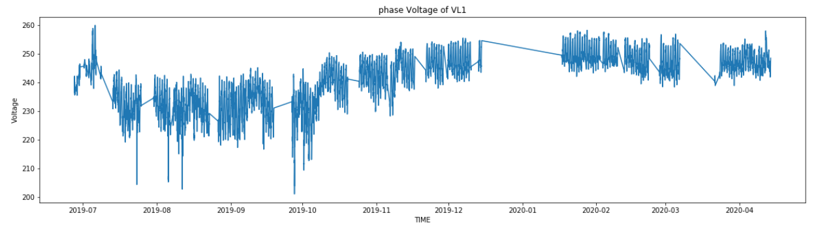
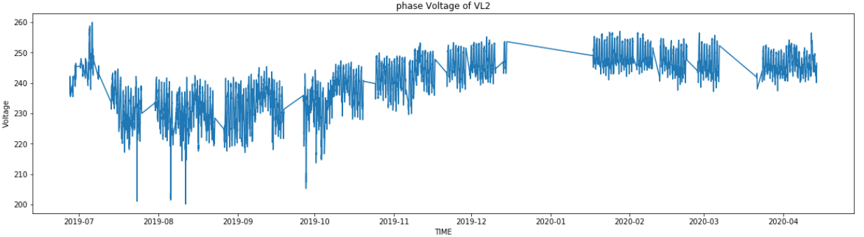
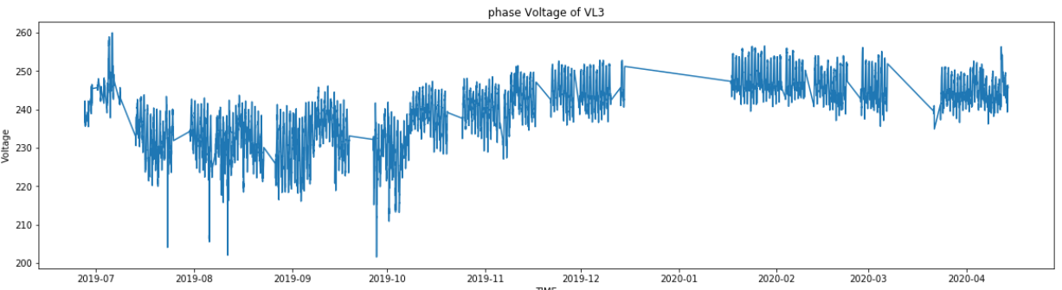
Data Understanding

Slide 4
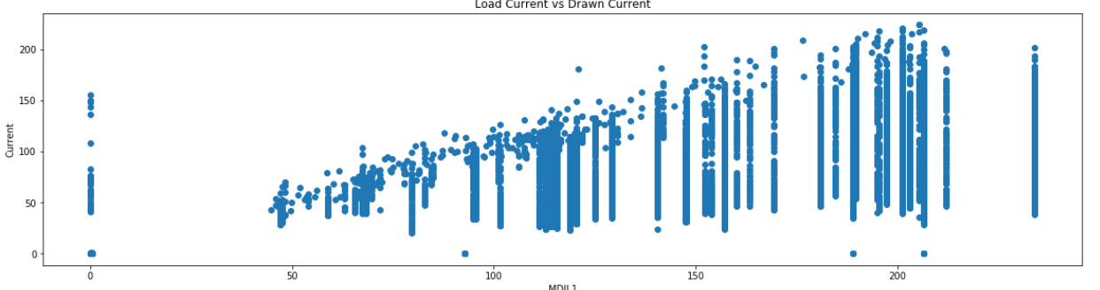
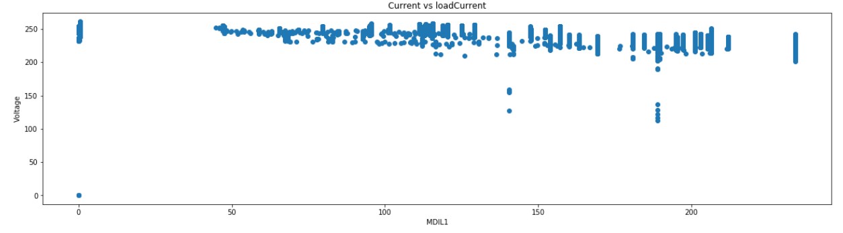
Data Understanding
If demand (load) increases the input draw current
If demand (load) increases the input voltage remain same . Different country has different voltage standard, Ex: In India 240V (Phase voltage)

Slide 5
Data Preparation
Attribute selection
Avg_PF-Average Power Factor
FRQ- Frequency
THD -Total Harmonic Distortion Line 1
MD- Maximum demand
VL1- Phase Line 1
VL2- Phase Line 2
VL3- Phase Line 3
IL1- Current Line 1
IL2- Current Line 2
IL3- Current Line 3
VL12- Voltage line 1 2
VL23- Voltage line 2 3
VL31- Voltage line 3 1
INUT- Neutral Current
Derived attributes:
POWER feature is extracted
Outliers
Handled using zscore technique
Feature Scaling: StandardScaler technique is used

Slide 6
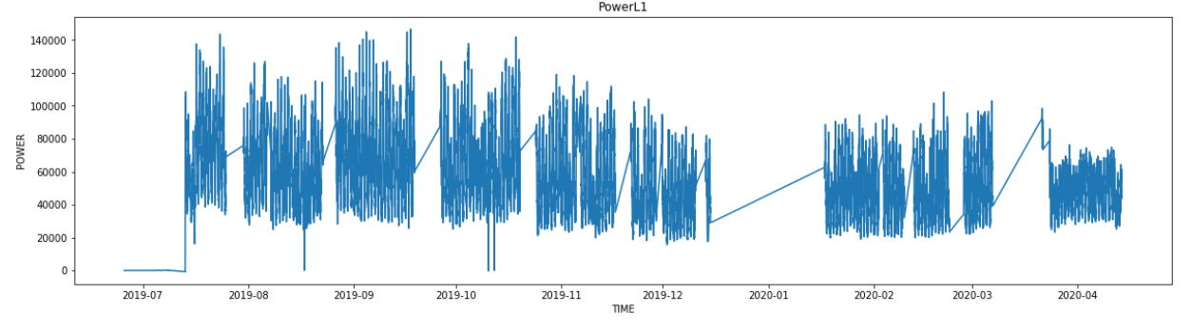
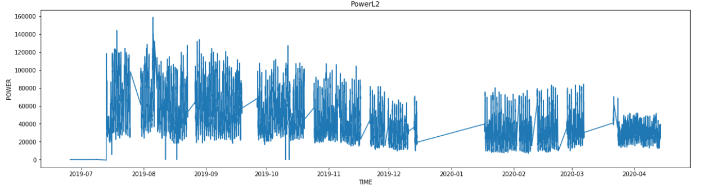
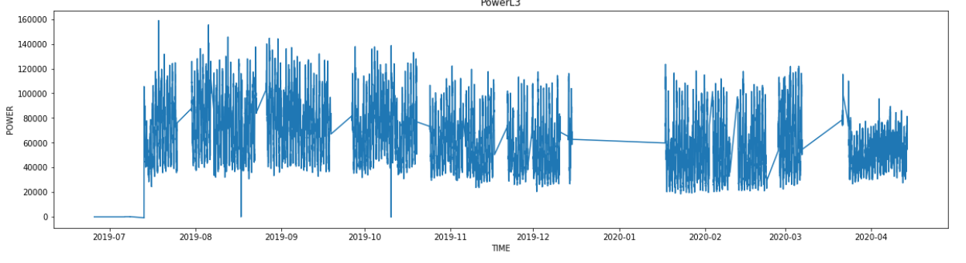
Feature Extraction
Finding input power of each indivual lines using formula power=3V_PhaseI_phase*power_factor

Slide 7
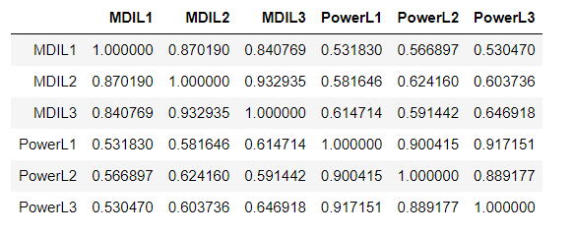
Feature Extraction
From the corr: Power drawn from the system depends on the load demands, as per data the max load demand is directly propotional to the input power, corr shows 50% due to the maxmum load is recoded over the perior.

Slide 8
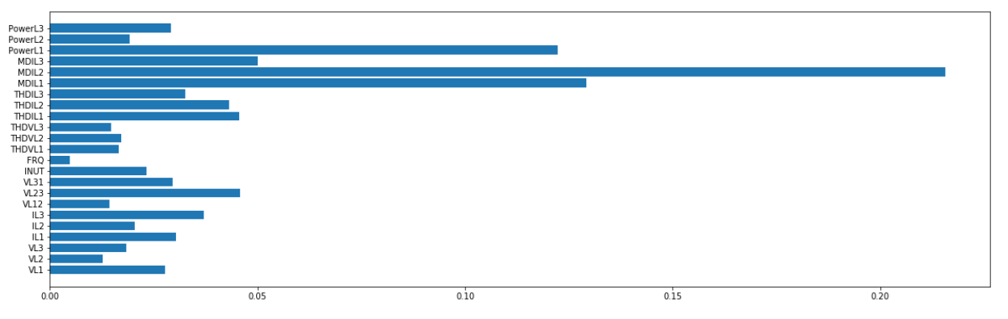
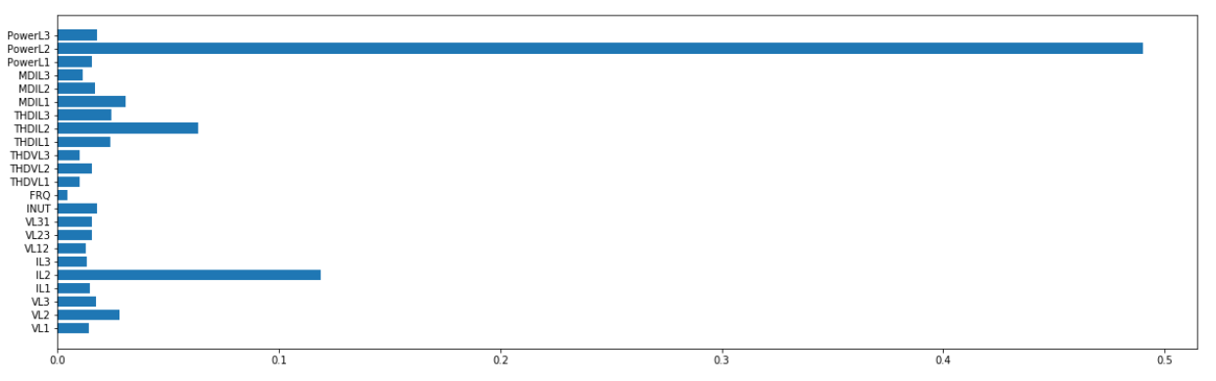
Feature Importance
Feature importance for PFL1
Feature importance for PFL2

Slide 9
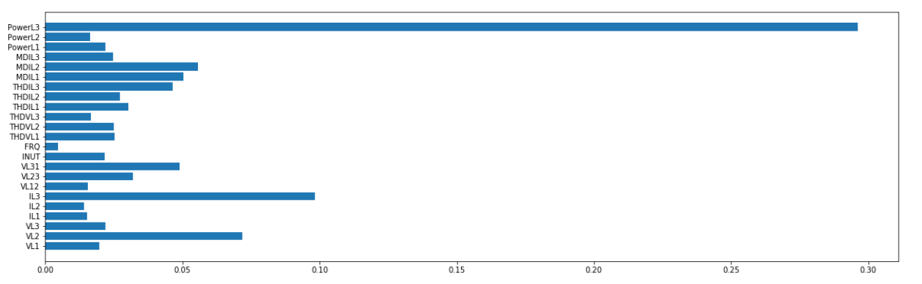
Feature Importance
Feature importance for PFL3

Slide 10
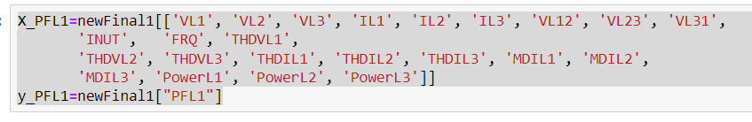
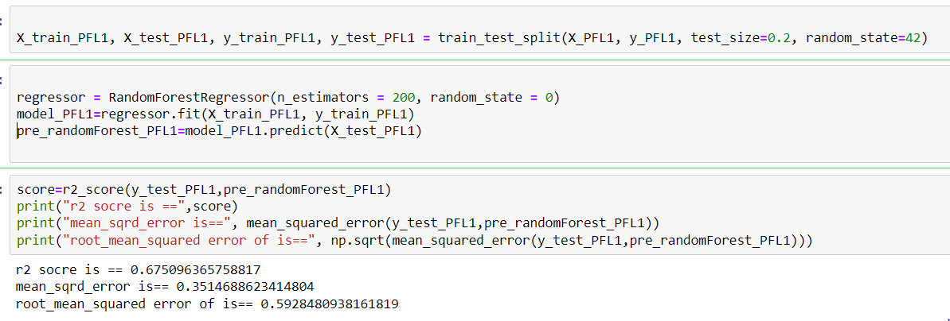
Modeling
Random forest regressor is used for predection of PFL1

Slide 11
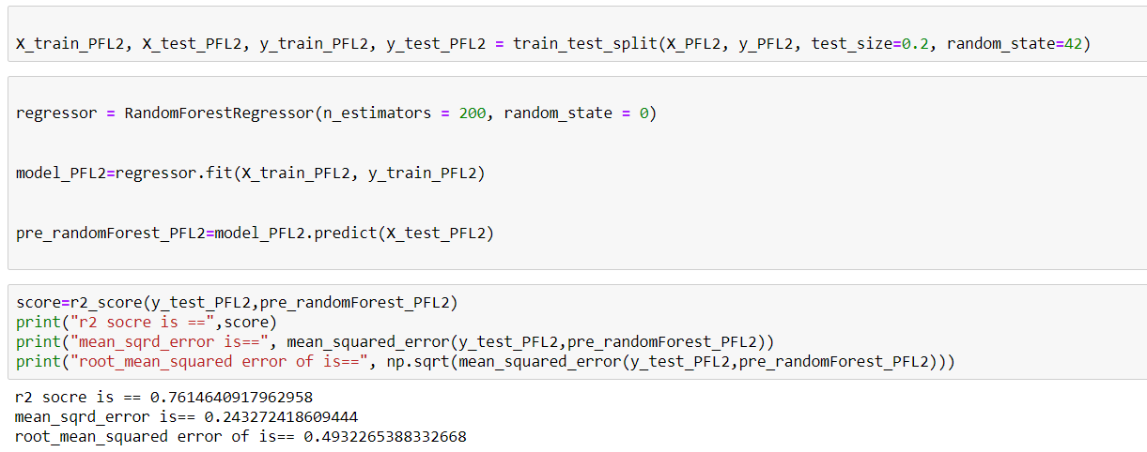
Modeling
Random forest regressor is used for predection of PFL2

Slide 12
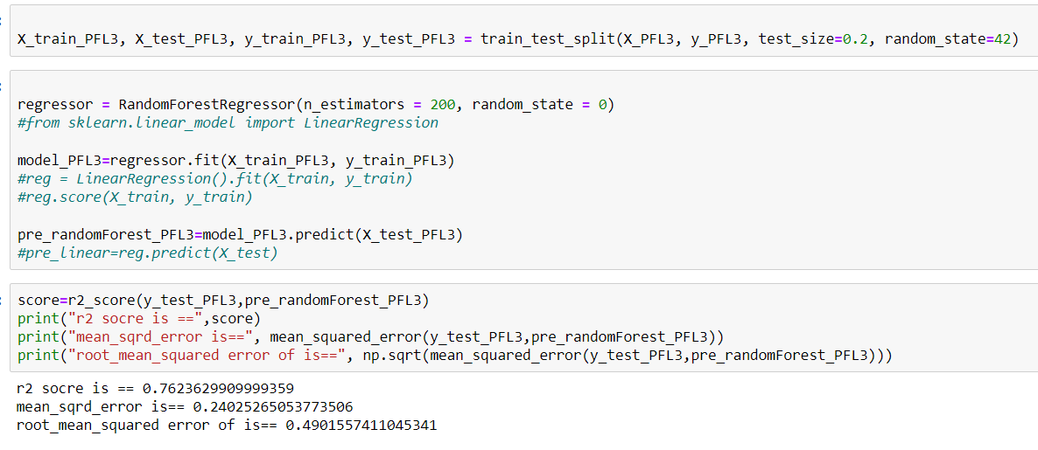
Modeling
Random forest regressor is used for predection of PFL3

Slide 13
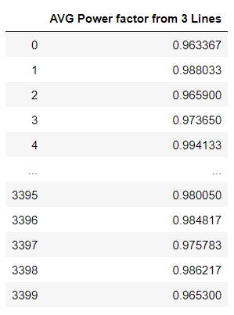
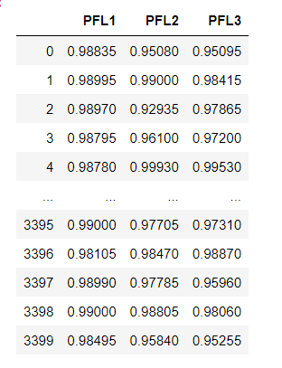
Prediction
Prediction of power factor of 3 lines
Prediction of avg power factor from 3 lines

