Slide 1

Institute of Management Research and Development ,Shirpur STUDY ON COURSERA
Presented by: Yash Yogesh Behere (07)
Girish Ravindra Chaudhari(20)
Guided by: Mahesh Bhavasar sir

Slide 2
INTRODUCTION
Coursera is an online education platform that partners with top universities, colleges, and educational institutions from around the world to provide high-quality courses and educational content to learners worldwide. The platform was founded in 2012 by two Stanford University professors, Andrew Ng and Daphne Koller, and it has since become a prominent player in the online education space.

Slide 3

OBJECTIVE
To study the growth of online e-learning in World.
To explore the online learning of model of Coursera app.
To analysis the user feedback of Coursera over other available online learning in India.
To find out mode by which the user become aware of Coursera.
To reveal the satisfaction level of the user.

Slide 4
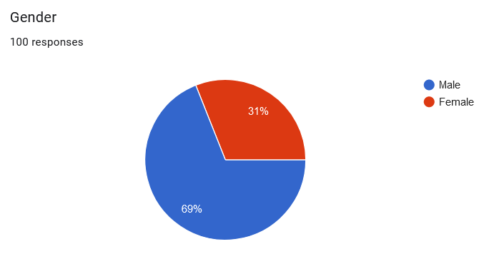
ANALYSIS
Male | 69
Female | 31
69% of the respondent are Male.
31% of the respondent are Female.

Slide 5
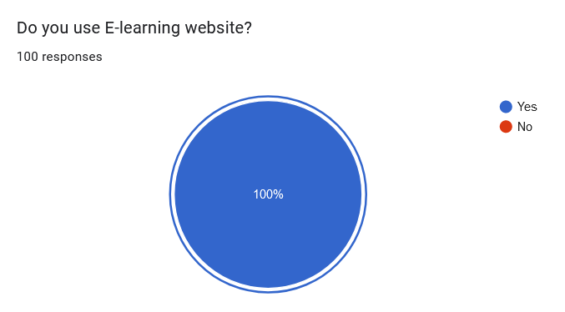
Yes | 100
No | 0
100% of the respondent to use E-learning website .
0% of the respondent to not use E-learning website.

Slide 6
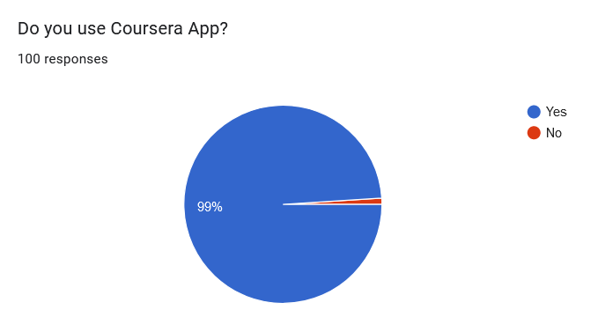
Yes | 99
No | 1
99% of the respondent to use Coursera app.
1% of the respondent to not use Coursera app.

Slide 7
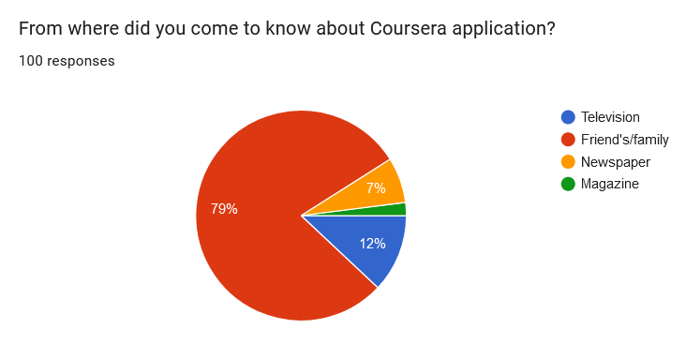
Friend’s/family | 79
Television | 12
Newspaper | 7
Magazine | 2
79% of the respondent to know about Coursera application from Friend’s and Family.
12% of the respondent to known about Coursera application from Television.
7% of the respondent to know about Coursera application from Newspaper.
2% of the respondent to know about Coursera app from Magazine.

Slide 8
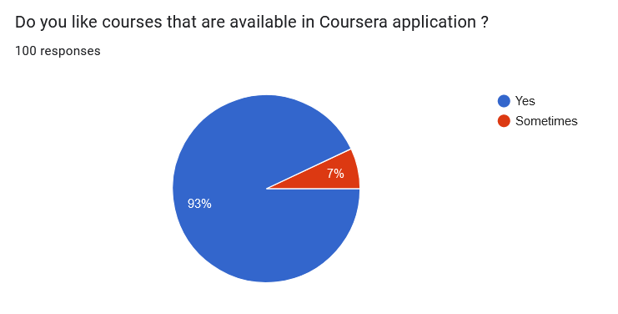
Yes | 93
No | 7
93% of the respondent to Yes like courses that are available in Coursera app.
7%of the respondent to No not like courses that are available in Coursera app.

Slide 9
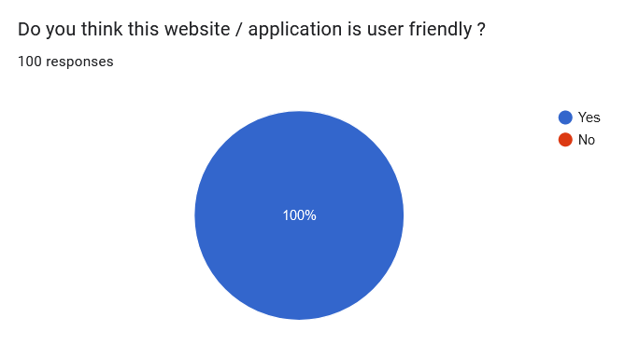
Yes | 100
No | 0
100% of the respondent to Yes Coursera app is user friendly.

Slide 10
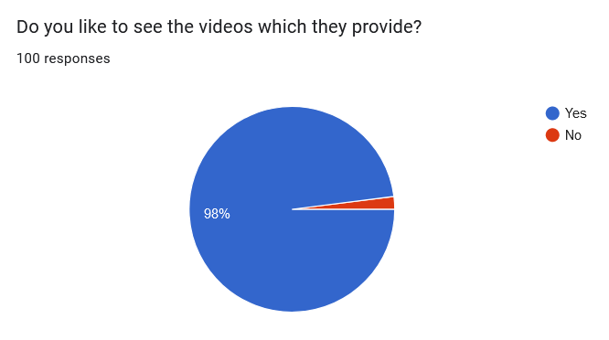
Yes | 98
No | 2
98% of the respondent to yes, like to see the videos which they provide.
7% of the respondent to No, like to see the videos which they provide.

Slide 11
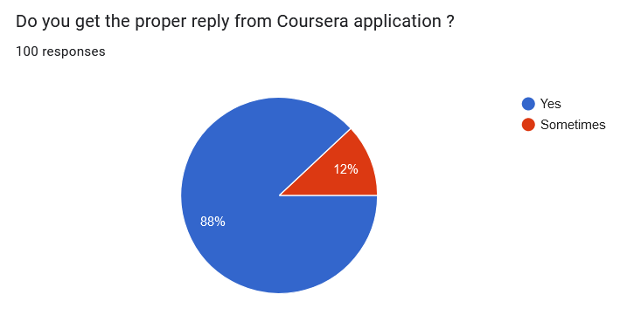
Yes | 88
Sometimes | 12
88% of the respondent to Yes, get the proper reply from Coursera application.
12% of the respondent to sometime, to get the proper reply from Coursera application.

Slide 12
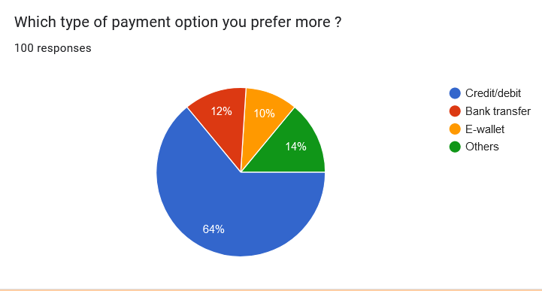
Credit/debit | 64
Others | 14
Bank transfer | 12
E-wallet | 10
64% of the respondent to Credit/debit, type of payment option you prefer more.
14% of the respondent to Others, type of payment option you prefer more.
12% of the respondent to Bank transfer, type of payment option you prefer more.
10% of the respondent to E-wallet, type payment option you prefer more.

Slide 13




Swot analysis
Weakness
Weakness
Strengths
Opportunities
High product Quality
Strong brand recognition
Market Leadership Position
Business model
Quality talent management:
Regional languages
Growing digitalisation in India
Introducing for professional courses
Untapped semi urban India.
Only tapped merely 2% of the students.
Finding out the cost-effective sales model is critical. The number of enrolments in US is lower and hence the sustainability of the model is critical.
Business model could be imitated.
High cost of replacing existing experts or classes. Data privacy.
Competitive pressures.
High lead time to produce one course

Slide 14

Findings
First of all this is the website for the e-learning of COURSERA where the 100% of the respondents going to use it.
59% to 35% of the peoples are knows about the COURSERA form T.V and friends/family respectively.
Coursera is very interesting for student learning and it has many course for the students. The type are in Coursera online course, mocks test, exams, Entrance exam.
Maximum students going to like the interactive visual learning and covers all the syllabus.
As compare other the 61.2% of the students says it’s better for the learning and cover all syllabus.
It is prove that Coursera is user friendly

Slide 15

CONCLUSION
According to me, it is one of the best study app available.
It has great animations, visualizations and understanding which is Something beyond the textbook.
Makes learning very easy ( A good revision tool for whatever you studied in school ).
Provides Subjective and Objective test for Practice.
The Practice option on app has a lot of good questions. Provide us with a student portal where we can ask our doubts and get them cleared, revision notes, popular questions, videos, etc.
REFERENCES
https://en.wikipedia.org/wiki/Coursera
https://www.coursera.org/
https://stackoverflow.com/
www.google.com

