Slide 1
Periodic Noise Removal Using Notch Filters
DIGITAL IMAGE PROCESSING PROJECT
Presentation outline
Introduction
Problem Statement and Proposed Solution
Literature Review
Methodology and Implementation
Results and Analysis
Conclusion
Important References
Ideal, Butterworth and Gaussian notch filters in the frequency domain
Notes:
Opening slide: the project removes periodic noise from images using three notch filters in the frequency domain, then walks through the outline shown on the right.

Slide 2
Introduction
Periodic noise is common
Spatial filters fall short
Images are often corrupted by stripes, grids or moiré patterns from electrical interference, scanning or sensor faults.
Mean and median filters blur the image and cannot remove periodic patterns cleanly.
Noise shows up as spikes
A notch filter targets them
Periodic noise appears as bright, symmetric spikes in the Fourier spectrum, so it can be removed in the frequency domain.
It suppresses only the noise frequencies and leaves the rest of the image almost untouched.
This project implements three notch filters: Ideal, Butterworth and Gaussian.
Notch Filters for Periodic Noise Removal
02
Notes:
Periodic noise is a structured pattern, so it concentrates into a few bright spikes in the Fourier spectrum. That is what makes a notch filter effective: it removes just those spikes.

Slide 3
Problem Statement and Proposed Solution
Problem
Proposed solution
Periodic noise degrades image quality and cannot be removed well by spatial filtering.
Choosing the right notch filter type and parameters is not obvious.
Implement Ideal, Butterworth (variable order) and Gaussian notch filters in Python.
Provide an interactive GUI: load an image, click the noise spikes on the spectrum and apply the filter.
Compare the filters side by side for noise removal, edge sharpness and ringing.
Notch Filters for Periodic Noise Removal
03
Notes:
Two linked questions: how to remove periodic noise without blurring, and how to pick the filter type and parameters. The GUI makes trying options quick.

Slide 4
Literature Review (1 of 2)
Ref. | Focused area | Methodology | Key findings | Relevance
[1] Gonzalez & Woods | Frequency-domain filtering, periodic noise removal | 2-D DFT, centered spectrum, notch reject filters built from shifted high-pass filters | Noise shows as symmetric spikes; notch filters remove them with little blurring | Theory for all three filters
[2] Cooley & Tukey | Fast Fourier Transform | Divide-and-conquer algorithm for the DFT | Cost drops from O(N²) to O(N log N) | Makes frequency filtering practical
[3] Butterworth | Filter design | Maximally flat magnitude response; order controls the transition | Higher order gives a sharper cutoff, approaching the ideal filter | Basis for the variable-order notch
Notch Filters for Periodic Noise Removal
04
Notes:
References 1 to 3 give the theory: why periodic noise appears as spikes, why the FFT makes this practical, and how Butterworth order trades sharpness against ringing.

Slide 5
Literature Review (2 of 2)
Ref. | Focused area | Methodology | Key findings | Relevance
[4] Jain | Image enhancement and restoration | 2-D transforms and filtering | Filtering in the transform domain suits structured noise | Supports the restoration approach
Common thread: structured noise is best handled in the transform domain.
Notch Filters for Periodic Noise Removal
05
Notes:
References 4 and 5 connect the theory to practice: transform-domain restoration, and the open-source Python implementation this work builds on.

Slide 6
Methodology and Implementation
Data collection
Algorithms used
Grayscale images with periodic noise (stripes, sinusoidal patterns), either user-supplied or synthetically corrupted.
Ideal, Butterworth (order n) and Gaussian notch reject filters.
Evaluation
Tools used
Visual side-by-side comparison of the filtered images, judged on noise removal, edge sharpness and ringing.
Python, NumPy (FFT) and a Python GUI for loading images and selecting noise spikes.
Notch Filters for Periodic Noise Removal
06
Notes:
Optional extension: MSE or PSNR against a clean reference image, if you add them to the implementation.

Slide 7

Proposed Model Implementation Flow
2 · FFT
3 · Spectrum
4 · Select
1 · Input
Shift zero frequency to the center and display the magnitude
Noisy image
Convert to grayscale and take the 2-D FFT
User clicks the noise spike locations
5 · Mask
Build the notch mask with symmetric pairs (u_k, v_k) and (−u_k, −v_k)
6 · Filter
7 · Inverse
8 · Output
Multiply the spectrum by the mask
Inverse shift, inverse FFT, take the real part
Filtered image shown beside the original
Notch Filters for Periodic Noise Removal
07
Notes:
Read left to right on the top row, then continue on the bottom row. Steps 4 and 5 are where the notch filters differ: the user picks the spike locations, and the mask shape depends on the filter type.

Slide 8
Notch Filter Equations
Ideal
H(u,v) = 0 if D_k ≤ D₀ or D_−k ≤ D₀, otherwise 1
Butterworth
H(u,v) = ∏ [1 / (1 + (D₀/D_k)^2n)] · [1 / (1 + (D₀/D_−k)^2n)]
Gaussian
H(u,v) = ∏ [1 − exp(−D_k·D_−k / (2·D₀²))]
D₀ is the notch radius and n the Butterworth order. D_k and D_−k are the distances from (u, v) to each notch centre of a symmetric pair; the product runs over the selected pairs.
Notch Filters for Periodic Noise Removal
08
Notes:
All three are reject filters. The Ideal filter is a hard circle, Butterworth smooths the edge with its order n, and Gaussian has the smoothest transition.

Slide 9
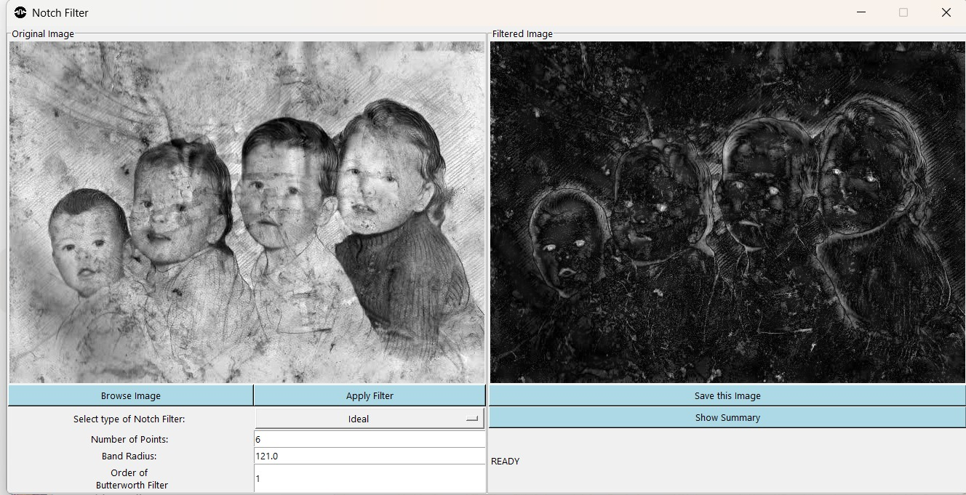
Ideal Notch Filter
Settings
Number of points: 6
Band radius: 121.0
Order: not used
Observation
The output is mostly dark with only face and outline edges left, so this hard cutoff removed a large share of the image content.
Notch Filters for Periodic Noise Removal
09
Notes:
Screenshot of the GUI with the Ideal filter. Same image and same settings as the Butterworth and Gaussian slides, so the three can be compared directly.

Slide 10
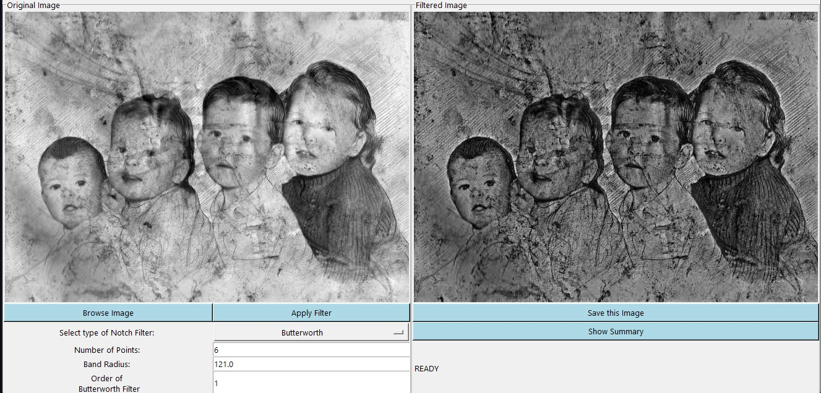
Butterworth Notch Filter
Settings
Number of points: 6
Band radius: 121.0
Order: 1
Observation
Faces and clothing keep their structure, but the image is darker overall. The smooth order-1 transition is gentler than the Ideal cutoff.
Notch Filters for Periodic Noise Removal
10
Notes:
Screenshot of the GUI with the Butterworth filter at order 1. A higher order would sharpen the transition and move the result closer to the Ideal filter.

Slide 11
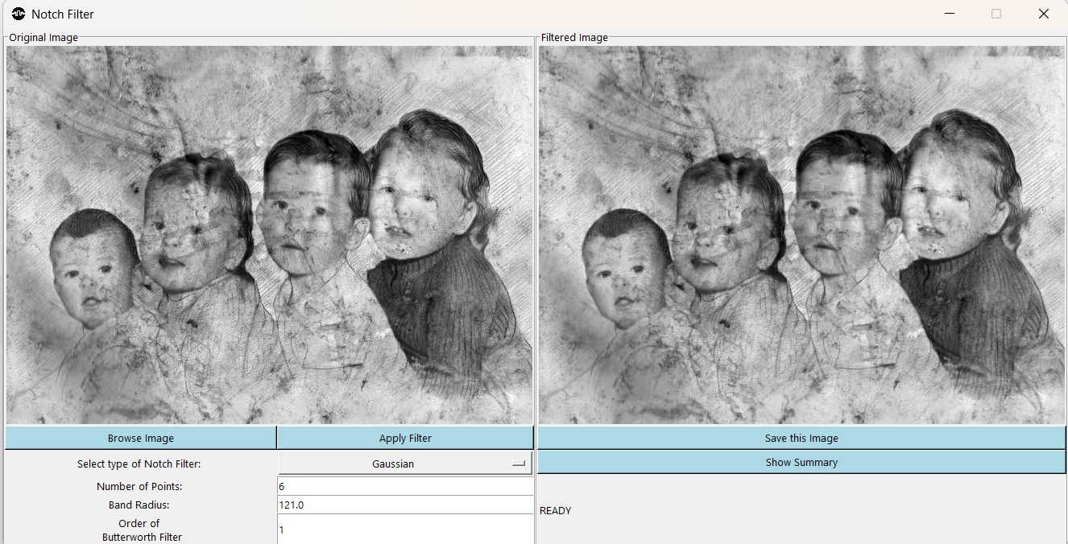
Gaussian Notch Filter
Settings
Number of points: 6
Band radius: 121.0
Order: not used
Observation
The output stays very close to the input. The smooth Gaussian transition changes the image far less than the other two filters at this radius.
Notch Filters for Periodic Noise Removal
11
Notes:
Screenshot of the GUI with the Gaussian filter, same image and same settings as the Ideal and Butterworth slides.

Slide 12
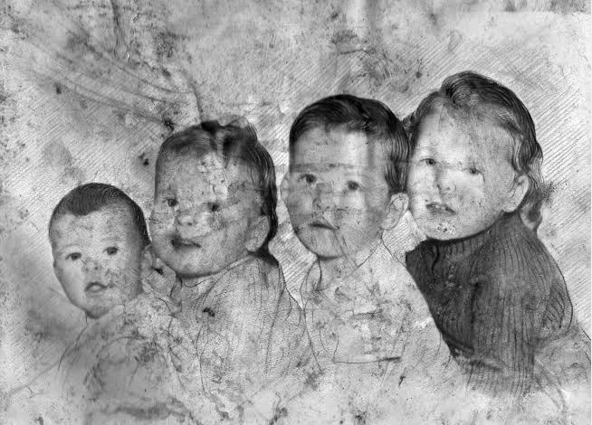
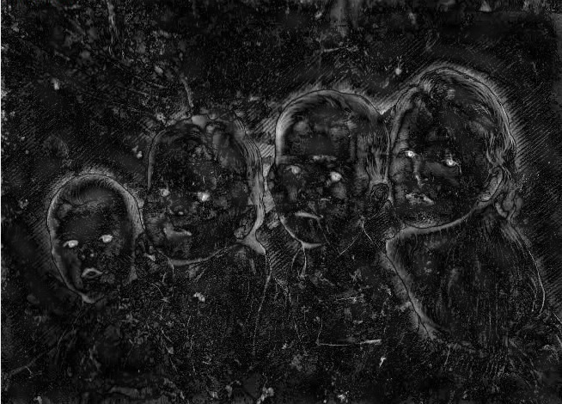
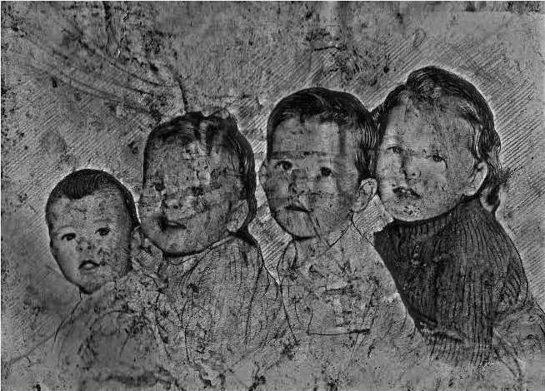

All Three Filters, Same Image
Original
Ideal
Butterworth (n = 1)
Gaussian
Same image and settings throughout: 6 points, band radius 121.0, Butterworth order 1.
Notch Filters for Periodic Noise Removal
12
Notes:
Filtered panels cropped from the GUI screenshots. From left: original, Ideal, Butterworth, Gaussian. The Ideal result is the most aggressive and the Gaussian result the gentlest.

Slide 13
Key Observations and Comparison
Filter | Noise removal | Ringing | Parameters
Ideal | Strongest effect; removed most image content at radius 121 | Expected highest, from the sharp cutoff | D₀
Butterworth | Moderate effect at order 1; structure kept | Expected moderate, tunable with the order | D₀, n
Gaussian | Weakest effect; output close to the input | Expected none, smooth transition | D₀
Noise removal entries come from the screenshots. Ringing entries are the usual expected trends, not measured here.
Notch Filters for Periodic Noise Removal
13
Notes:
Ideal has a sharp cutoff and tends to ring, Gaussian is smooth with no ringing but acts less sharply, and Butterworth sits between them with the order as the tuning knob.

Slide 14
Conclusion and Future Work
Conclusion
Future work
Notch filters remove periodic noise by suppressing only the noise frequencies.
Three variants were implemented: Ideal, Butterworth (variable order) and Gaussian.
Filter choice trades sharpness against ringing; notch radius and order strongly affect quality.
The interactive GUI makes point selection and comparison easy.
Automatic detection of noise spikes (peak detection in the spectrum).
Color image support.
Quantitative metrics (PSNR, SSIM) and batch processing.
Band-reject and adaptive notch filters.
Notch Filters for Periodic Noise Removal
14
Notes:
Main takeaway: a notch filter is a targeted tool, and the choice of Ideal, Butterworth or Gaussian is a trade-off between sharpness and ringing.

Slide 15
Important References
R. C. Gonzalez and R. E. Woods, Digital Image Processing, 4th ed. New York, NY, USA: Pearson, 2018.
J. W. Cooley and J. W. Tukey, “An algorithm for the machine calculation of complex Fourier series,” Math. Comput., vol. 19, no. 90, pp. 297–301, 1965.
S. Butterworth, “On the theory of filter amplifiers,” Wireless Engineer, vol. 7, pp. 536–541, 1930.
A. K. Jain, Fundamentals of Digital Image Processing. Englewood Cliffs, NJ, USA: Prentice Hall, 1989.
Notch Filters for Periodic Noise Removal
15

Slide 16
Thank You
TEAM MEMBERS:
ROHIT SHAW (23BCE7212)
YASH BHARDWAJ (23BEC7036)

