Slide 1
An Analysis of US Airline Delay and Cancellation Data
Yash Bulsara
Guided By: Dr. Stefan Robila
Montclair State University

Slide 2
Introduction
In this project I took different datasets of flights to analyze.
Air travel has become an integral part of our interconnected world, and understanding the dynamics behind delays and cancellations is crucial for both industry stakeholders and travelers.
This analysis aims to provide valuable insights that can inform airline operations, passenger expectations, and policy decisions, ultimately contributing to a more efficient and reliable air travel experience
My objective is to unravel the patterns, challenges, and triumphs within the aviation industry over the past decade, shedding light on the factors influencing flight punctuality and disruptions

Slide 3
Datasets
For this Analysis I took different datasets.
First dataset is from Kaggle, “an airline delay and cancellation data”. The dataset has flight information such as flight date, carrier name, flight number, origin and destination airport, arrival and departure time, and delay.
The Second Dataset is also from Kaggle which is” 2015 Flight delays and cancellations”. The dataset has some additional information such as airport name, city, state, and day of week, which helped me to analyze the dataset to get more information.
Additionally I downloaded the data from the OST website, which has some additional information about flight delays and cancellations.

Slide 4
Tools
I used an anaconda environment for my analysis. I performed my analysis on Jupyter textbook.
I also used many libraries in python like-
Numpy and Pandas for handling data
Matplotlib for evaluation
Plotly to plot data

Slide 5
Project Goal
Identifying trends in delays and cancellations over the years.
Assessing the performance of different airlines and airports.
Analyzing the impact of factors such as weather, air traffic congestion, and aircraft maintenance on flight operations.
Developing predictive models to anticipate potential delays and cancellations.
Evaluating the effectiveness of operational strategies to minimize disruptions.

Slide 6
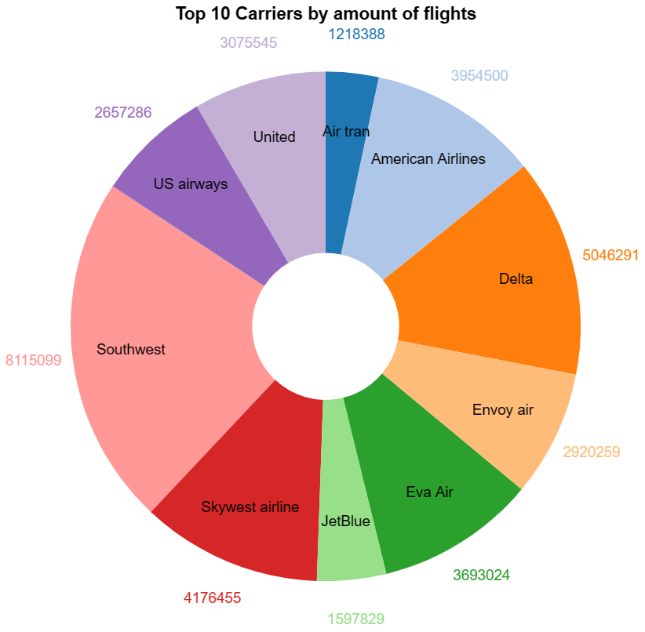
Top 10 carriers by amount of flights

Slide 7
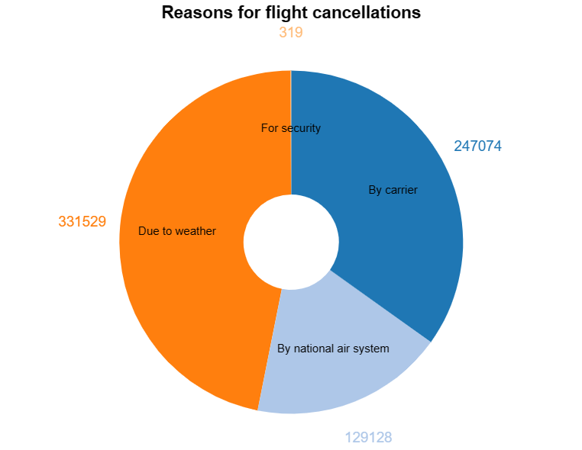
Reasons for Flight Cancellations

Slide 8
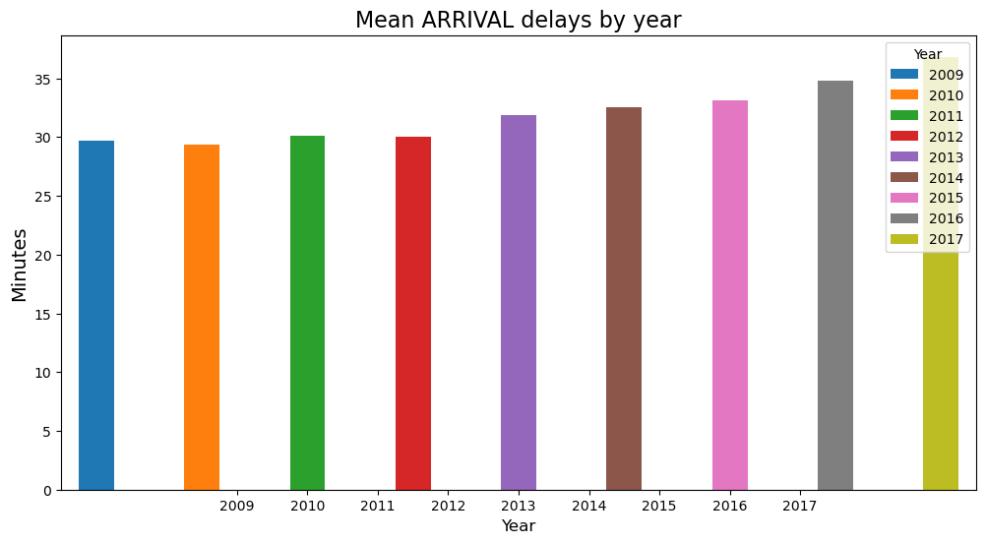
Average delays by year

Slide 9
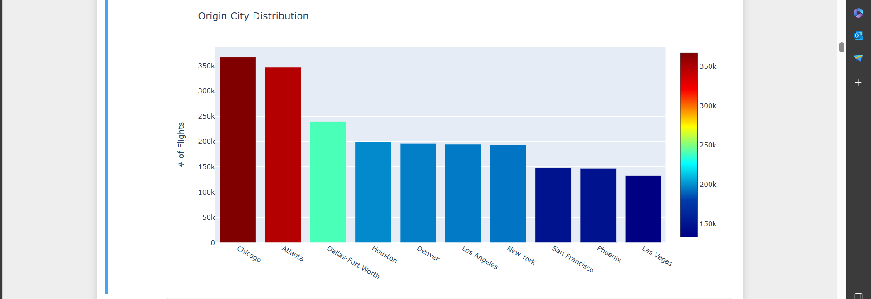
Delays by City

Slide 10
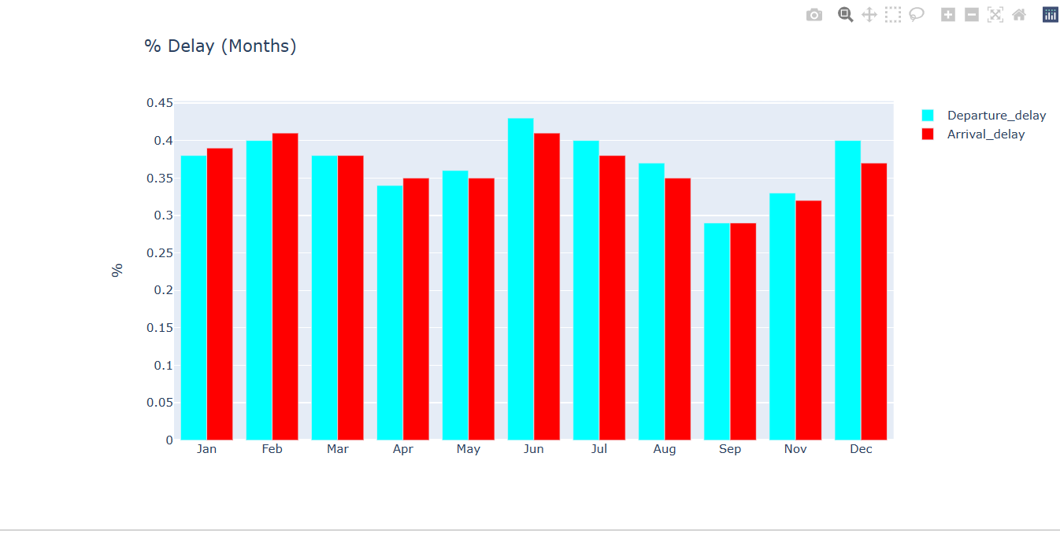
Average delay by months

Slide 11
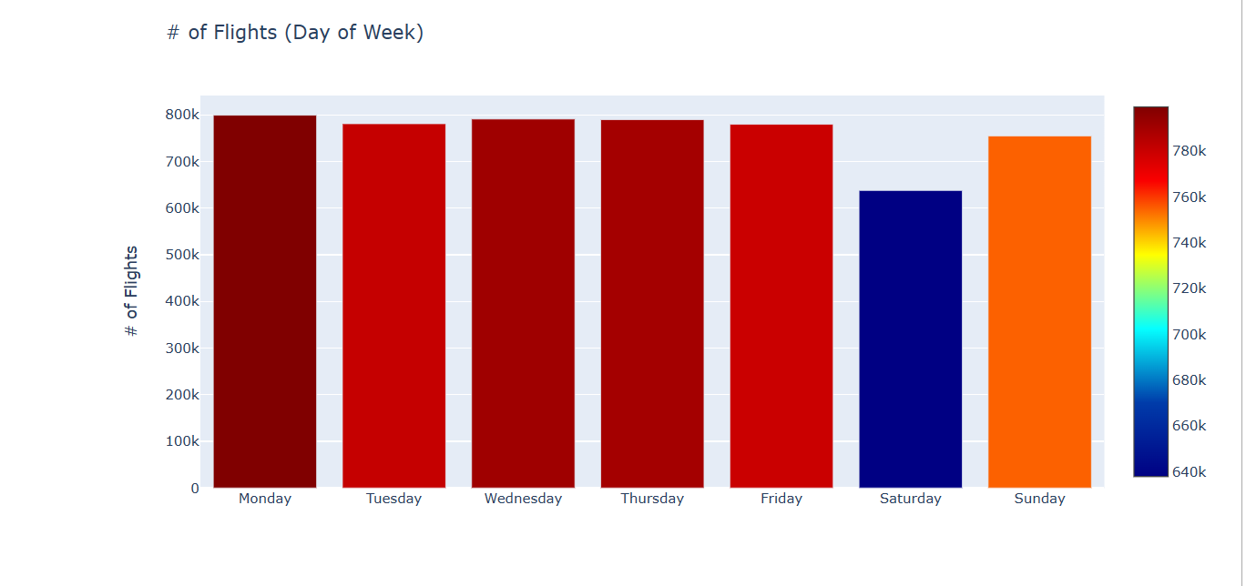
Average delay by week

Slide 12
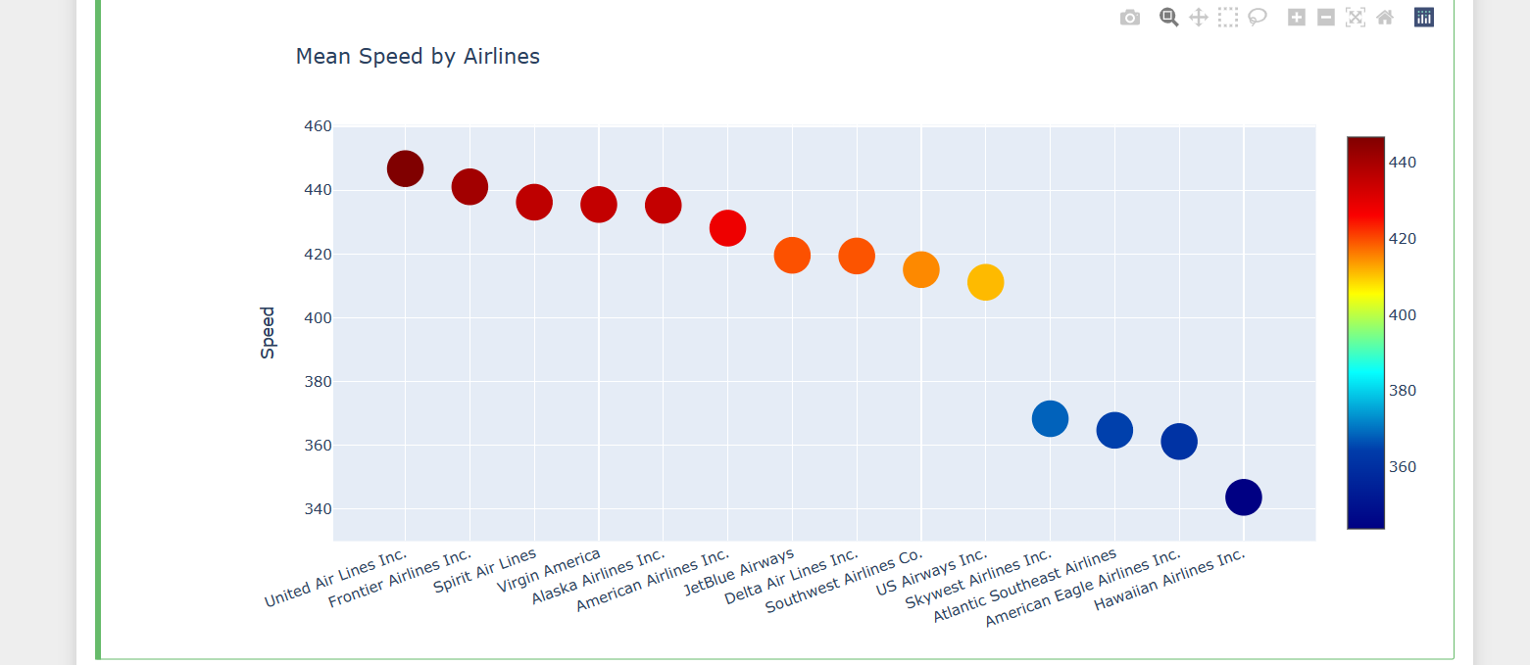
Average Airlines Speed

Slide 13
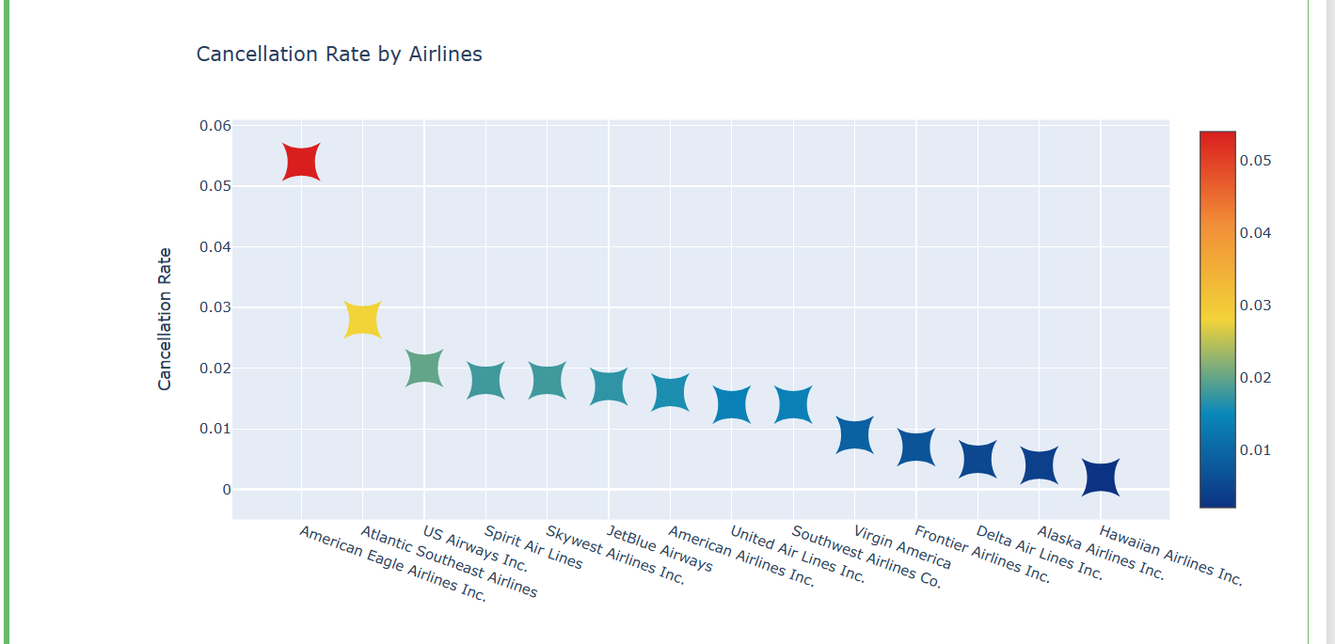
Cancellation By Airlines

Slide 14
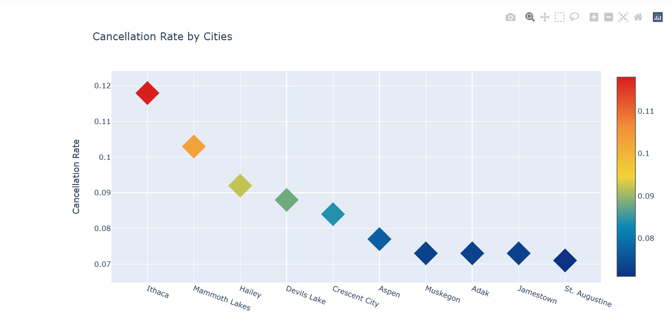
Cancellation by city

Slide 15
Conclusion
Analysis results can be used by researchers and analysts to find patterns and assess the effectiveness of various airports and airlines. By taking the reference of analysis results, the authorities can take steps to reduce the delays. The overall operational effectiveness of the aviation sector can be increased.

Slide 16
Thank You

