Slide 1
Boundary value ODE Using Interval Arithmetic
Under the supervision of
Prof. Shaunak Sen
Yash Kumar
Lokendra Singh Gohil

Slide 2
Problem Statement
This project aims to solve a Boundary Value problem which involves non-linear differential equations subject to endpoint constraints.
We aim to solve the problem using techniques like Interval Arithmetic which ensures rigorous bounds.
Specifically, we are solving the Brachistochrone Problem. For this problem, traditional analytical solutions already exist, but we are trying to solve it using Taylor Series and Interval Arithmetic methods.

Slide 3
Introduction to Brachistochrone Problem
The Brachistochrone problem is a classical problem in calculus of variations
Find the shape of the curve down which a bead sliding from rest and accelerated by gravity will slip (without friction) from one point to another in the least time. The term derives from the Greek (brachistos) "the shortest" and (chronos) "time, delay."

Slide 4


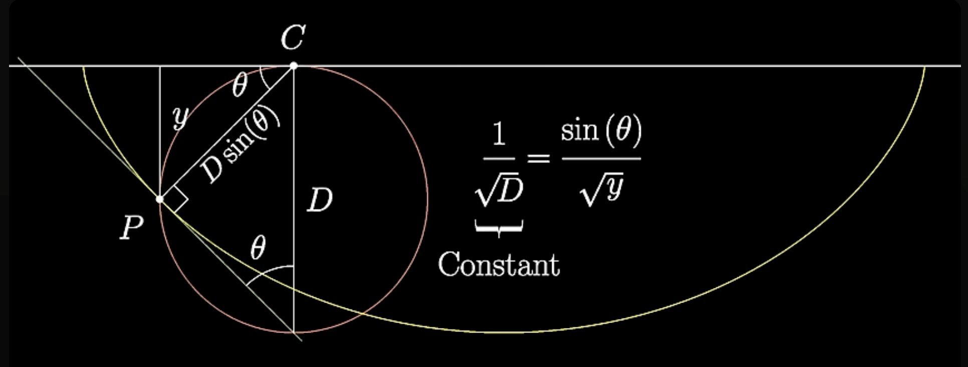
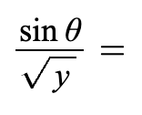
Snell's Law Solution
Which path Light would take?
Use the empirical fact that Light takes the fastest path
The problem is modelled as if Light is travelling through vertical column with different velocity = √ y, and the path light will take in such a scenario to travel between 2 point will be the shortest path
Then using Snell's law the angle made by the path with the vertical will satisfy
constant
or constant
This path is just the expression
of the path of a Cycloid

Slide 5
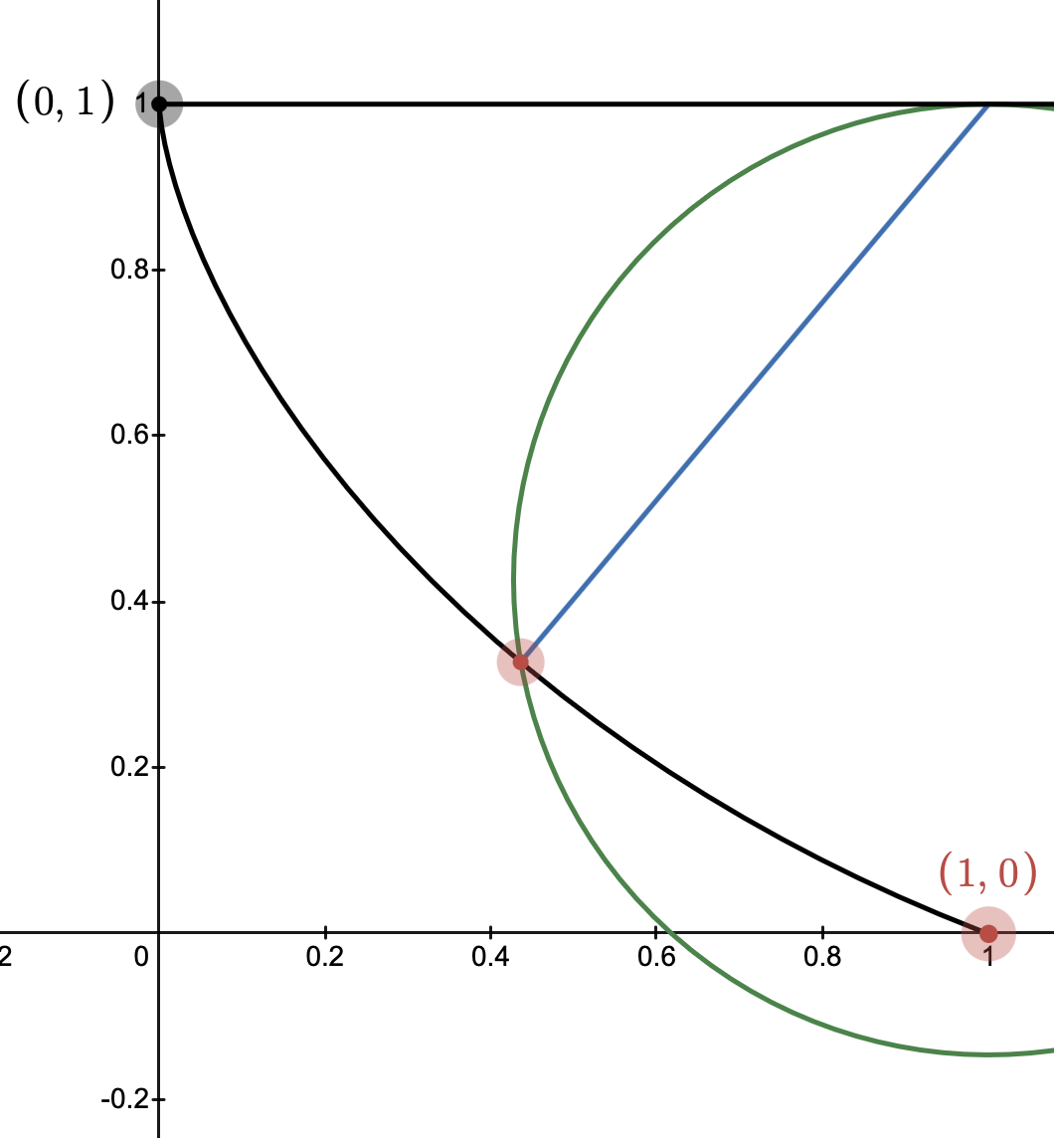
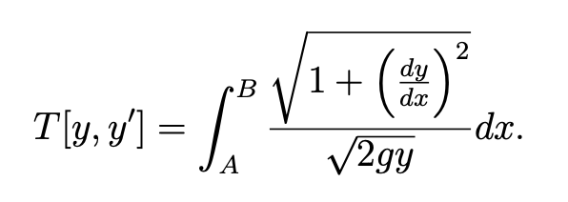

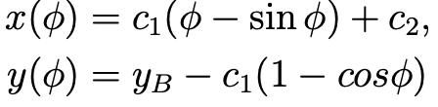
Existing Analytical Solution
The Time to traverse a segment of the curve is given by:
This equation may be simplified to:
The solution curve of the equation given as parametric equations of an upside down cycloid are:

Slide 6



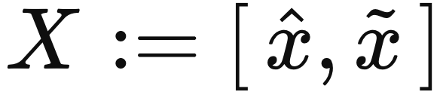
Motivation
Computers work in discrete steps and use floating-point numbers, which can cause rounding errors. These small errors can build up over time, so we use interval arithmetic to track possible ranges of values and keep the results accurate.
When we use Taylor series, we get polynomial equations. These can be solved accurately using interval version of Newton-Raphson method, which gives guaranteed bounds on the answer.
Intervals appear naturally in math. For example, in the Mean Value Theorem: with cannot be treated numerically in real numbers because is unknown. But the relation with can be used numerically with the aid of interval analysis.

Slide 7
Motivation
Computers work in discrete steps and use floating-point numbers, which can cause rounding errors. These small errors can build up over time, so we use interval arithmetic to track possible ranges of values and keep the results accurate.
Intervals appear naturally in math. For example, in the Mean Value Theorem:
with
cannot be treated numerically in real numbers because is unknown

Slide 8
Overview of Our Solution
(Using Taylor Series & Interval Arithmetic)
The Taylor series expansion is used to approximate the solution to the nonlinear boundary value ODE, providing a systematic way to construct accurate power series representations of the solution over intervals
The series is substituted into our differential equation to obtain simultaneous equations by coefficient matching
Interval Newton Method to be used for finding rigorous bounds of the coefficients of the Power series, and the curve represented as an Interval valued function to ensure the solution is enclosed
By applying interval arithmetic within the boundary value ODE framework, the solution aims to precisely capture uncertainties and verify solution correctness

Slide 9
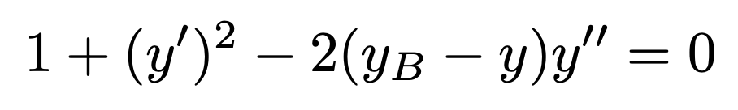
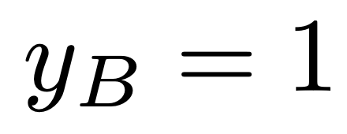
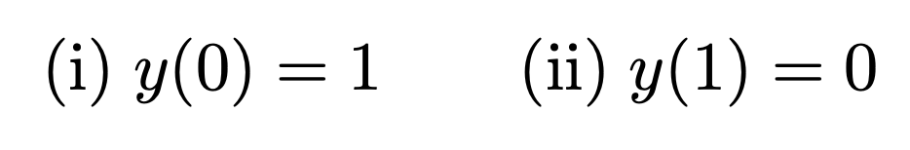



Taylor Series & Interval Arithmetic Solution
Solving for Initial case
The Differential Equation:
The Conditions:
Taylor Series :
Expression obtained after substitution

Slide 10
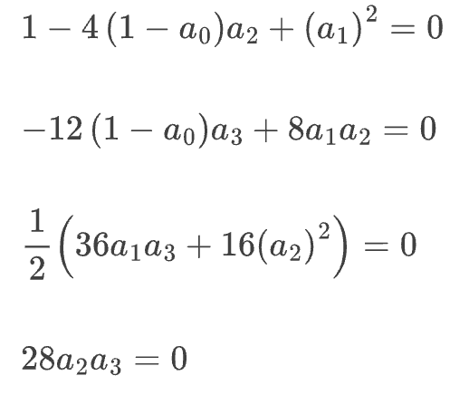
Taylor Series & Interval Arithmetic Solution
Equations obtained on matching coefficients:
Particularly for n = 3, we have 4 variables. We already have 2 conditions from the boundary values, so we take the first two equations of the above 4 equations obtained.

Slide 11

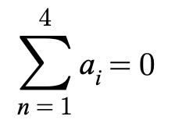
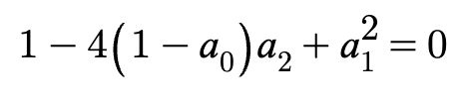



Problem with this case
So, the 4 equations that we solve are:
When we try to plug in
we arrive at

Slide 12
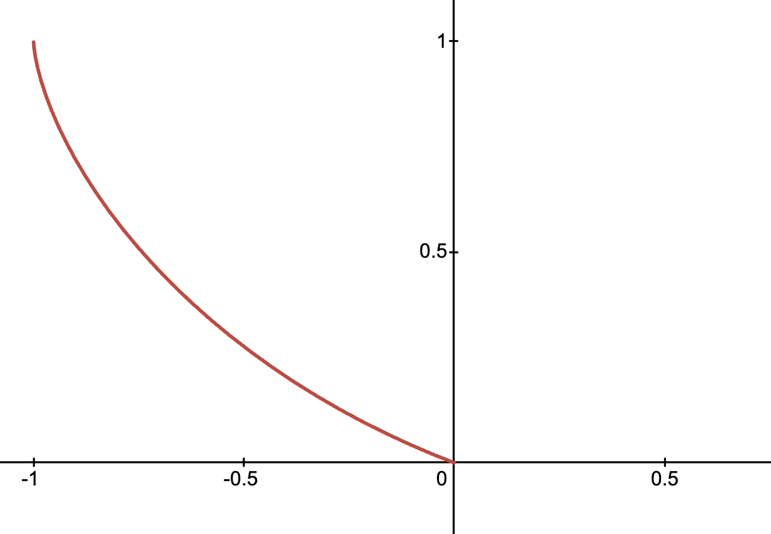
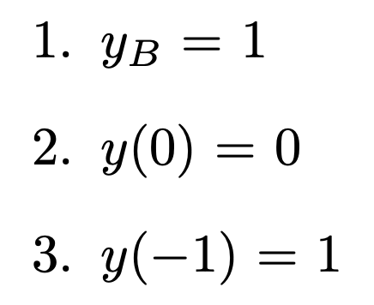
Updated Case: Shifted Brachistochrone
Instead, solve for a shifted Brachistochrone which starts from (-1,1) and passes through (0,0)
So, our conditions now become:

Slide 13
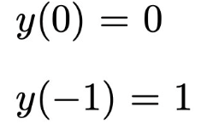
Solution Method
We have 2 equations already
We take the first n-1 equations of the equations obtained
So, our conditions now become

Slide 14






Example: Solving for second order
The polynomial:
The conditions:
After solving these, we get:
Since we shifted the Brachistochrone, to shift it back, the required Polynomial should be

Slide 15
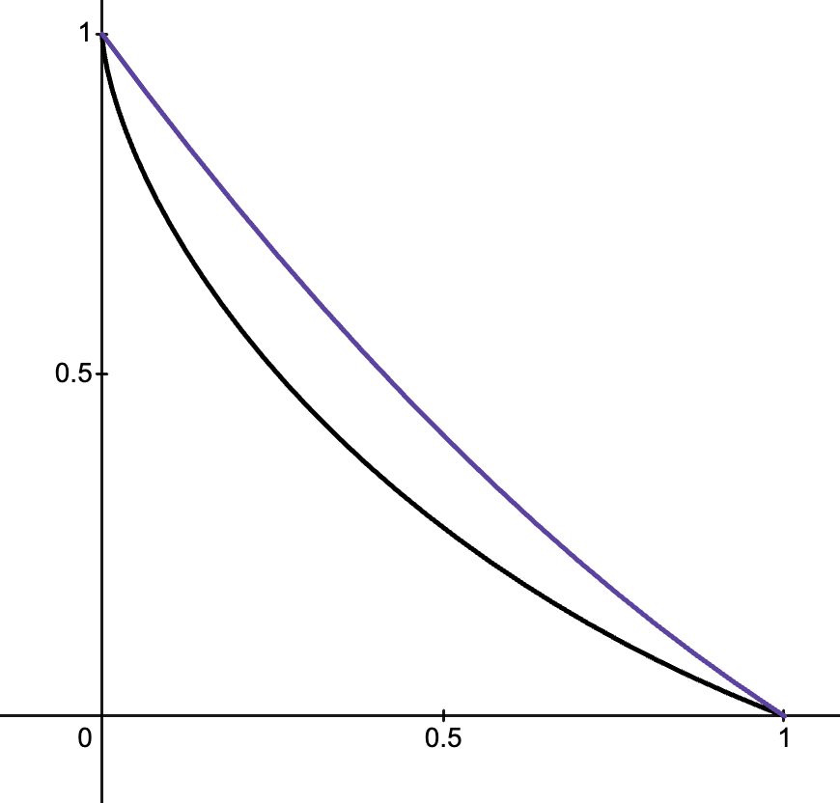
Plot of second order polynomial
This is the Plot of
Black: Original Brachistochrone
Purple: Second order approximation

Slide 16
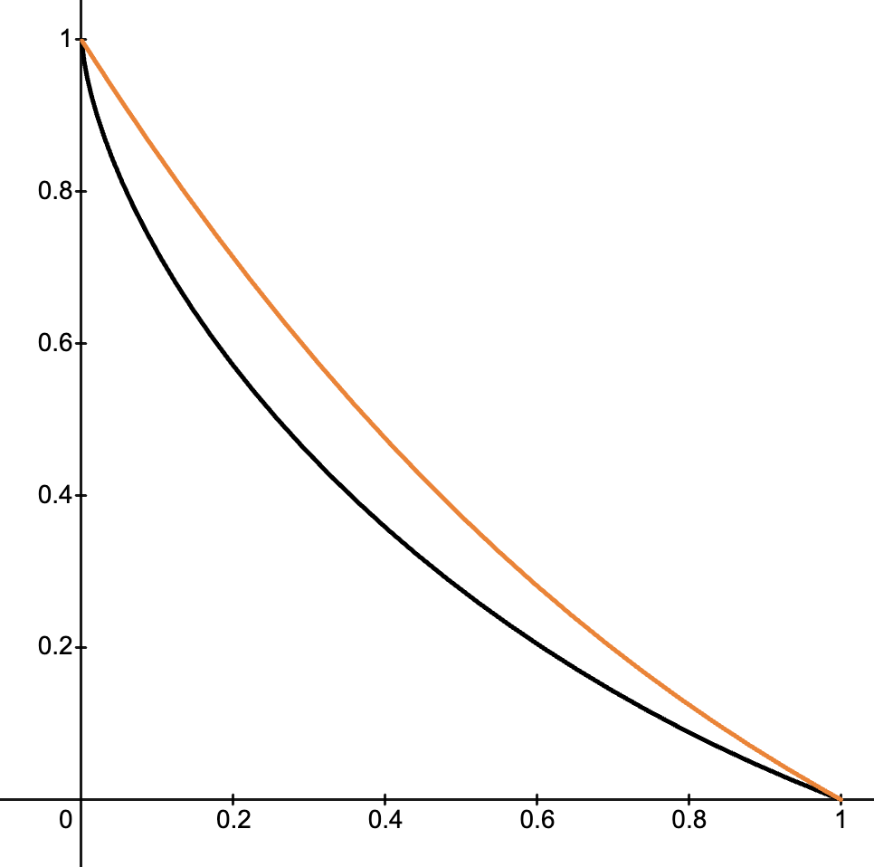
Third order polynomial
Similarly, this is the Plot of a third order approximation:

Slide 17
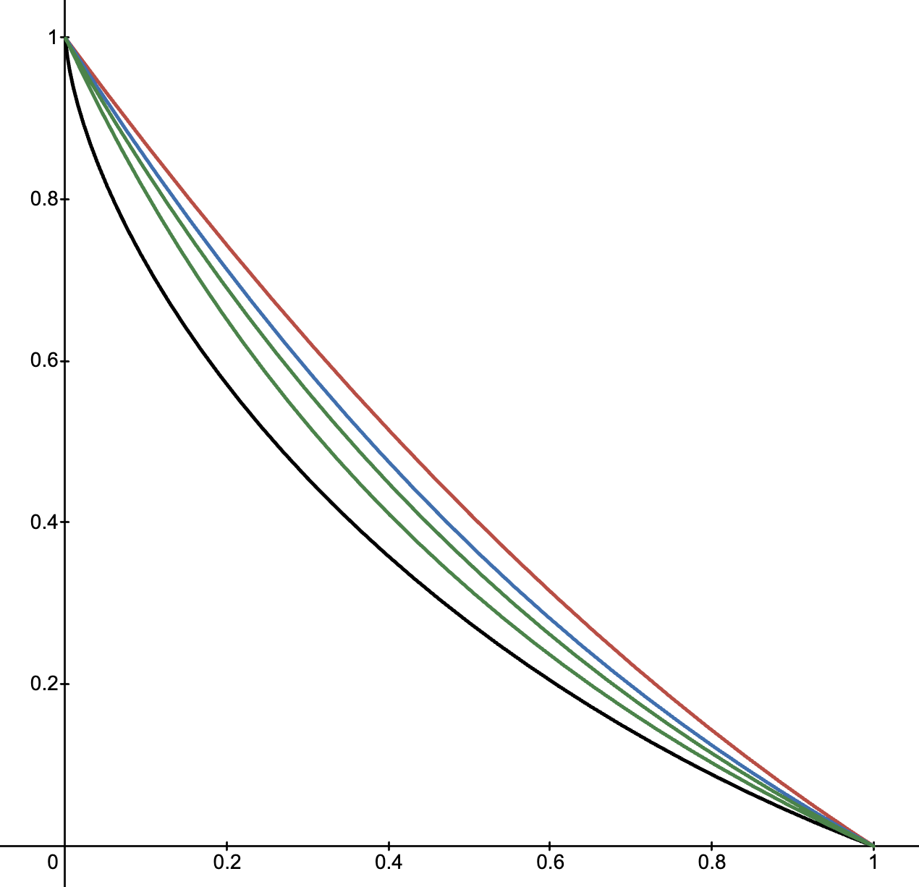
Plots of 2nd, 3rd, 4th and 7th orders

Slide 18
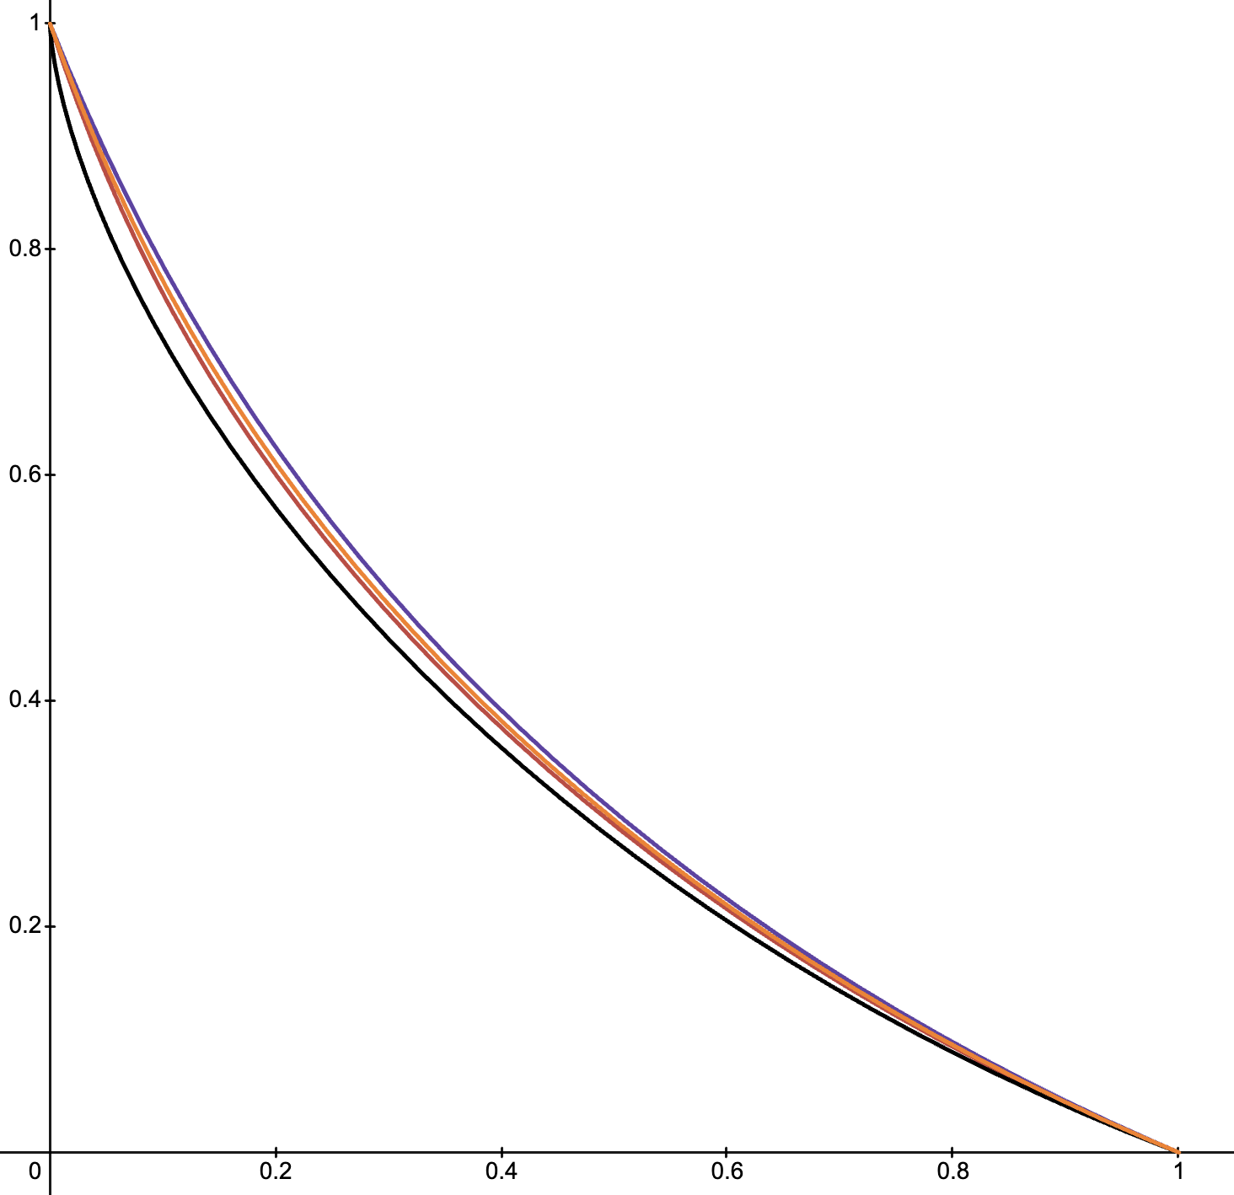
Plots of 11th, 15th and 20th orders

Slide 19
Future Work
Implement Interval Newton Raphson Algorithm to find rigorous bounds for the coefficients of Power Series and plot the Interval Valued curve solution of Brachistochrone Problem
Use our knowledge of the solution for Brachistochrone problem to implement an algorithm to solve general Boundary value ODE problems

Slide 20
Thank You

