Slide 1
Real-Time Social Media Sentiment Analysis Platform
End-to-end data pipeline built using ADF, ADLS Gen2, Databricks, Delta Lake, dbt, Airflow, Pytest and Slack
Meet the Team
Yash
Adarsh
Shaista
Nawaz
Sneha
Rakesh

Slide 2
Project Overview
The Challenge
Large Volumes
Data Quality Issues
Analysis Difficulty
Large volumes of social media data from multiple datasets
Raw data contains missing values, duplicates, and inconsistencies
Difficult to analyze sentiment, engagement, users, and trends directly from raw data
Our Solution
01
02
03
Azure Data Factory & ADLS Gen2
Databricks Medallion Architecture
Analytics & Data Quality
Ingest and store the social media datasets in a centralized data lake.
Process data through Bronze → Silver → Gold layers using PySpark.
Create clean Gold data for dashboards, with Pytest validation, Airflow orchestration, and Slack failure alerts.
Platform at a Glance
5
3
4+1
14
Datasets ingested
Medallion layers
Dimension & fact tables
Dashboard views

Slide 3
Technology Stack
Technology | Purpose
Microsoft Azure | Cloud Platform
Azure Data Factory (ADF) | Data Ingestion
Azure Data Lake Storage Gen2 | Storage
Azure Databricks + PySpark | Processing
Unity Catalog | Data Governance
Delta Lake | Storage Format
dbt | Transformation
Apache Airflow | Orchestration
Dashboards | Visualization
Pytest | Testing
Slack | Alerts

Slide 4
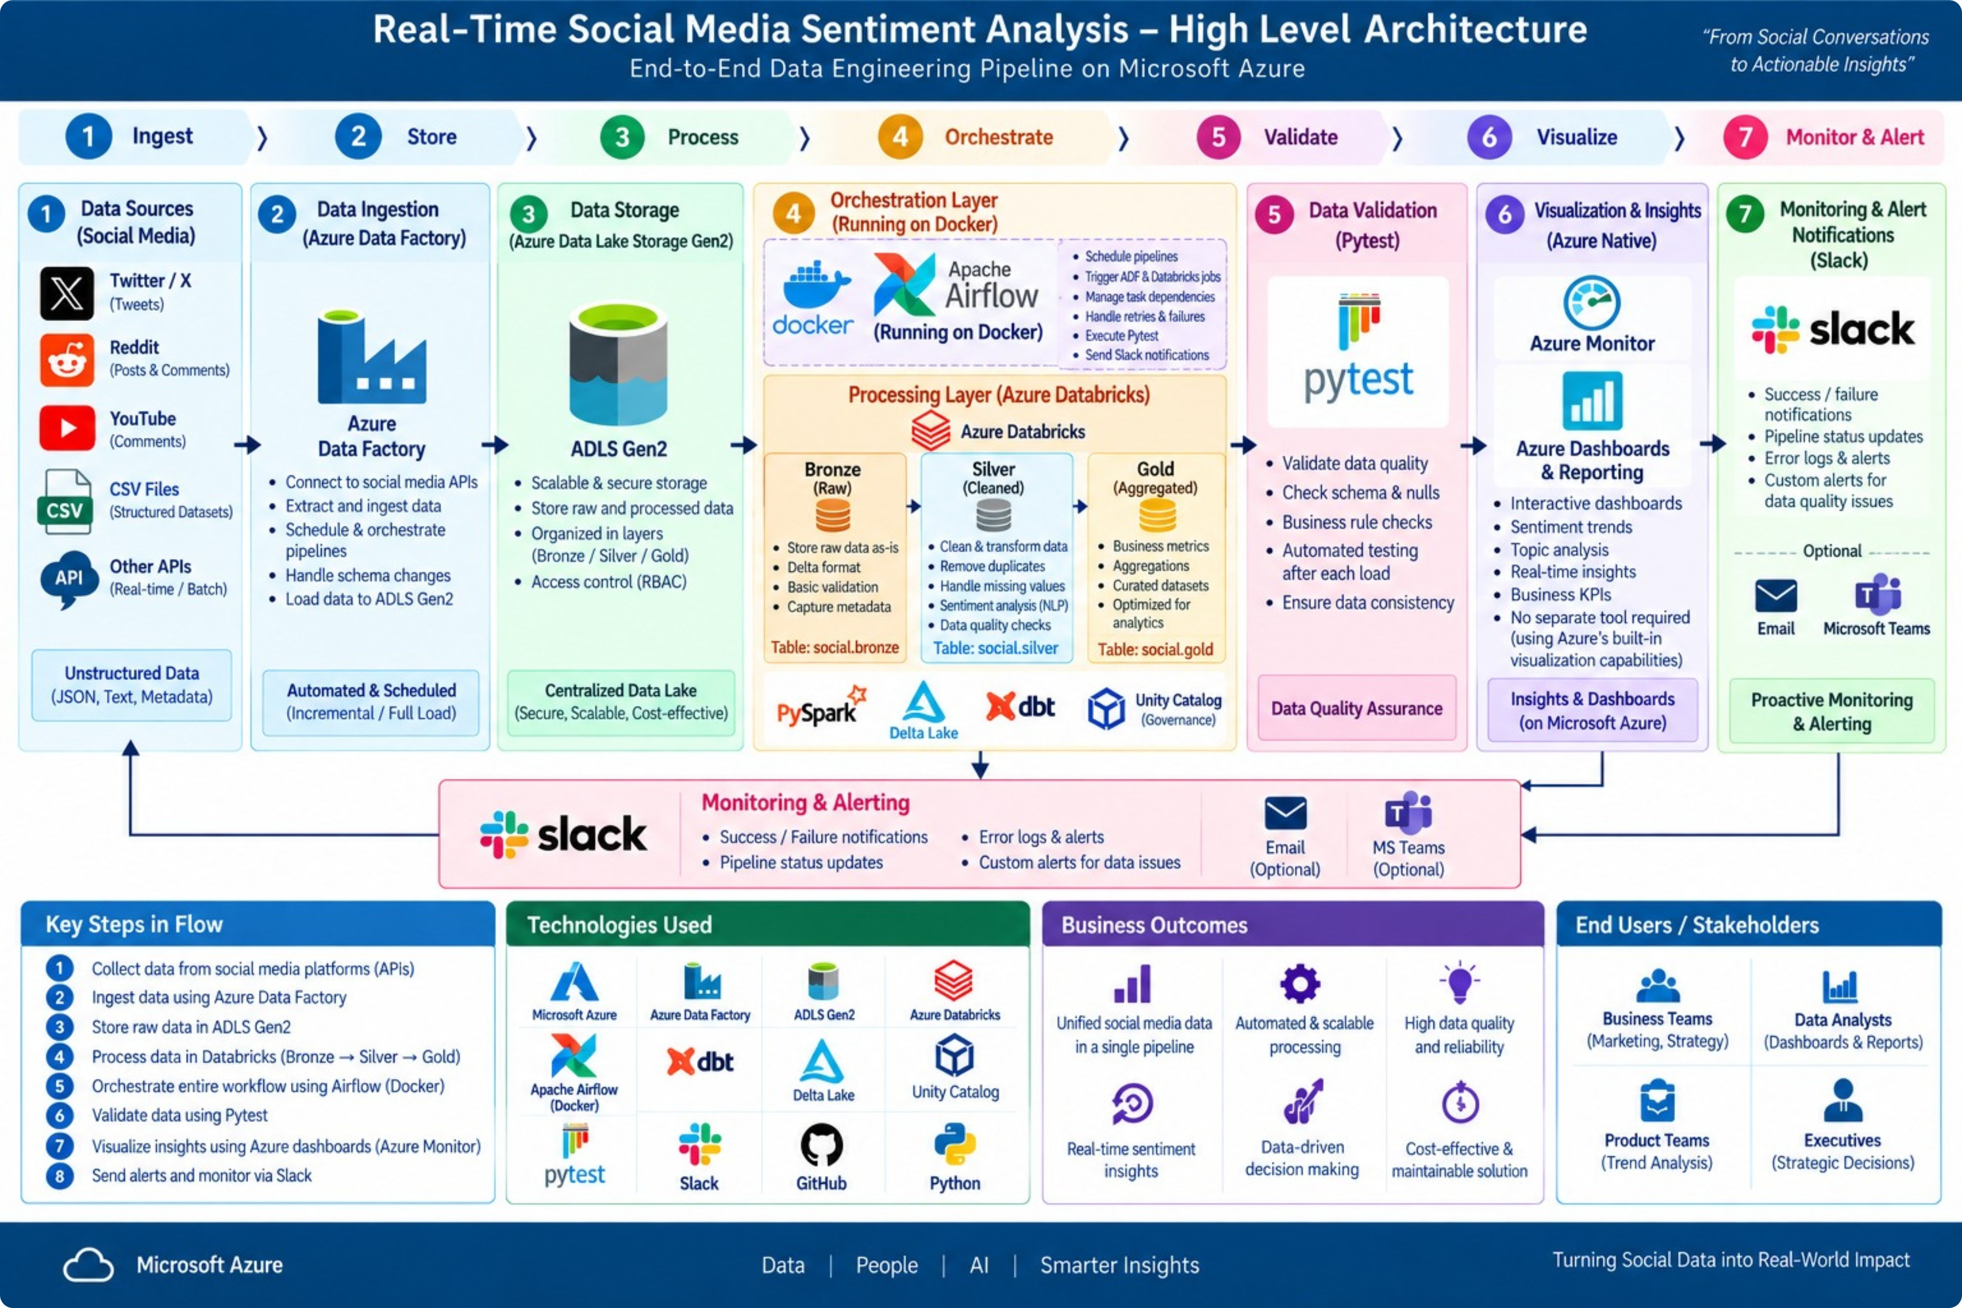
High-Level Architecture

Slide 5
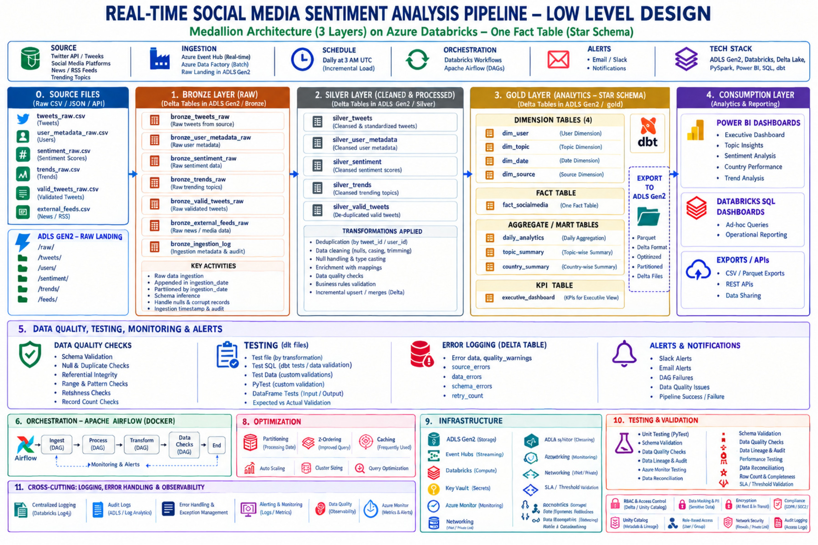
Low-Level Design

Slide 6
Bronze Layer — Raw Data
Source Datasets
ADF Ingestion
Five CSV datasets covering tweets, sentiment, trends, valid tweets, and user metadata.
Linked Services and a Copy Activity pipeline move CSV files into ADLS Gen2.
Parquet Format
Databricks & Unity Catalog
CSV files are converted to Parquet for efficient downstream processing.
Unity Catalog manages data access, allowing Databricks to securely access Parquet files and load Bronze tables.

Slide 7
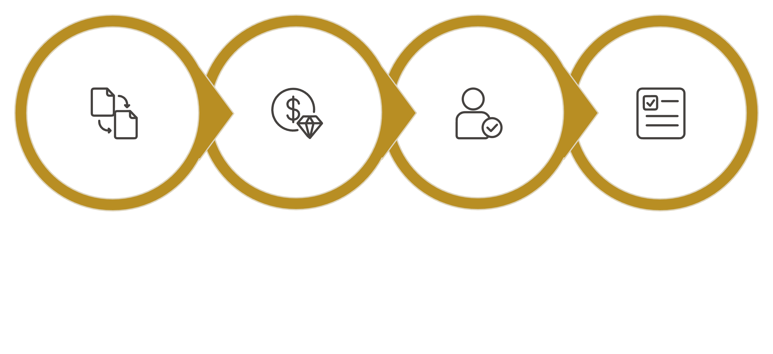
Silver Layer — Cleaned Data
Silver data becomes the single source of truth for all downstream Gold transformations.
What Happens in Silver
Duplicate Removal: Remove duplicate records carried over from the Bronze layer.
Null Handling: Apply defined cleansing rules to address missing values systematically.
Standardization: Normalize text, timestamps, identifiers and formats for consistency.
Data Validation: Apply validation and business rules to produce reliable Silver tables ready for Gold promotion.
Duplicate Removal
Null Handling
Standardization
Data Validation

Slide 8
Gold Layer — Analytics Ready
The Gold layer transforms cleaned Silver data into business-ready analytical models for reporting and dashboarding.
Analytical Models
Aggregations & KPIs
dbt models are created for sentiment, trends, tweets, engagement, and user metadata analysis.
Calculates metrics such as tweet count, sentiment distribution, engagement, impressions, and topic performance.
Dashboard Ready
Business Insights
Gold models provide structured data for creating AI-assisted dashboards in Databricks.
Helps users understand sentiment, engagement, trends, country-wise activity, and user insights for easier decision-making.

Slide 9
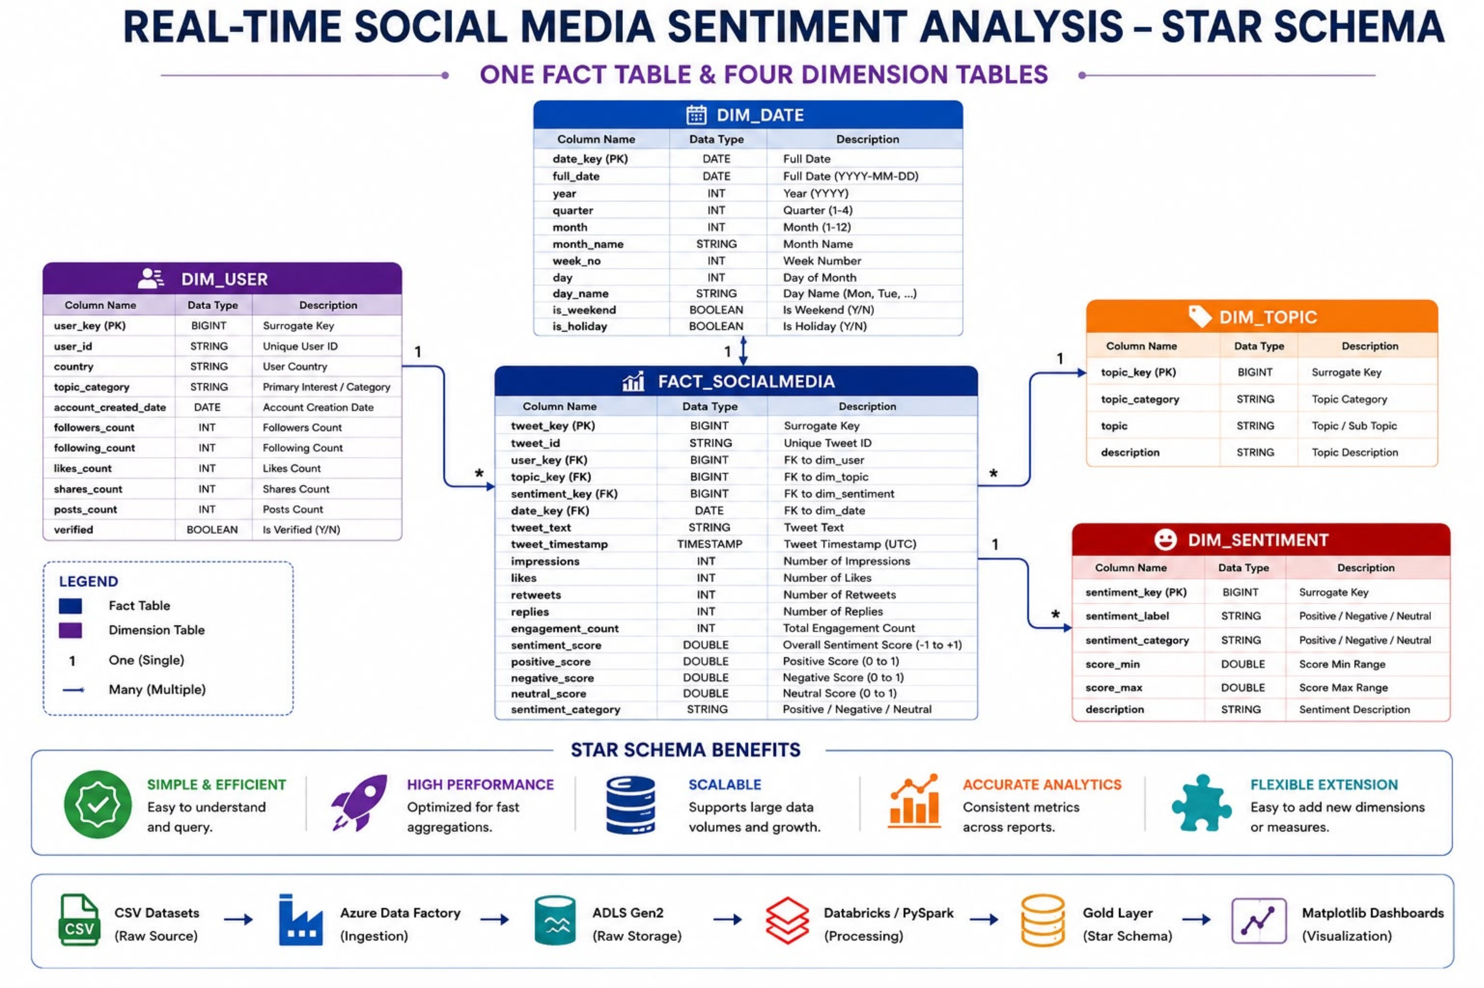
Star Schema

Slide 10
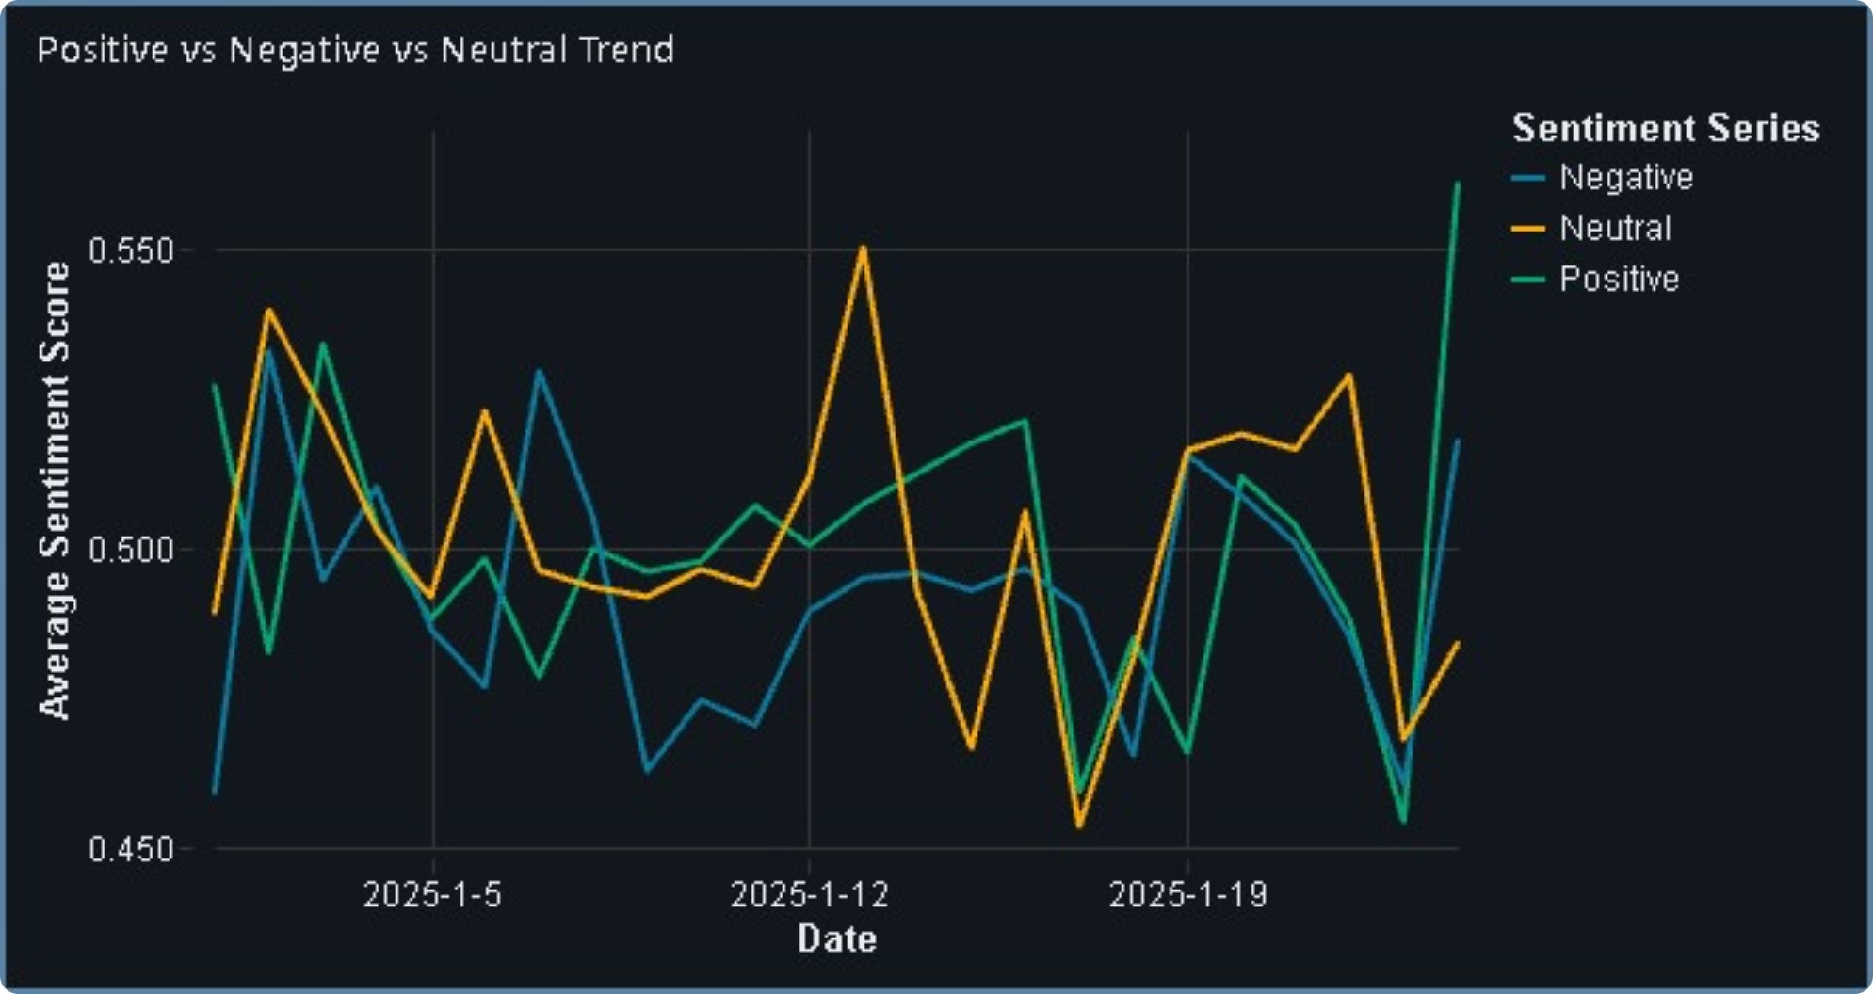
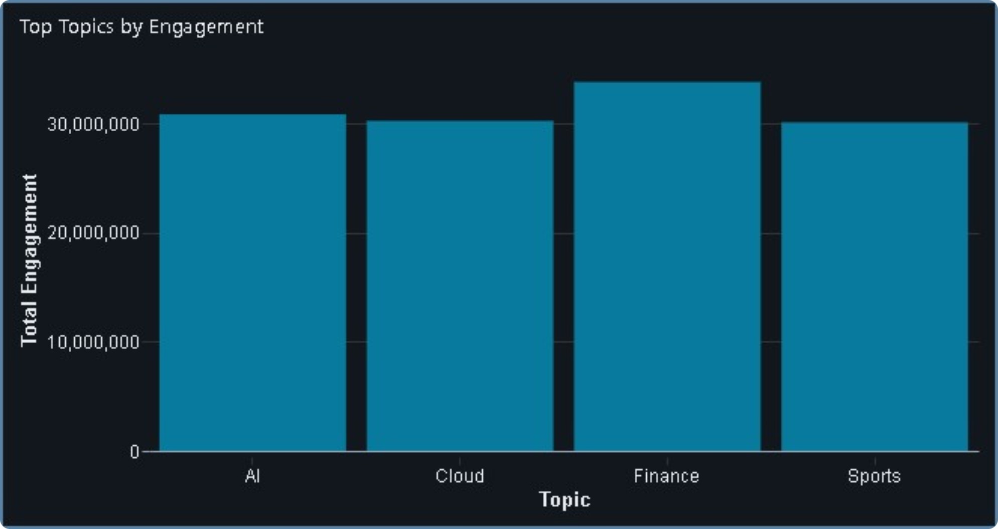
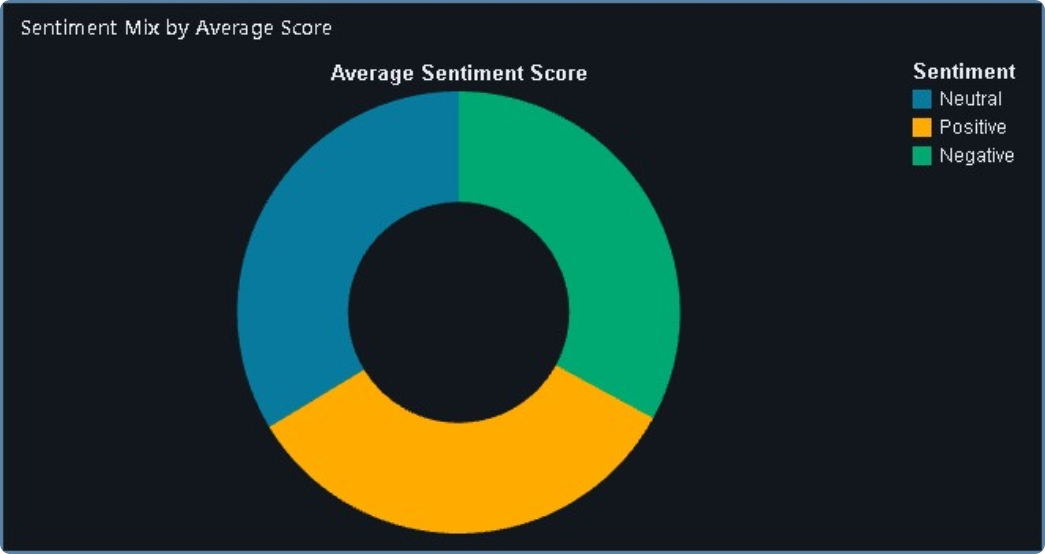
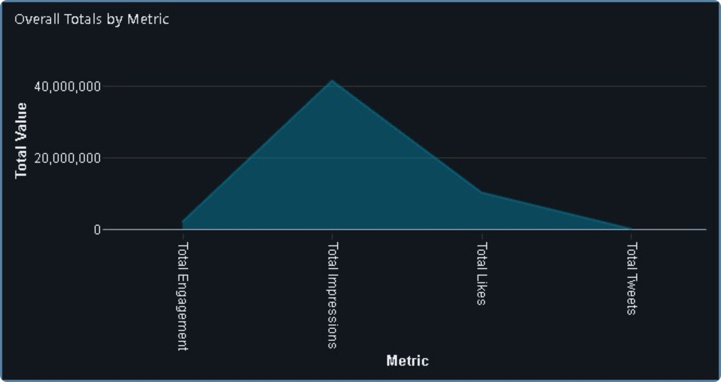
Analytics Dashboards
Sentiment & Engagement Analytics
Built in Databricks SQL using the Gold layer, these dashboards provide insights into sentiment trends, topic engagement, and overall social media performance.

Slide 11
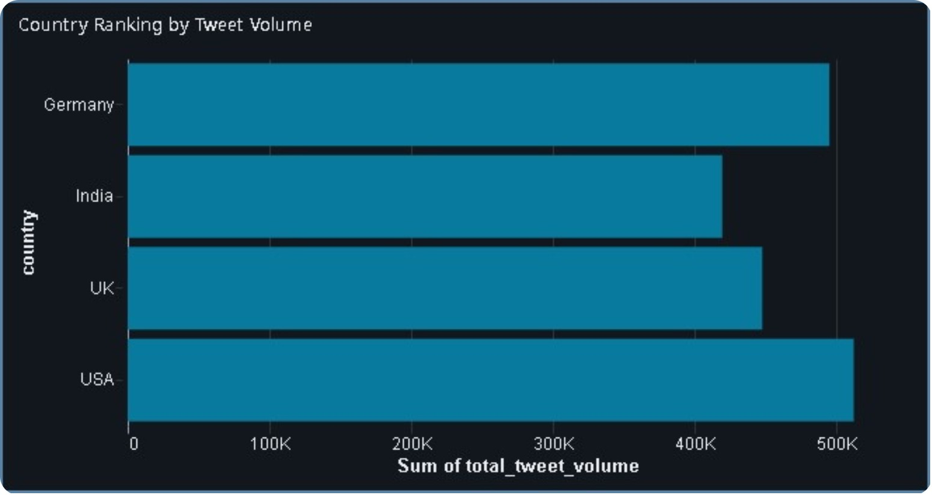
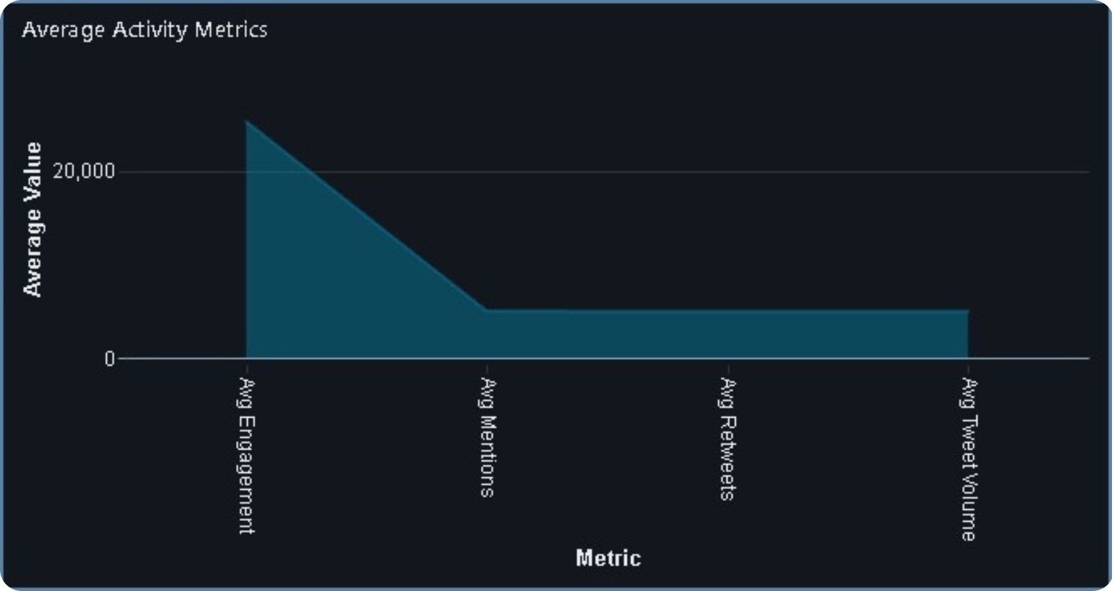
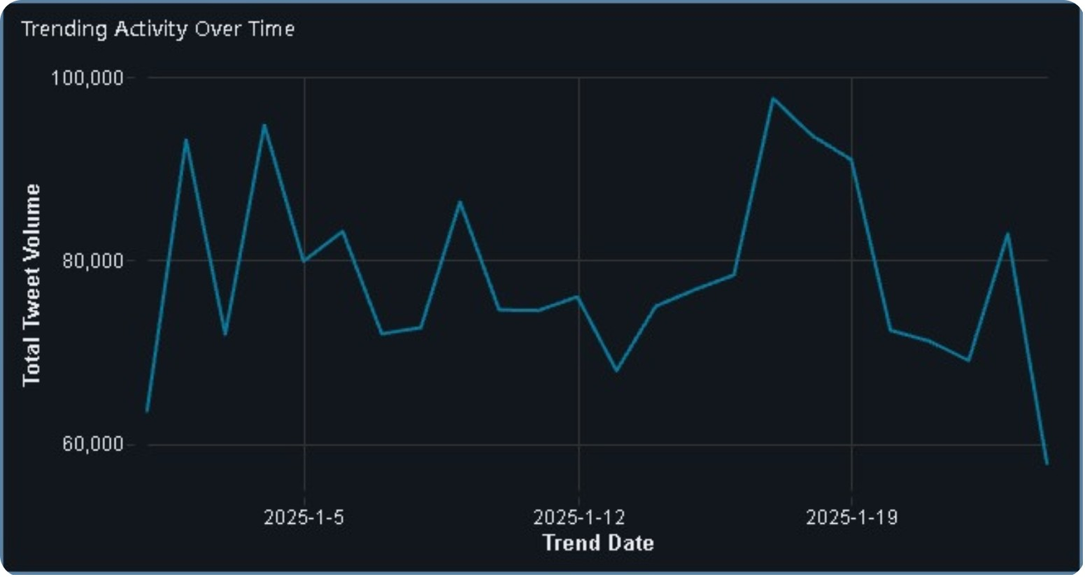
Trends & Activity Insights
Highlights changes in tweet activity over time, average engagement metrics, and tweet volume across countries to identify key social media trends.

Slide 12
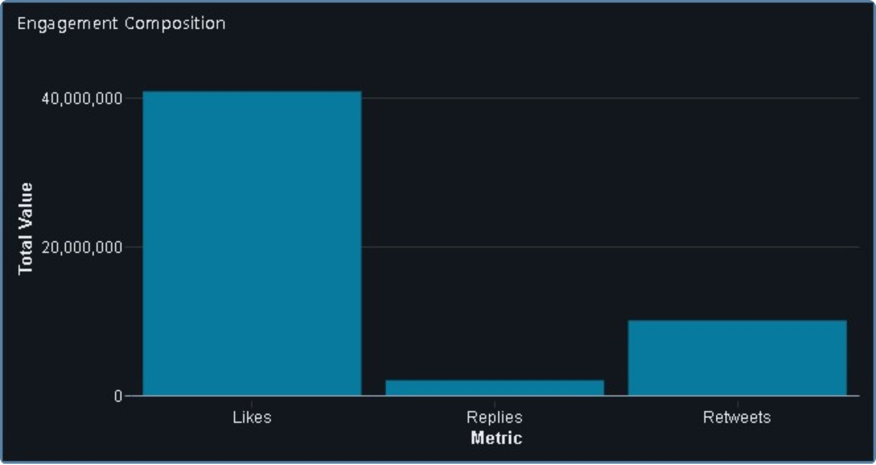
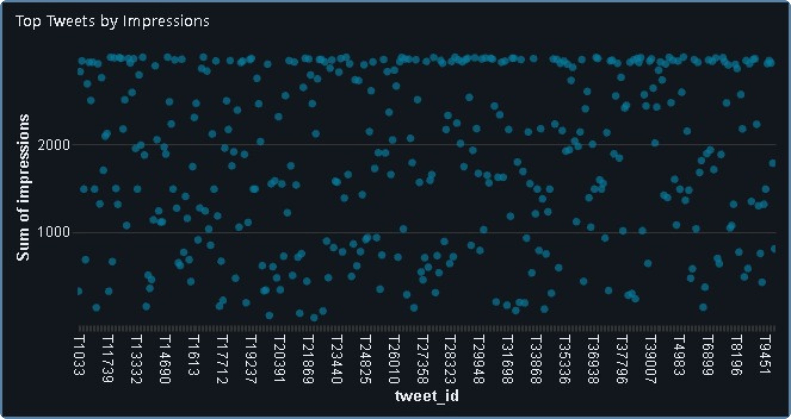
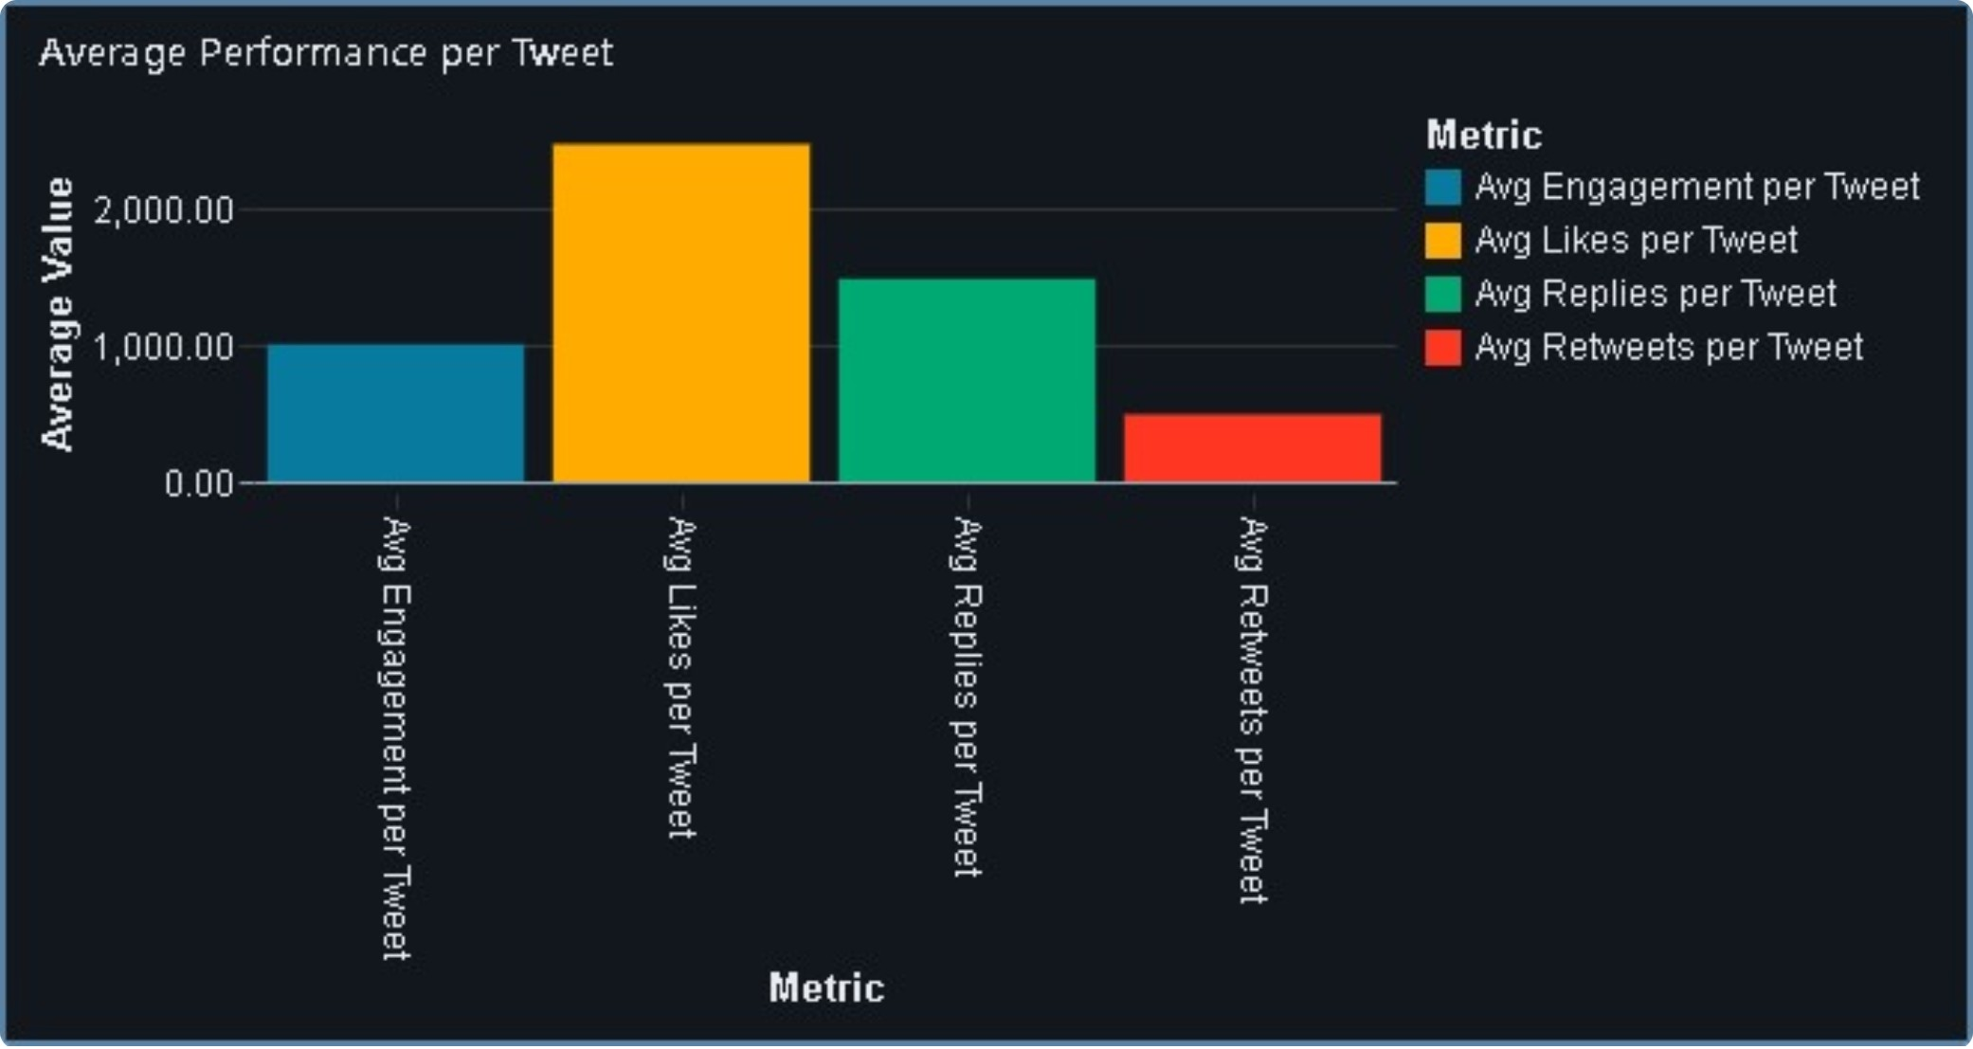
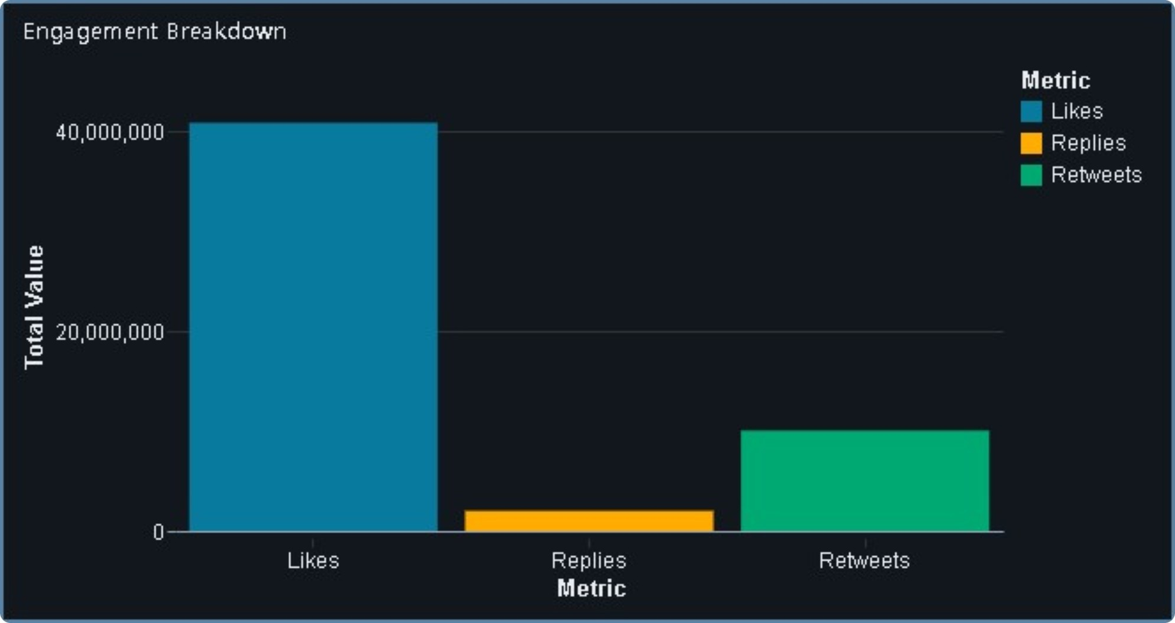
Tweet & Engagement Insights
Highlights tweet reach, engagement levels, and average interactions per tweet to understand overall content performance.

Slide 13
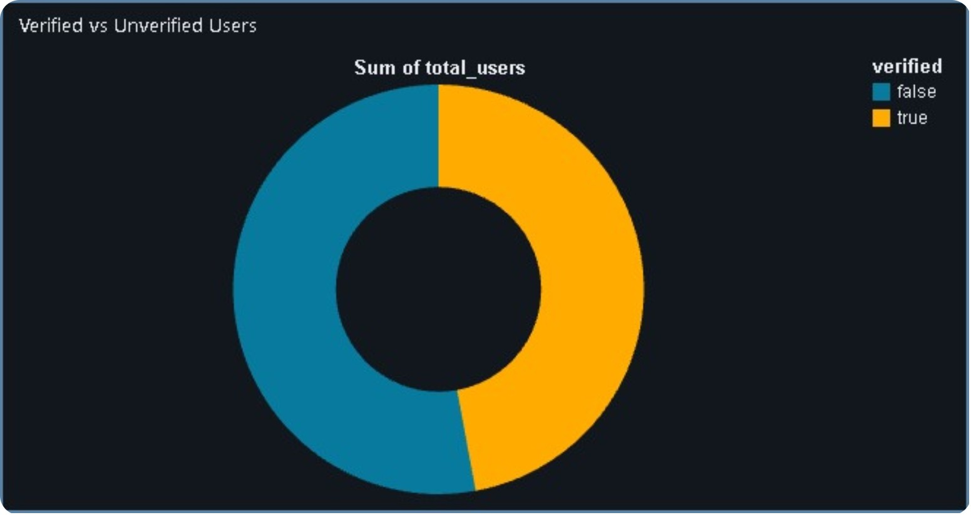
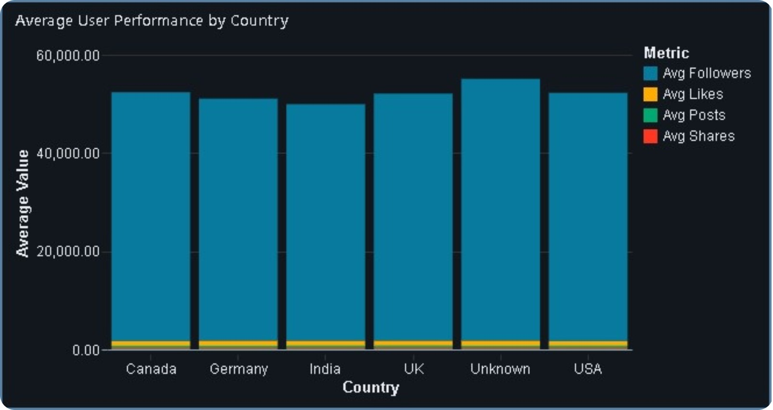
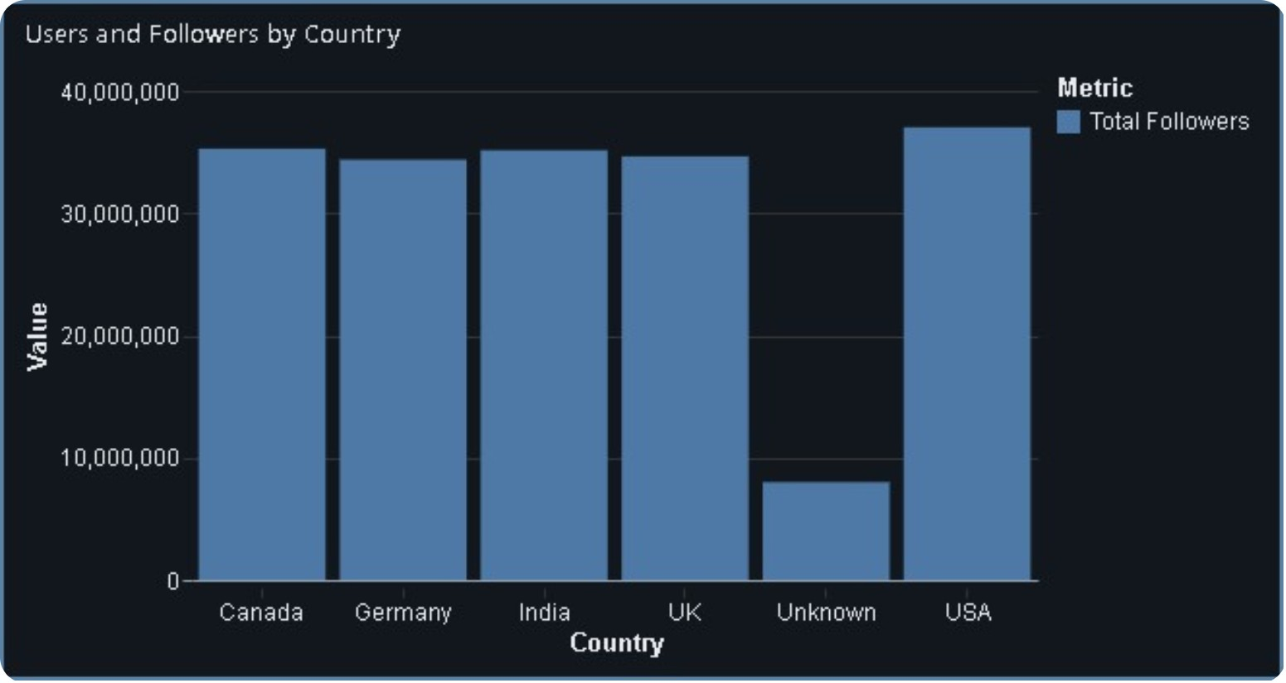
User & Follower Insights
Highlights follower distribution, user performance across countries, and the proportion of verified and unverified users.

Slide 14
Bronze, silver ,Gold Layer — pytest Checks
Automated pytest suite (test_bronze), (test_silver), (test_gold), run on every Bronze Delta table before data is promoted to Silver and run on every Silver Delta table before data is promoted to Gold.
Read the Files — Load and verify the source datasets from ADLS Gen2.
Table Validation — Confirm that the required Bronze, Silver and Gold tables are created successfully.
Row Count Check — Verify that tables contain records after ingestion and transformation.
Required Columns — Validate that all expected columns are present in each layer.
Duplicate Check — Identify and verify duplicate records, especially during Silver-layer cleansing.
Metadata Validation — Check important metadata and audit columns used during processing.
Null Check — Validate required fields and ensure missing values are handled correctly.
Data Type Validation — Confirm that columns have the expected data types after transformation.

Slide 15
Testing & Validation — Data Quality Checks
Every layer ships with its own pytest notebook (test_bronze, test_silver, test_gold) — 8 automated checks each, run before data is promoted downstream.
Bronze — Raw Ingestion Checks
Silver — Clean Data Checks
Gold — Business Layer Checks
Table existence
Row count validation
Required column validation
Null checks
Duplicate checks
Table and row count validation
Required column validation
Null validation
Duplicate validation
Data type validation
Fact and dimension table validation
Row count validation
Key relationship checks
Duplicate checks
Data type validation

Slide 16




Monitoring & Alerts
Pipeline Monitoring
Execution Logs
Track ADF, Databricks and Airflow pipeline runs
Maintain job status, errors and execution details
Failure Alerts
Data Quality Check
Send Slack notifications for pipeline failures
Pytest validates data across Bronze, Silver and Gold

Slide 17
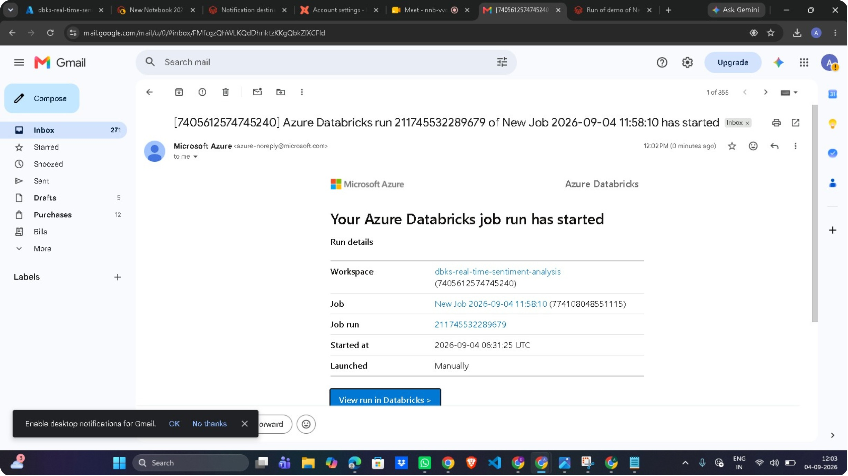
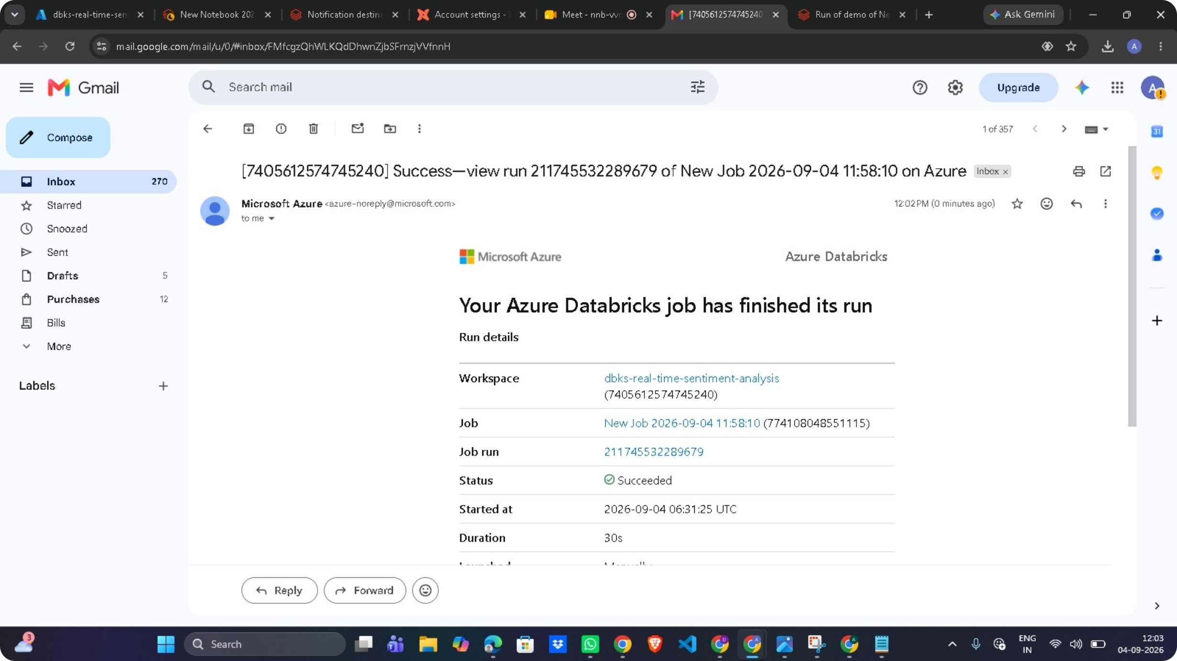
Slack Integration: Azure Databricks sends notifications when pipeline jobs start, complete successfully, or fail, helping the team monitor job execution and quickly respond to pipeline failures.

Slide 18
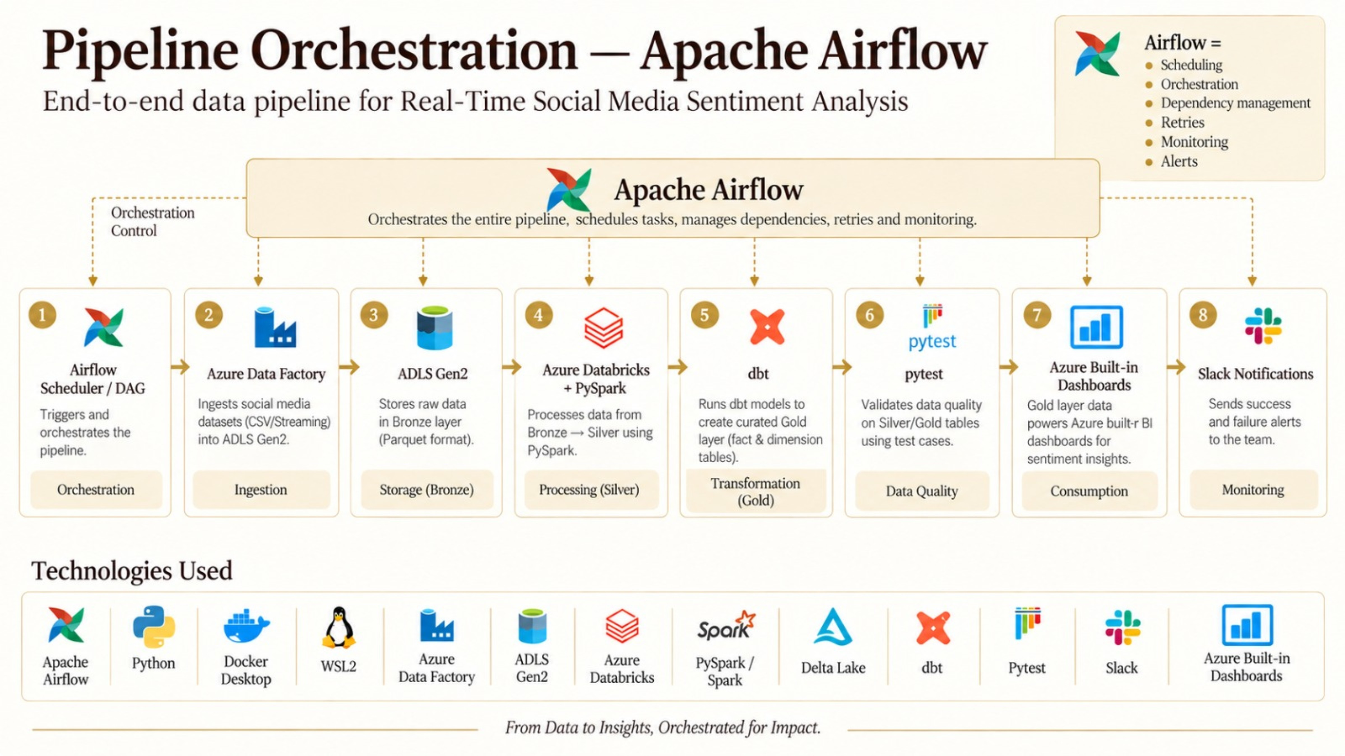
Pipeline Orchestration — Apache Airflow

Slide 19
Business Impact & Outcomes
Faster Insights
Better Data Quality
User & Topic Insights
Operational Efficiency
Analyze social media sentiment and trends efficiently.
Cleaned and validated data supports reliable analysis.
Identify sentiment patterns across users and topics.
Automated pipelines reduce manual data processing.

Slide 20
Thank You

