Slide 1



ALPINE ASCENTS
EXPLORE BEYOND THE ORDINARY
The Mountains
Are Calling.
A mountaineering education website: history, techniques, safety and records
Course CPISM Group D Batch Code 2606E2
PROJECT TEAM
YASHFEEN FATIMA
AREESHA JUNAID
ZAKRIA KHAN
MUHAMMAD HUZAIFA IQBAL
Student1733472
Student1733481
Student1734513
Student1733900
Notes:
Introduce the project: Alpine Ascents, a mountaineering education website built by Group D (course CPISM, batch code 2606E2). Introduce the four team members.

Slide 2
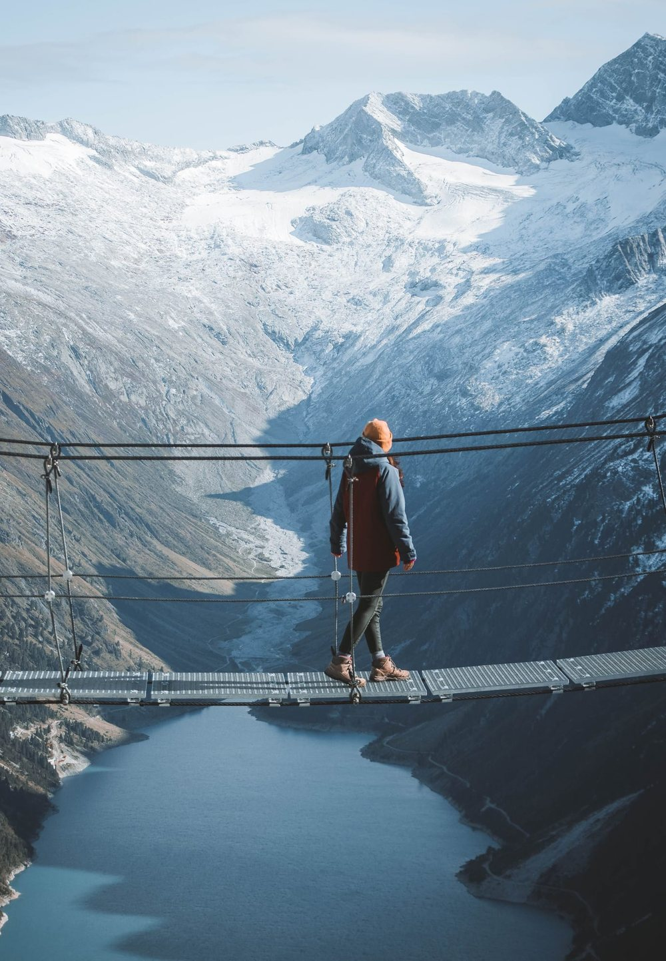

01 · PROJECT OVERVIEW
What Alpine Ascents is
An educational website on mountaineering: its history, styles, techniques, hazards, records and community, gathered into one connected site with photos, videos and interactive tools.
14
68 + 12
16
pages, one menu
photos and videos
climbing clubs mapped
PROBLEM STATEMENT
Mountaineering has no single rule book, so beginners piece it together from scattered sources, and for the untrained it can be dangerous. There is no one trusted place that teaches the history, the skills and the risks together.
Alpine Ascents · Group D · CPISM
02 / 06
Notes:
Overview: Alpine Ascents is an educational site with 14 pages, 68 photos, 12 videos and a world map of 16 climbing organisations. Problem: mountaineering knowledge is scattered and has no governing rule book, so beginners have no single trusted place to learn history, skills and risks together.

Slide 3
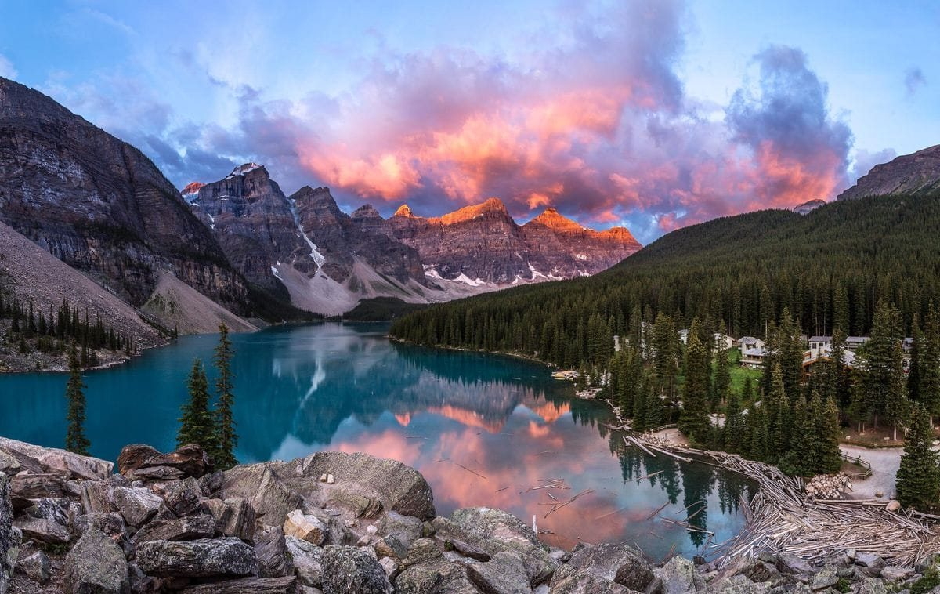
02 · SOLUTION AND OBJECTIVES
One website, every side of the mountain
Project Objectives
01
Teach the history, styles and techniques of mountaineering.
Alpine Ascents is a single, trusted guide on the web. It brings history, techniques, shelters and safety together, so a learner can go from curiosity to prepared climber in one place.
02
Put safety first with hazards, a checklist and emergency steps.
03
Celebrate records, including the five 8,000 m peaks in Pakistan.
04
Build a community with a clubs map, news and feedback.
LEARN · PREPARE · EXPLORE
Alpine Ascents · Group D · CPISM
03 / 06
Notes:
Solution: one clear website that covers history, equipment, techniques, shelters and safety. Objectives: teach, put safety first, celebrate records (five of the fourteen 8,000 m peaks are in Pakistan) and build a community.

Slide 4
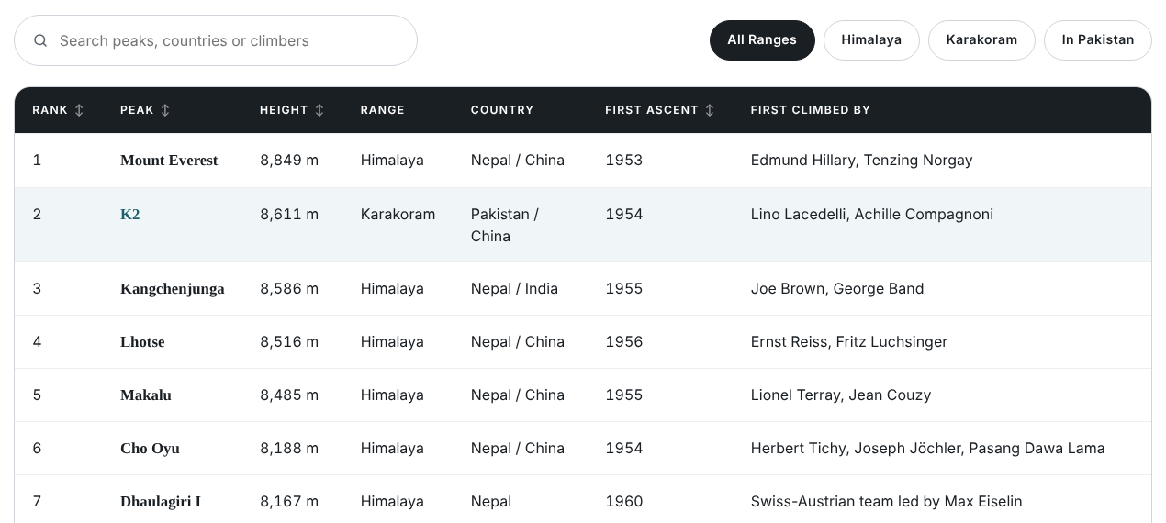



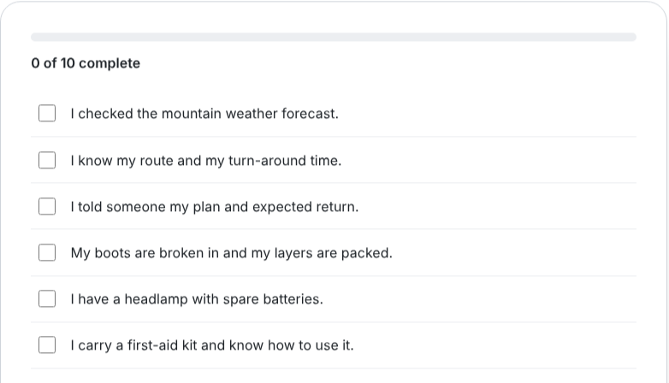

03 · KEY FEATURES AND TECHNOLOGY
Built to explore, simple to run
Plain HTML, CSS and JavaScript. No build step and no server code.
Key features
Search, filter and sort tables
Checklist that saves your ticks
Clubs map with distance lookup
Shelter booking with live total
Technology
HTML5
CSS3
JavaScript
Live pages from the site: the 8,000 m peaks table and the pre-climb checklist
Leaflet maps
localStorage
Alpine Ascents · Group D · CPISM
04 / 06
Notes:
Features: searchable and sortable tables on the Records page, a safety checklist that remembers ticks in the browser, a Leaflet and OpenStreetMap clubs map with a find-clubs-near-me button, and a shelter booking form with a live price total. Technology: plain HTML5, CSS3 and JavaScript, no build step or server code; visitor details are kept in the browser (localStorage) only.

Slide 5
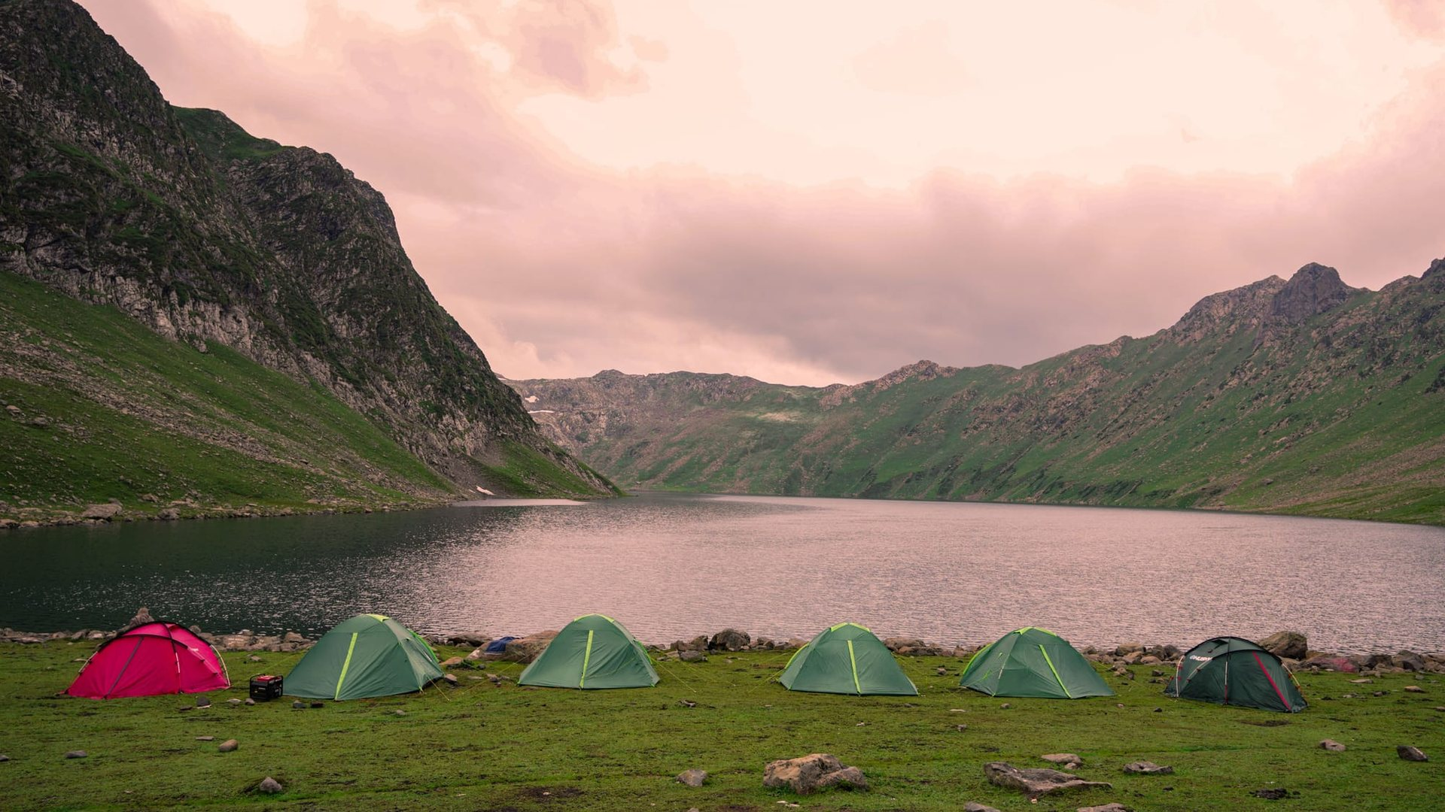
04 · CHALLENGES AND BENEFITS
Hurdles we cleared
Benefits and Target Users
1
A lot of content across 14 pages
One shared stylesheet and one script per page keep the look and menu consistent.
WHO IT IS FOR
Beginners and trekkers
Students and researchers
Campers planning shelters
Climbing clubs and fans
2
Phones, tablets and desktops
The layout adapts, and below about 1,120 px the menu folds into a button.
3
Photos and maps need the internet
Local photos where possible, plus a troubleshooting table in the user guide.
WHAT THEY GAIN
Trusted facts in one place
Safer trip preparation
Access on any device
4
Protecting visitor details
Everything stays in the visitor’s own browser. Nothing is sent anywhere.
Notes:
Challenges: managing content across 14 pages, responsive design, dependence on internet-loaded photos and maps, and keeping visitor data private. Target users: beginners, students, campers and clubs. Benefits: trusted information, safer preparation and access on any device.

Slide 6
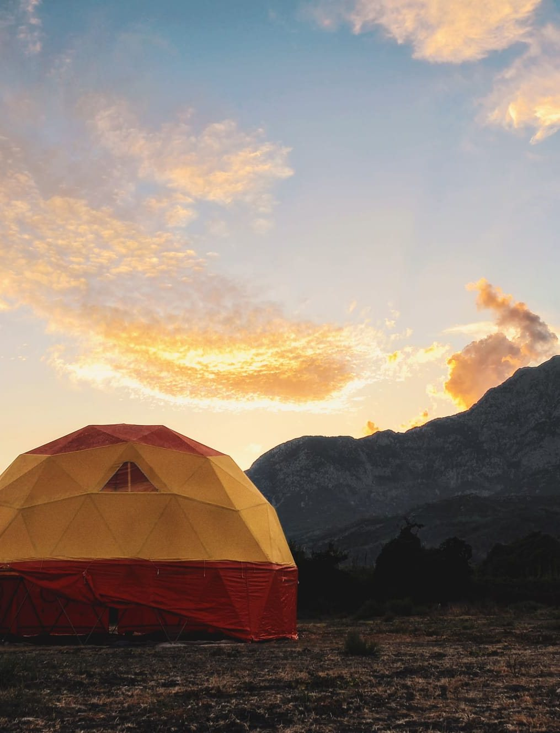
05 · FUTURE SCOPE AND CONCLUSION
Future scope
Live weather and route data for each peak
User accounts and saved trips with a real database
Real shelter booking and payments
Urdu and other languages, plus a mobile app
Conclusion
Alpine Ascents turns scattered mountain knowledge into one clear, safe and interactive guide. Reach the summit, and return safely.
Thank you
Group D · CPISM · 2606E2
Notes:
Future scope: live weather and route data, user accounts with a real database, real booking and payments, and more languages including Urdu plus a mobile app. Conclusion: Alpine Ascents turns scattered mountain knowledge into one clear, safe and interactive guide. Thank the audience and invite questions.

