Slide 1



Financial Marketing Using PowerBI

Slide 2

Learning Objectives
By the end of this presentation, you will be able to:
Understand the Dataset – Explore the structure of the Financial Marketing dataset, including key columns and their significance.
Perform Data Analysis – Analyze financial metrics such as Total Sales, Profit, COGS, Discounts, and more to uncover insights.
Visualize Key Trends – Use Power BI charts (Bar, Pie, Line, Ribbon, Area) to represent sales, profit, and market distribution effectively.
Identify Business Insights – Interpret the results to understand customer behavior, pricing strategies, and discount impacts on revenue.
Make Data-Driven Decisions – Leverage analytics to suggest strategies for optimizing financial performance and marketing effectiveness.
GOAL
Source :
www.freepik.com/

Slide 3
Tools and Technology used:
Power BI – For creating interactive data visualizations and reports.
Microsoft Excel – Used for initial data storage, cleaning, and preprocessing.
Data Analysis Expressions (DAX) – For performing calculations and aggregations in Power BI.
Power Query – For data transformation, merging, and cleaning before visualization.
Data Modeling – Used to establish relationships between different tables in the dataset.

Slide 4
Methodology
Our approach to analyzing the Financial Marketing Dataset follows a structured process:
Data Collection & Understanding
Loaded the Financial Marketing dataset into Power BI.
Reviewed key columns such as Segment, Country, Product, Discount Band, Sales, Profit, COGS, etc..
Data Cleaning & Transformation
Handled missing values and ensured data consistency using Power Query.
Converted date columns for proper chronological analysis.
Created new calculated fields where necessary (e.g., Average Sales Price, Profit Margins).
Data Modeling & Relationships
Established relationships between tables to enable effective data analysis.
Used DAX functions for advanced calculations and aggregations.
Data Visualization & Analysis
Created various charts to present insights, such as:
Bar Chart – Total Units Sold by Product
Pie Chart – Total Gross Sales by Country
Line Chart – Total Profit by Month
Ribbon Chart – Total COGS by Discount Band Across Countries
Card Visuals – Key Metrics like Avg Sales Price, Total Profit, etc.

Slide 5
Problem Statement:
The Financial Marketing Dataset is analyzed to derive key business insights using Power BI. Below are the problem statements addressed through various visualizations:
1. Total Units Sold by Each Product
Objective: Identify which products have the highest and lowest sales volume.
Visualization: Bar Chart (X-Axis: Product, Y-Axis: Total Units Sold)
2. Total Gross Sales by Each Country
Objective: Understand revenue contribution from different countries.
Visualization: Pie Chart (Legend: Country, Values: Total Gross Sales)
3. Total Profit by Each Month
Objective: Analyze profit trends and seasonality over time.
Visualization: Line Chart (X-Axis: Month, Y-Axis: Total Profit)

Slide 6
4. Average Manufacturing Price of Each Product
Objective: Compare manufacturing costs across different products.
Visualization: Clustered Bar Chart (X-Axis: Product, Y-Axis: Avg Manufacturing Price)
5. Total Profit by Each Segment
Objective: Evaluate profitability across different market segments.
Visualization: Pie Chart (Legend: Segment, Values: Total Profit)
6. Key Financial Metrics using Card Charts
Objective: Display important summary metrics.
Visualization: Card Visuals (Average Sales Price, Average Manufacturing Price. Total COGS, Total Profit)
7. Five Additional Visuals for Deeper Insights:
Total Sales by Segment (Clustered Bar Chart),
Total Profit by Country & Segment (Stacked Column Chart),
Trend of Total Sales Over Time (Line Chart),
Percentage Share of Discounts by Discount Band (Donut Chart),
Trend of Total Profit Over Time (Area Chart),
Total COGS by Discount Band Across Different Countries (Ribbon Chart)

Slide 7
Solution:
Based on the Financial Marketing Dataset analysis, the following solutions address key business insights derived from the visualizations:
1. Total Units Sold by Each Product
Insight: Identified best-selling and least-selling products.
Solution: Optimize inventory and focus on promoting lower-performing products to improve sales.
2. Total Gross Sales by Each Country
Insight: Determined which countries generate the highest revenue.
Solution: Allocate more marketing and sales efforts to high-performing regions while strategizing for underperforming regions.
3. Total Profit by Each Month
Insight: Recognized seasonal trends and fluctuations in profit.
Solution: Adjust pricing, promotions, and stock levels based on peak and low seasons to maximize profit.
4. Average Manufacturing Price of Each Product
Insight: Compared manufacturing costs across different products.
Solution: Identify cost-saving opportunities in production without compromising quality to improve profit margins.

Slide 8
5. Total Profit by Each Segment
Insight: Analyzed which customer segments are the most profitable.
Solution: Focus marketing strategies on high-profit segments and optimize offerings for lower-profit segments.
6. Key Financial Metrics using Card Charts
Insight: Provided an overview of critical financial performance indicators.
Solution: Use these KPIs to monitor business health and adjust financial strategies accordingly.
7. Five Additional Visuals for Deeper Insights:
Total Sales by Segment:
Helps in segment-wise revenue tracking.
Total Profit by Country & Segment:
Guides geographic and segment-focused financial strategies.
Trend of Total Sales Over Time:
Helps in forecasting and strategic planning.
Percentage Share of Discounts by Discount Band:
Analyzes the impact of discounting strategies.
Trend of Total Profit Over Time (Area Chart):
Helps track profit growth, stability, and decline over time.
Total COGS by Discount Band Across Different Countries
(Ribbon Chart): Analyzes the impact of discount bands on cost across countries.

Slide 9
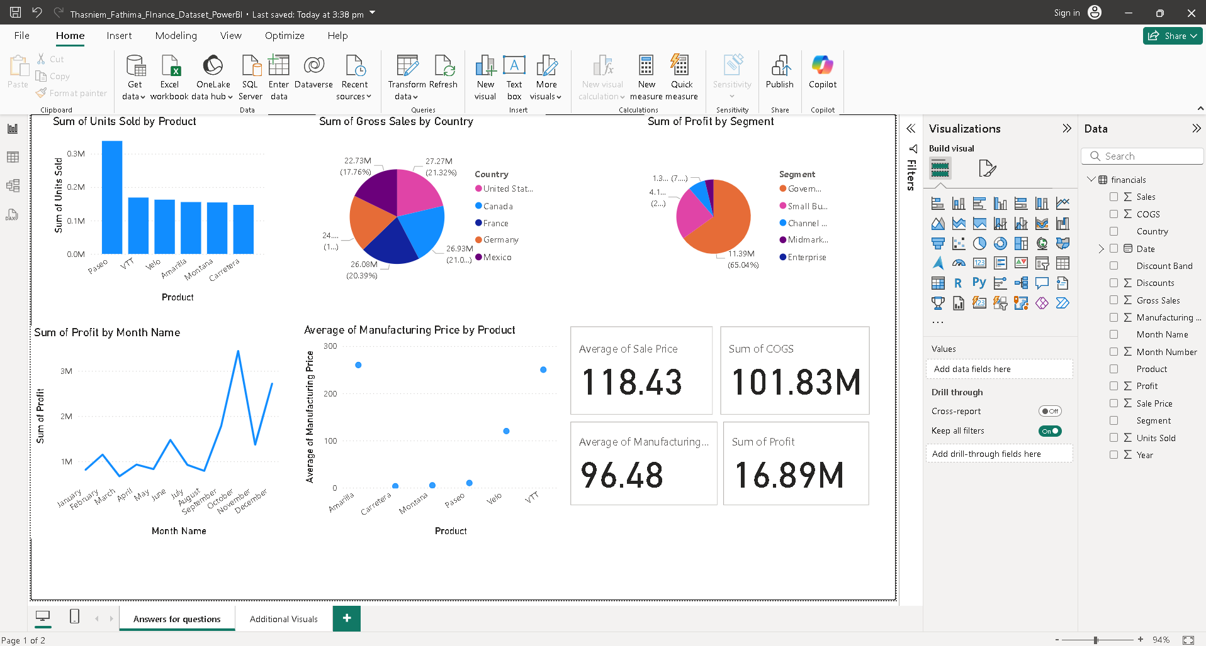
Screenshot of Output:

Slide 10
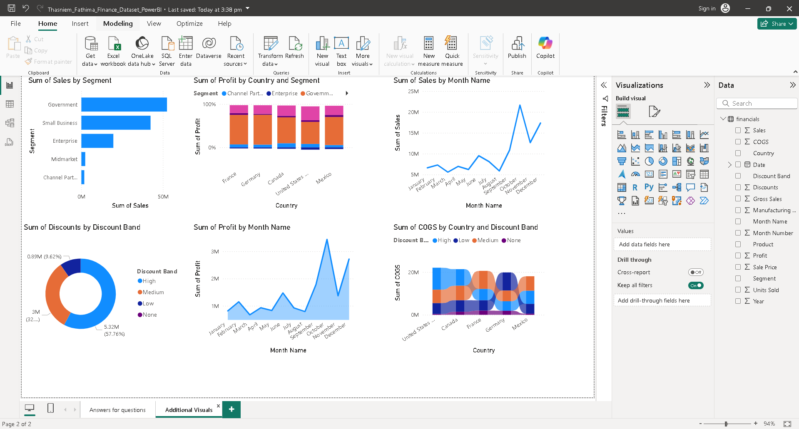

Slide 11
Conclusion:
Sales and profit trends vary across products, countries, and time periods.
High-performing products and regions should be prioritized for marketing and inventory management.
Seasonal profit fluctuations highlight the need for strategic pricing and promotions.
Discount strategies significantly impact costs and profitability across different regions.
Data-driven insights help in optimizing financial planning, sales strategies, and overall business growth.
Leveraging data visualization in Power BI enables better decision-making, helping businesses optimize sales, pricing, and financial strategies for sustainable growth.

