Slide 1

Disneyplus Shows and Movies: EDA and Data Visualization
Prepared By
Yash Pandey

Slide 2

Project Description
Explore the captivating realm of DisneyPlus movies and TV shows.
Discover crucial details: titles, directors, casts, release years, ratings, and durations.
Begin with dataset loading and innovative feature creation.
Reveal pivotal insights, trends, and relationships within DisneyPlus content.
Gain valuable insights into audience preferences and engagement.
Guide strategic decisions and content curation endeavors.

Slide 3

Table Of Content
1 Understanding the Scope
2 Variable Description
3 Data Understanding
4 Data Cleaning
5 Data Visualization

Slide 4

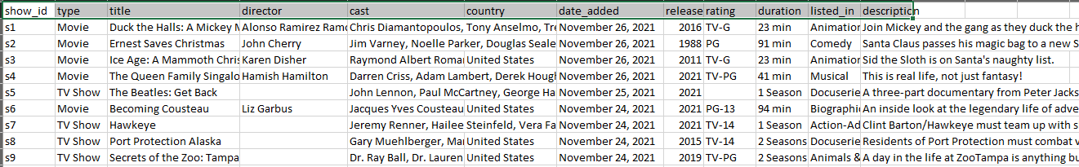
Understanding the Scope
The goal of this analysis is to explore the collection of movies and TV shows offered on DisneyPlus. Through an examination of factors such as titles, directors, release years, ratings, and durations, we endeavor to unveil insights and patterns within Disney's cinematic repertoire.
Variable Description
show_id: Unique identifier for each movie or TV show.
type: Indicates whether the entry is a movie or a TV show.
title: The title of the movie or TV show.
director: The director(s) of the movie or TV show.
cast: The cast members featured in the movie or TV show.
country: The country or countries where the movie or TV show was produced.
date_added: The date when the movie or TV show was added to DisneyPlus.
release_year: The year of release for the movie or TV show.
rating: The rating assigned to the movie or TV show (e.g., G, PG, PG-13).
duration: The duration of the movie or TV show (in minutes).
listed_in: The genre(s) or category/categories associated with the movie or TV show.
description: A brief description or summary of the movie or TV show.

Slide 5

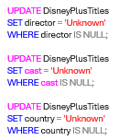
Data Cleaning
Removing Duplicates: Detect and eliminate duplicate entries to ensure data integrity and accuracy.
Handling Missing Values: Identify and address missing values in the dataset through imputation or removal.

Slide 6
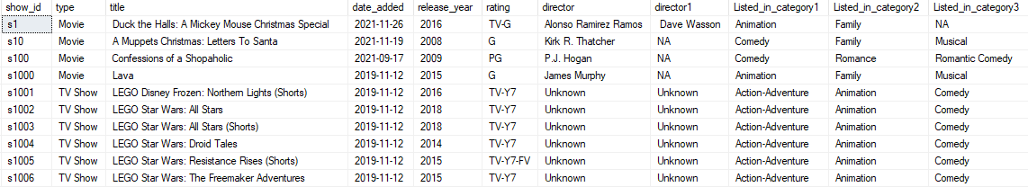
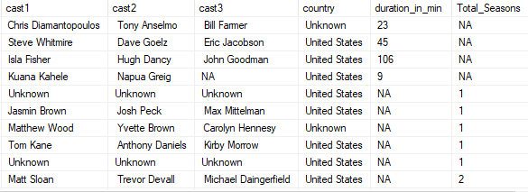
Standardizing Formats: Standardize variable formats, such as dates, ratings, and durations, to enhance analysis consistency
Ensuring Data Consistency: Verify consistency in categorical variables, such as genres, countries, director and cast to maintain data coherence.
After standardizing the director, listed_in, and cast columns, we'll segment the DisneyPlusTitles table into two sub-tables: DisneyPlusTitles_TV_Shows and DisneyPlusTitles_Movies. This will enable us to conduct a thorough analysis on a well-structured and clean dataset.
.

Slide 7
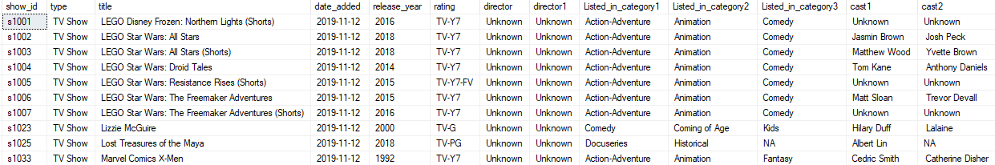
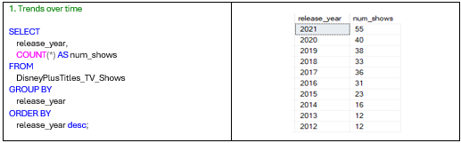
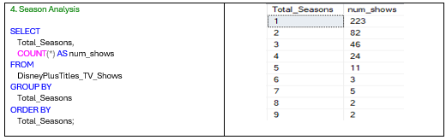
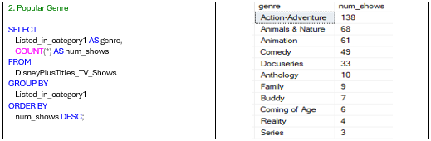
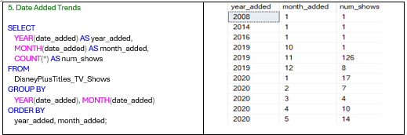
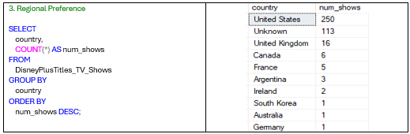
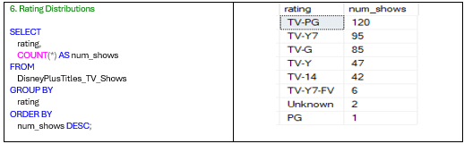
DisneyPlusTitles_Tv_Shows

Slide 8
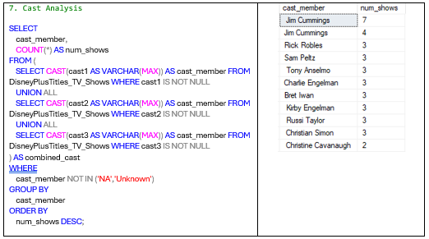

Slide 9
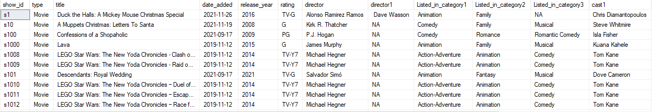
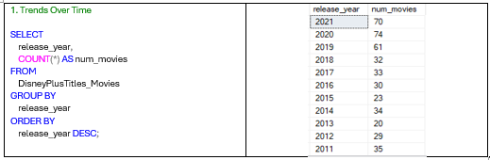
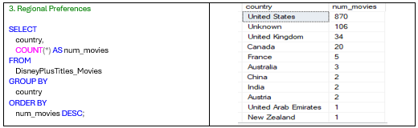
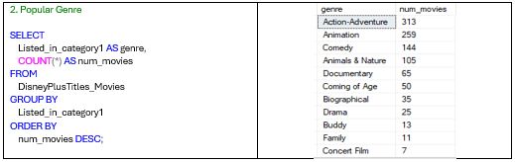
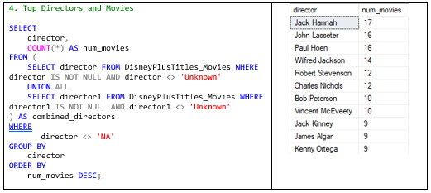
DisneyPlusTitles_Movies

Slide 10
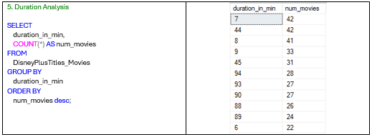
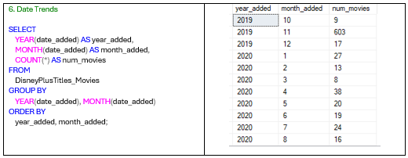

Slide 11
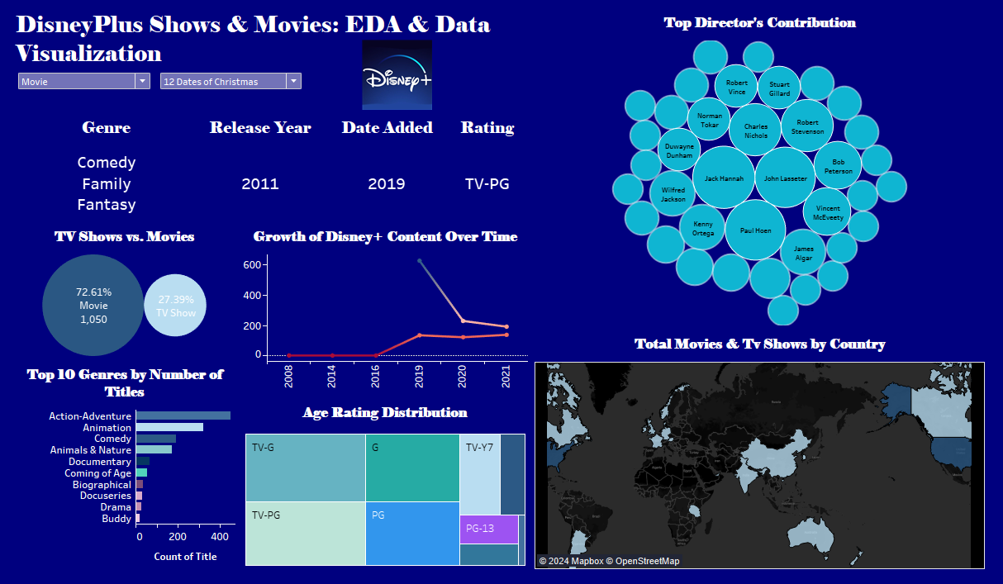

Slide 12
Thank You

