Slide 1
AI-Powered NCERT PCM Tutor
A Retrieval-Augmented Generation (RAG) Project
Developed to solve AI Hallucinations for Students

Slide 2
1. The Problem Statement
Students increasingly use ChatGPT for doubts, but face two issues:
  1. Out-of-Syllabus Answers: Generic AI gives college-level derivations, confusing high schoolers.
  2. AI Hallucinations: Standard LLMs confidently invent incorrect formulas when they don't know the answer.
Solution: An AI strictly restricted to NCERT textbooks. If it's not in the book, it says 'Not found in notes'.

Slide 3
2. The Solution: RAG Architecture
Retrieval-Augmented Generation (RAG) restricts AI to provided facts.
  Retrieval: The user's question searches the NCERT PDF database for relevant chunks.
  Generation: The AI is forced to answer ONLY using those specific retrieved paragraphs.
  Result: 100% accuracy based on syllabus, with zero hallucinations.

Slide 4
3. Technology Stack & Rationale
Selected for performance, cost-efficiency, and modern architecture:
  Frontend/Backend: Next.js + Tailwind CSS (Responsive UI, unified API routes)
  Vector Database: Supabase with pgvector (Efficient semantic similarity search)
  Embeddings: Google Gemini API (High-dimensional text understanding)
  LLM Engine: OpenRouter API (Access to Qwen/Gemma with dynamic failovers)

Slide 5
4. Data Ingestion Pipeline
Extracting text from 47 complex NCERT PDFs manually was impossible.
  Wrote a custom Python script using PyMuPDF to extract text chapter-by-chapter.
  Split text into overlapping chunks to preserve context.
  Generated embeddings via Gemini and pushed to Supabase.
  Added exponential backoff logic to handle API Rate Limits automatically.

Slide 6
5. Key Features & Overcoming Challenges
Backend Post-Processing: Wrote regex rules to strip AI hallucinations and enforce the 'Not found in notes' strict fallback.
  LaTeX Math Rendering: Integrated react-katex to render complex chemical equations and integrals beautifully on the frontend.
  Spam Protection: Built an IP-based rate limiter (10 req/hr) to protect free-tier APIs.

Slide 7
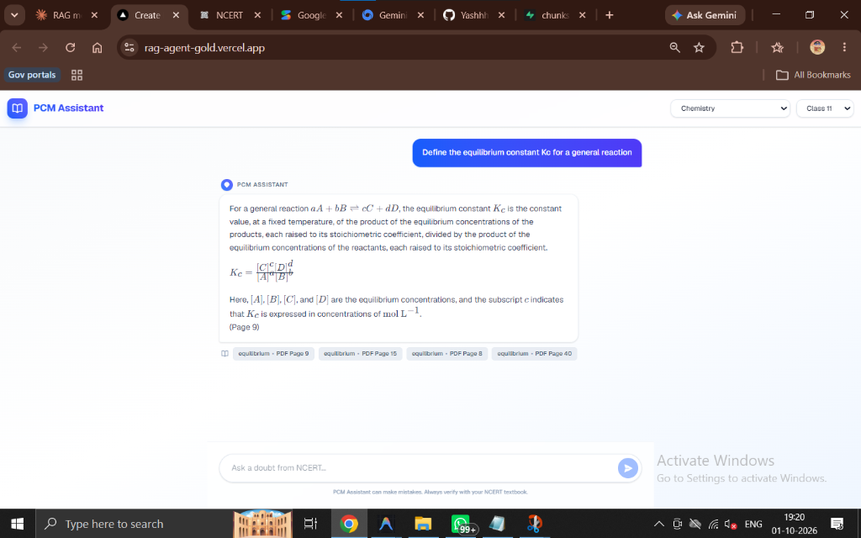
Live Project: Chemistry UI (Math Rendering)

Slide 8
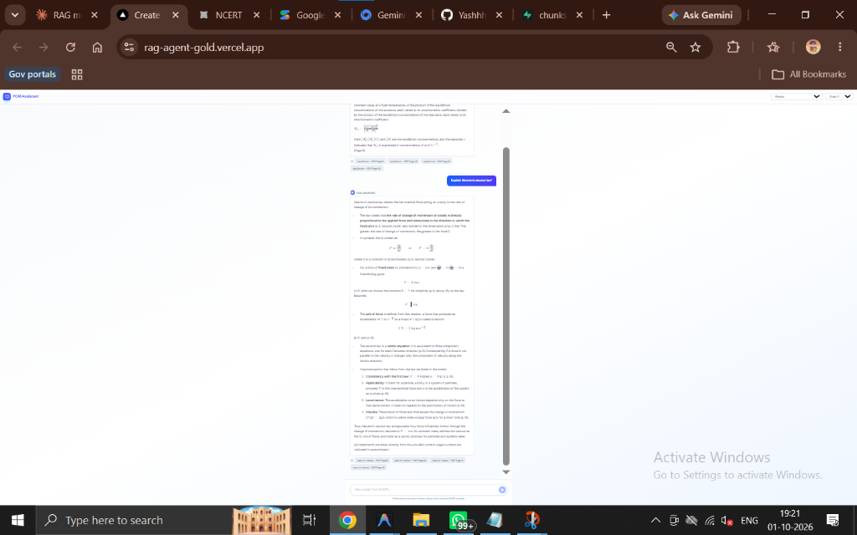
Live Project: Physics UI (Source Chips)

Slide 9
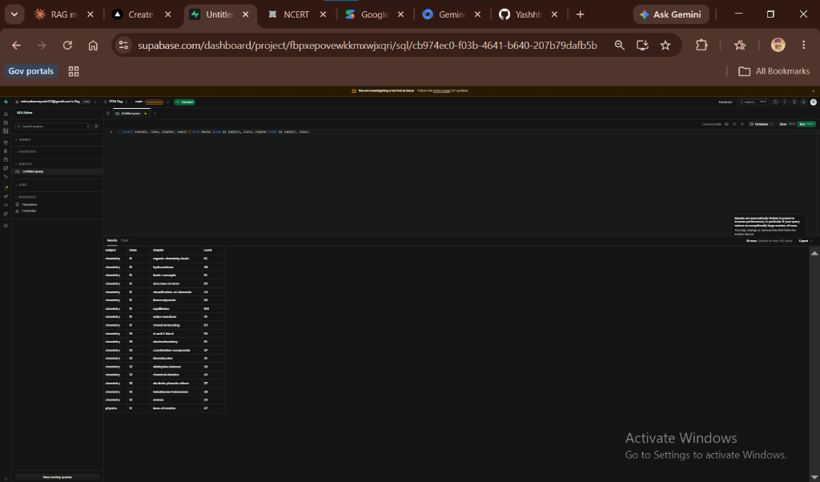
Backend: Supabase Vector Database

Slide 10
6. Conclusion
The AI-Powered NCERT PCM Tutor successfully demonstrates:
  Practical application of RAG over large, complex educational datasets.
  Full-stack integration of modern tools (Next.js, Python, Supabase, LLM APIs).
  A cost-effective, scalable, and highly accurate solution for Indian students.

