Slide 1

THBS GENERAL STORES
By :
BATCH – 93 GROUP –3:
YASHRAJ CHOUHAN (EMP ID : 6406)
RAVI KUMAR (EMP ID: 6408)
URKARSH GEDAM (EMP ID:6405)
SACHIN K S(EMP ID:6404)
SAMARTH KUMAR (EMP ID : 6407)

Slide 2
User operations :
Login / Register
View products list
Add products to cart
Place order
Search products
Change password

Slide 3
Admin operations :
Login
View products list and update delivery status
Add new products
View users
Update products and users details
Change password

Slide 4
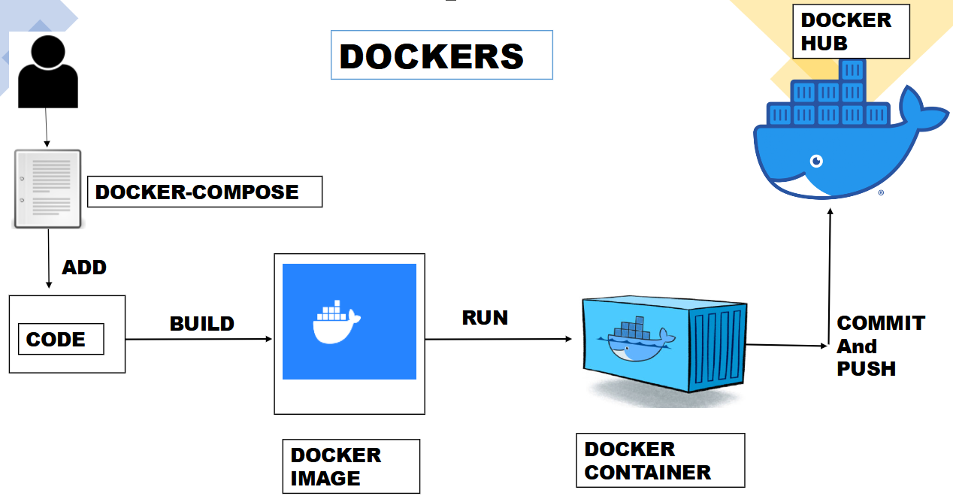
Docker

Slide 5
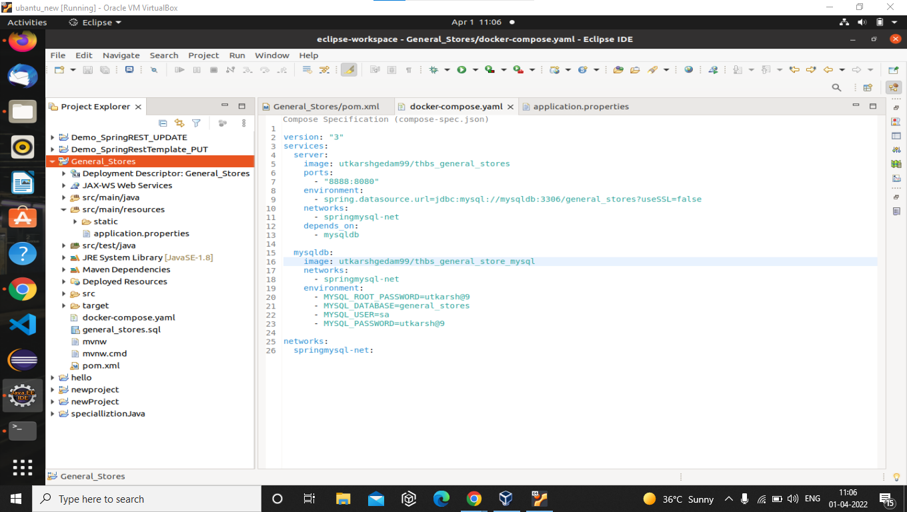
Docker-compose file

Slide 6
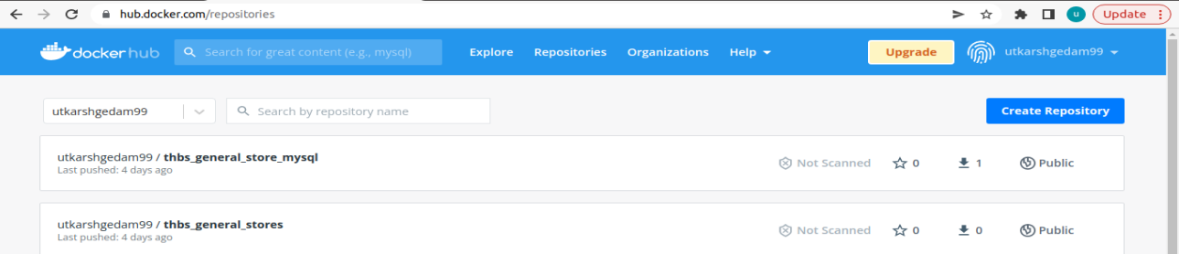
Docker images

Slide 7
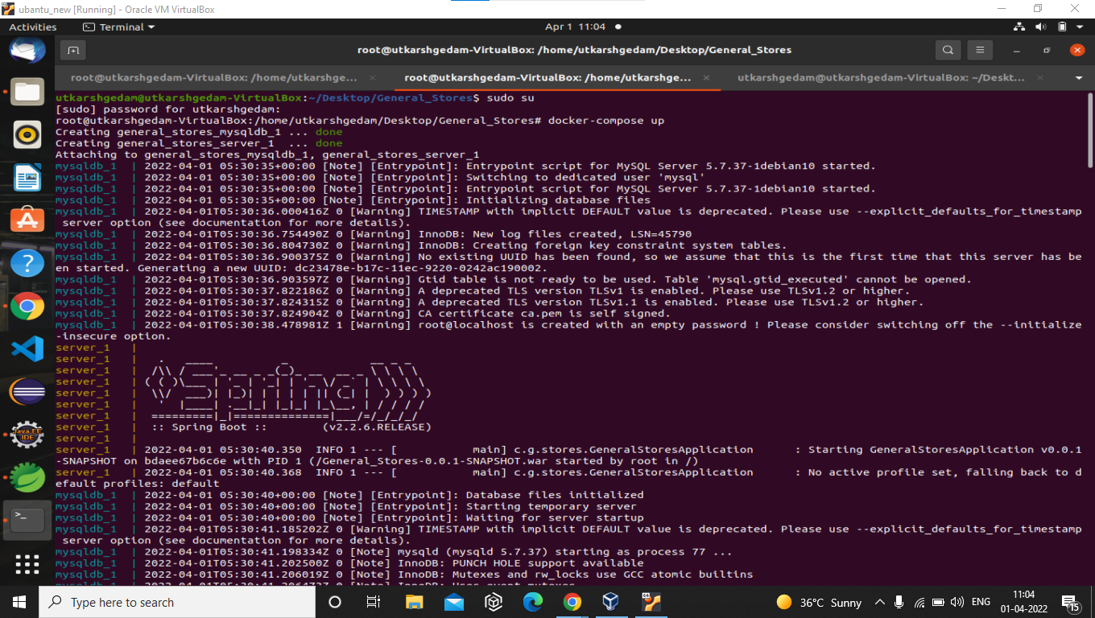
Running application through docker

Slide 8
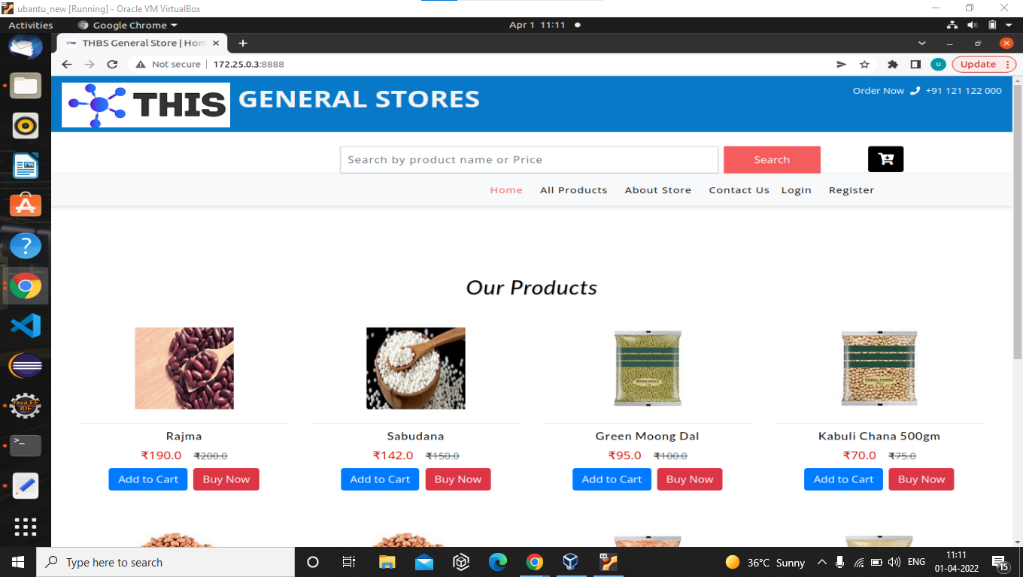
Accessing application through docker

Slide 9
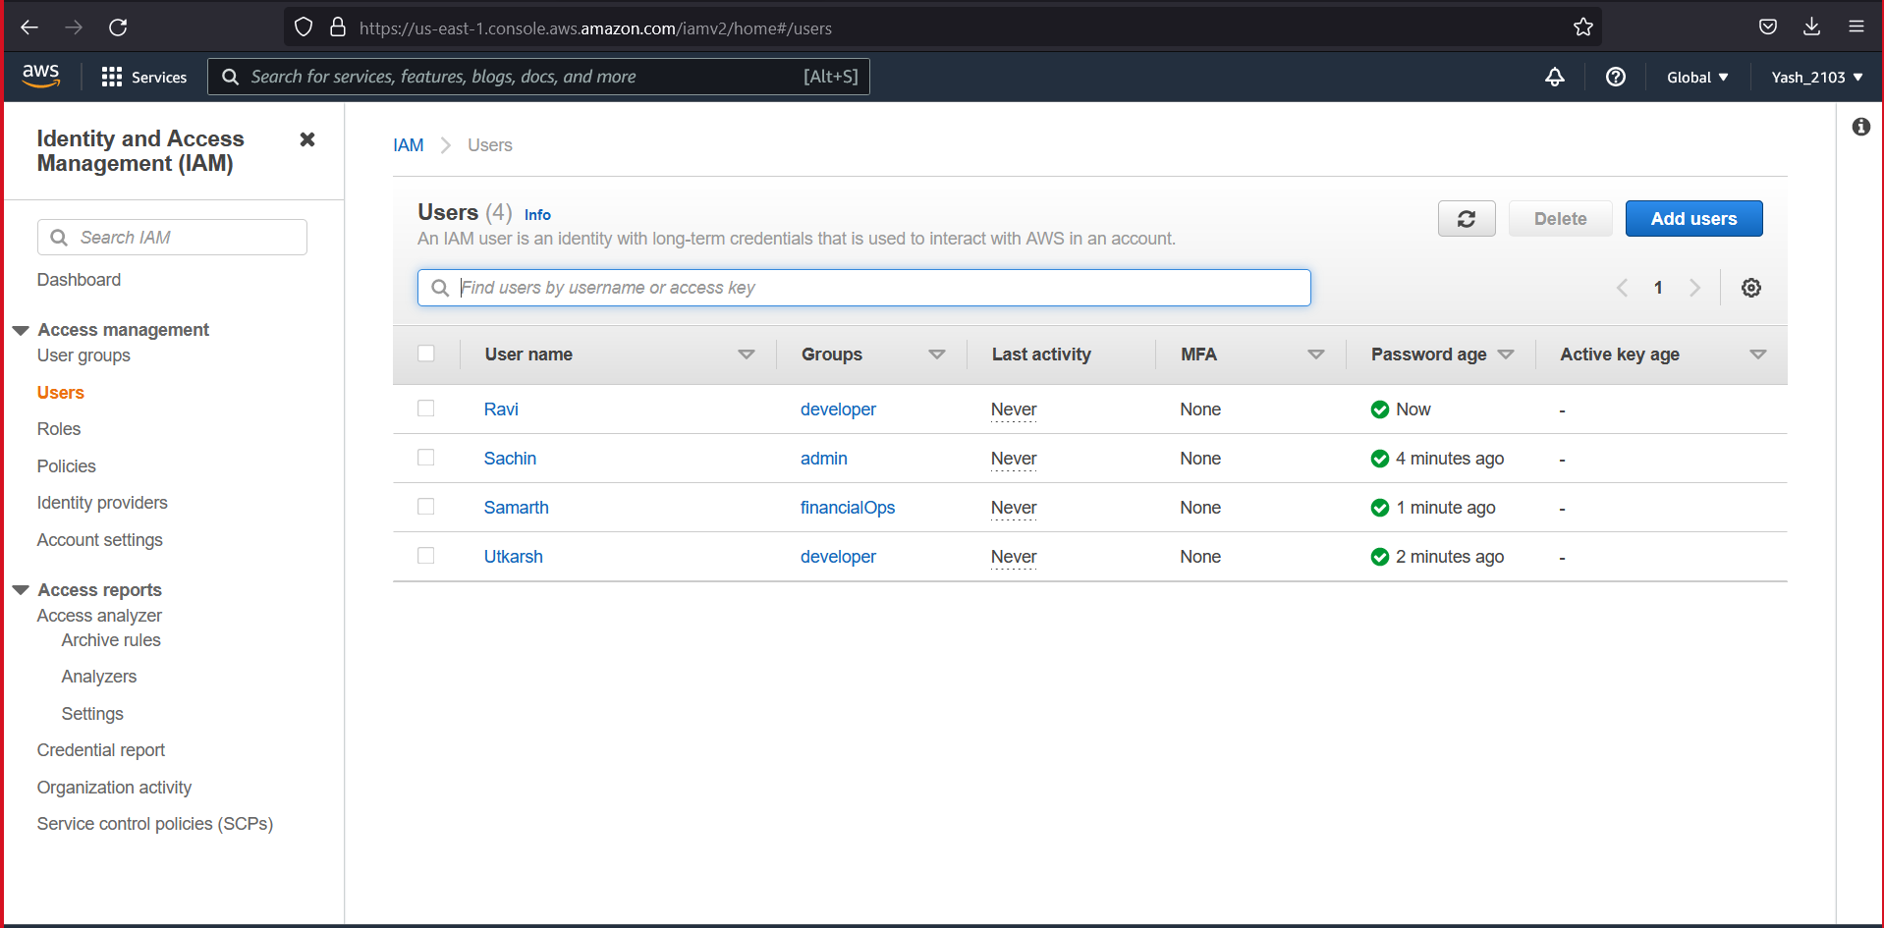
AWS

Slide 10
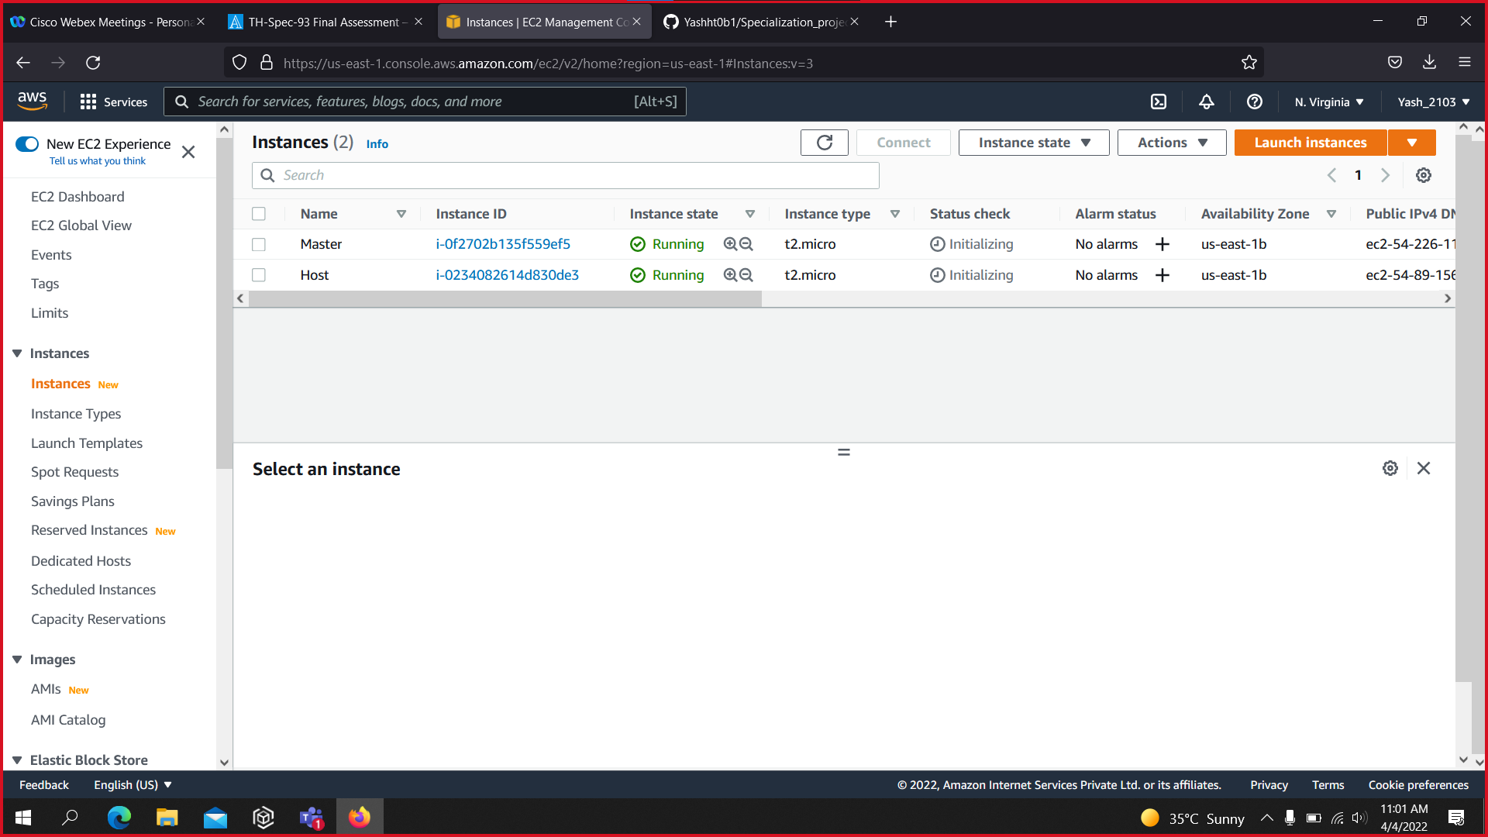

Slide 11
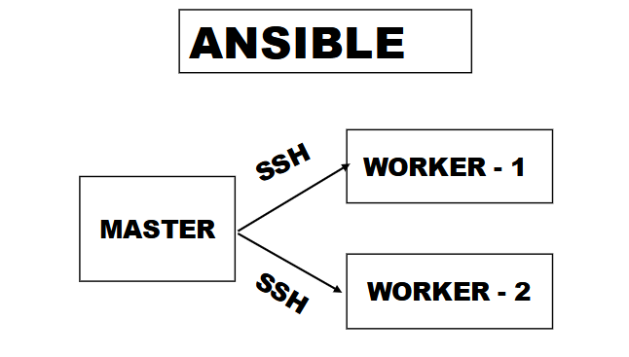
Ansible

Slide 12
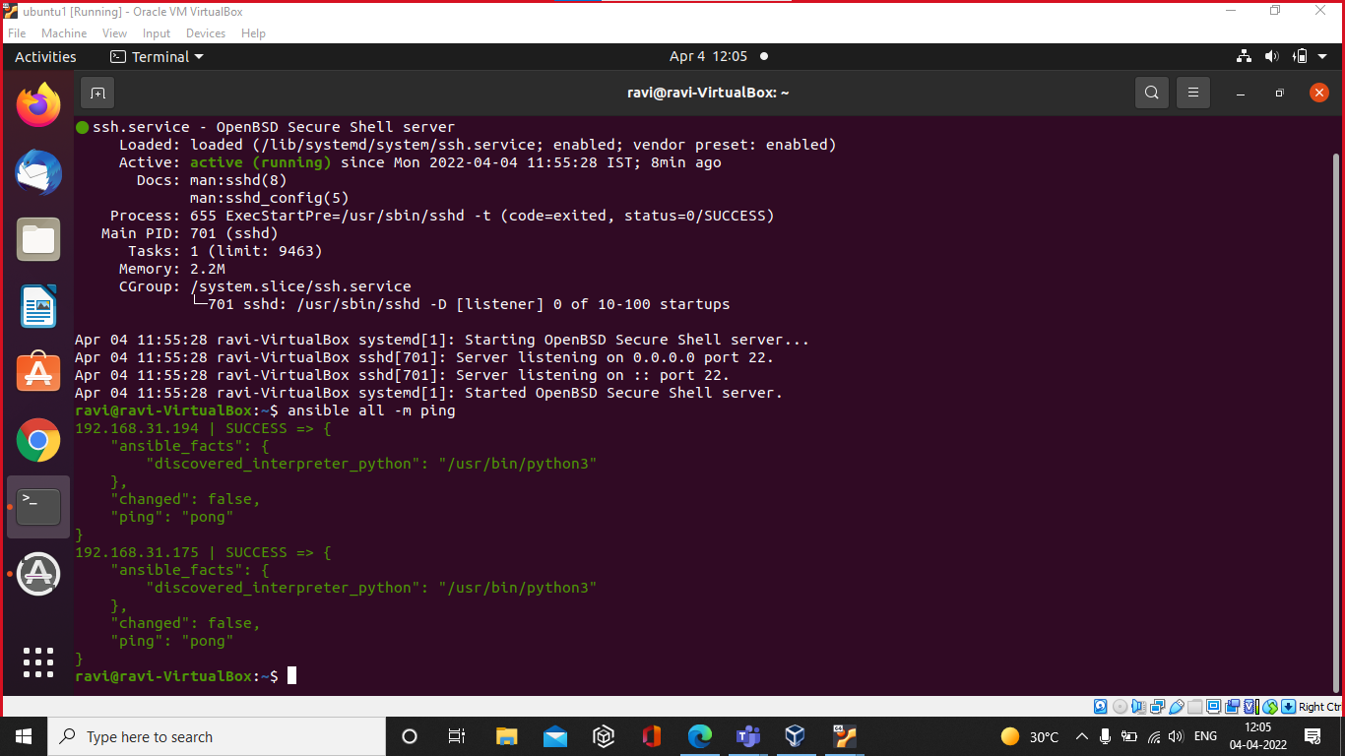

Slide 13
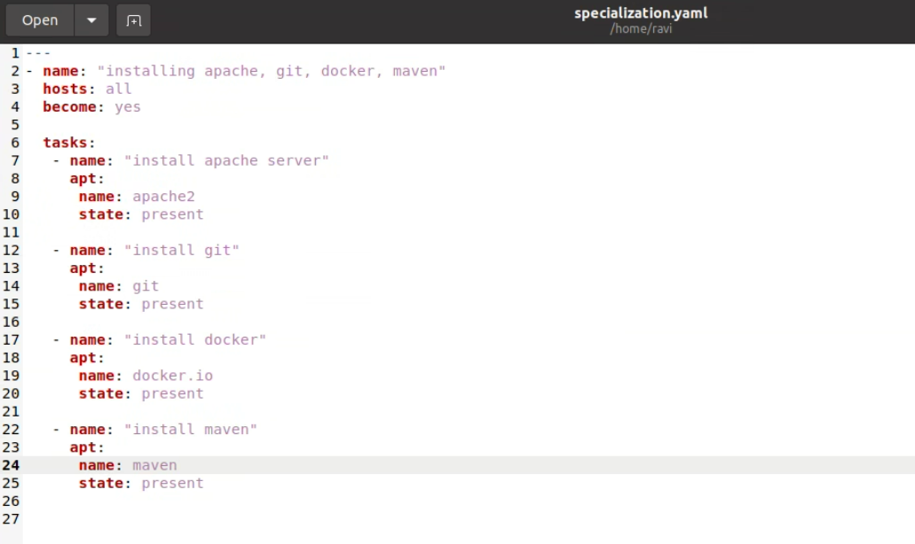
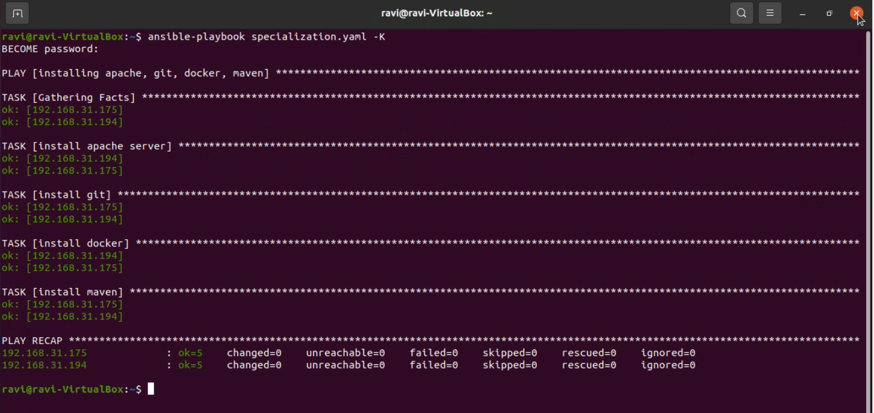

Slide 14
THANK YOU

