Slide 1

NexalQ
Team Name : Algorix
P R E S E N T A T I O N 2 0 2 6
Student Name
Student Email
Guide
Dr. Ankit Dixit
Yashi Srivastava Utkarsh Kumar Varsha Jaiswal
yashisrivastava800@gamil.com utkarshkumar6565@gmail.com jaiswalvarsha943@gmail.com

Slide 2
OUTLINE
Abstract of the Project Problem Statement Proposed Solution
System Architecture
Live Demo of the Project Conclusion &Future Scope

Slide 3
ABSTRACT
●Core Summary: NexalQ bridges the operational gap between raw startup concepts and structural market viability. The platform provides founders, incubators, and stakeholders with immediate quantitative success metrics alongside deep qualitative business intelligence.
●Impact Statement: By changing how startup evaluations are handled, the platform converts ambiguous, high-risk conceptual indicators into clear, actionable, and data-backed strategic options.

Slide 4
PROBLEM STATEMENT
●The Core Challenge: Evaluating early-stage business concepts is highly complex due to unorganized qualitative data, erratic initial conditions, and high market volatility.
●Key Pitfalls:
• Inability to evaluate overlapping operational risk vectors
simultaneously.
•Heavy reliance on manual, slow, and expensive advisory processes.
•High failure rates among early-stage startups due to a lack of data-
driven market validation before launching.

Slide 5
PROPOSED SOLUTION
●AutomatedBusinessEvaluation: NexalQ processes key startup
operational metrics—including domain experience, funding requirements, marketing budgets, and competition levels—against historical models.
●Key Values Provided:
•Multi-scenario risk assessment and automated target classification metrics.
•Generative business intelligence providing real-time strategic recommendations.
•Cost-effective, immediate business planning insights available directly through a simple single-page dashboard application.

Slide 6
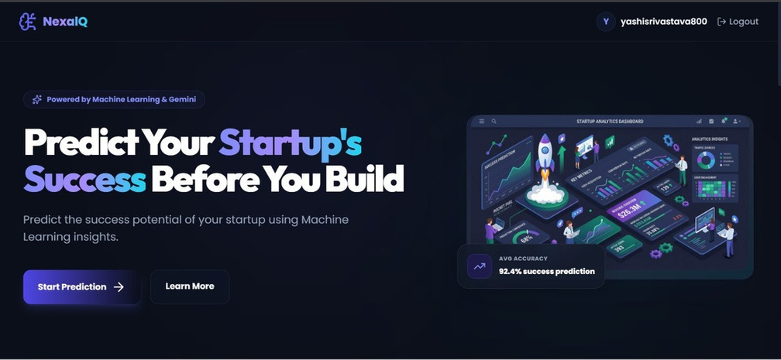
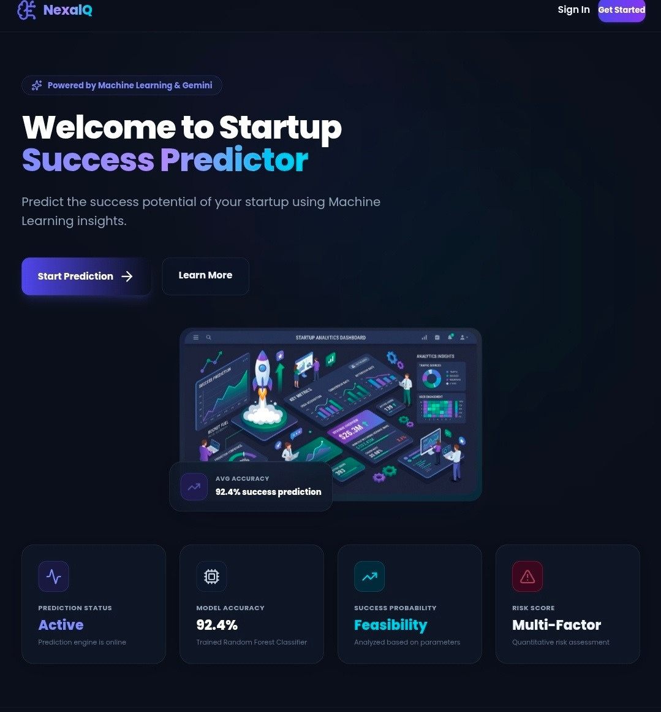
Live Demo
Live demo link:-
https://startup-backend-tx8s.onrender.com
Github link:-
https://github.com/Yashi-28/Startup

Slide 7
CONCLUSION & FUTURE SCOPE
•Conclusion: NexalQ replacesguesswork withclear data metrics,
showing that integrated machine learning can reliably evaluate startup viability.
•Future Horizons:
•Transitioning core language tasks to the latest google.genai SDK package ecosystem.
•Integrating live web scraping systems to fetch real-time market and competitor metrics.
•Adding automated, secure B2B investor match-making logic directly within the application workspace.

Slide 8
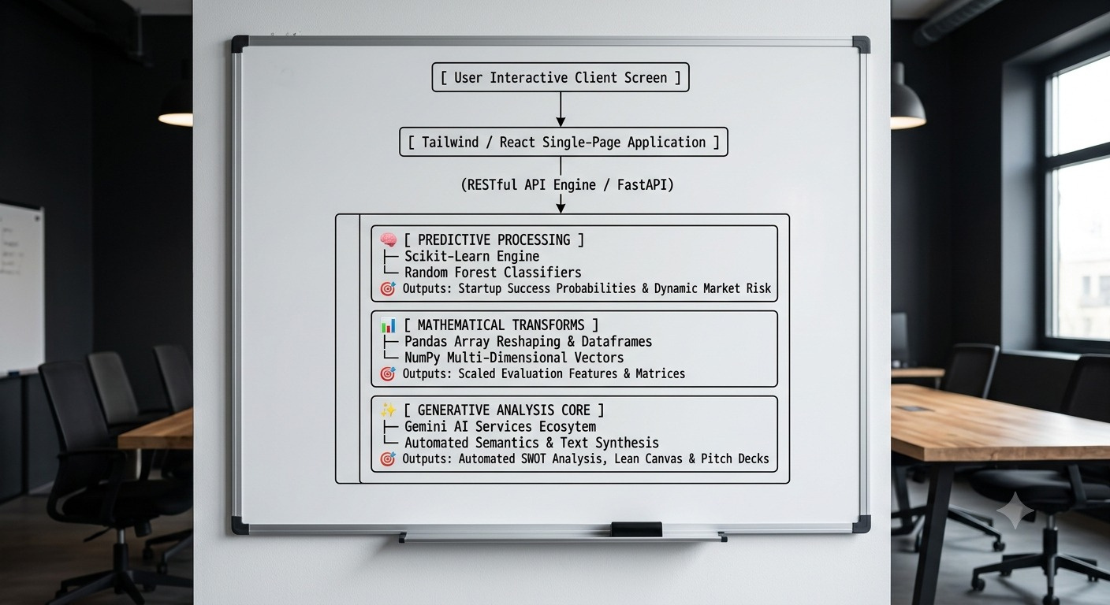
SYSTEM ARCHITECTURE
•Python FastAPIenables low-latency
backend processing.
•Pandas scales complex data vectors efficiently.
•NumPy transforms heavy numerical matrix data.
•FastAPI integrates secure RESTful app endpoints.
•Scikit-Learn trains advanced machine learning engines.
• Random Forest calculates venture
success probabilities.
•Classifiers accurately predict target industry verticals.
•Gemini AI dynamically parses
complex metrics.
• Generative models synthesize
custom business strategies.

Slide 9
Thank You

