Slide 1
PROJECT-1 DATA ANALYTICS EXAMPLE
YASHI GUPTA

Slide 2

CHRISTMAS PARTY PLANNING
SO AS WE HAVE LEARNT TILL NOW THAT WE USE DATA ANALYTICS WITHOUT EVEN REALISING IT ,INCORPORATE IT IN OUR DAY TO DAY DECISIONS.
CHRISTMAS PARTY PLANNING IS A EXAMPLE FOCUSING AND CLASSIFYING IT INTO DIFFERENT STEPS INCLUDED IN DATA ANALYTICS LIFECYCLE.

Slide 3
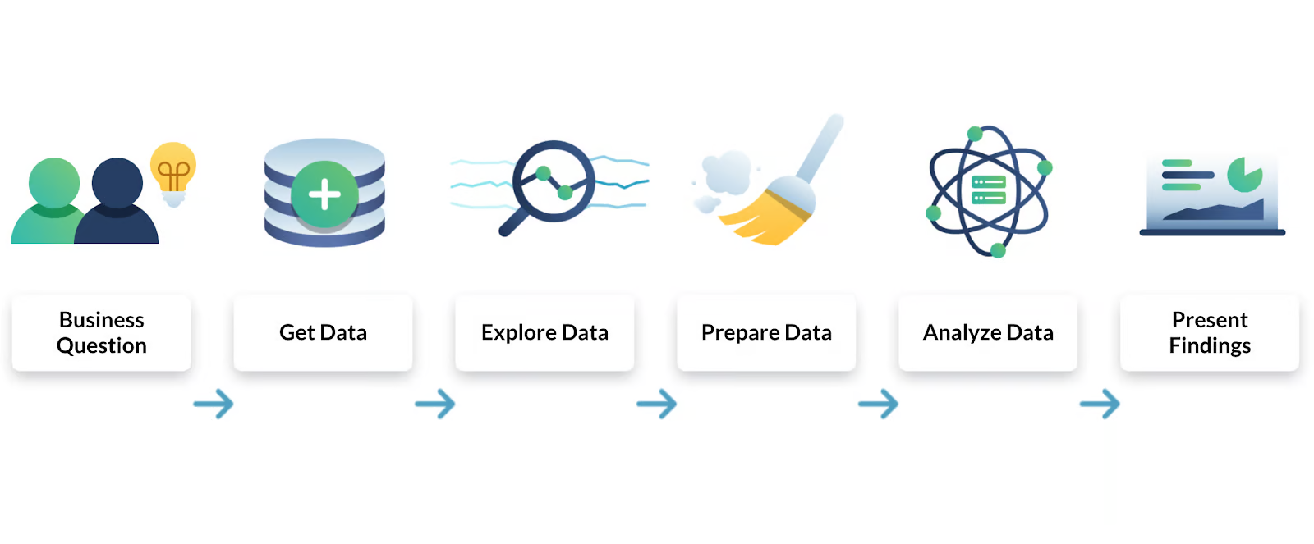
STEPS INVOLVED IN DATA ANALYTICS LIFECYCLE
Plan
Prepare
Process
Analyze
Share
Act
IN A MORE SCIENTIFIC MANNER CAN BE CALLED AS

Slide 4
STEP 1 PLAN
SO WHEN IT'S A PARTY THE MAIN QUESTIONS THAT ARISES ARE-
Q1) FOR WHAT GROUP IS THIS PARTY ARRANGED FOR?
FAMILY
FRIENDS (SELECTED GROUP)
OFFICE COLLEAGUES
A MIX GROUP
AS WE KNOW FOR DIFFERENT GROUPS THERE MUST BE DIFFERENT INTEREST AND DIFFERENT SENSE OF HUMOR AND FOR EVERYONE TO ENJOY THIS PARTY WE NEED TO MAKE SURE THE ARRANGEMENTS ARE AS PER THE SELECTED GROUPS.
THE IMPORTANT PART IS TO ASK THE RIGHT QUESTIONS FOR THE SELECTED GROUPS

Slide 5

FOR FRIENDS MOSTLY OF SAME AGE GROUPS -
2)IN V/S OUT?
INDOOR PARTY
OUTDOOR PARTY
NOTE-WE HAVE SELECTED INDOOR PARTY CONSIDERING THE COLD WEATHER (ANOTHER EXAMPLE OF DATA ANALYSIS)
3)TYPE OF PARTY??
THEMED
NON THEMED

Slide 6
FOR A THEMED PARTY THE VERY OBVIOUS NEXT QUESTION SHOULD BE WHAT WILL BE THE THEME?
FAMOUS CHRISTMAS MOVIES
RED AND WHITE
CHRISTMAS CHARACTERS
ICONIC CHRISTMAS VILLAINS
CASUAL SWEATER WEATHER
OTHER
P.S- MAKE A LIST AND FORWARD IT TO YOUR GUESTS

Slide 7
MAKE A LIST OF GUESTS YOU WANT TO INVITE
CLOSE FRIENDS
BIG GROUPS

Slide 8
STEP 2 Prepare
ALLOCATION OF FUNDS
TYPE OF FOOD PREFERENCES ACCORDING TO PEOPLE (SOME ARE VEGAN,VEGETARIAN,NON VEGETARIAN)
GAMES OF CHOICE
SEND OUT A POLL FOR SUCH DECISIONS

Slide 9
STEP 3- Process
AFTER THE GATHERING OF DATA AND DECIDING ON CRUCIAL CHOICES FOR THE PARTY WE NEED TO PROCESS THE DATA GATHERED FOR MAXIMUM ENTERTAINMENT
1- DECIDE ON THE MENU AFTER GETTING THE POLL RESULTS.
2-MAKE SURE TO ALIGN THE GAMES AND ACTIVITIES SO THERE IS ENOUGH TIME
3-DECIDE ON GIFTS AND MAKE DIY AND COST CUTTINGS .INVESTIGATE FURTHER AND CHOOSE THE BEST OPTION.

Slide 10
STEP 4 - ANALYSE
COMPARE PRICING OPTIONS FOR VENUES, CATERING, AND DECORATIONS, ENSURING THAT THEY FIT WITHIN THE ESTABLISHED BUDGET.
SUM THE COSTS FOR VENUE, CATERING, AND DECORATIONS TO MAKE SURE THE TOTAL STAYS WITHIN YOUR PLANNED BUDGET.
IDENTIFY ANY AREAS WHERE YOU MAY NEED TO ADJUST (E.G., CHOOSING A SMALLER VENUE).

Slide 11
STEP 5- SHARE
COMMUNICATE THE FINALIZED DETAILS
A] SEND INVITATIONS
INCLUDE DATE, TIME, AND LOCATION.
SPECIFY THE DRESS CODE
B] SHARE ACTIVITY DETAILS
PROVIDE INSTRUCTIONS FOR GAMES
ASSIGN ROLES OR TASKS FOR ACTIVITIES DECIDED
C] CONFIRM RSVPS
FOLLOW UP TO ENSURE EVERYONE HAS CONFIRMED
FINALIZE FOOD AND SEATING ARRANGEMENTS BASED ON THE NUMBER OF GUESTS.

Slide 12
STEP 6 -ACT
PURCHASE DECORATIONS, GIFTS, AND PARTY SUPPLIES
SET UP THE VENUE AND DECORATIONS
HOST THE PARTY
ADJUST AS NEEDED
ENJOYYY!!!!
MERRY CHRISTMAS

Slide 13
SUMMARY -
TO NOW WE KNOW EVEN TO ORGANIX\ZEA ART DATA ANALYTICS STEPS ARE NEEDED. WE CAN FURTHER USE MORE DATA ANALYTICS TOOLS TO MAKE OUT WORK MORE EASIER AND EFFECTIVE .THIS THE A 6 STEP PROCESS WAS ORGANIZING A CHRISTMAS PARTY AND STUDYING EACH STEP ALONG THE WAY.

