Slide 1

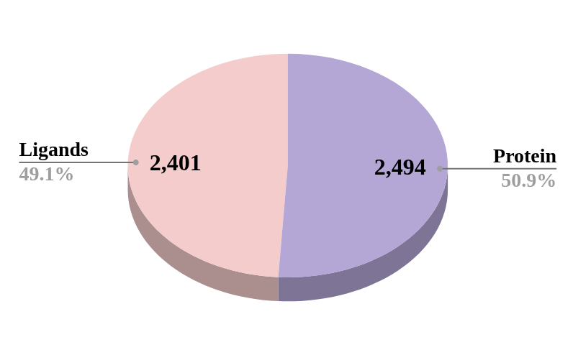

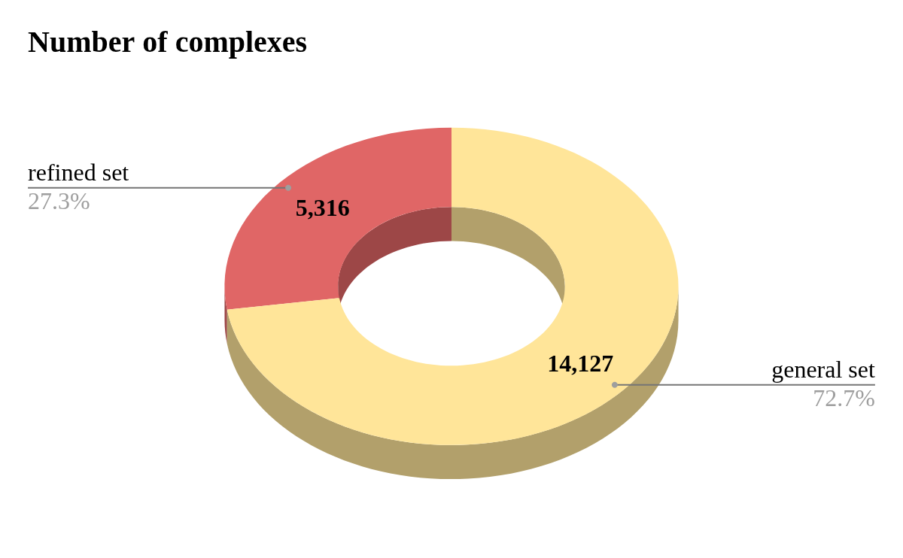



Hyperparameter Tuning
Dataset collection
PDBbind 2020v2 Protein Ligand database.
Best Parameter
Feature generation
ECIF - 2337(complexes) 1540(features)
RDKIT - 2337(complexes), 217(features)
Model Trained
After applying filtering- Kinase Protein Ligand dataset - 2496 complexes
Model Development
Decision Tree
Random Forest
Gradient Boosting Trees
XGBoost
SVM
External Prediction
ECIF
ECIF+RDKIT
External Dataset
Source:PDB
Keywords: Kinases
Total Kinases complex after filtering: 12,475
Total downloaded successfully: 6,802
Preprocessing
The ligands of the training complexes were standardized using rdkit. pIC values were added as labels.

