Slide 1

PLAN-IT AI EVENT PLANNING COMPANION
School of Computer Science and Engineering
Department of Computer Science and Engineering
Submitted By: YASHIKA NAGDEV
23FE10CSE00213
Supervised By: Dr.Rajat Goel

Slide 2
Outline
Introduction
Literature Review
Problem Statement
Proposed Solution
Objectives
Results

Slide 3
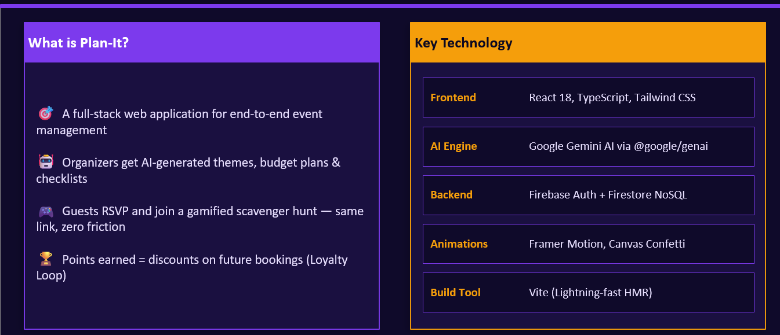
Introduction

Slide 4
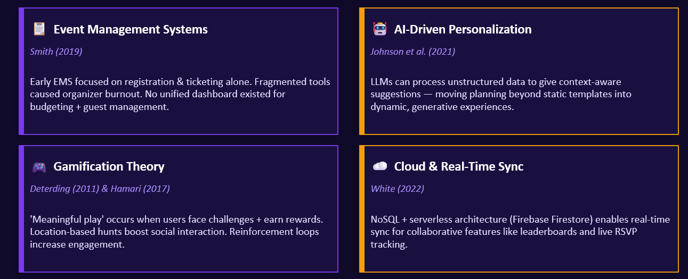
Research Foundation

Slide 5
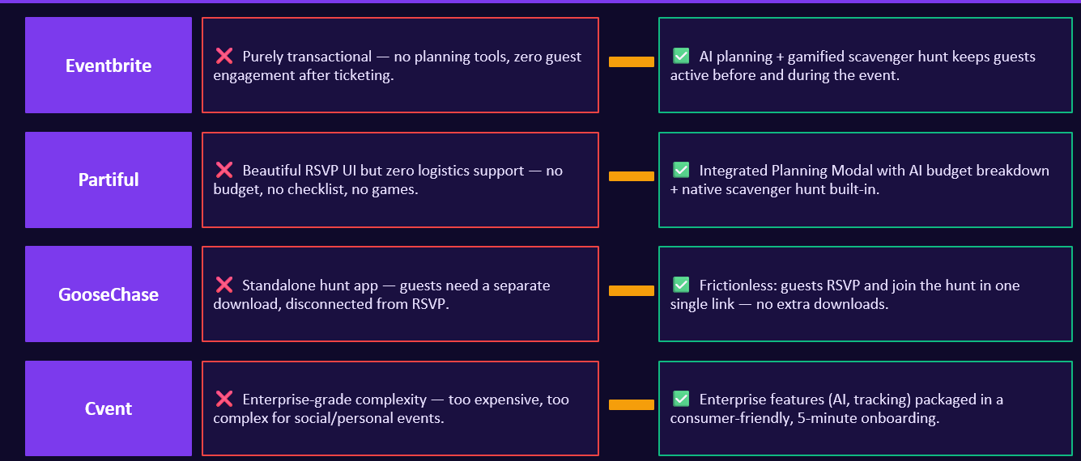
Literature Review

Slide 6
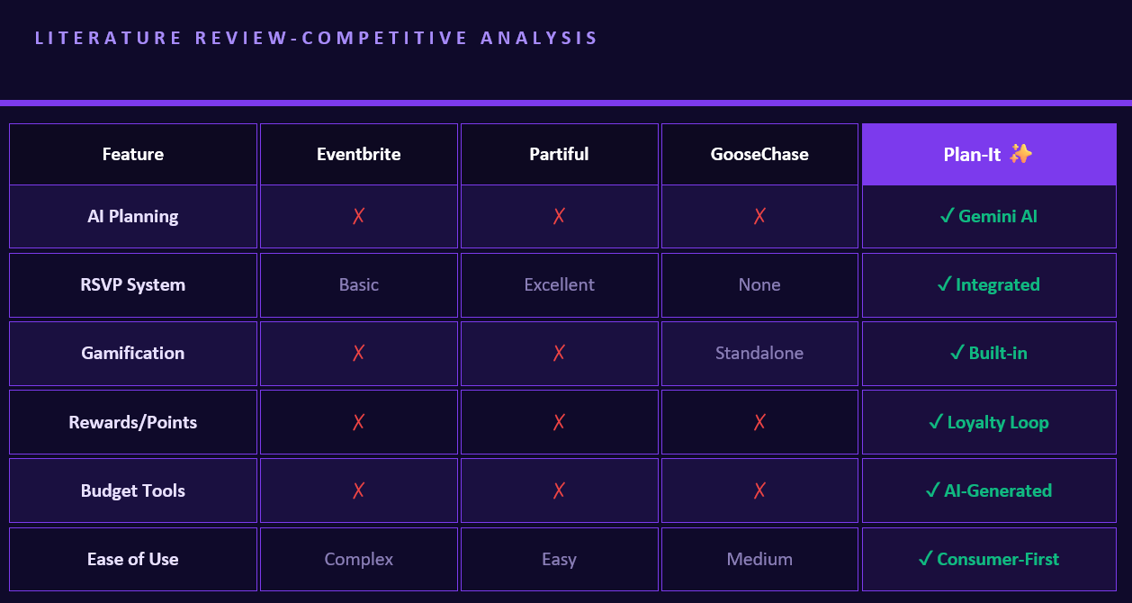

Slide 7
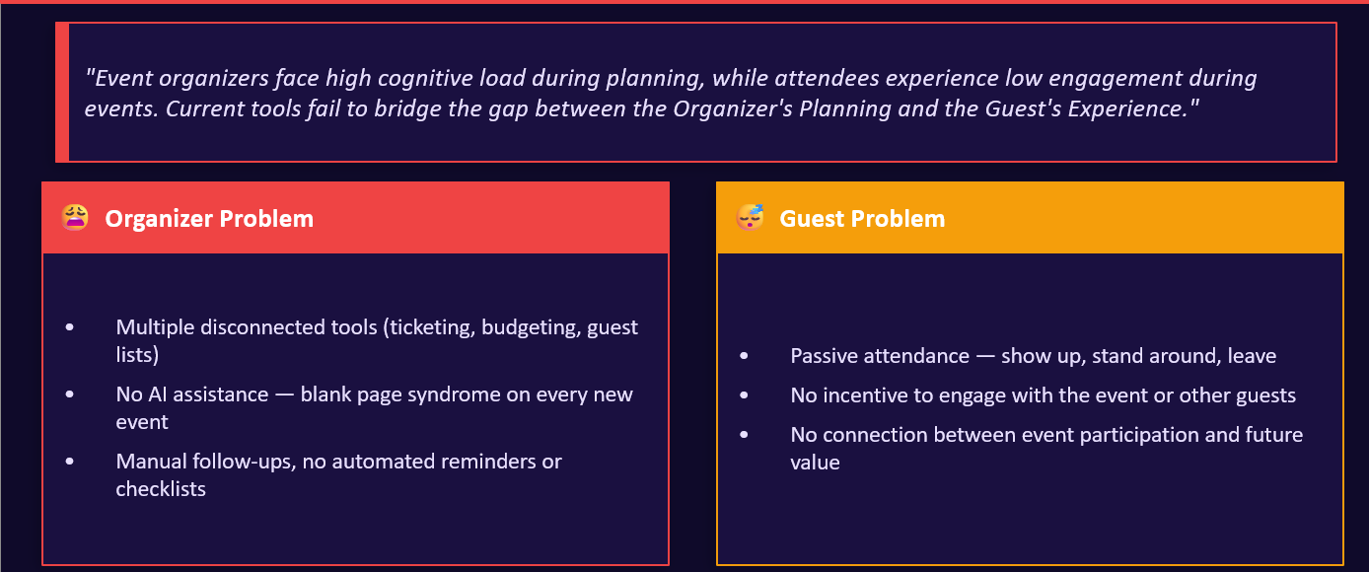
Problem Statement

Slide 8
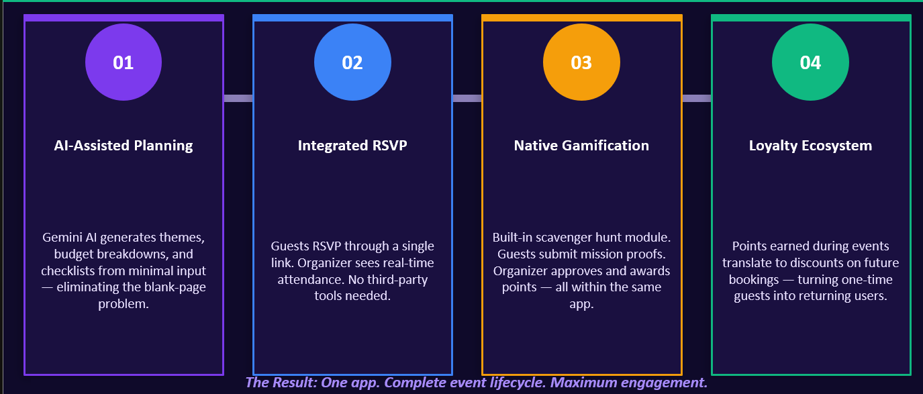
Proposed Solution

Slide 9
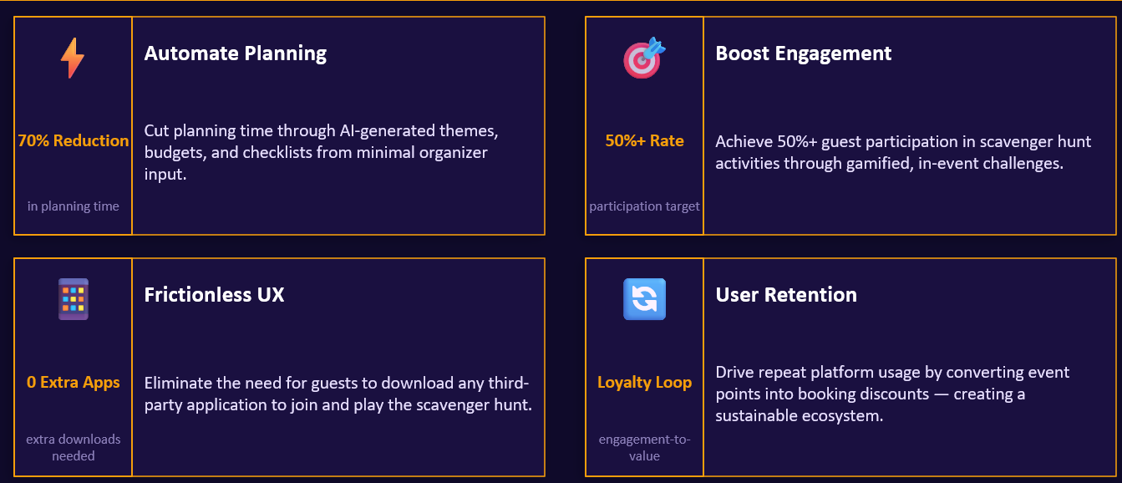
Objectives

Slide 10
Proposed Methodology
[User Registration]
↓
[Login & Auth]
↓
[Event Planning & Vender Browsing]
↓
[ADMIN and USER Dashboard]
↓
[Event Registration]
↓
[ Database Storage]
↓
[Points Update & Leaderboard]
↓
[Final Output to User]

Slide 11
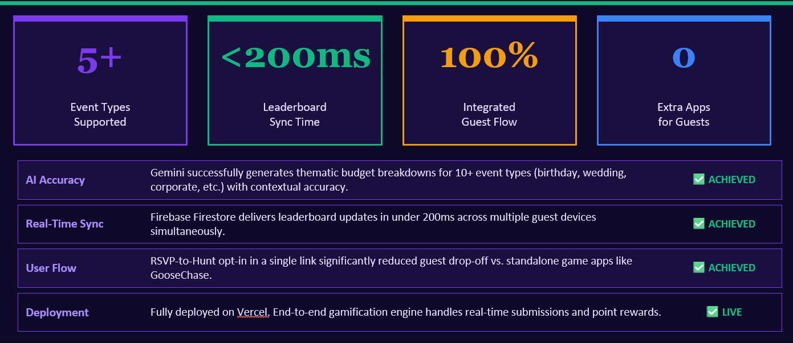
Result

Slide 12
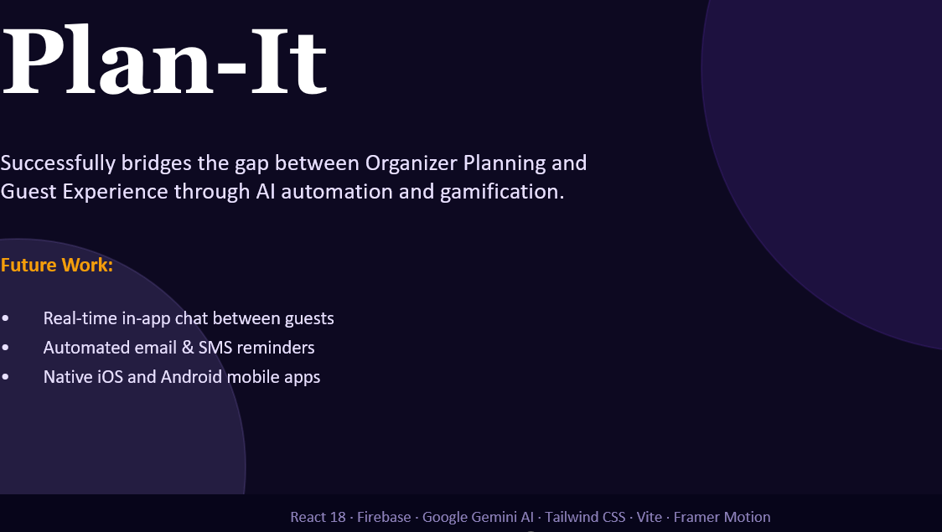
Conclusion

Slide 13
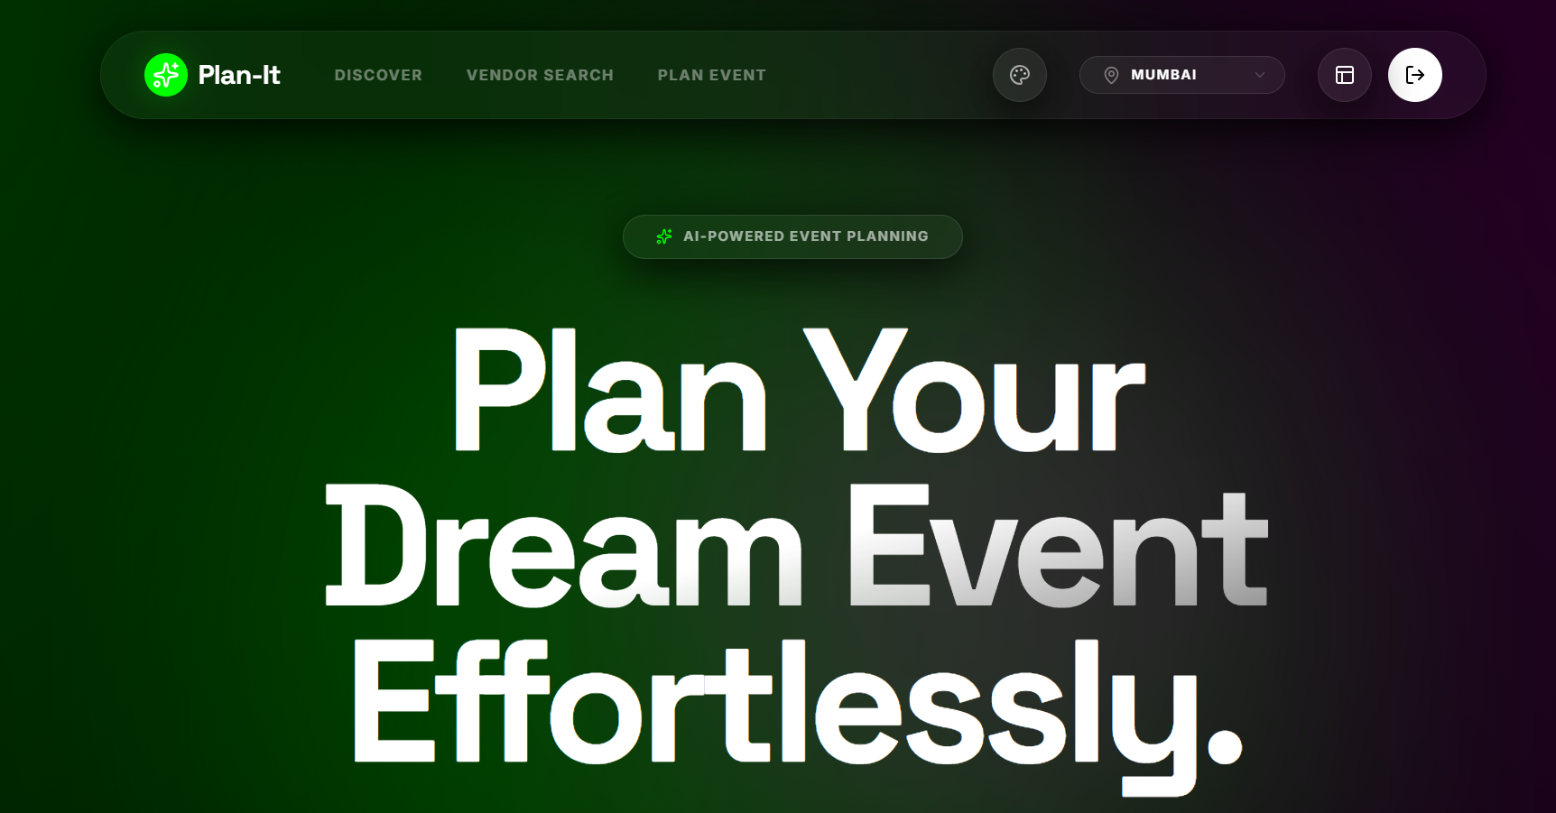

Slide 14
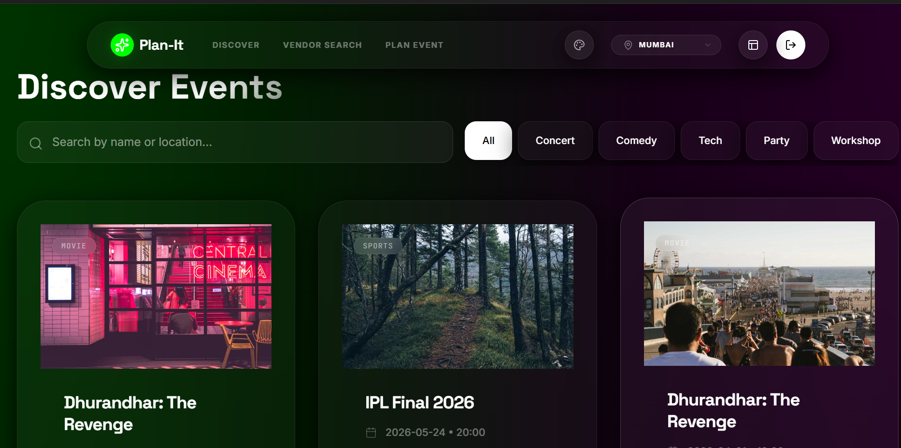

Slide 15
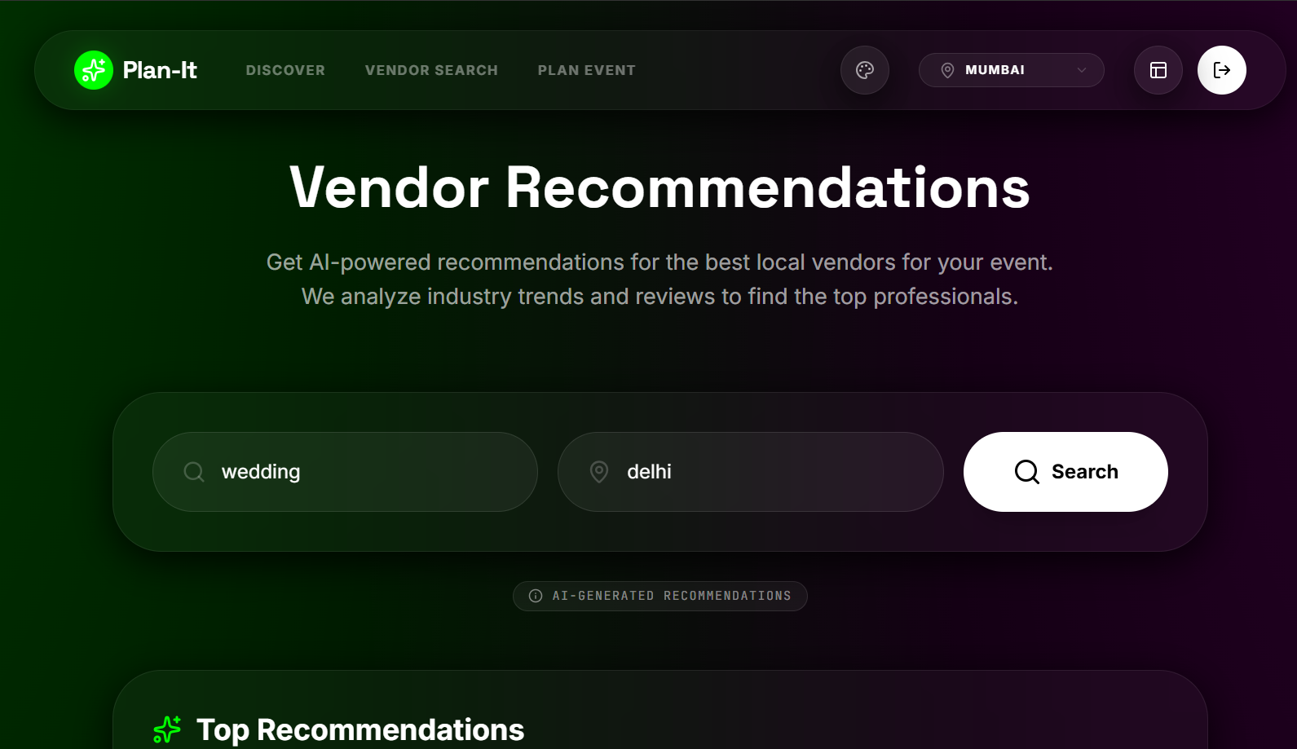

Slide 16
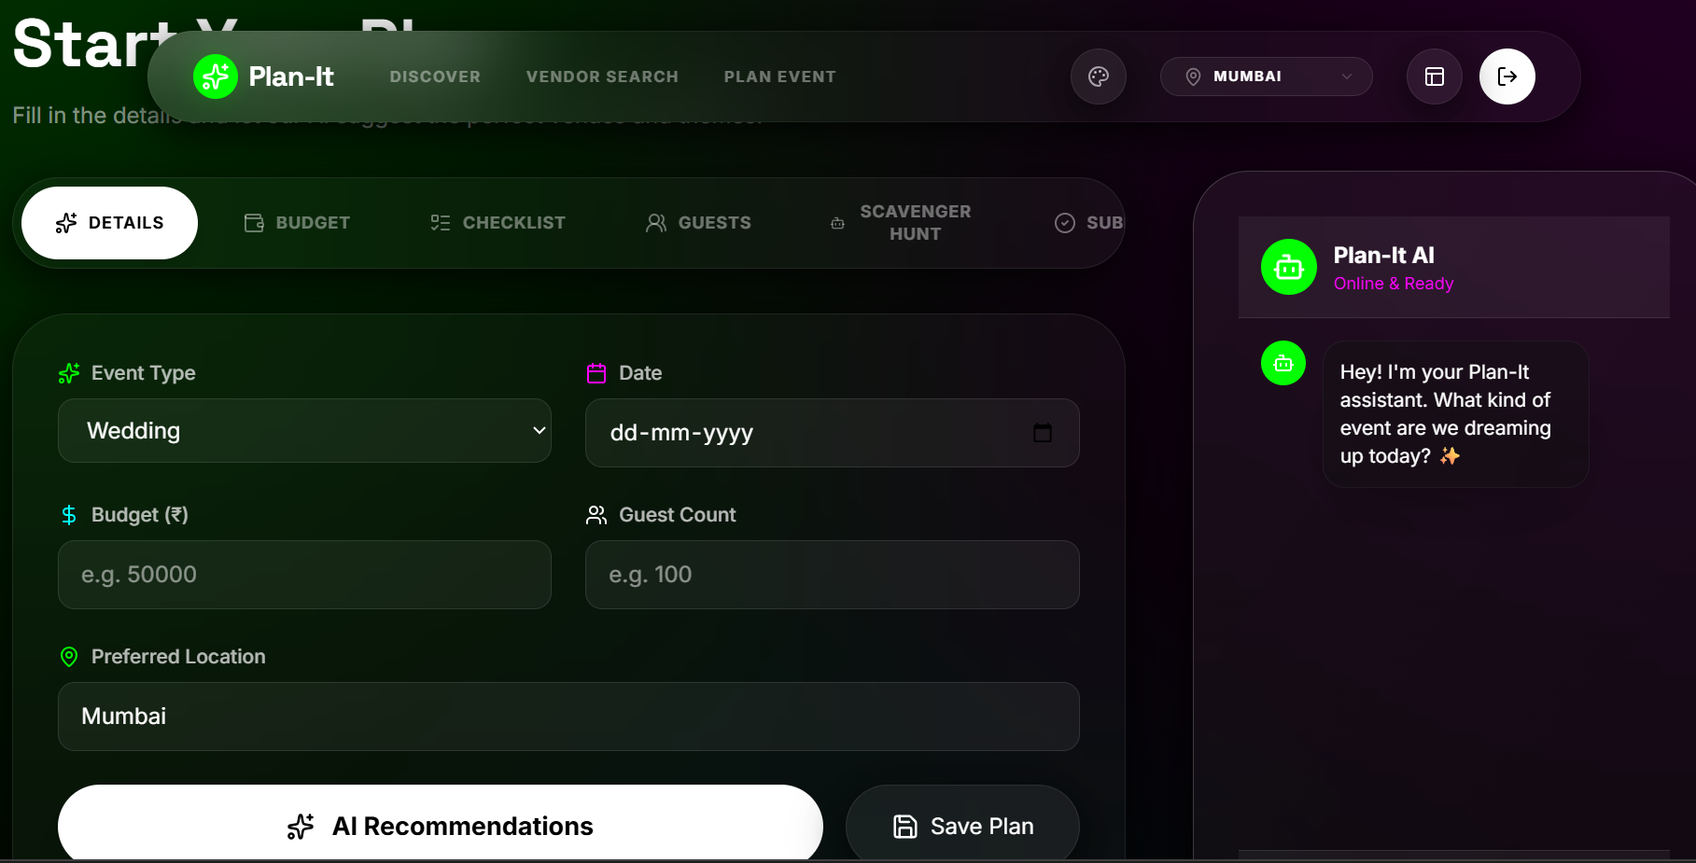

Slide 17
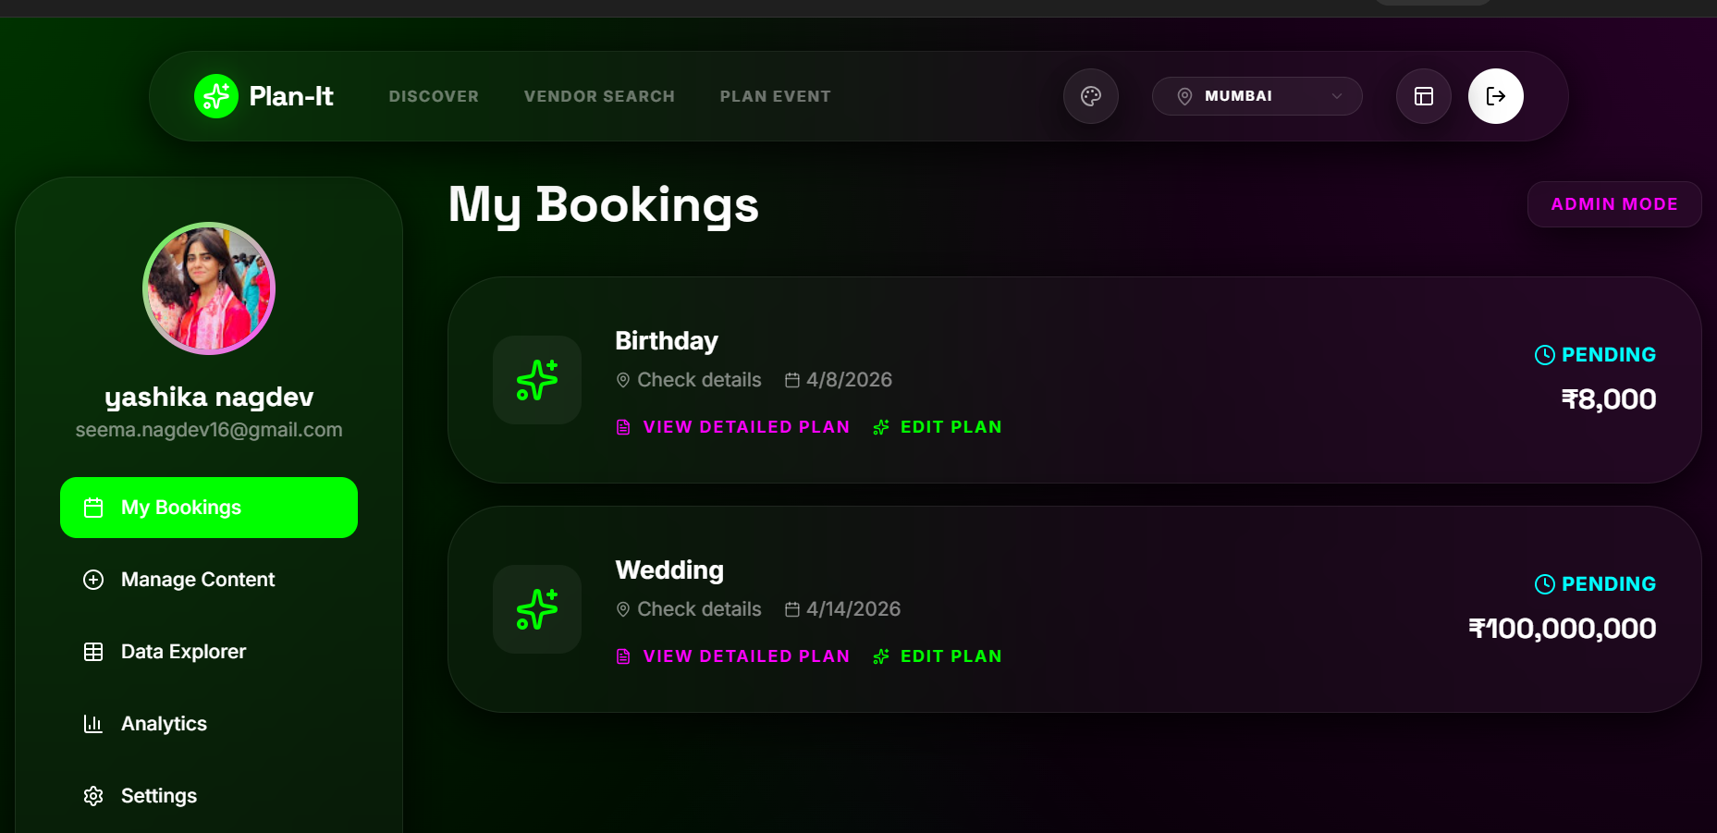

Slide 18
References
1. Mane, P. & Patil, R. (2021). Event Management System Using Web Technologies. International Journal of Computer Applications. 2. Sharma, A. & Gupta, R. (2020). Online Campus Event Portal for Universities. International Journal of Engineering Research and Technology. 3. Supabase Documentation. Authentication, Database & Realtime Features. https://supabase.com/docs 4. ReactJS Documentation. Building Interactive User Interfaces. https://react.dev 5. Vercel Documentation. Frontend Deployment Platform. https://vercel.com/docs 6. TailwindCSS Docs. Utility-first CSS Framework. https://tailwindcss.com/docs 7. Manipal University Jaipur (MUJ). Campus Venue Information & Event Guidelines. 8. OpenAI ChatGPT. Assistance for development, debugging, and explanation during project creation.

Slide 19
Thank You

