Slide 1
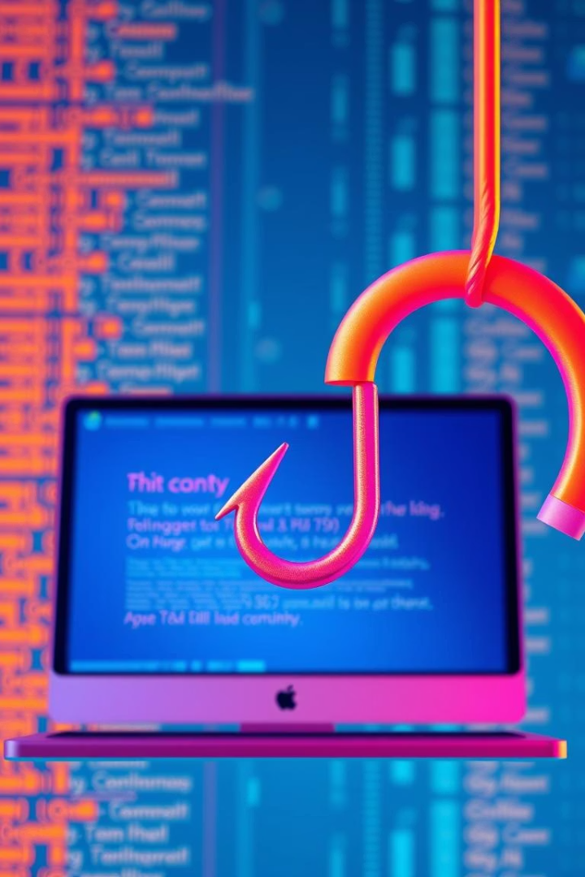
Phishing Awareness Training
Learn how to recognize and avoid phishing scams. Protect yourself and your organization.
yt
by yashika tambe

Slide 2
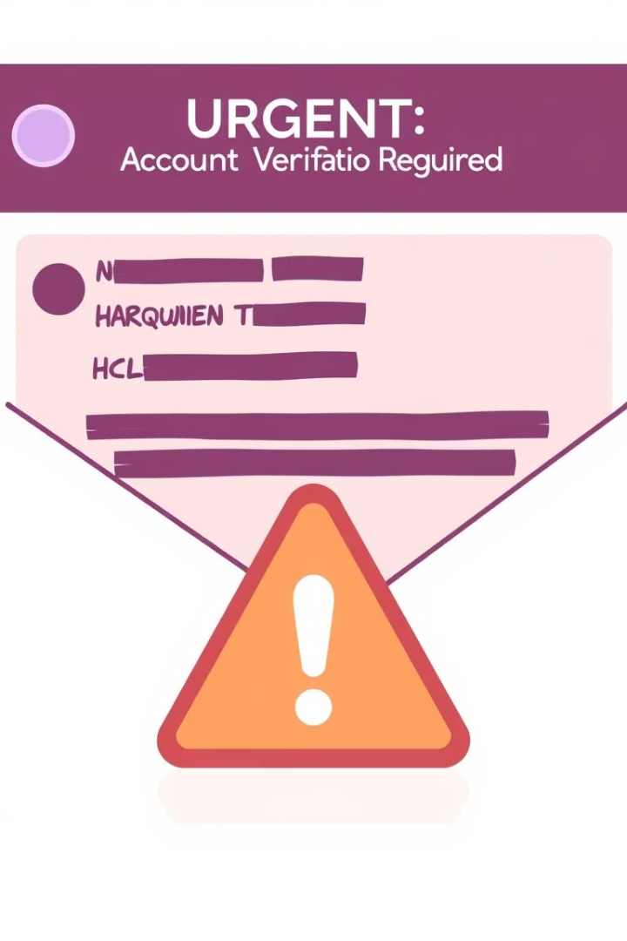
What Is Phishing?
Phishing Emails
Fake Websites
Fraudulent emails designed to steal sensitive data or spread malware.
Lookalike sites that trick users into entering login credentials or personal information.
Social Engineering
Manipulating people to disclose confidential information through deception.

Slide 3
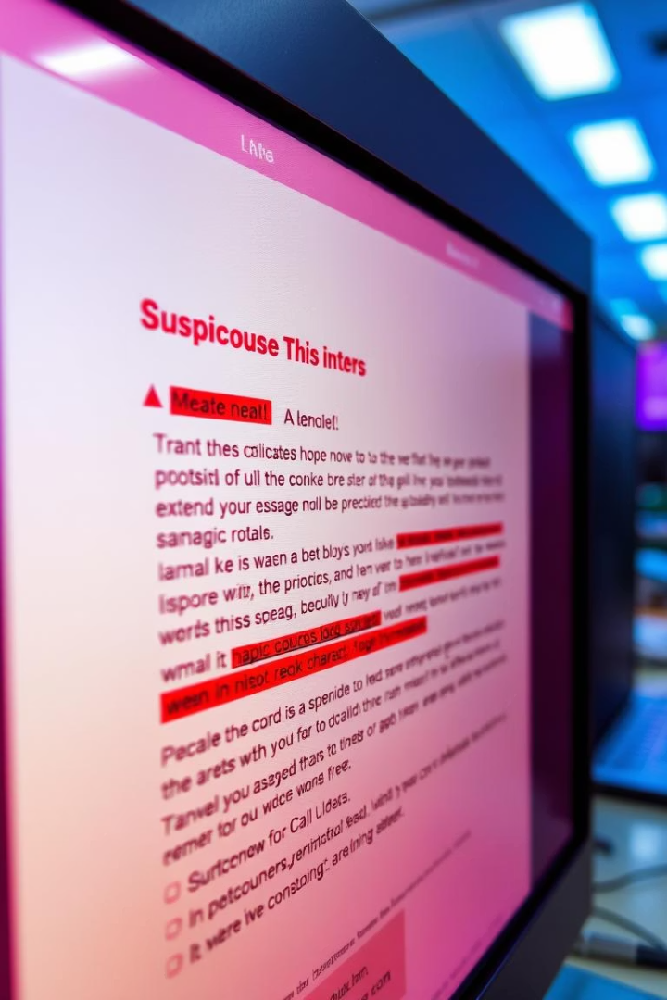
Common Phishing Indicators
Urgent or Threatening Language
Pressure you to act quickly or risk penalties.
Unexpected Attachments or Links
Be wary of unsolicited files and unfamiliar URLs.
Spelling and Grammar Errors
Poor language is a common phishing giveaway.
Sender Address Mismatch
Email address doesn't match the claimed organization.

Slide 4
Phishing Email Examples
Real Email
Phishing Email
Clear branding and professional language
Generic greetings
Known sender with valid domain
Suspicious links or calls to action
Personalized content
Unsolicited attachments

Slide 5
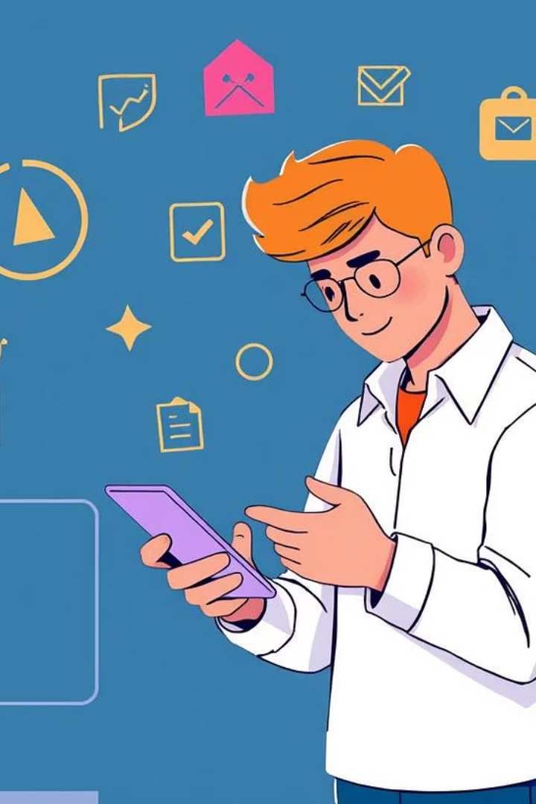




How to Protect Yourself
Verify Sender
Check email addresses carefully before responding or clicking.
Hover Over Links
Reveal real destination URLs to avoid malicious sites.
Never Share Sensitive Info
Avoid providing passwords or personal data in emails.
Report Suspicious Emails
Use company tools to flag phishing attempts immediately.

Slide 6




Understanding Social Engineering
Research
Build Trust
Attackers gather info about you or your colleagues.
1
They pretend to be colleagues or authority figures.
2
Consequences
4
Exploit Trust
Lead to data breaches, financial loss, or malware infection.
3
Convince targets to share sensitive info or click links.

Slide 7
Recognizing Suspicious Websites
Check URL Carefully
1
Look for slight misspellings or unusual domains.
Look for HTTPS
2
Secure sites have HTTPS with a padlock icon.
Avoid Clicking Through Emails
3
Type URLs manually instead of clicking links.
Use Browser Safety Tools
4
Enable phishing and malware protection features.

Slide 8
Key Takeaways and Next Steps
Stay Alert
Practice Caution
Always scrutinize emails and websites before acting.
Verify identities and avoid sharing sensitive info.
Report Suspicious Activity
Continue Learning
Use company channels to report potential phishing attempts.
Regular training helps keep phishing awareness sharp.

