Slide 1

VOICE BASED EMAIL SYSTEM FOR VISUALLY CHALLENGED

Slide 2


INTRODUCTION
We All Know the importance of Internet
But using it is difficult for visually impaired
Thus we created a Voice Based Email System to help blinds communicate
And that too for communication

Slide 3
SPEECH RECOGNITION IN PYTHON
It is the process of converting spoken words to text.
It is a library that acts as a wrapper for many popular speech APIs
It is very flexible to use
It depends on module pyaudio(for microphone).

Slide 4
TEXT-TO-SPEECH IN PYTHON
It is the conversion of written text into spoken voice.
pyttsx(python-text-to-speech) is one of the several APIs available in Python and used in our project
It is platform independent(windows,linux,MacOS)
It works Offline
Rather than saving the text as audio file, pyttsx actually speaks it there, which makes it more reliable to use for voice-based projects.

Slide 5
DESIGN AND IMPLEMENTATION
G-MAIL API Connection
Done with the help of SMTPLIB module in Python
SMTPLIB is used to carry simple mail transfer protocols
GUI
We used tkinter std. built in library in Python
Phases
Login to client’s G-mail Account
Send Email through client’s G-mail Account
Can be sent to single as well as multiple users
Read unseen email in G-mail Account

Slide 6
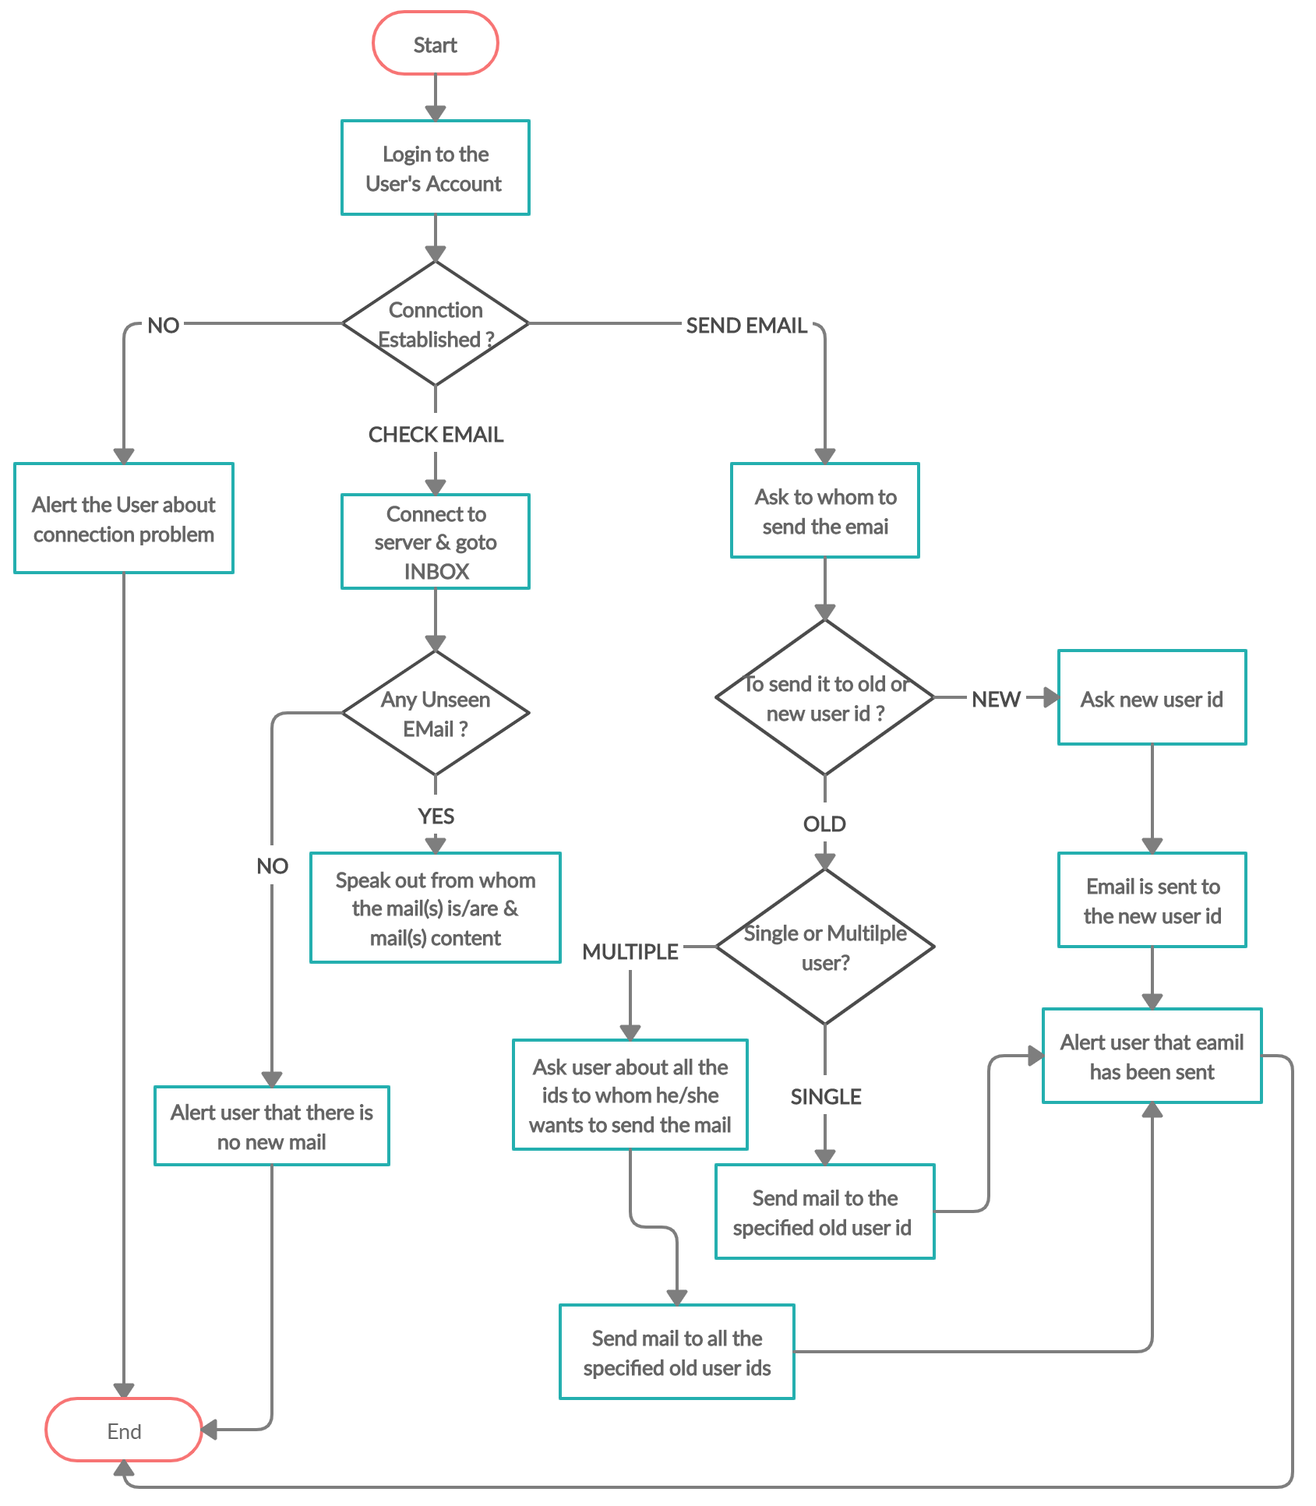
FLOW CHART OF THE SYSTEM

Slide 7
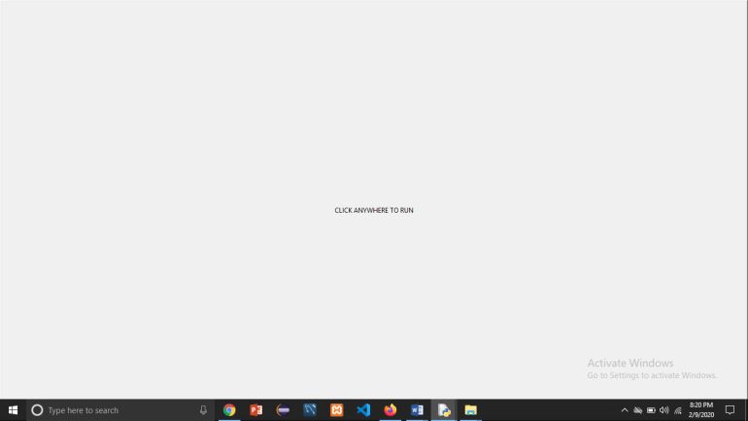
SYSTEM OUTPUTS
GUI :-

Slide 8
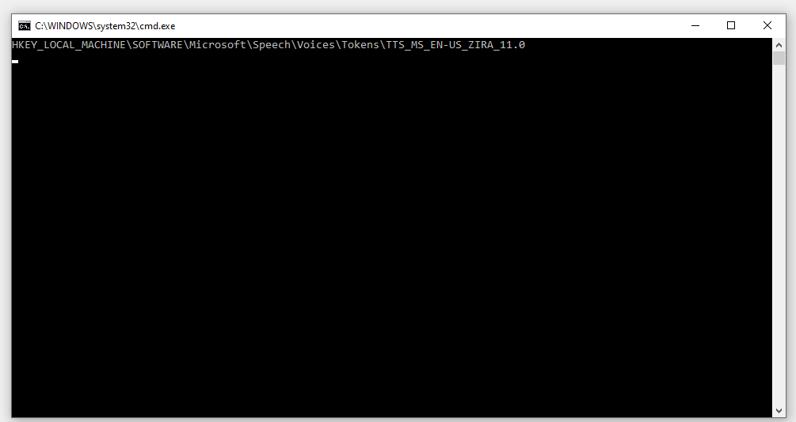
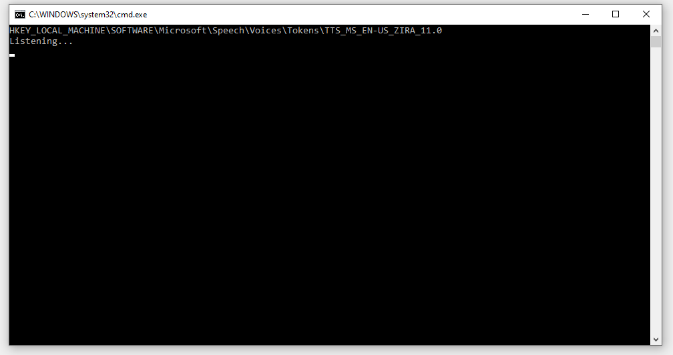
Connection with the mail server is established (Authentication) :-
System has started giving commands to the client :-

Slide 9
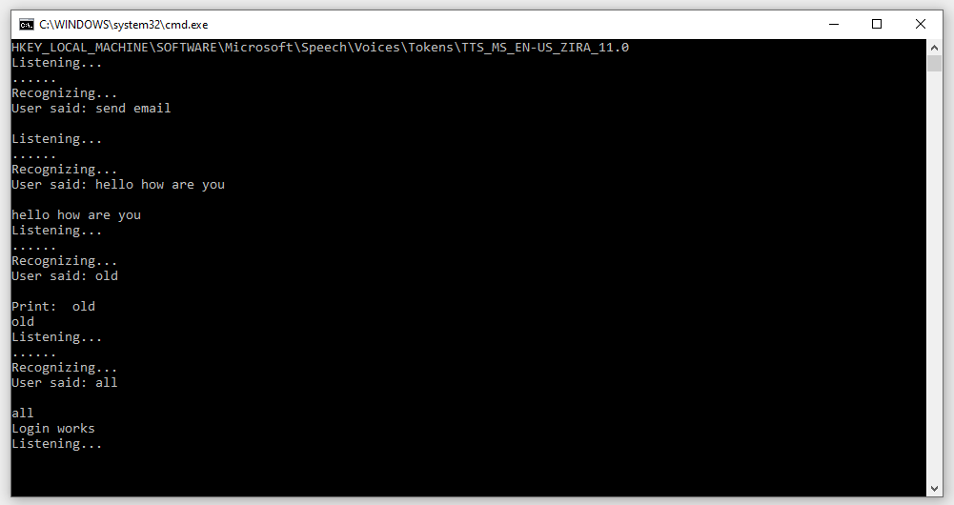
Send Email commands to be sent to the Old User IDs :-

Slide 10
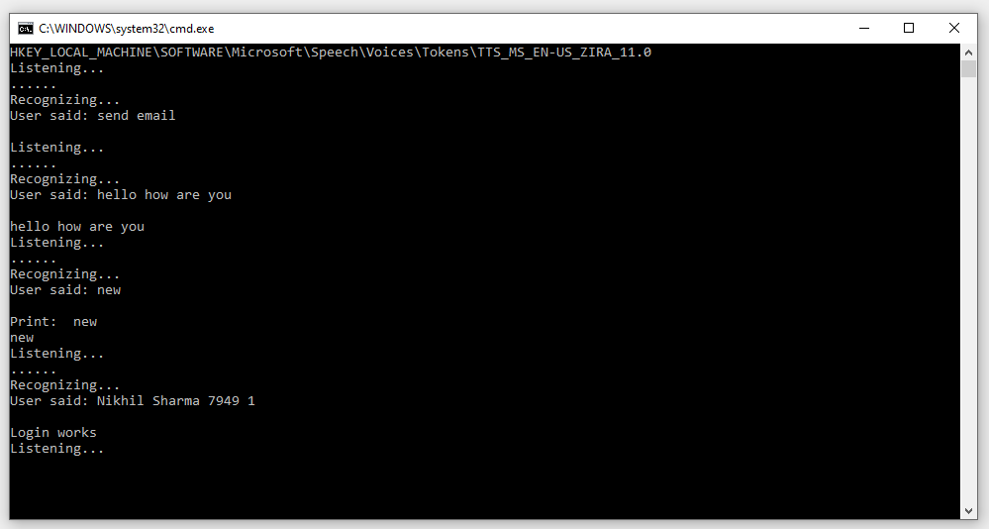
Send Email commands to be sent to the New User IDs :-

Slide 11
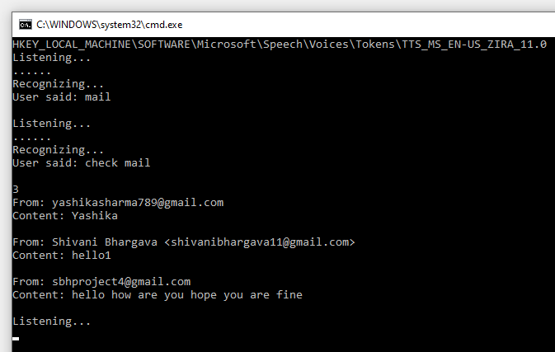
Check Email Commands :-

Slide 12
CONCLUSION
This project is proposed for the betterment of society. This project aims to help the visually impaired people to be a part of growing digital India by using internet and also aims to make life of such people bit easy.
This system will help in overcoming some drawbacks that were earlier faced by blinds.
Instructions are given by the IVR
Also, the success of this project will also encourage developers to build something more useful for visually impaired or illiterate people, who also deserve an equal standard in society.

