Slide 1
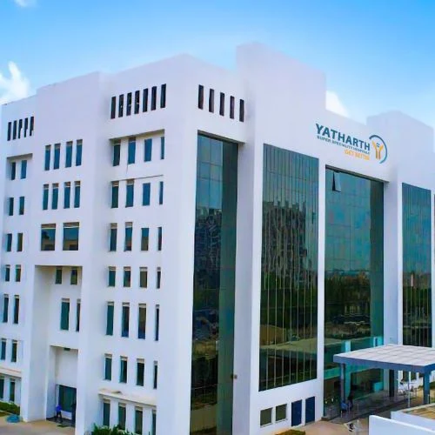
BDM CAPSTONE PROJECT
Spatial and Demographic Analysis of Hospital Registration Data for Optimizing Healthcare Outreach
ORGANISATION: YATHARTH SUPER-SPECIALTY HOSPITAL, FARIDABAD

Slide 2
BUSINESS PROBLEM STATEMENTS
Revenue Growth = Increasing Patient Inflow = Increasing Outreach = Where is it needed?
Spatial analysis
DEMOGRAPHIC ANALYSIS
Identifying high and low performing geographic regions to optimize spatial outreach.
Analyzing the Patient distribution across Faridabad and its sub-regions.
Understanding demographic gaps to develop targeted outreach programs.
Analyzing the distribution of Patients across Age and Gender Groups.

Slide 3
DATA COLLECTION AND PROCESSING
Patient Registration Data includes Registration Number, Registration Date, Date of Birth, Age, Gender and Address with 10319 patient records
Time Period: 11 months (July 2024 – May 2025)
Challenges: Format Inconsistencies and Missing Fields
DATA FILTERING
SPATIAL
DEMOGRAPHIC
Rule-Based Text Matching with Keyword Filtering
Age and Gender Based Categorical Classification
Sub-regions of Faridabad
Regions in Greater Faridabad
TIME-BASED FILTERING

Slide 4
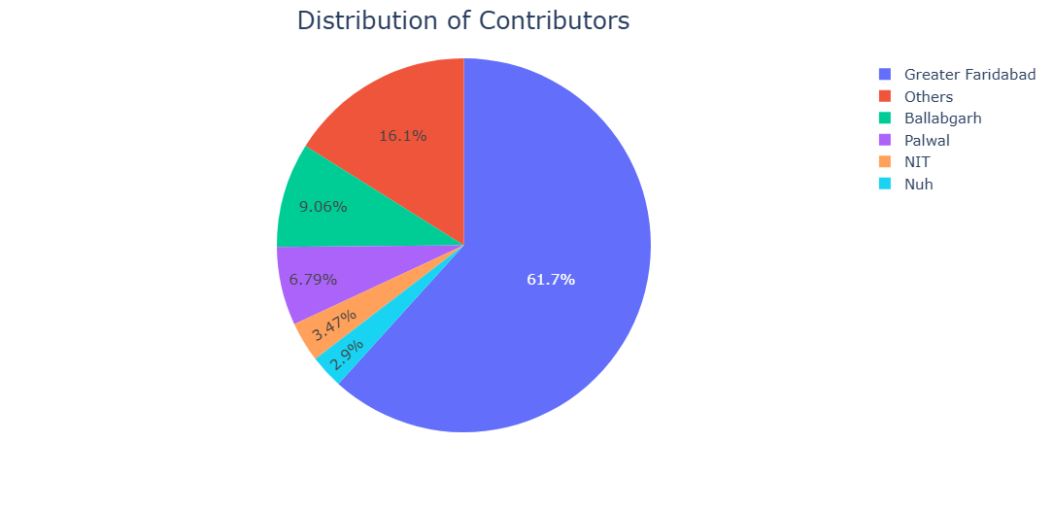
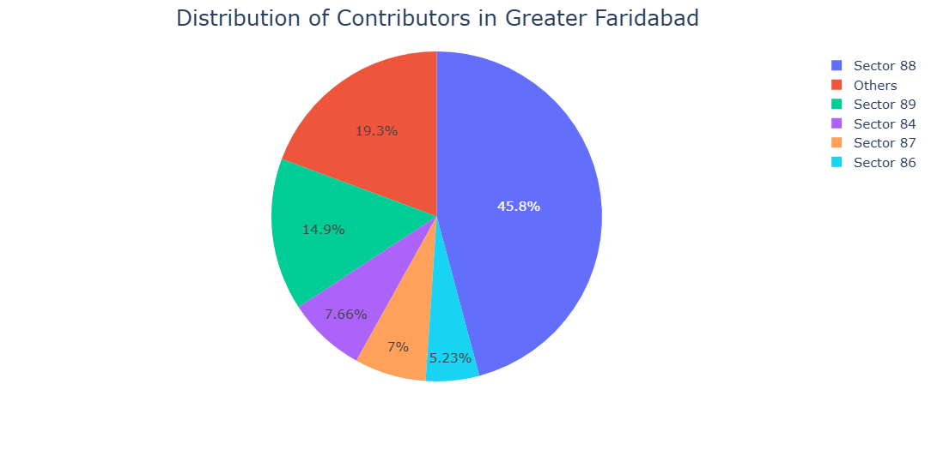
CONTRIBUTION FROM DIFFERENT REGIONS
FARIDABAD
GREATER FARIDABAD
Dominated by Greater Faridabad due to its location
Other = Contribution < 300 (~2.9%)
Dominated by Sector 88 and Sector 89
Other = Contribution < 300 (~4.71%)

Slide 5
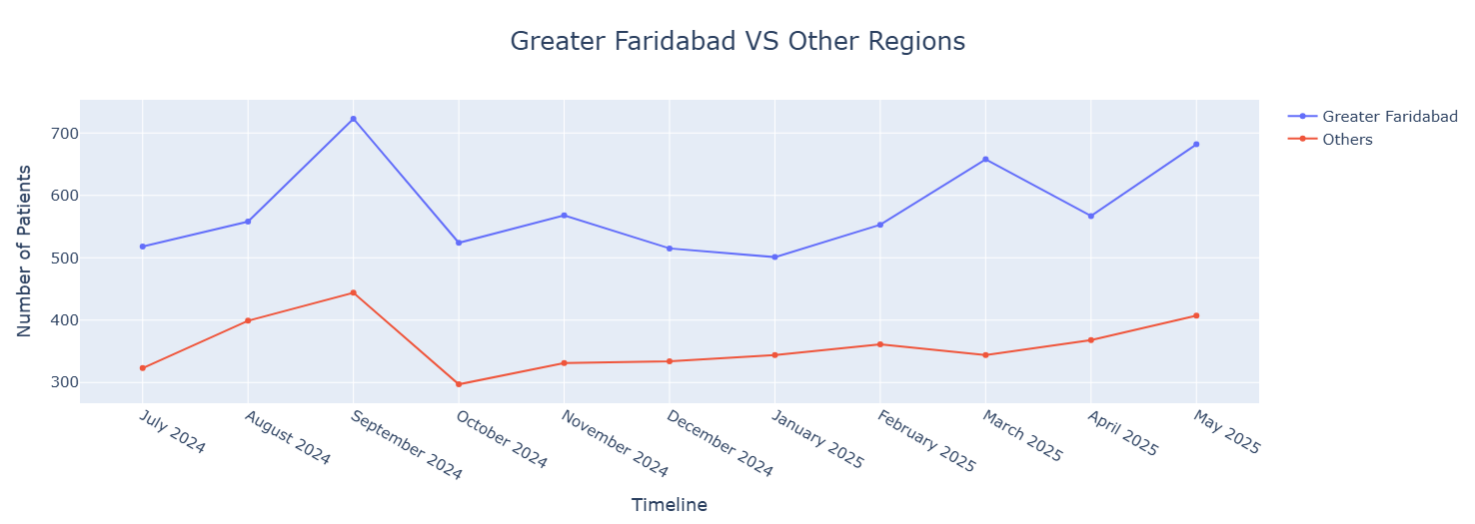
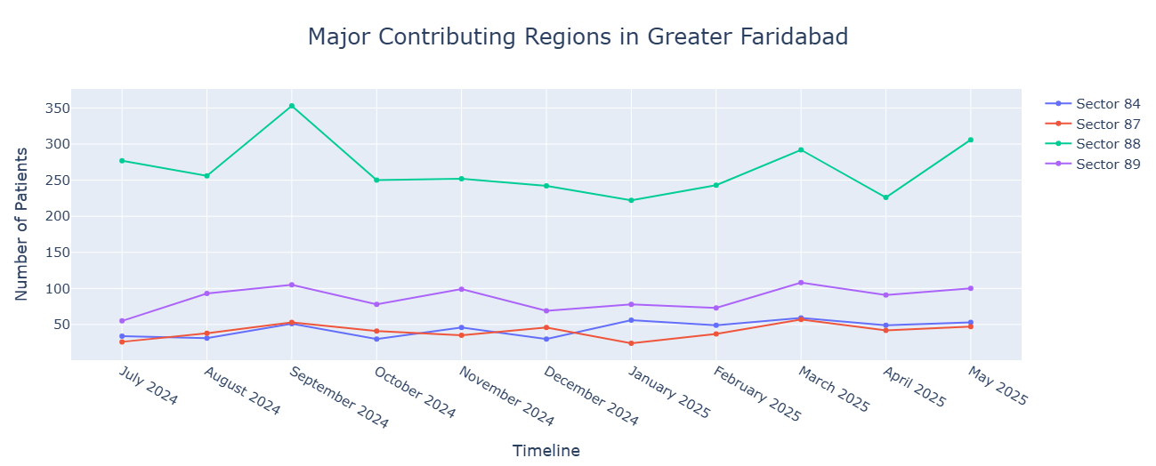
TEMPORAL TRENDS
October Dip due to Diwali and Dusshera festivities
Increased footfall in March due to seasonal factor, making it a favorable business month
Sector 88: noticeable peaks and fluctuation
Neighboring sectors: Consistent patient inflow
Notes:
gettyimages-1061332616-2048x2048

Slide 6
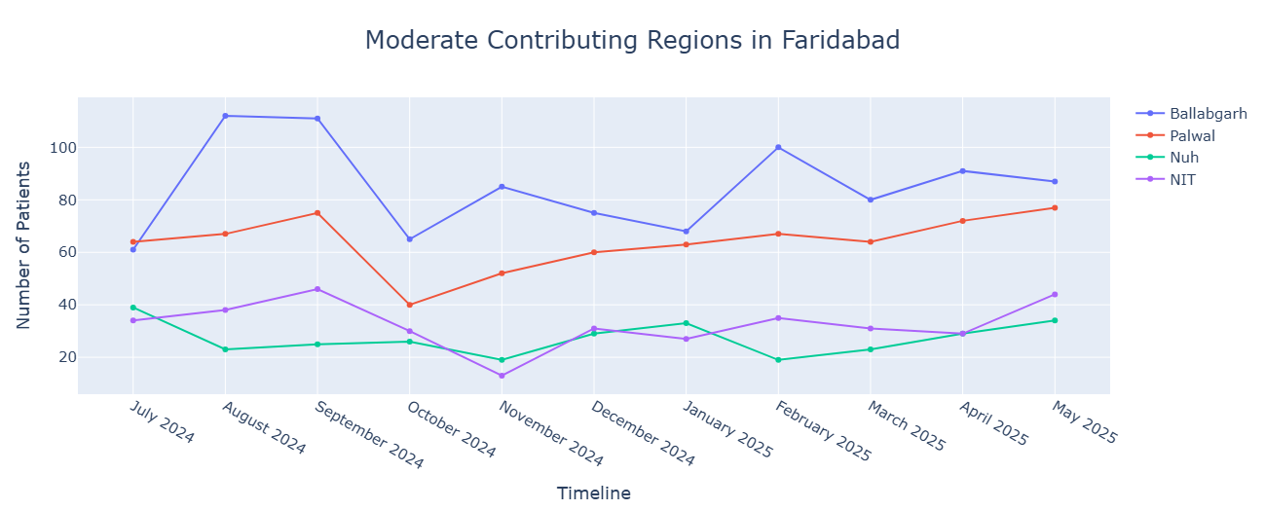
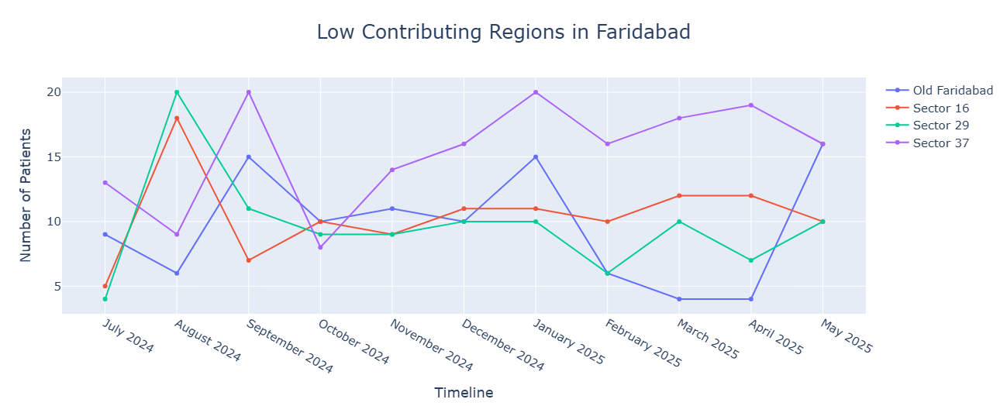
CONTRIBUTION FROM DIFFERENT REGIONS
Ballabgarh: inflow not recovered over time, could suggests presence of competition or weakening outreach
Palwal: Increasing patient inflow
NIT and Nuh: Inconsistencies in patient engagement
Old Faridabad: negligible inflow during March
Sector 37: Growing inflow after October Dip
Overall inconsistencies in the footfall
Palwal(40 km) vs Old Faridabad(12 km): Proximity does not guarantee engagement.

Slide 7
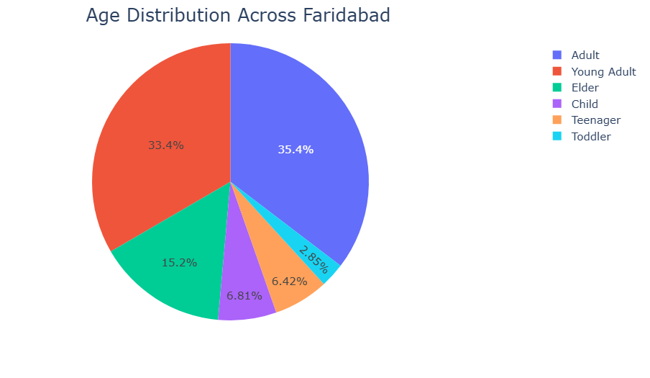
AGE DISTRIBUTION
High Contributing: Young Adult, Adult & Elder age group
Low Contributing: Toddlers, Child & Teenagers
Underutilization of Pediatric and Neonatology services

Slide 8
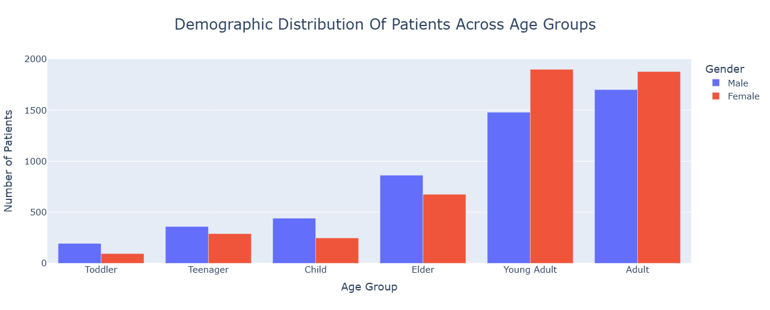
GENDER DISTRIBUTION
Relatively balanced patient inflow
Higher health-care seeking behaviour in Young Adult and Adult women.
Lower number of Females in Elder age group: mobility constraints, cultural barrier & lack of female-tailored geriatric care
Pediatrics: gender-based healthcare gaps due to socio-cultural factors

Slide 9
RECOMMENDATIONS
STRENGTHENING REGIONAL OUTREACH
ENHANCE PATIENT ENGAGEMENT
SEASONAL OUTREACH PLANNING
REFERRAL AND NETWORKING PROGRAMS
CONTINOUS MONITOURING AND ANALYSIS
Target underserved regions
Regular health camps and screening drives
Awareness Campaigns and Community health talks
Highlight Pediatric care
Partnership with Schools and daycares
Child-friendly infrastructures and Communication techniques
Festival offers and packages
Seasonal disease awareness programs
Anticipate demand during Seasonal illness cycle and establish awareness programs
Strengthen relationships with local doctors and clinics
CME workshops and joint conferences
Digital referral Applications
Robust patient data monitoring system
Identify gaps early and plan accordingly
Adjustenment of resource allocation based on performance data

Slide 10

CONCLUSION
Marketing Potential in underserved regions
Identification of seasonal patterns
Underutilized Pediatric and Female Child care
Referral Networks

