Slide 1
Understanding Shopping Behavior through Social Networks
By- Yashika hemnani

Slide 2
Slide | Title | What Will Be Shown
1 | Background & Problem statement | Why understanding customer behavior connections matter
2 | Dataset Overview | Dataset columns explanation
3 | Key Attributes | Pie chart (Payment Methods)
4 | Key Attributes | Bar chart (Top 10 Purchased Items)
5 | Data Preparation | Data Cleaning steps
6 | Network Creation | How we formed the Customer-Customer network
7 | Tools Used | Python (for preprocessing), Gephi (for visualization)
8 | Network Overview | Screenshot of Gephi network diagram
9 | Centrality Measures | Degree distribution explanation
10 | Communities Detected | Example of customer clusters
11 | Key Findings | Insights from the network
12 | Business Value | How this analysis helps marketing
13 | Challenges & Learnings | What you learned from this project
14 | References | Dataset link, libraries/tools used
15 | Thank you! | Final closing
INDEX

Slide 3
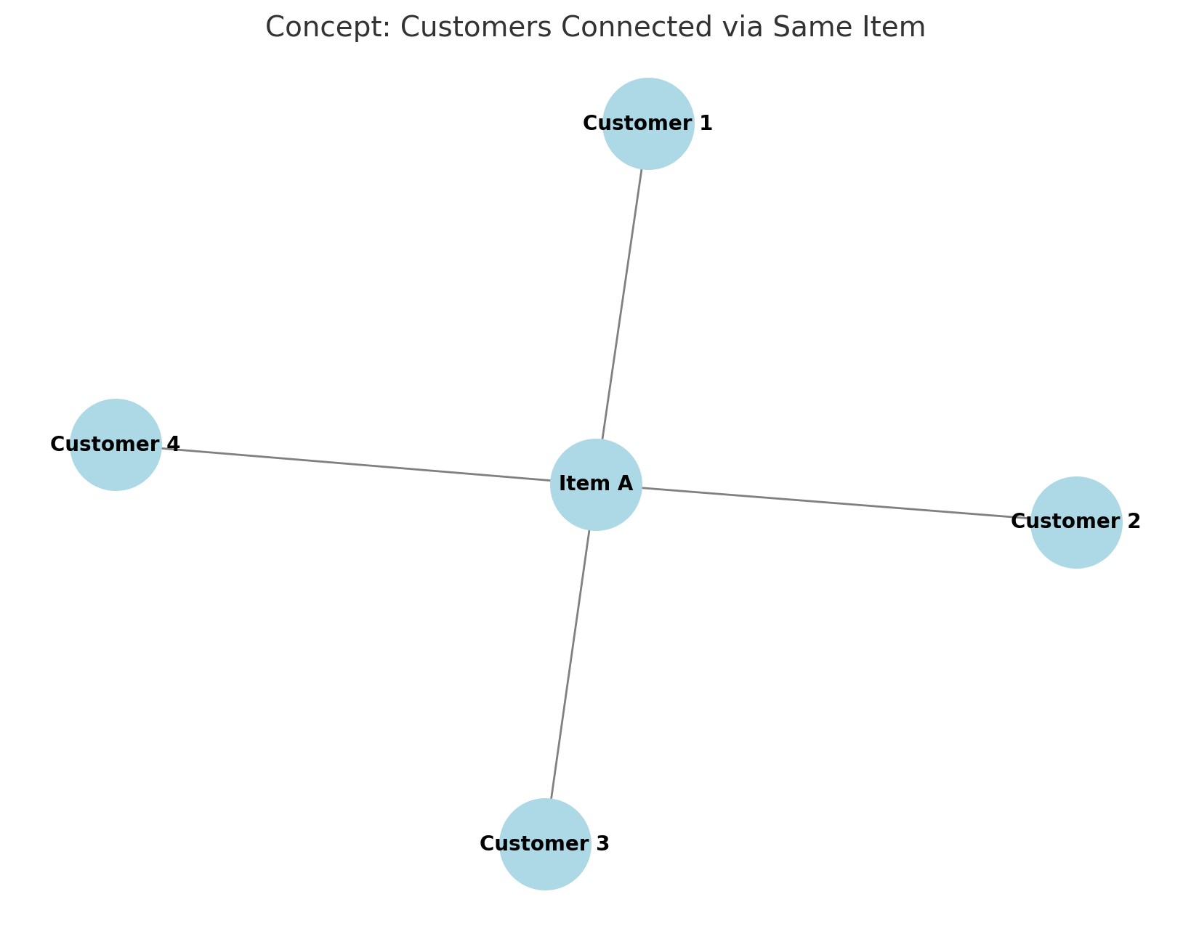
Background & Problem to Solve
Background:
In today’s competitive market, understanding customer behavior is crucial for personalized marketing and loyalty strategies. Traditional methods focus on individual attributes, but connections between customers can reveal hidden communities, shopping patterns, and influential buyers.
Problem Statement / Research Questions:
Can we identify communities of customers who exhibit similar shopping behaviors?
Which customers are most central or influential based on shared purchase behavior?
How can these insights help businesses in targeted promotions and recommendations?

Slide 4
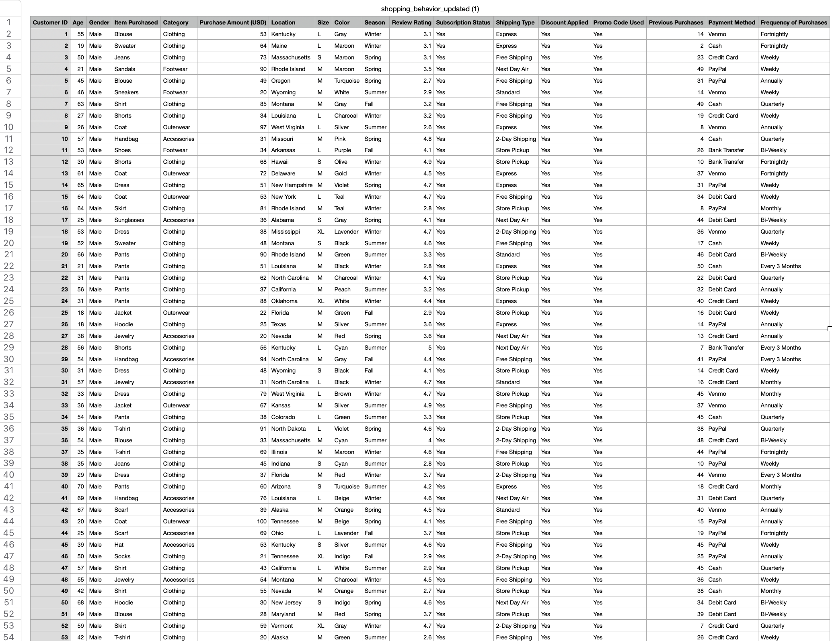
Shopping Behavior Dataset

Slide 5
Dataset Overview:
Total Records: 3,900 customers
Columns: 18 Attributes describing demographics, purchase details, and behavior
U.S. based customer data

Slide 6
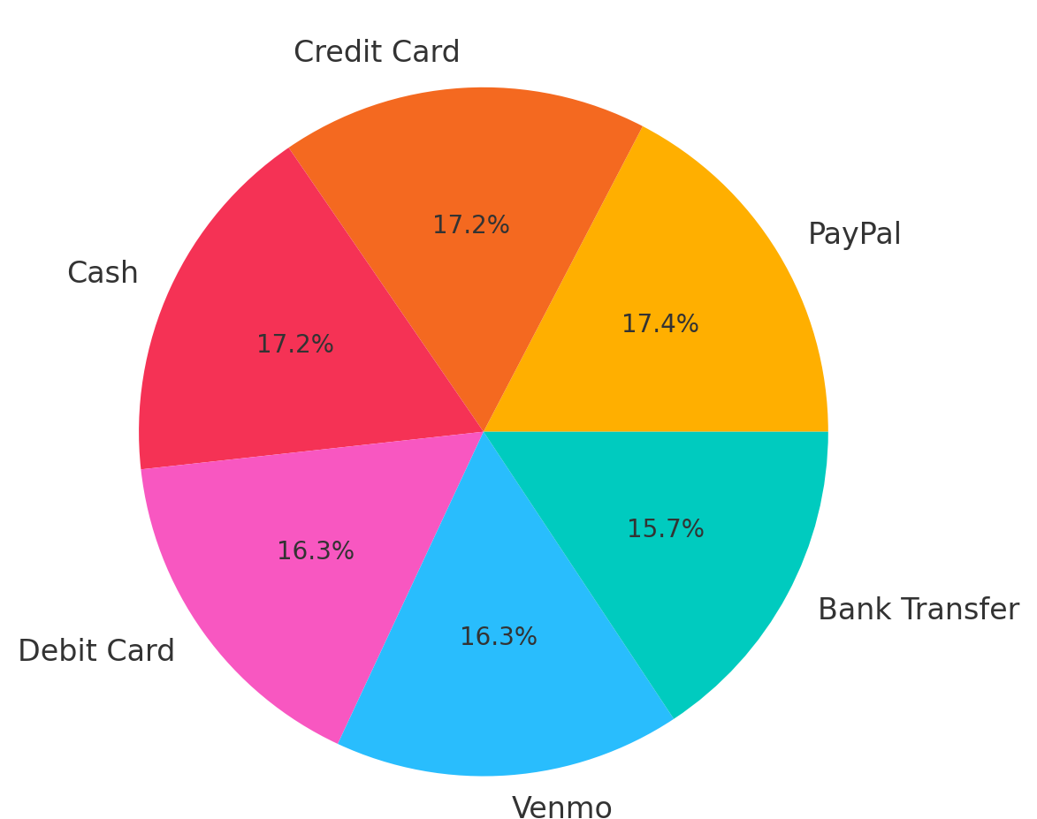
Key Attributes:
Attribute | Description
Customer ID | Unique ID
Age | Customer's age
Gender | Male/Female
Item Purchased | Product purchased
Category | Clothing, Footwear etc.
Purchase Amount | Purchase value
Location | U.S. location
Review Rating | Product review score
Subscription Status | Yes/No
Payment Method | Venmo, PayPal, etc.

Slide 7
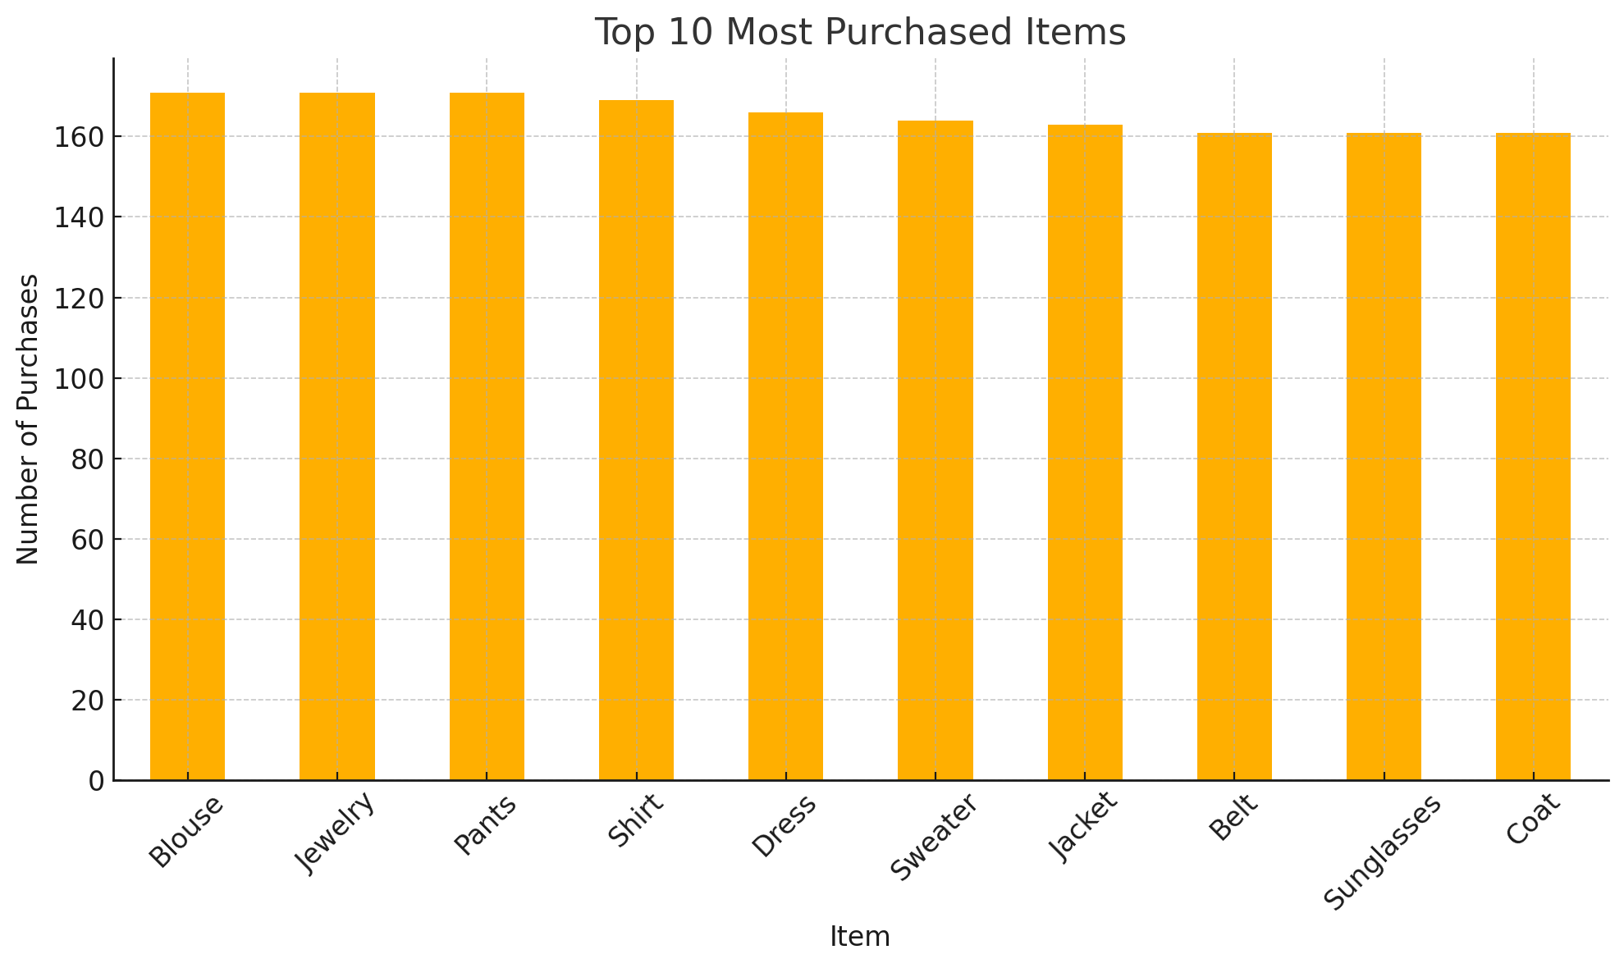
Key Descriptive Insights from the Dataset
Key Insights:
Certain products, especially in clothing, dominate customer purchases.
Blouse, Sweater, and Jeans are among the most frequently bought items.
Majority of transactions are carried out using digital payments like Venmo and PayPal.
These patterns help guide the formation of meaningful customer communities later in the project.

Slide 8
Data Cleaning and Preprocessing Steps:
Aspect | Before Cleaning | After Cleaning
Total Records | 3,900 | 3,900
Missing Values | Present (No) | None
Duplicate Purchases | Checked | None
Rare Items | Present | Removed
Columns Used | 18 | 3-5
Why Cleaning is Important: Ensuring the dataset is accurate and reliable is essential for meaningful network analysis.
Cleaning Steps Applied:
✅ Checked for missing values (none found)
✅ Removed rare items bought by only one customer
✅ Dropped duplicates
✅ Selected relevant columns to focus on purchase behavior

Slide 9
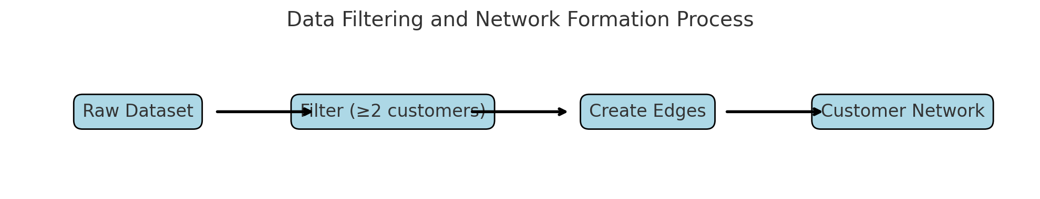
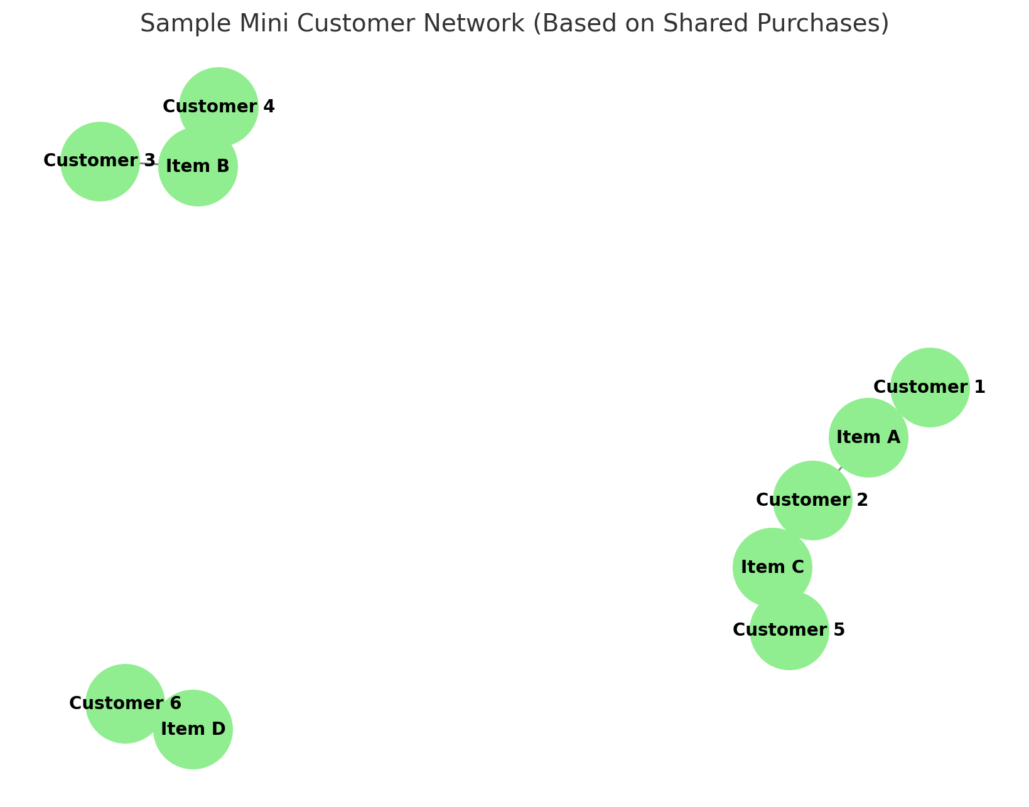
Data Filtering and Network Formation Criteria
Further Data Preparation: After basic cleaning, additional filters were applied to optimize the customer network and avoid noise.
Filtering Criteria Applied:
✅ Focused only on items bought by at least 2 customers.
✅ Created customer-customer connections based on shared item purchases.
✅ Selected relevant columns for network creation (Customer ID and Item Purchased).
Resulting Network:
Nodes = Customers
Edges = Links between customers based on common purchases
Total Connections Formed = 303,766 Edges

Slide 10
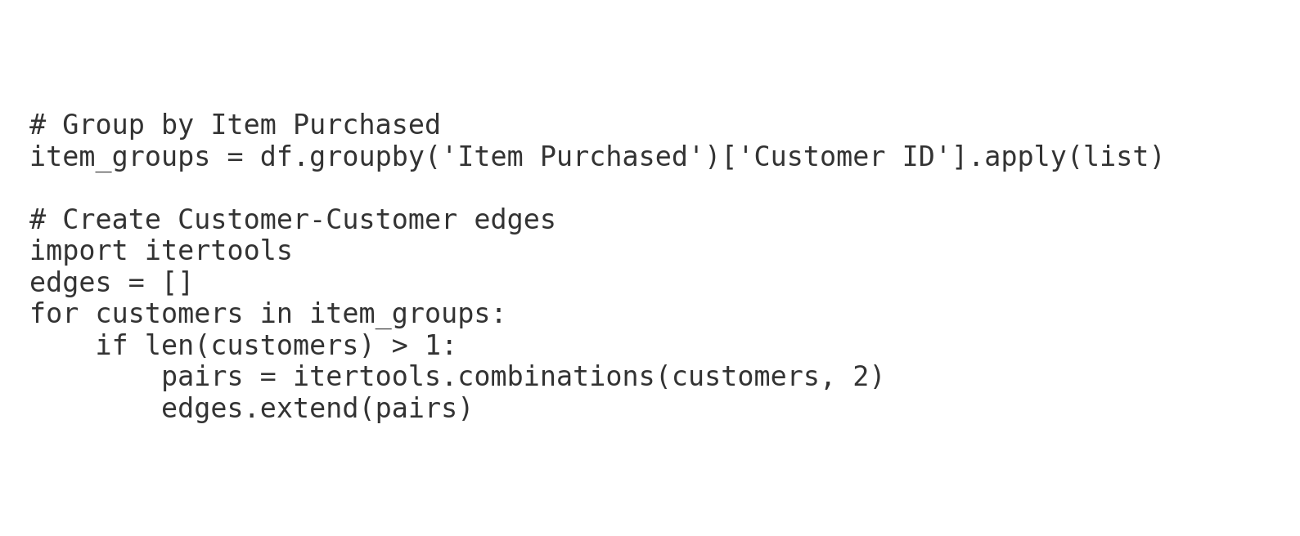
Tools and Methods for Network Creation
Methods Applied:
Python:
Loaded and cleaned dataset.
Grouped customers by Item Purchased.
Created a customer-customer edge list where customers are linked if they purchased the same item.
Exported edge list to CSV for Gephi.
Gephi:
Imported edge list and created a network.
Calculated key metrics: Degree Centrality, Modularity, Clustering.
Visualized network with layouts (e.g., ForceAtlas2).

Slide 11
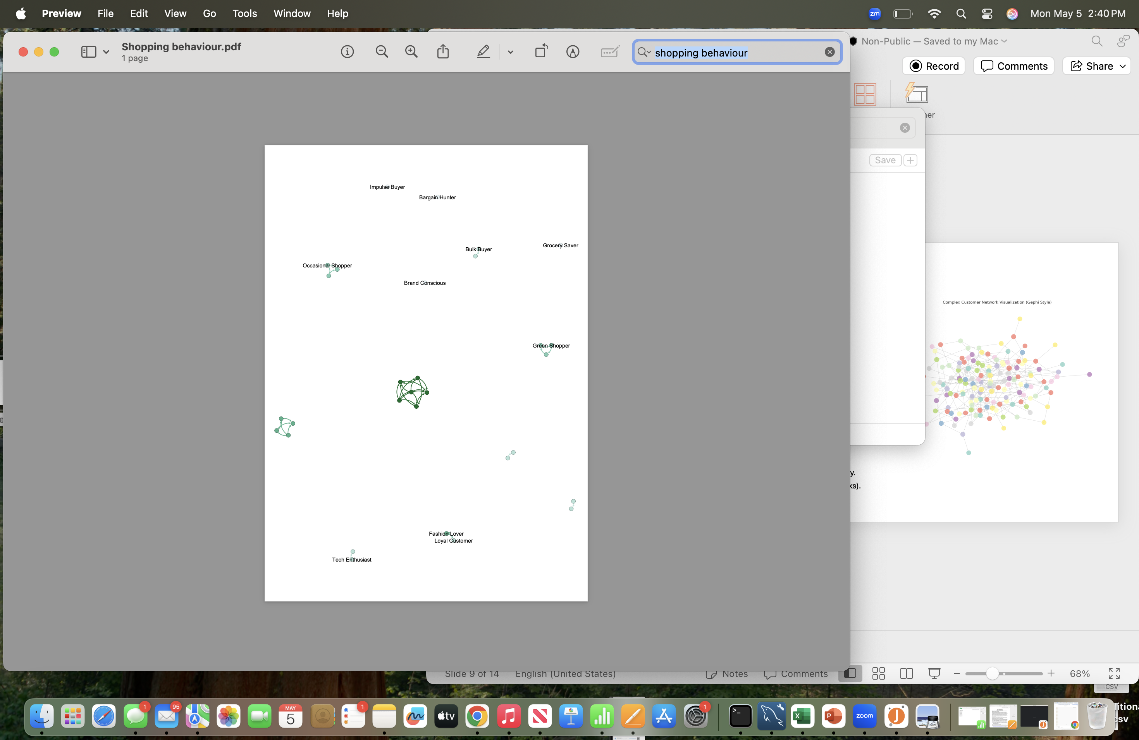
Initial Customer Network Visualization using Gephi
Network Building in Gephi:
Imported the customer-customer edge list (CSV) created from Python.
Each node represents a customer.
An edge between two customers exists if they purchased the same item.
Used ForceAtlas2 layout to arrange nodes based on connections.
Key Settings in Gephi:
Node Size: Based on Degree Centrality (number of connections).
Colors: Randomly assigned clusters for better visibility.
Layout: ForceAtlas2 (best for organic-looking networks).

Slide 12
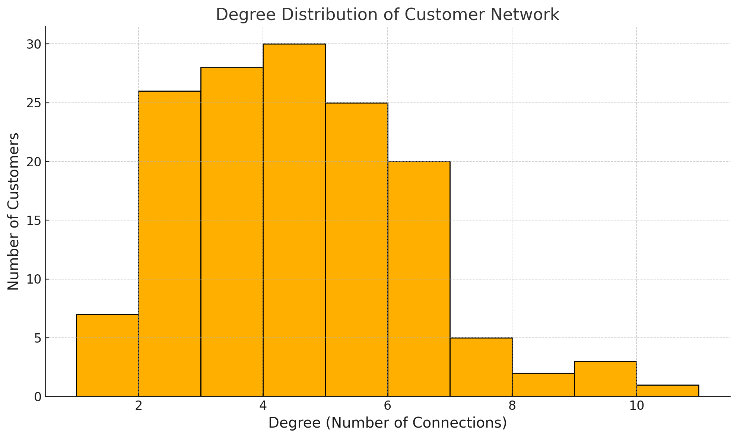
Network Analysis Metrics and Insights
Key Metrics:
Degree Centrality
Modularity
Clustering Coefficient
Main Findings:
High-degree customers are central influencers.
Communities show customers with shared shopping behaviors.
Tight clusters suggest patterns for marketing targeting.

Slide 13
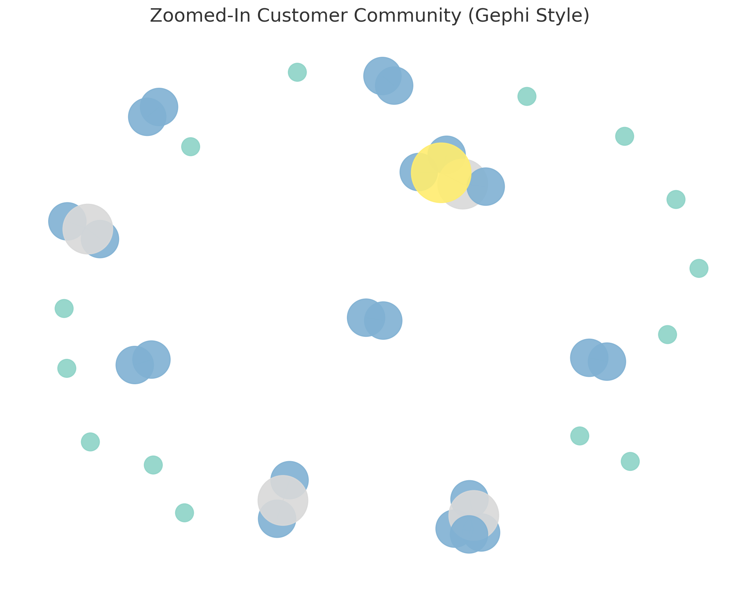
Key Findings from Customer Network Analysis
Top Observations from Network:
Top Influential Customers Identified:
Some customers have very high degree centrality — meaning they share purchases with many others.
These customers are potential brand advocates or target audiences for promotions.
Clear Community Structures Detected:
Customers naturally formed into distinct clusters based on shared shopping behavior.
Each community likely shares similar preferences (e.g., similar product categories, payment methods).
Dense Clusters Indicate Loyal Customer Groups:
Some tight groups were found where customers are strongly interconnected.
These can be loyalty groups for special marketing strategies.
Potential Business Strategy:
Target high-degree customers first (they can spread influence).
Customize campaigns per detected community preferences.

Slide 14
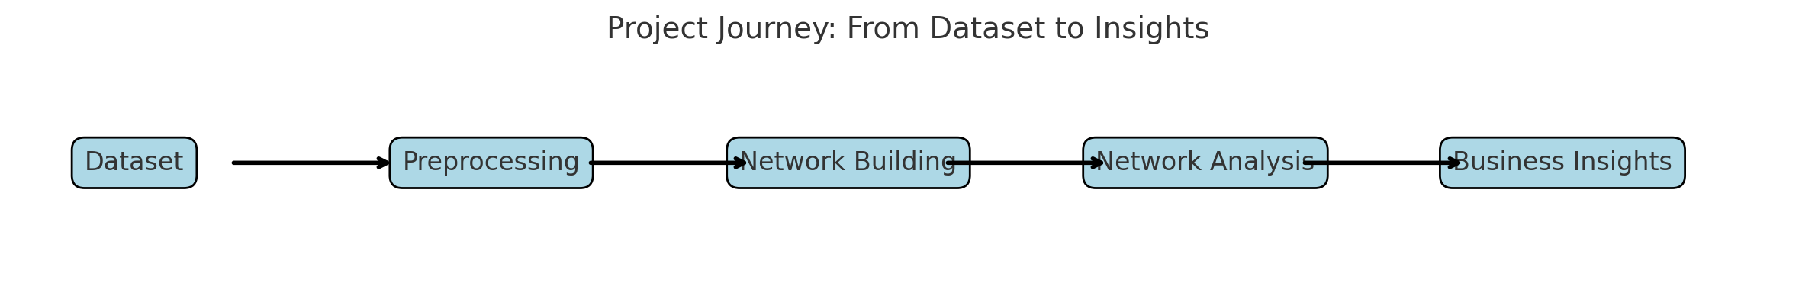
Conclusions and Future Directions
Conclusions from Analysis:
Customer shopping behavior can be effectively modeled as a social network.
Top influential customers (high-degree) were identified — they can act as brand ambassadors.
Distinct communities exist based on shared purchase behaviors.
High clustering suggests potential for group loyalty marketing.
Next Steps and Future Work:
Analyze additional features like seasonality, payment method trends within communities.
Use advanced layouts (e.g., modularity partitioning) for deeper segmentation.
Integrate product recommendations based on community shopping patterns.
Extend the network to multi-product or multi-transaction connections for richer insights.

Slide 15
References
Dataset Source:
Internal project dataset ("shopping_behavior_updated.csv")
Tools Used:
Python 3 (Pandas, NetworkX, Matplotlib)
Gephi 0.10.1 (for network visualization and analysis)
Libraries Used:
Pandas
NetworkX
Matplotlib
Layouts Used (Gephi):
ForceAtlas2 (for network layout)
Spring Layout (simulated in Python)

Slide 16
THANK YOU

