Slide 1

📰 AI-Driven Fake News Detection System
A Machine Learning Approach using Naive Bayes, Python, and MongoDB
PROTOTYPE SYSTEM
NLP · CLASSIFICATION

Slide 2

Abstract
This project delivers a desktop application that classifies news articles as "Real" or "Fake" using a probabilistic Multinomial Naive Bayes model — trained from scratch without relying on black-box libraries.
GUI Layer
ML Engine
Data Layer
Tkinter-based interface for real-time user input and results display
Word-frequency probability calculations with Laplace smoothing
MongoDB NoSQL database for persistent prediction history tracking

Slide 3

Introduction: The Misinformation Crisis
The Problem
The Gap
False news spreads 6× faster than true stories on social platforms. Manual fact-checking cannot keep pace with the volume of content generated daily.
Existing AI tools are either too slow, too opaque, or require cloud infrastructure — leaving everyday users without accessible, transparent detection tools.
Our Objective
Build a lightweight, local-hosted classifier that calculates word-frequency probabilities to identify linguistic bias — with full transparency into every decision.

Slide 4

Problem Statement & System Design
Core Problem
Modular Architecture
Manual fact-checking is slow and unscalable. Standard black-box AI models provide predictions without explainability — users cannot understand why an article was flagged.
01
Preprocessing Engine
Tokenizes, cleans, and normalizes raw text input
Lack of transparency erodes user trust in automated classification systems.
02
Naive Bayes Classifier
Computes class probabilities from word-frequency dictionaries
03
Database Storage Layer
Persists every prediction to MongoDB for audit and analytics

Slide 5
Project Objectives
Our core development goals are centered around building a robust, transparent, and user-friendly fake news detection system.
High Accuracy Classification
Intuitive User Interface
Persistent Data Storage
Develop an intuitive Tkinter GUI to provide real-time user interaction and facilitate immediate news article analysis.
Integrate a MongoDB database for efficient storage and retrieval of all prediction history, enabling auditing and future analysis.
Implement a Naive Bayes classification algorithm using log-probabilities to achieve high accuracy in distinguishing real from fake news.
Visualized Trends
Robust Text Processing
Visualize prediction trends and system performance metrics using Matplotlib-generated bar charts for clear insights.
Establish a robust text-cleaning pipeline encompassing tokenization, normalization, and stop-word removal to effectively process raw news data.

Slide 6

Methodology: The Math Behind the Model
Bayes' Theorem
Engineering Safeguards
The classifier estimates the posterior probability of a class C given observed words x:
Laplace Smoothing (Add-1)
Log-Probabilities
Replaces multiplication of small probabilities with addition of log values, eliminating arithmetic underflow.
Prevents zero probabilities for unseen words by adding 1 to every word count in the vocabulary.
The "naive" assumption: all word features are conditionally independent given the class.

Slide 7
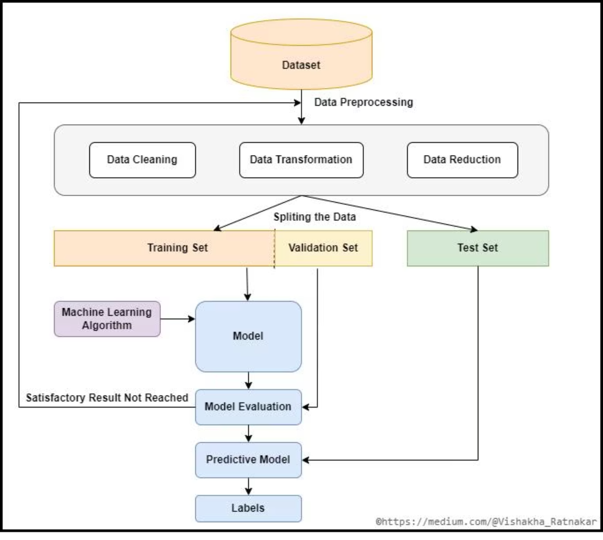
System Flowchart
The end-to-end pipeline runs entirely offline — from dataset ingestion through preprocessing, classification, and persistent storage — with results rendered in the Tkinter GUI in real time.

Slide 8
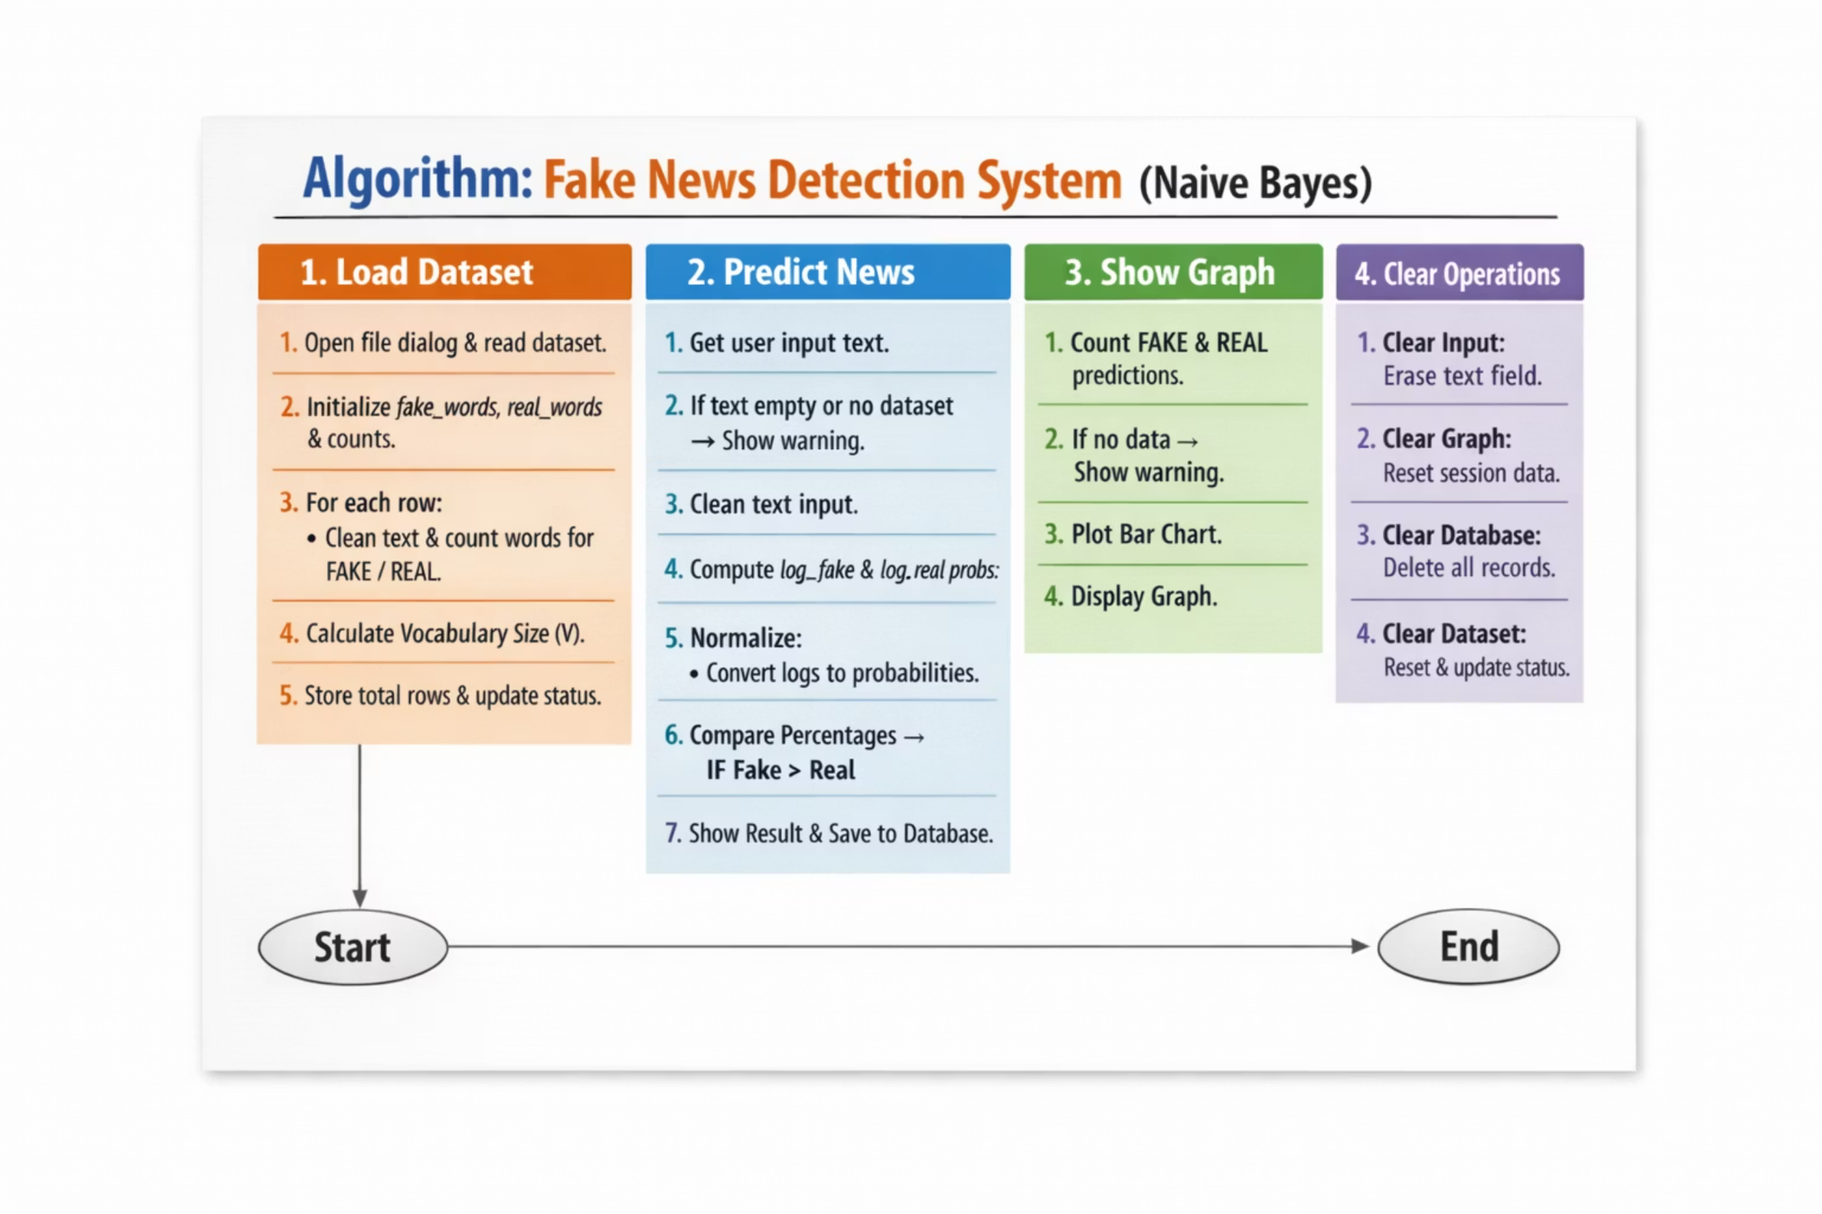
Algorithm: Step-by-Step

Slide 9
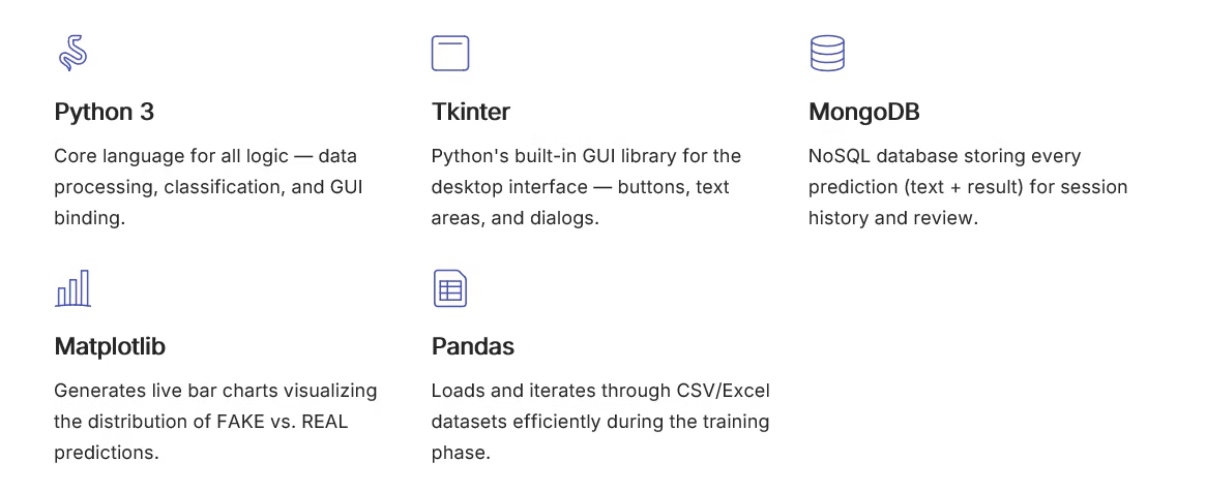
Tools & Technology Stack

Slide 10
Project Results
Our system successfully meets all project objectives, delivering a robust, transparent, and user-friendly fake news detection solution.
Accurate Classification
Data Persistence
Interactive Visualization
The Naive Bayes model accurately classifies news as 'FAKE' or 'REAL', providing clear confidence percentages for each.
Integrated MongoDB ensures reliable logging and retrieval of all historical analysis data for audit and future insights.
A dynamic Matplotlib module provides real-time visualization of prediction trends, offering immediate performance insights.
Efficient Preprocessing
Full-Scale UI
A regex-based pipeline effectively cleans and normalizes raw text, enhancing the accuracy of the classification model.
A high-resolution Tkinter dashboard offers a responsive, intuitive interface with a modern dark-mode aesthetic.

Slide 11
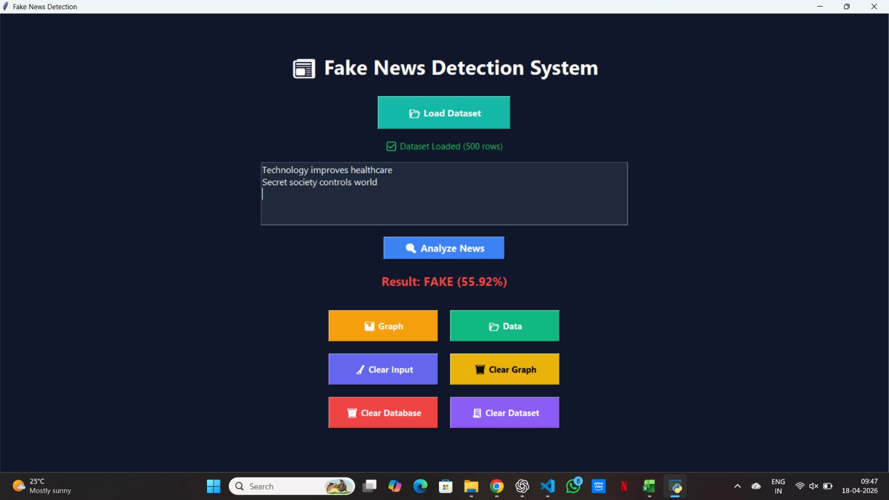
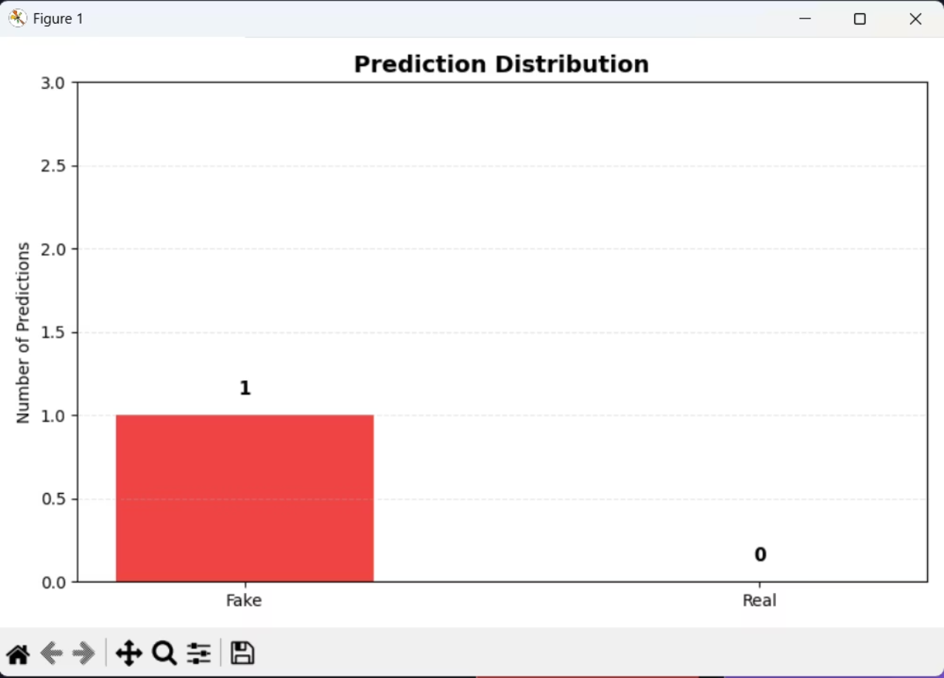
Results & Analysis
Tkinter Application Interface
Prediction Distribution (Matplotlib)
The desktop GUI presents a clean input field for news text, a classify button, and a real-time result panel displaying Real or Fake with confidence scores.\
The embedded bar chart visualizes the cumulative count of Real vs Fake classifications stored in MongoDB across sessions.

Slide 12
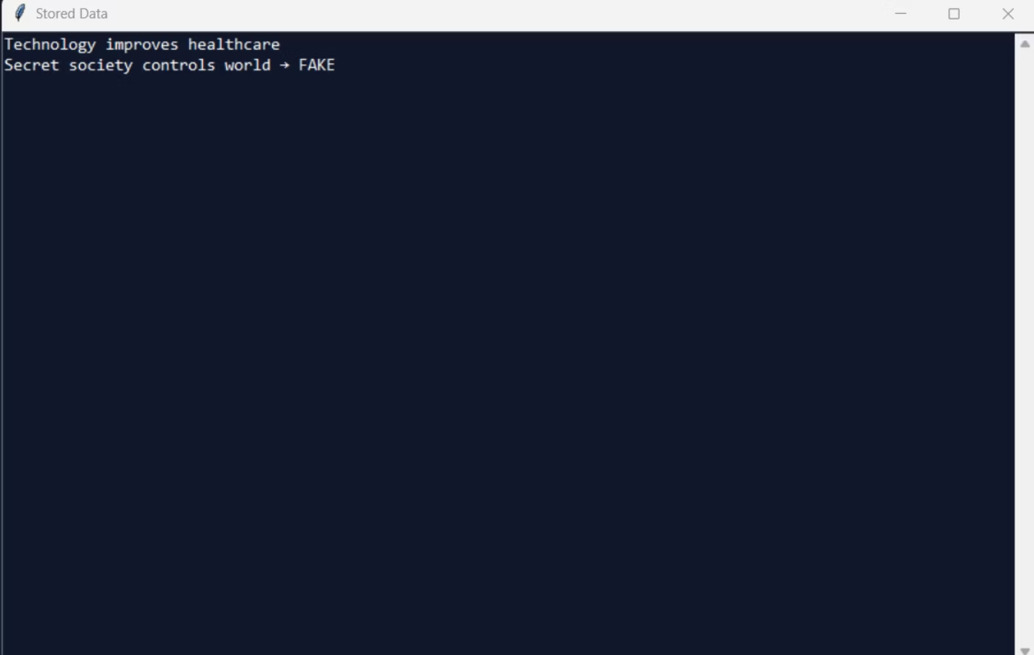
Results & Analysis
Stored Data Output (Console View)
The displayed console output shows sample news classifications, where each input headline is labeled as Real or Fake based on the trained model.

Slide 13
Key Outcomes
Technical Success Metrics
Mathematical Accuracy
Database Reliability
Successfully utilized Log-Probability and Laplace Smoothing to ensure the model remains stable even with large text inputs.
Demonstrated seamless CRUD operations with MongoDB, allowing for a searchable history of analyzed news.
Robust Preprocessing
Scalability
Developed a regex cleaning pipeline that standardizes raw data for better prediction consistency.
The system architecture allows for expanding the dataset without rewriting the core algorithm, making it future-proof.

Slide 14
Conclusion & Future Scope
✅ What We Achieved
🔭 Roadmap Ahead
1
N-gram Features
Functional Classifier
Zero Division Errors
Bi-grams and tri-grams to capture phrase-level context beyond single words
Fully operational local-hosted news classifier with transparent probability outputs
Log-normalization and Laplace smoothing eliminate all arithmetic edge cases
2
Live Web Scraping API
Integrate real-time news link ingestion for on-the-fly classification
Persistent Analytics
3
Deep Learning Upgrade
MongoDB layer enables longitudinal tracking of prediction patterns
Replace or augment with LSTM/BERT models for state-of-the-art accuracy

Slide 15
References & Sources
Dataset
Logic & Documentation
Core Libraries
Sourced from Kaggle (Fake and Real News Dataset) and curated repositories on GitHub to ensure a balanced variety of news articles.
Algorithmic structure and technical documentation assisted by ChatGPT for optimized Python implementation.
Reference the use of Pandas for data manipulation, Matplotlib for visualization, and PyMongo for database connectivity.
Database
Powered by MongoDB for local NoSQL data management and storage.

