Slide 1
AI-Powered Collections Strategy
Leveraging Agentic AI for Scalable, Fair, and Effective Debt Management at Geldium

Slide 2
How the System Works
Customer Data Input: Repayment history, credit score, income, customer interactions
Decision Logic Engine: AI model predicts risk and suggests actions
Action Module: Sends personalized reminders, plans, or escalations
Learning Loop: Continuously refines decisions based on outcomes
Notes:
Prompts to try:
Generate a simple outline for an AI collections system workflow, including inputs, decision logic, action triggers, and learning loop.
List 3–5 key customer attributes that would be most predictive for collections decision-making, and explain why each one matters.
Suggest examples of business rules and AI-driven actions the system could use at different risk levels (e.g., low, medium, high risk).
Create a rough sketch or step-by-step description of how customer data flows through the system from intake to action.

Slide 3
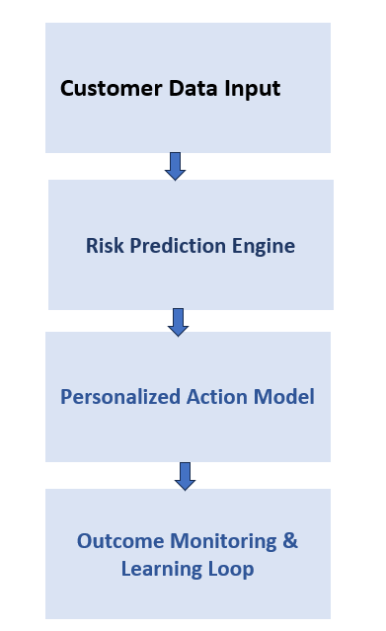
System Workflow Diagram

Slide 4
Role of Agentic AI
Autonomous AI: Predicting risk, sending reminders, adapting messages, learning from data
Human Oversight: Approving payment plans, reviewing edge cases, handling disputes, auditing fairness
Notes:
Prompts to try:
Explain how agentic AI could automate financial collections while keeping humans in critical decision points.
List 3–5 examples of collection actions, and classify each as best suited for full automation or requiring human oversight, with a brief reason why.

Slide 5
Responsible AI Guardrails
Fairness & Bias Mitigation: Continuous auditing for disparate impact across demographic groups.
Explainability: Transparent model (Logistic Regression) provides clear reasons for predictions.
Human-in-the-Loop: Human agents retain final decision-making authority for critical cases.
Regulatory Compliance: Automated checks ensure adherence to all financial regulations.
Notes:
Prompts to try:
List key fairness, transparency, and compliance practices to build into an AI-powered credit collections system.
Suggest specific ways to monitor and audit the system over time to ensure it stays fair, compliant, and effective.

Slide 6
Expected Business Impact
Quantitative Outcomes (Business KPIs):
Reduced Delinquency Rates
Improved Cash Flow
Lower Operational Costs
Enhanced Productivity of Collections Team
Qualitative Outcomes (Customer Benefits):
Improved Customer Experience
Fair and Equitable Treatment
Customer Empowerment through Proactive Support
Notes:
Prompts to try:
Suggest KPIs for an AI-powered collections strategy that balances business outcomes with customer fairness.
Describe 2–3 ways an AI collections system could improve both operational efficiency and customer experience.

Slide 7
Thank You

