Slide 1
Employee Data Analysis using Excel
STUDENT NAME:YASHIKA.J
REGISTER NO:122203117 [unm 14512022H58]
DEPARTMENT:B.COM CORPORATE SECRETARYSHIP
COLLEGE: MAHALAKSHMI WOMEN'S COLLEGE OF ARTS AND SCIENCE

Slide 2
PROJECT TITLE
Employee Performance Analysis using Excel

Slide 3


AGENDA
Problem Statement
Project Overview
End Users
Our Solution and Proposition
Dataset Description
Modelling Approach
Results and Discussion
Conclusion
3/21/2024 Annual Review

Slide 4

PROBLEM STATEMENT
1. Employee performance analysis involves evaluating an employee's work quality, efficiency, and effectiveness.
2. It helps identify areas for improvement, recognition of achievements, and strategies for professional development.
3.This process typically includes assessing key performance indicators, feedback from supervisors and peers, and goal achievement

Slide 5

PROJECT OVERVIEW
.
1. A project overview can be used as a summary or introduction in a project proposal, which contains more detailed information about the project's schedule and budget.
2. Keep it simple: Avoid technical language and keep your writing simple and easy to understand
3.A detailed description of a project's goals and objectives, the steps to achieve these goals, and the expected outcomes. In addition, a project overview enables you to outline the project schedule, budget, necessary resources, and status.

Slide 6

WHO ARE THE END USERS?
1.The term "end user" refers to the consumer of a good or service, often who has some innate know-how that is unique to consumers
2.An end user is a person or other entity that consumes or makes use of the goods or services produced by businesses.
3.Delivery to the end user is often the final step in manufacturing and selling products.

Slide 7

OUR SOLUTION AND ITS VALUE PROPOSITION
1.A value proposition tells prospects why they should do business with you rather than your competitors, and makes the benefits of your products or services crystal clear from the outset.
2.clearly explain how a product fills a need, communicate the specifics of its added benefit, and state the reason why it's better than similar products on the market.
3.Identify a specific problem being dealt with by a specific audience.

Slide 8
Dataset Description
1.Datasets involve a large amount of data points grouped into one table. Datasets are used in almost all industries today for various reasons.
2.A dataset that includes a listing of all real estate sales in a specific geographic area during a designated time period
3.A dataset that includes the attendance rate for public school students pre-K-12 by student group and by district during the 2021–2022 school

Slide 9

THE "WOW" IN OUR SOLUTION
1.The ‘wow’ moments truly occur when we are impressed. When someone makes us feel appreciated, respected and heard, we are impressed.
2.With all the reports of fraud today, it’s something we need to think twice about doing.
3.An incredibly frustrating experience that happens all too often is when Customer Service tells you something like “That’s outside our policy or procedures, sorry, can’t help.”
3/21/2024 Annual Review
9

Slide 10
MODELLING
1.Modeling involves making a representation of something. Creating a tiny, functioning volcano is an example of modeling.
2.At present, fashion Models in America are found to make an average salary of $167,104 per year or $80 per hour. Out of this, the top 10% make over $525,000 per year, while the bottom 10 percent are under $53,000 per year.
3.Fitness Industry – This industry hires models to display the multiple fitness programmes and products thus promoting a healthy lifestyle.
10

Slide 11
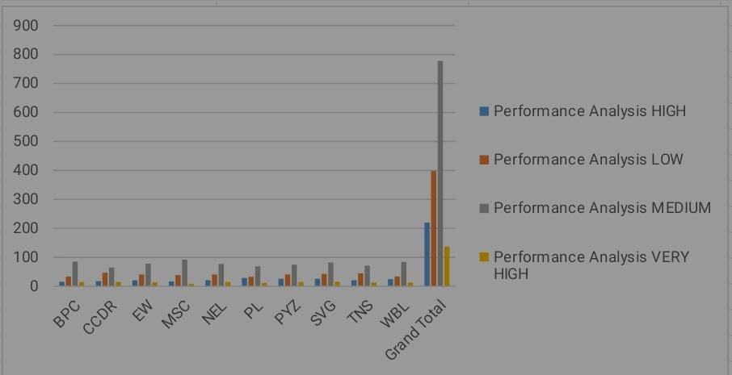
RESULT

Slide 12
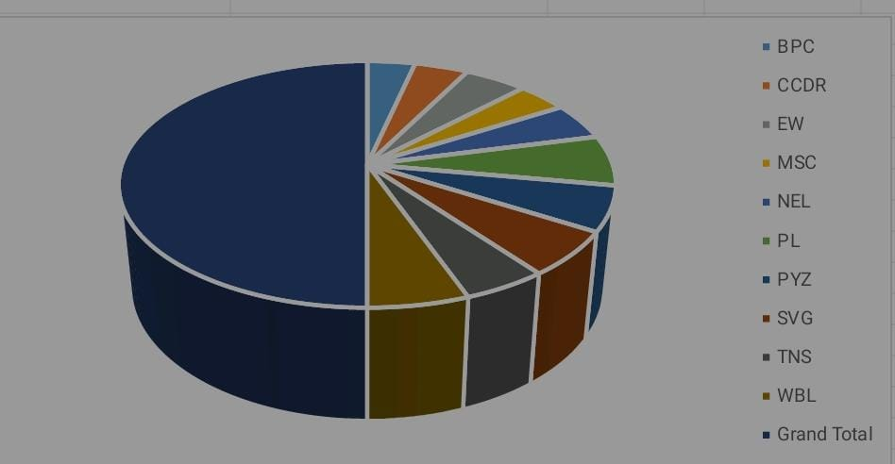
RESULT

Slide 13
conclusion
1.Economic analysis is a useful tool for planning and evaluating prospects in changing management practice(s), also in a close to subsistence farming economy.
2.Economic Planning help in mobilizing and allocating the resources in desired manner.  Objective of economic planning is to reduce inequality, economicgrowth, balanced regional growth, modernization.
3.A single paragraph restating the main points or main findings.

