Slide 1


DECODELABS • DATA SCIENCE INTERNSHIP
From Raw Data to
Fraud Detection
Task 1 : Data Cleaning & Feature Engineering
Task 2: Credit Card Fraud Detection with Machine Learning
Prepared by Yashil Modi
Data Science Internship Project Walkthrough

Slide 2

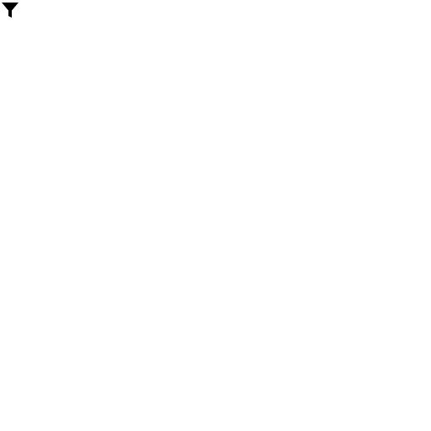

PROJECT OVERVIEW
Two Tasks, One Data Science Workflow
TASK 1
TASK 2
Data Cleaning &
Feature Engineering
Credit Card
Fraud Detection
A 1,200-row retail order export is cleaned, checked for outliers with the IQR rule, and expanded with 6 engineered features ready for analysis.
Two machine learning models are trained and compared to catch fraud among 284,807 transactions, only 0.173% of which are fraudulent.
1,200 orders | 14 → 20 columns
284,807 transactions | 2 models compared
YASHIL · DECODELABS DATA SCIENCE INTERNSHIP
02

Slide 3
PART ONE
Task 1: Data Cleaning &
Feature Engineering
Turning a messy 1,200-row retail export into an analysis-ready dataset
YASHIL · DECODELABS DATA SCIENCE INTERNSHIP
03

Slide 4

TASK 1 · THE DATASET
Dataset for Data Analytics.xlsx
1,200
14
2023–2025
rows (orders)
raw columns
2023-01-01 to 2025-06-30
Raw Columns (14)
OrderID
Date
CustomerID
Product
Quantity
UnitPrice
ShippingAddress
PaymentMethod
OrderStatus
TrackingNumber
ItemsInCart
CouponCode
ReferralSource
TotalPrice
YASHIL · DECODELABS DATA SCIENCE INTERNSHIP
04

Slide 5

TASK 1 · DATA CLEANING
Missing Values & Outlier Detection
309 missing CouponCode values filled with "No Coupon" → 0 missing values remain
IQR Outlier Bounds (Q1 - 1.5×IQR to Q3 + 1.5×IQR)
Column | Lower Bound | Upper Bound | Actual Range | Outliers Found
Quantity | -1.0 | 7.0 | 1 – 5 | 0
UnitPrice | -317.20 | 1,024.83 | 11.39 – 699.93 | 0
ItemsInCart | -0.5 | 11.5 | 1 – 10 | 0
0 outliers found across all three columns — every value already falls inside its IQR bounds.
YASHIL · DECODELABS DATA SCIENCE INTERNSHIP
05

Slide 6

TASK 1 · FEATURE ENGINEERING
New Features & Final Output
6
300
891
new engineered features
orders flagged high-value
orders used a coupon
High-value cutoff: 1,578.48 (75th percentile of TotalPrice) — so 300 of 1,200 orders, exactly the top quarter, are flagged.
891 + 309 = 1,200
every order either used a coupon or was filled with "No Coupon".
Output:
cleaned_dataset.xlsx — 1,200 rows × 20 columns (14 original + 6 engineered).
YASHIL · DECODELABS DATA SCIENCE INTERNSHIP
06

Slide 7
TASK 1 · FEATURE ENGINEERING
The Six Engineered Features
Feature | Built from | What it captures
OrderMonth | Date | Month number (1-12) for seasonality
OrderWeekday | Date | Day name to compare weekday behaviour
IsWeekend | Date | 1 if the order fell on Sat or Sun
HasCoupon | CouponCode | 1 if a real coupon was used (not "No Coupon")
AvgItemValue | TotalPrice / ItemsInCart | Average spend per item in the cart
IsHighValueOrder | TotalPrice | 1 if above the 75th percentile (1,578.48)
YASHIL · DECODELABS DATA SCIENCE INTERNSHIP
07

Slide 8
PART TWO
Task 2: Credit Card
Fraud Detection
Training and comparing machine learning models on 284,807 real transactions
YASHIL · DECODELABS DATA SCIENCE INTERNSHIP
08

Slide 9

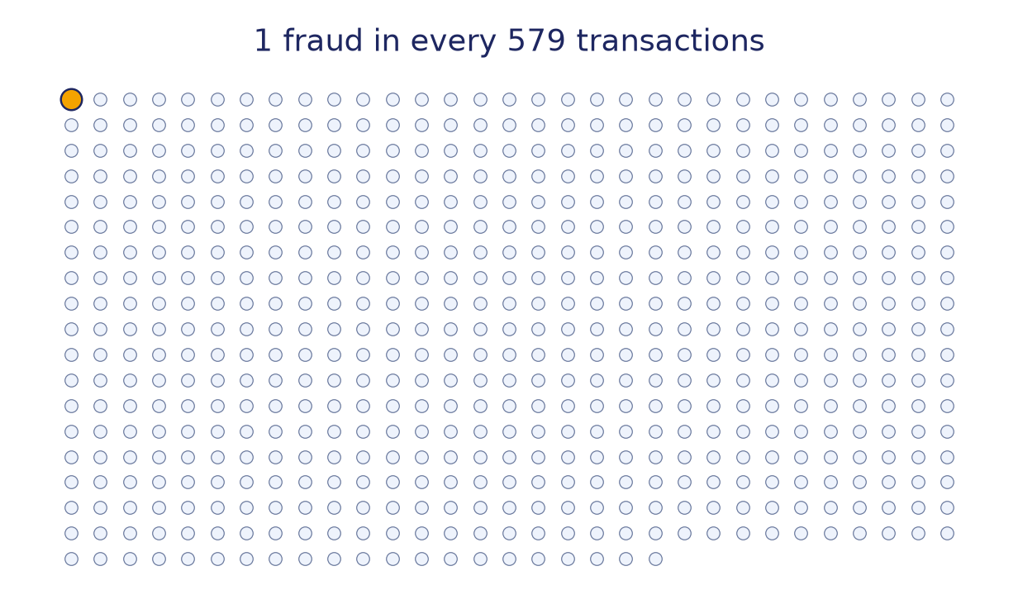
TASK 2 · THE DATASET
creditcard.csv — A Highly Imbalanced Dataset
284,807
31
0.173%
transactions
columns
of transactions are fraud
Time, V1–V28, Amount, Class
V1–V28 are PCA-anonymised features that protect cardholder identity. Class = 1 marks fraud, Class = 0 is legitimate.
Why accuracy is misleading:
At 0.173% fraud, predicting "legitimate" every time would score 99.8% accuracy — and catch zero fraud.
YASHIL · DECODELABS DATA SCIENCE INTERNSHIP
09

Slide 10

TASK 2 · METHODOLOGY
A Leakage-Safe Modelling Pipeline
1
→
2
→
3
→
4
→
5
Stratified Split
SMOTE
Model
GridSearchCV
Evaluate
227,845 train /
56,962 test
Inside the pipeline,
train folds only
Logistic Regression /
Random Forest
StratifiedKFold
tuning
On the held-out
test set
Best Hyperparameters
Why SMOTE sits inside the pipeline
Logistic Regression:
C = 0.01, k_neighbors = 5
Random Forest:
max_depth = 10, k_neighbors = 3
Generating synthetic samples before the split lets information leak from test data into training. Placing SMOTE inside the pipeline means it runs only on each training fold, never touching the test set.
YASHIL · DECODELABS DATA SCIENCE INTERNSHIP
10

Slide 11
TASK 2 · RESULTS
Logistic Regression vs. Random Forest
Quick Read
Random Forest
Higher precision (0.55 vs 0.06), higher F1 (0.68 vs 0.11), higher ROC-AUC (0.983 vs 0.972).
Logistic Regression
Higher recall (0.918 vs 0.878) — it catches slightly more fraud, at the cost of far more false alarms.
ROC-AUC vs PR-AUC
ROC-AUC is close (0.971 vs 0.983), but PR-AUC exposes the real gap: 0.713 vs 0.816.
YASHIL · DECODELABS DATA SCIENCE INTERNSHIP
11

Slide 12
TASK 2 · CHOOSING THE RIGHT METRIC
Why We Judge on PR-AUC, Not Accuracy
Accuracy is a trap
Predicting "legitimate" every single time scores 99.83% accuracy and catches zero fraud. Useless on a 0.173% problem.
ROC-AUC flatters both models
It rewards ranking across all 284,807 rows, and the 284,315 legitimate ones dominate. So both models look strong: 0.971 vs 0.983.
PR-AUC tells the truth
Average precision looks only at the fraud class. Logistic Regression = 0.713, Random Forest = 0.816 - the real gap ROC-AUC hides.
Tuned vs judged
GridSearchCV tuned both models on ROC-AUC; we then compare them on PR-AUC and the confusion matrix, which reflect the business cost of each error.
YASHIL · DECODELABS DATA SCIENCE INTERNSHIP
12

Slide 13
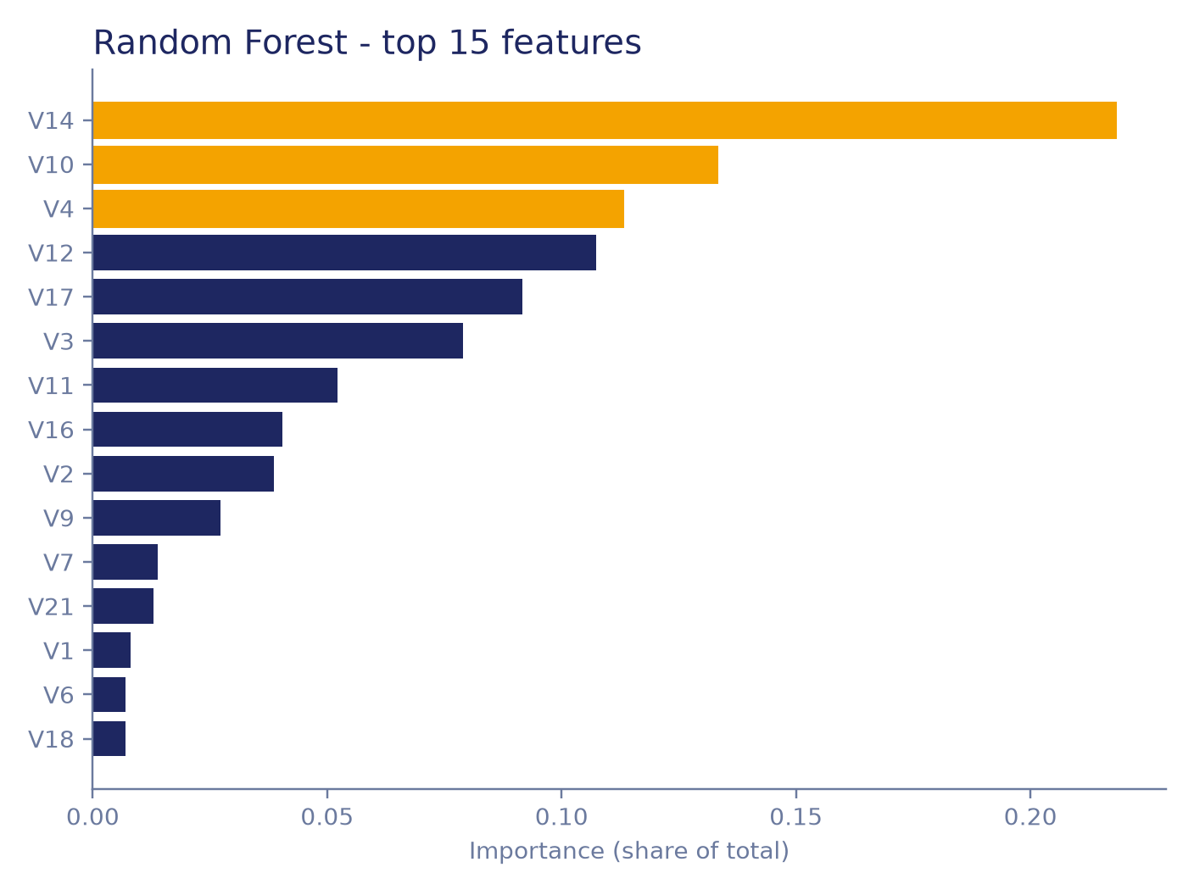
TASK 2 · MODEL INTERPRETABILITY
What the Random Forest Learned
Reading the chart
The strongest signals are the anonymised PCA features V14, V10 and V4. Because V1-V28 are PCA outputs we cannot name the raw behaviour behind them, but the model leans on a small handful of them, not Time or Amount.
YASHIL · DECODELABS DATA SCIENCE INTERNSHIP
13

Slide 14

TASK 2 · PRECISION VS. RECALL
Reading the Confusion Matrices
Logistic Regression
Random Forest
rows = actual class · columns = predicted class
rows = actual class · columns = predicted class
55,416
1,448
56,795
69
Correctly flagged legitimate
False alarms (flagged fraud, actually legit)
Correctly flagged legitimate
False alarms (flagged fraud, actually legit)
8
90
12
86
Missed fraud (flagged legit, actually fraud)
Fraud correctly caught
Missed fraud (flagged legit, actually fraud)
Fraud correctly caught
Logistic Regression catches 90 of 98 frauds but raises 1,448 false alarms. Random Forest catches 86 of 98 frauds with only 69 false alarms — far more precise, at the cost of 4 missed frauds.
YASHIL · DECODELABS DATA SCIENCE INTERNSHIP
14

Slide 15

KEY TAKEAWAYS
What This Project Demonstrates
Clean deliberately
Filling missing values (not dropping them) preserved all 1,200 orders — a blank CouponCode means “no coupon used,” not corrupt data.
The IQR rule tells the real story
It flags outliers using spread, not assumptions — and found zero here, confirming the data was already clean.
Class imbalance breaks accuracy
At 0.173% fraud, precision, recall, F1 and especially PR-AUC matter far more than accuracy or ROC-AUC.
Pipelines prevent leakage
SMOTE must sit inside cross-validation, generated only from training folds, never touching test data.
Model choice is a trade-off
Random Forest’s precision advantage (69 vs 1,448 false alarms) outweighed Logistic Regression’s slightly higher recall.
YASHIL · DECODELABS DATA SCIENCE INTERNSHIP
15

