Slide 1
Habits
John Doe

Slide 2
In the morning

Slide 3
Getting up
$$y_{i}=β_{0}+β_{1}x_{1,i}+ϵ_{i}$$
Turn off alarm
Get out of bed

Slide 4
Breakfast
Eat eggs
Drink coffee

Slide 5
In the evening

Slide 6
Dinner
Eat spaghetti
Drink wine

Slide 7
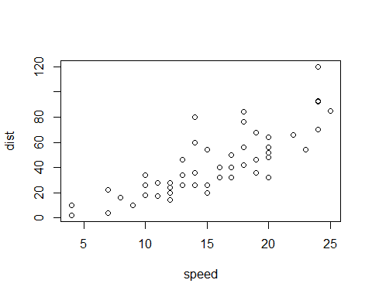
A scatterplot.

Slide 8
Going to sleep
Get in bed
Count sheep

