Slide 1

BCSE308P • COMPUTER NETWORKS LAB
Wi-Fi Quality Mapping
& Dead-Zone Diagnostics
A dashboard-based approach to visualize signal quality,
compare locations, and identify weak-signal areas.
Project Presentation
TEAM MEMBERS
Yashita Kushwah — 24BCE2473
Ishita Duggal — 24BCE2502
Yashika Kushwah — 24BDS0364
Faculty: Dr. SREETHAR S
BCSE308P • Computer Networks Lab • Wi-Fi Quality Mapping
01

Slide 2
01 • PURPOSE
Project Objective
Measure & organize
Visualize coverage
Diagnose weak areas
Work with Wi-Fi measurement data and summarize signal-quality information.
Present signal strength and quality through clear dashboard charts and views.
Use configurable signal thresholds to flag locations that may need attention.
Goal: make Wi-Fi quality easier to interpret so users can identify areas for further measurement or network improvement.
BCSE308P • Computer Networks Lab • Wi-Fi Quality Mapping
02

Slide 3
02 • CONTEXT
Introduction
Wi-Fi quality can vary significantly from one location to another.
Walls, distance, interference, and access-point placement can contribute to weaker signals.
Raw measurements are difficult to compare without a consistent visual summary.
A dashboard brings measurements, location comparisons, and diagnostic views together.
What the project provides
• Data-driven visual analysis
• Location-level comparison
• Quality distribution views
• Threshold-based diagnostics
• Screenshots and test documentation
BCSE308P • Computer Networks Lab • Wi-Fi Quality Mapping
03

Slide 4
03 • NEED
Problem Statement & Motivation
Without a structured view of Wi-Fi measurements, it is difficult to spot weak-signal locations, compare quality across areas, and communicate findings clearly.
Challenge 1
Challenge 2
Challenge 3
Measurements may be scattered across files or locations.
Weak coverage can be overlooked in raw tables.
Results need a repeatable, explainable presentation.
BCSE308P • Computer Networks Lab • Wi-Fi Quality Mapping
04

Slide 5
04 • SOLUTION
Scope & Key Features
Dashboard
Signal coverage
Location performance
Central place to review the project's Wi-Fi analysis.
Visualize measured signal levels across available observations.
Compare measured quality between locations.
Quality distribution
Dead-zone diagnostics
Supporting tools
Understand how observations are distributed across quality levels.
Highlight weak-signal cases against a chosen threshold.
Data validation, analysis, visualization, and report generation scripts.
BCSE308P • Computer Networks Lab • Wi-Fi Quality Mapping
05

Slide 6
05 • DESIGN
System Architecture
Wi-Fi data
(CSV / measurements)
Validation &
preprocessing
Analysis core &
diagnostics
Streamlit dashboard
& visual outputs
Flow: load observations → validate and prepare data → analyze signal quality and thresholds → display insights for review.
BCSE308P • Computer Networks Lab • Wi-Fi Quality Mapping
06

Slide 7
06 • METHODOLOGY
Data & Analysis Method
Measurement and summary data are stored in CSV files in the data/ folder.
Validation utilities help check whether input data is usable.
The analysis core organizes observations for the dashboard and diagnostic views.
Threshold-based checks compare signal values with a selected cutoff.
Visualizations summarize coverage, location performance, and quality distribution.
Interpretation note
Signal thresholds are diagnostic settings, not a universal guarantee of connectivity. Actual user experience also depends on interference, throughput, latency, and device conditions.
BCSE308P • Computer Networks Lab • Wi-Fi Quality Mapping
07

Slide 8
07 • CORE LOGIC
Dead-Zone Diagnostics
Input
Comparison
Output
Measured signal values and a selected signal-strength threshold.
Compare observations with the threshold to flag weak-signal candidates.
A diagnostic view that helps users inspect locations needing further checks.
Example thresholds shown in the project screenshots: −58 dBm and −80 dBm.
The threshold changes the classification of weak-signal observations; it does not itself change the Wi-Fi network.
BCSE308P • Computer Networks Lab • Wi-Fi Quality Mapping
08

Slide 9
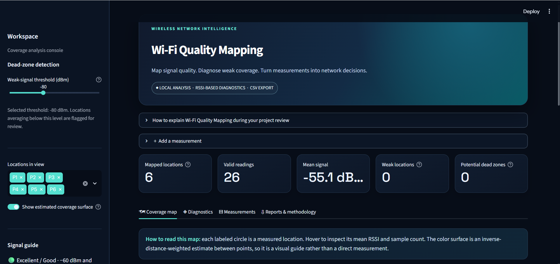
08 • IMPLEMENTATION
Dashboard
BCSE308P • Computer Networks Lab • Wi-Fi Quality Mapping
09

Slide 10
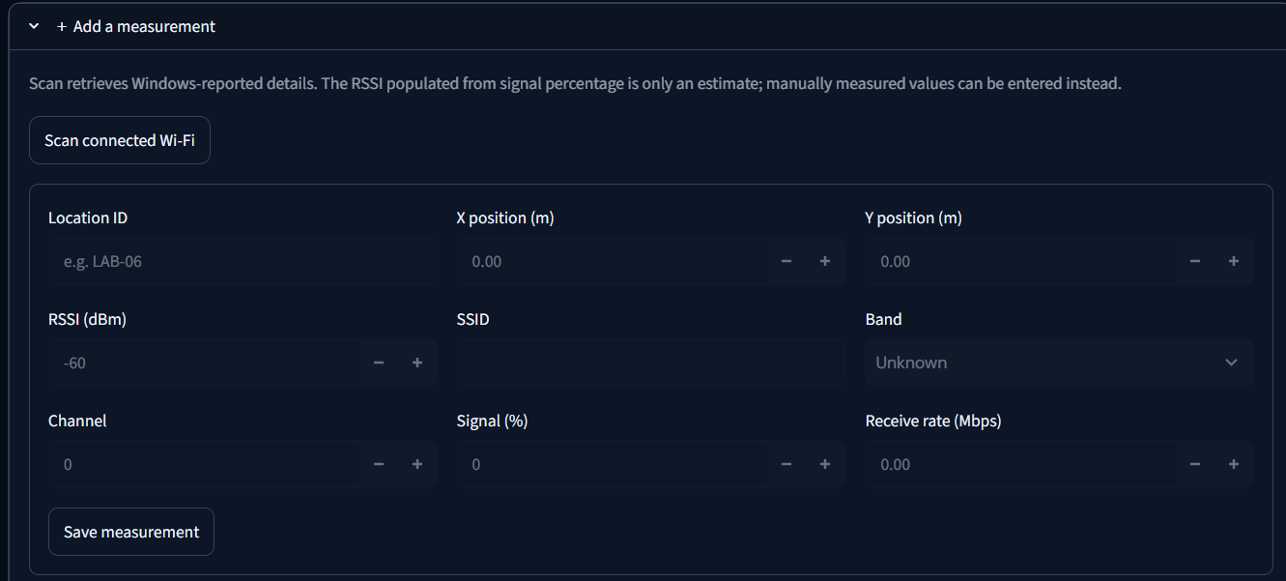
08 • IMPLEMENTATION
Wi-Fi Measurement Collection Interface
BCSE308P • Computer Networks Lab • Wi-Fi Quality Mapping
09

Slide 11
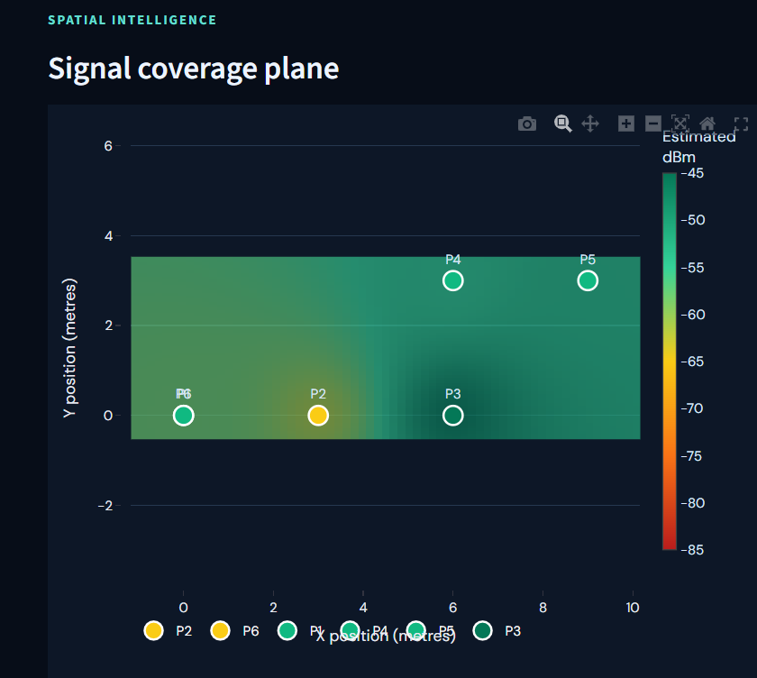
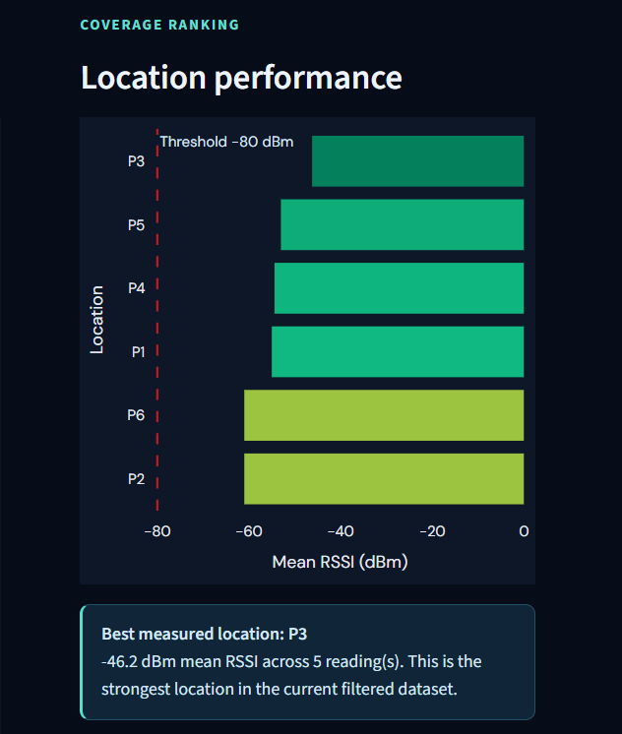
09 • VISUAL RESULTS
Coverage & Location Performance
Use these views to compare where signal is stronger or weaker and where additional measurements may help.
BCSE308P • Computer Networks Lab • Wi-Fi Quality Mapping
10

Slide 12
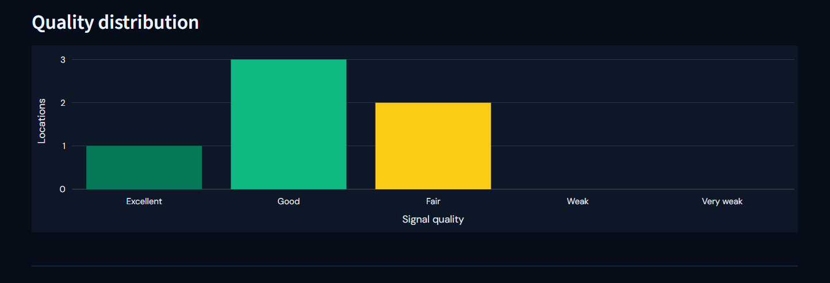
10 • VISUAL RESULTS
Wi-Fi Quality Distribution
BCSE308P • Computer Networks Lab • Wi-Fi Quality Mapping
11

Slide 13
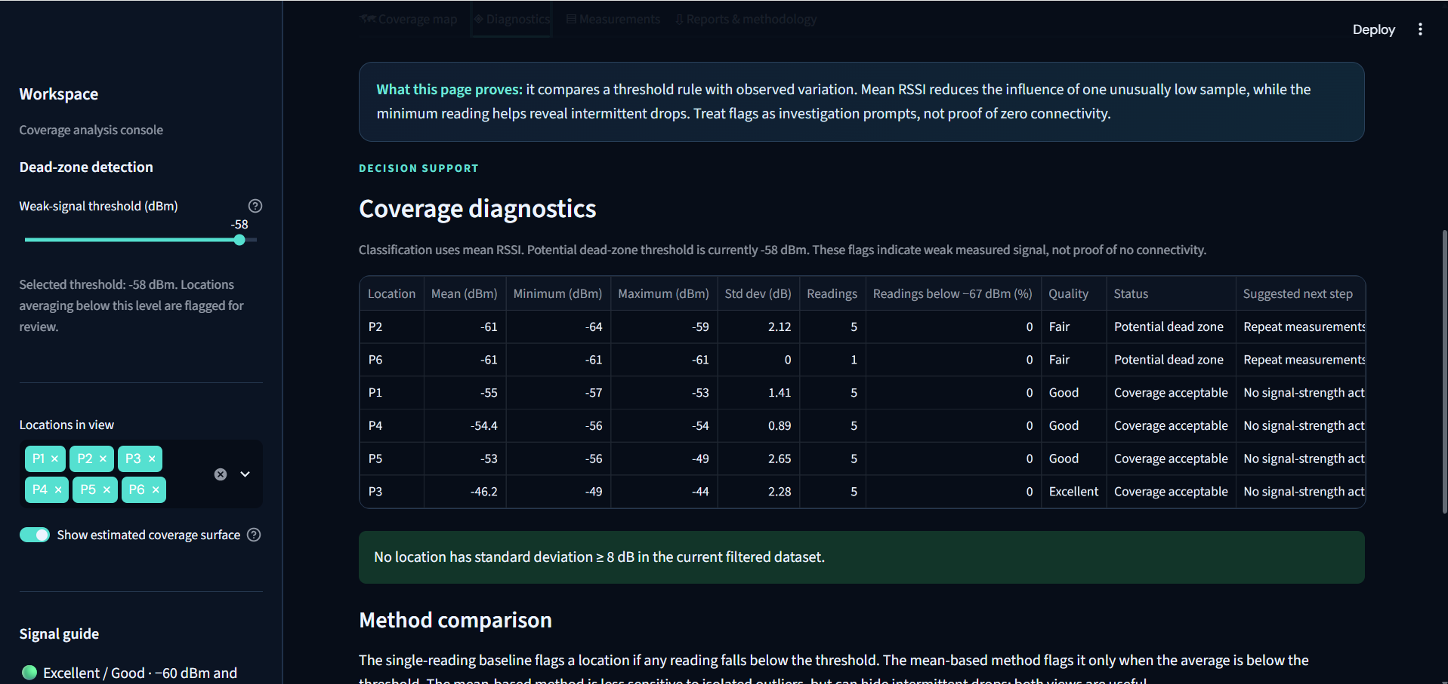
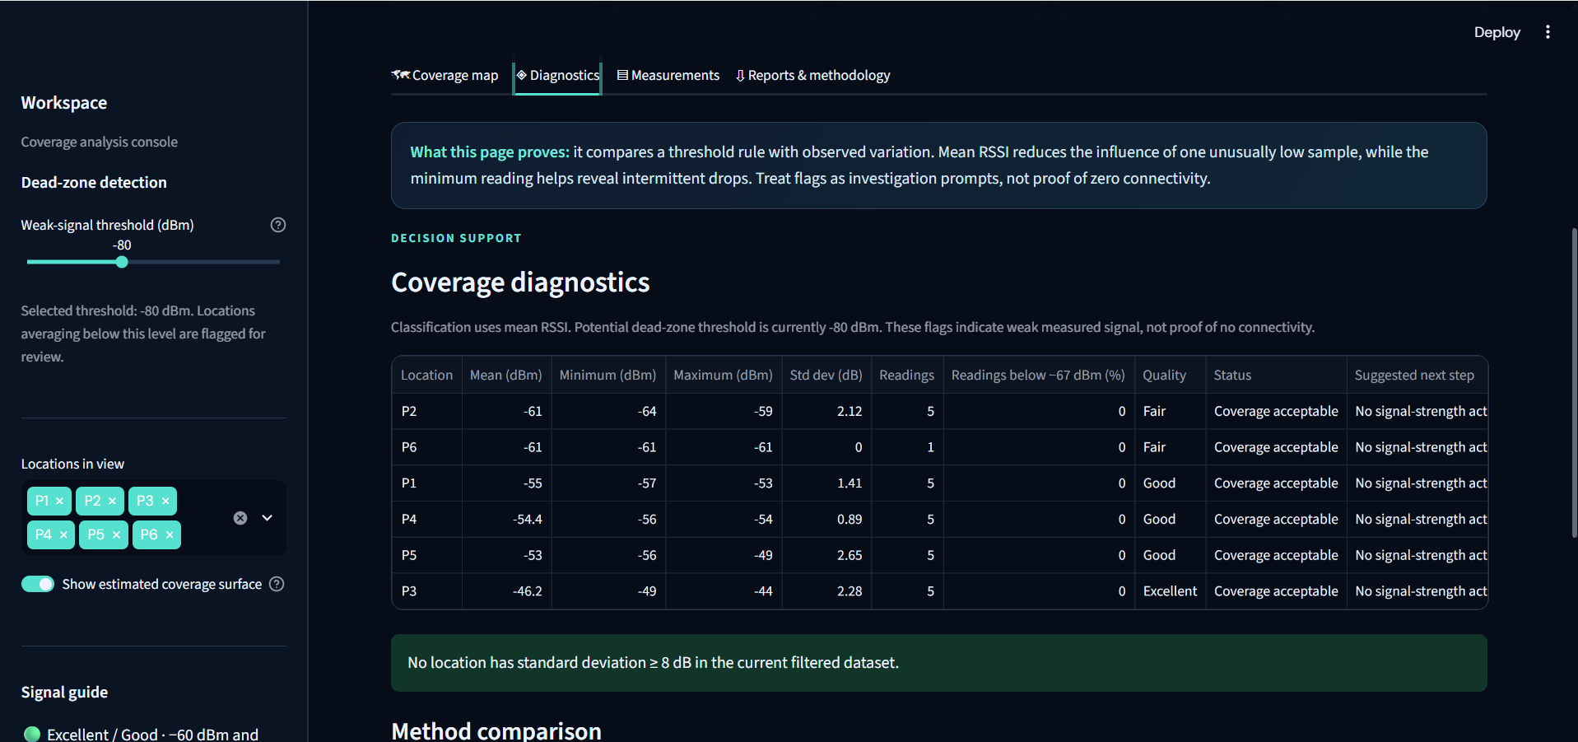
11 • DIAGNOSTIC OUTPUTS
Threshold Comparison
Different cutoffs produce different diagnostic classifications; select thresholds appropriate to the use case.
BCSE308P • Computer Networks Lab • Wi-Fi Quality Mapping
12

Slide 14
12 • QUALITY ASSURANCE
Testing & Verification
Automated tests
Recorded result
Manual verification
4 tests executed with pytest.
4 passed • 0 failed.
Streamlit dashboard launched and views were checked.
Test command: py -m pytest
BCSE308P • Computer Networks Lab • Wi-Fi Quality Mapping
13

Slide 15
13 • IMPLEMENTATION
Technology Stack & Repository
Language & dashboard
Data & tests
Project assets
Python • Streamlit
CSV files • pytest
README • requirements • screenshots • config
BCSE308P • Computer Networks Lab • Wi-Fi Quality Mapping
14

Slide 16
14 • NEXT STEPS
Limitations & Future Scope
Current limitations
Future improvements
• Results depend on the quality and coverage of input measurements.
• Threshold flags are indicators, not definitive proof of a dead zone.
• A broader real-world survey would improve coverage confidence.
• Add more measurement locations and repeated samples.
• Add live or guided Wi-Fi data collection.
• Include signal trends over time and more network metrics.
• Improve maps and exportable diagnostic reports.
BCSE308P • Computer Networks Lab • Wi-Fi Quality Mapping
15

Slide 17
CONCLUSION
Turning Wi-Fi measurements into actionable visual insight
The dashboard organizes and visualizes Wi-Fi quality observations.
Location comparisons and threshold-based diagnostics help identify weak-signal candidates.
Source code, documentation, screenshots, and tests are available in the public repository.
Thank you • Questions?
BCSE308P • Computer Networks Lab • Wi-Fi Quality Mapping
16

