Slide 1
Attacks and Security Implementations on Docker Containers
INSE 6130 – Operating Systems

Slide 2
Outline
Introduction
Attacks On Containers
Attacking insecure volume mounts
Abusing cap_dac_read_search Capability
Attacking Container with sys_ptrace Capability
Corrupting docker source image
Privilege escalation using modifying AppArmor profile
Security Applications On Containers
Defence against Fork Bomb Shell Attack
Defence against Privilege Escalation using Apparmor
Contribution

Slide 3

Introduction
Docker containers offer a lightweight and efficient approach to application deployment, surpassing traditional virtual machines (VMs) in many aspects.
However, the shared kernel and network isolation in Docker introduce unique security challenges that need to be addressed.
Notes:
Web applications face a constant threat from SQL injection attacks.
Attackers exploit vulnerabilities by injecting malicious SQL code into input fields, compromising the application's SQL database.
This can lead to unauthorized data access, manipulation, and financial loss.
Recent news reveals a SQL injection vulnerability in WordPress, potentially exposing 1 million sites to cyber attacks.
The vulnerability was swiftly addressed, thanks to a cybersecurity researcher and a patch was released by WordPress.

Slide 4
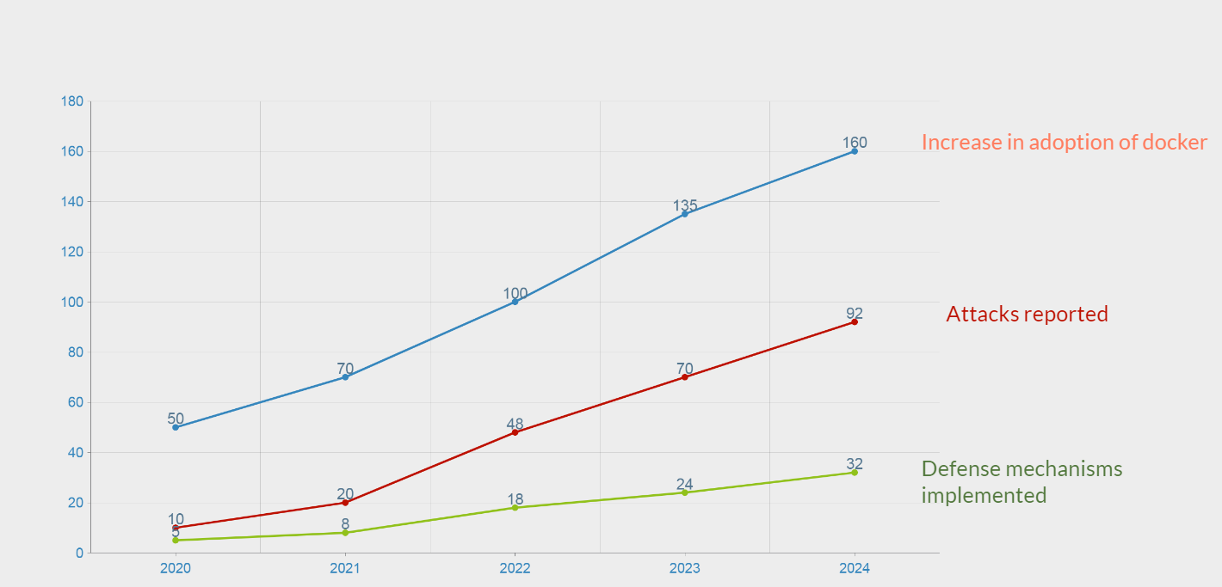
Attack Trends on Docker
The widespread adoption of Docker containers across organizations has led to a surge in attacks targeting Docker environments.
Attackers are drawn to Docker's shared kernel feature and direct host access, providing them with increased opportunities compared to previous isolated virtualization solutions.
Despite the growing threat landscape, existing defense mechanisms struggle to keep pace with the rising number of attacks on Docker environments.
Notes:
Web applications face a constant threat from SQL injection attacks.
Attackers exploit vulnerabilities by injecting malicious SQL code into input fields, compromising the application's SQL database.
This can lead to unauthorized data access, manipulation, and financial loss.
Recent news reveals a SQL injection vulnerability in WordPress, potentially exposing 1 million sites to cyber attacks.
The vulnerability was swiftly addressed, thanks to a cybersecurity researcher and a patch was released by WordPress.

Slide 5
ATTACKS ON CONTAINERS

Slide 6
Attacking insecure volume mounts
Using volume mounted docker.sock to gain privileges in the host system with docker runtime.
NodeJS application is vulnerable to remote code execution.
Using a reverse shell to gain to access to container.
Access the host resource using the docker.sock.
Gaining access to host and can control (run/ delete/modify) other containers present in host.
Notes:
- Here is the classification of the different detection methods:
Each classification represents a different strategy for identifying and mitigating SQL injection threats.
- Let's explore the three distinct methods:
Behavioral Analysis Based Detection method: - the Behavioral Analysis based detection method refers to observing the behavior of the application during runtime to identify signs of SQL injection vulnerabilities.
This method involves dynamically testing the application and
analyzing how it responds to various inputs, queries, and interactions with the database.
- Witcher Framework and SqliScan tool both performs behavioral analysis to detect SQLi attacks.
Pattern Matching and Rule Based detection
This method involves using predefined patterns, such as SQL keywords or special characters, and rules,
such as conditions indicative of SQL injection, to identify potential SQL injection attacks within data or input queries.
By analyzing queries for these predefined patterns or rules,
suspicious activity indicative of SQL injection is flagged for further investigation or mitigation.
- Customized OWASP ZAP approach, Tokenization and lexicon matching approach and Regular Expression based S-SQLI approaches proposed by researchers falls under this category.
3. Machine Learning based detection
Machine learning-based SQL injection (SQLi) attack detection methods leverage machine learning algorithms and models to autonomously analyze patterns within SQL queries.
By training on labeled datasets,
these methods learn to distinguish between normal and potentially malicious queries,
continuously improving detection accuracy through iterative learning processes
and real-time feedback mechanisms.
- SQLi-Fuzzer and CNN-BiLSTM model uses machine learning based SQLI attack detection method

Slide 7
2. Abusing cap_dac_read_search Capability
Breaking out of the container using by abusing cap_dac_read_search capability.
Using publicly available exploit.
Identifying mounted files.
Accessing sshd_config file.
Creating a local user and modifying root password hash with new user’s in /etc/shadow and /etc/passwd/.
Gaining root access.

Slide 8
3. Attacking Container with sys_ptrace Capability
Exploiting sys_ptrace capability to breakout the container.
Gaining reverse shell using metasploit's msfvenom payload.
Injecting exploit and injector program to the container using simple python server.
Identifying the process running as root in the host system to gain root access to connect back.
Gaining access to host by payload injection.

Slide 9
4. Corrupting docker source image
The target docker server is running a webserver image on port 80.
webserver is stored on the unprotected private docker registry.
Backdoor the WordPress image by adding a web shell
Create a Dockerfile to prepare the backdoored image.
Pushing image to private registry
Using the webshell to pass commands using curl.

Slide 10
5. Privilege escalation by modifying AppArmor profile
Mounting Host Disk (/dev/sda1) from the container, gives access to the host's file system
But, due to apparmor profile, mounting is restricted by default.
Modifying apparmor profile inorder to gain mounting feature.
This gives the container mounting permissions and hence access to the host's file system including users and password files

Slide 11
SECURITY APPLICATION

Slide 12
Security Summary
1.CGroups
Designed to regulate various system resources such as memory allocation, CPU time, I/O bandwidth, and cache size.
Enabling prioritization and allocation of resources to specific containers, regardless of their relative importance.
2. Apparmor
Security component within the Linux kernel, granting administrators the ability to control user access to various programs and files within Docker Containers.
Through AppArmor profiles, permissions for reading, writing, or executing files on specific paths are specified
3. Seccomp
An another Linux Kernel Security Feature which acts as a Firewall for System Calls ( Filter for System Calls)

Slide 13
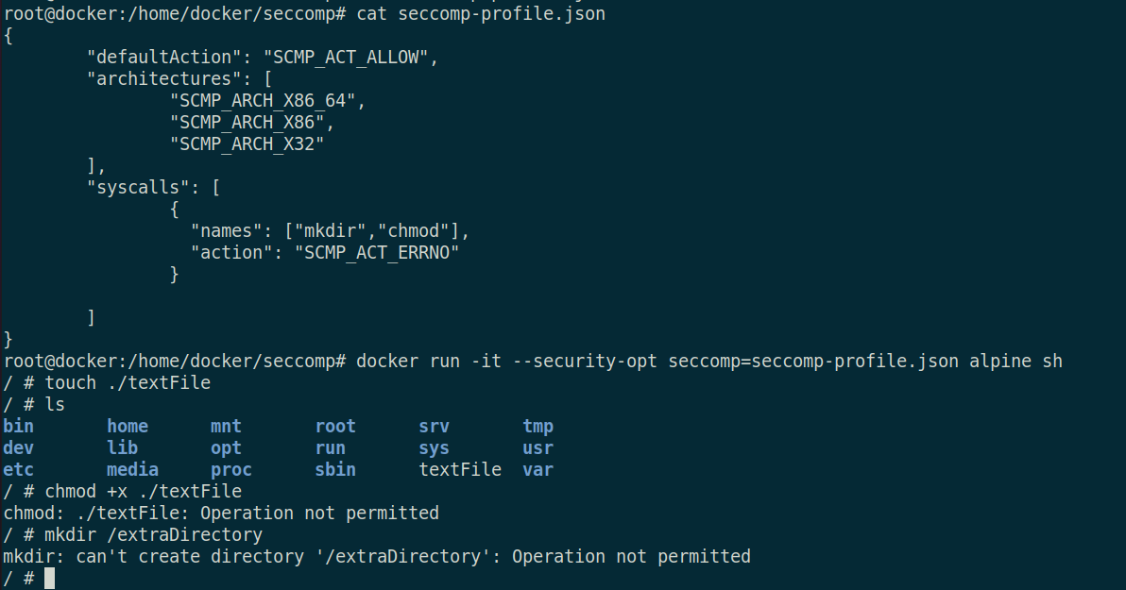
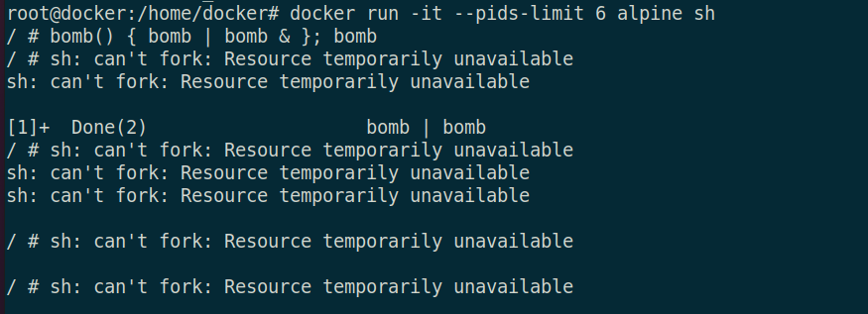
Seccomp CGroups

Slide 14
Project Contributions
Category | Implementation | Group Member Name
Attack | Attacking insecure volume mounts | Avin Vincent
Attack | Abusing cap_dac_read_search Capability | Bindu Chinnabathini
Attack | Attacking Container with sys_ptrace Capability | Likitha Reddy
Attack | Corrupting docker source image | Challa Likitha
Attack | Privilege escalation using App Armor Profile | Moksh Sood
Security | Defence against Privilege Escalation using App Armor | Bala Krishna Yadav Kunati
Attack & Security | Defence against Fork Bomb Shell | Divya Varshini M
Security | Seccomp Profile | Yash Khosla
Notes:
Now, I would like to explain one of the class and an approach proposed in a latest research paper:
- The CNN-BiLSTM method is an advanced approach for detecting SQL Injection Attacks.
It combines two powerful neural network architecures, Convolutional Neural Networks (CNN) and Bidirectional Long Short-Term Memory (BiLSTM) networks.
In this method, the CNN analyzes the overall structure and general features within SQL queries, such as length, presence of keywords, syntax, parameterization, and contextual clues.
These features help distinguish between normal and potentially harmful queries.
The BiLSTM network complements this by analyzing the sequential dependencies within the queries, understanding the order of words, phrases, or commands and how they relate to each other.
By considering both spatial (overall structure) and sequential (order of elements) features, the CNN-BiLSTM method achieves superior accuracy in identifying SQL injection attacks compared to traditional methods.
the approach has demonstrated superior prediction accuracy compared to traditional machine learning algorithms in detecting SQL injection attacks as shown in the table.
This high accuracy can help in effectively identifying and preventing malicious SQL queries.
Additionally, the method can be deployed for real-time detection of attacks, providing immediate alerts or actions.
Through iterative training and refinement, the model continuously improves its detection capabilities and adapts to new attack vectors, ensuring enhanced cybersecurity resilience over time.
These attributes collectively make the CNN-BiLSTM method a highly effective approach for detecting SQL injection attacks.
************************************************************************Extra Notes***********************************************************
The CNN-BiLSTM based approach for detecting SQL Injection Attacks utilizes two machine learning model Convolutional Neural Networks (CNN) and Bidirectional Long Short-Term Memory (BiLSTM) networks to effectively identify and prevent SQL injection attacks.
Here is an overview of how the method works:
Data Collection: In this step, a dataset containing both normal and malicious SQL queries is collected from various sources.
Data Preprocessing: The collected dataset undergoes preprocessing, which includes cleaning the data, labeling the queries as normal or malicious, and converting the queries into a format suitable for machine learning processing.
Machine Learning Pipeline: - The preprocessed data is fed into the machine learning model, which is based on the hybrid CNN-BiLSTM architecture.
Input Layer
Acts as the entry point for the data into the neural network architecture.
Transmits the input queries to the subsequent layers for processing and learning patterns related to SQLI attacks.
Embedding layer:
Helps the neural network understand the underlying structure and relationships within the SQL queries.
Enables the model to effectively learn patterns and features from the textual input data for improved detection of SQLI attacks.
Feature Extraction using CNN:
CNN Layer: The input preprocessed data is fed into the Convolutional Neural Network (CNN) layer for feature extraction.
Feature Extraction: The CNN layer extracts spatial features from the input queries, focusing on spatial relationships and patterns within the queries.
BiLSTM for Sequence Processing:
BiLSTM Layer: The output from the CNN layer is then passed to the Bidirectional Long Short-Term Memory (BiLSTM) layer for sequence processing.
Sequence Processing: The BiLSTM layer analyzes the sequential dependencies within the extracted features, capturing long-term dependencies and contextual information in both forward and backward directions.
Dense or Fully Connected Layers:
Fully Connected Layers: The features extracted by the CNN and BiLSTM layers are processed by fully connected layers for further analysis.
Processing Features: The fully connected layers combine the spatial and sequential features to make the final classification decision.
Output Layer for Classification:
Softmax Layer: The processed features are then passed through the output layer for classification.
Classification Decision: The Softmax layer predicts the probability distribution of the query being normal or malicious, providing the final classification decision.
- The approach has demonstrated superior prediction accuracy compared to traditional machine learning algorithms in detecting SQL injection attacks as shown in this table. This high accuracy can help in effectively identifying and preventing malicious SQL queries.
- The model can be deployed for real-time detection of SQL injection attacks, providing immediate alerts or actions when a malicious query is detected. This real-time detection capability enhances the security posture of web applications by preventing unauthorized access to databases.
- Through iterative training, validation, and refinement processes, the CNN-BiLSTM model can continuously improve its detection capabilities and adapt to new attack vectors, contributing to enhanced cybersecurity resilience.

Slide 15
Thank you!

