Slide 1

Project title
By Stduent Name/Group Name

Slide 2

Index
Problem Statement
Your solution
Working (Method/Mind map)
Conclusion.

Slide 3
PROBLEM STATEMENT
Retail stores require fast and accurate billing systems to manage transactions and calculate taxes.
Manual billing methods can cause:
1.Calculation errors
2.Time delays
3.Inefficient record keeping
The POS Billing & GST System automates the billing process and ensures accurate GST calculations.

Slide 4
PROPOSED SOLUTION
The POS Billing & GST System provides a simple software solution to automate retail billing and tax calculation.
The system solves the problem by:
1.Allowing product selection using Product ID (simulating product scanning)
2.Automatically calculating GST based on product tax rate
3.Generating a clear and accurate invoice
4.Displaying the total bill amount
5.Providing a daily sales summary with total GST collected
This solution reduces manual calculation errors and improves the efficiency of the billing process in retail stores.

Slide 5
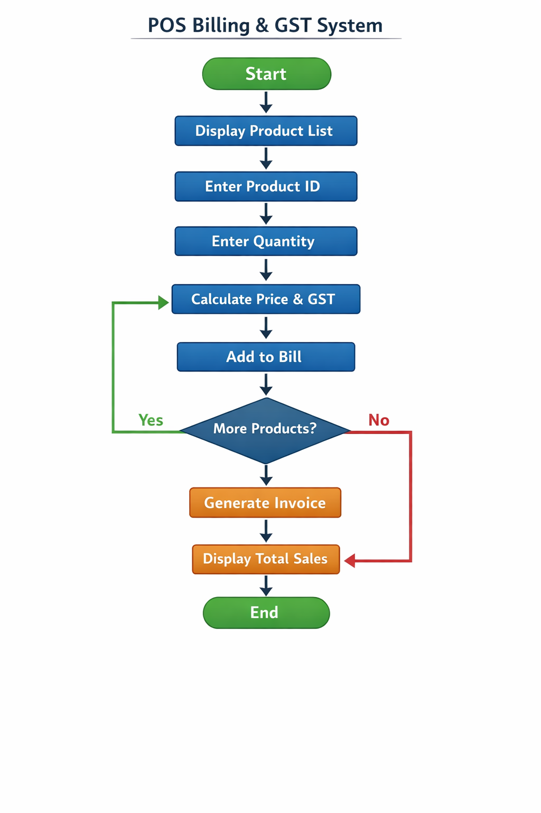
WORKING

Slide 6
CONCLUSION
The POS Billing & GST System successfully demonstrates how programming can be used to automate the retail billing process. The system allows users to select products, calculate GST automatically, and generate an invoice for the customer. By automating these calculations, the system helps reduce human errors that commonly occur in manual billing.
The project also provides a clear summary of total sales and GST collected, which helps store owners keep track of daily transactions. This improves efficiency and makes the billing process faster and more reliable.
Through the development of this project, important C++ programming concepts such as structures, arrays, loops, and conditional statements were applied to solve a real-world problem. Overall, the system shows how simple software solutions can make retail operations more organized, accurate, and efficient.

Slide 7
Thank You

