Slide 1

Customer Shopping Behavior Analysis
Uncovering spending patterns, customer segments, and product preferences from 3,900 transactions.

Slide 2
Dataset at a Glance
3,900
18
Purchases
Columns
37
$59.76
Missing Values
Avg. Purchase
Review Rating only
Demographics, purchase details, and shopping behavior features across 4 product categories.

Slide 3

Data Preparation in Python
Clean
Engineer
Imputed missing Review Ratings using median by category
Created age_group and purchase_frequency_days
Integrate
Loaded cleaned DataFrame into PostgreSQL for SQL analysis

Slide 4
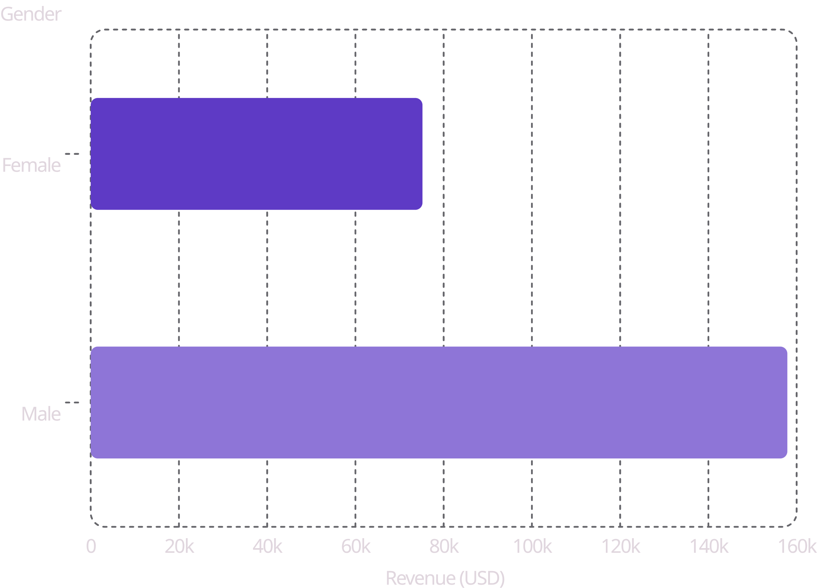
Revenue by Gender
Key Insight
Male customers generated 2.1× more revenue than female customers — a significant gap worth investigating further.

Slide 5
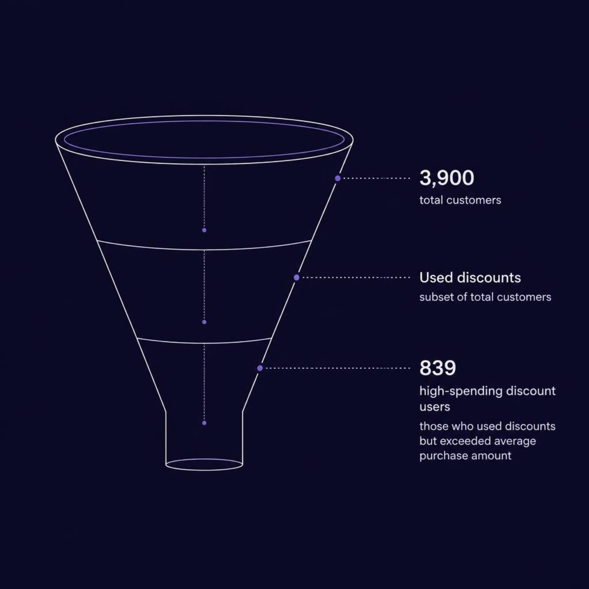

High-Spending Discount Users
839 Customers
Used discounts yet spent above average purchase amount. These are your most valuable discount-driven buyers.
Top spender: Customer #9 — $97 with discount applied

Slide 6
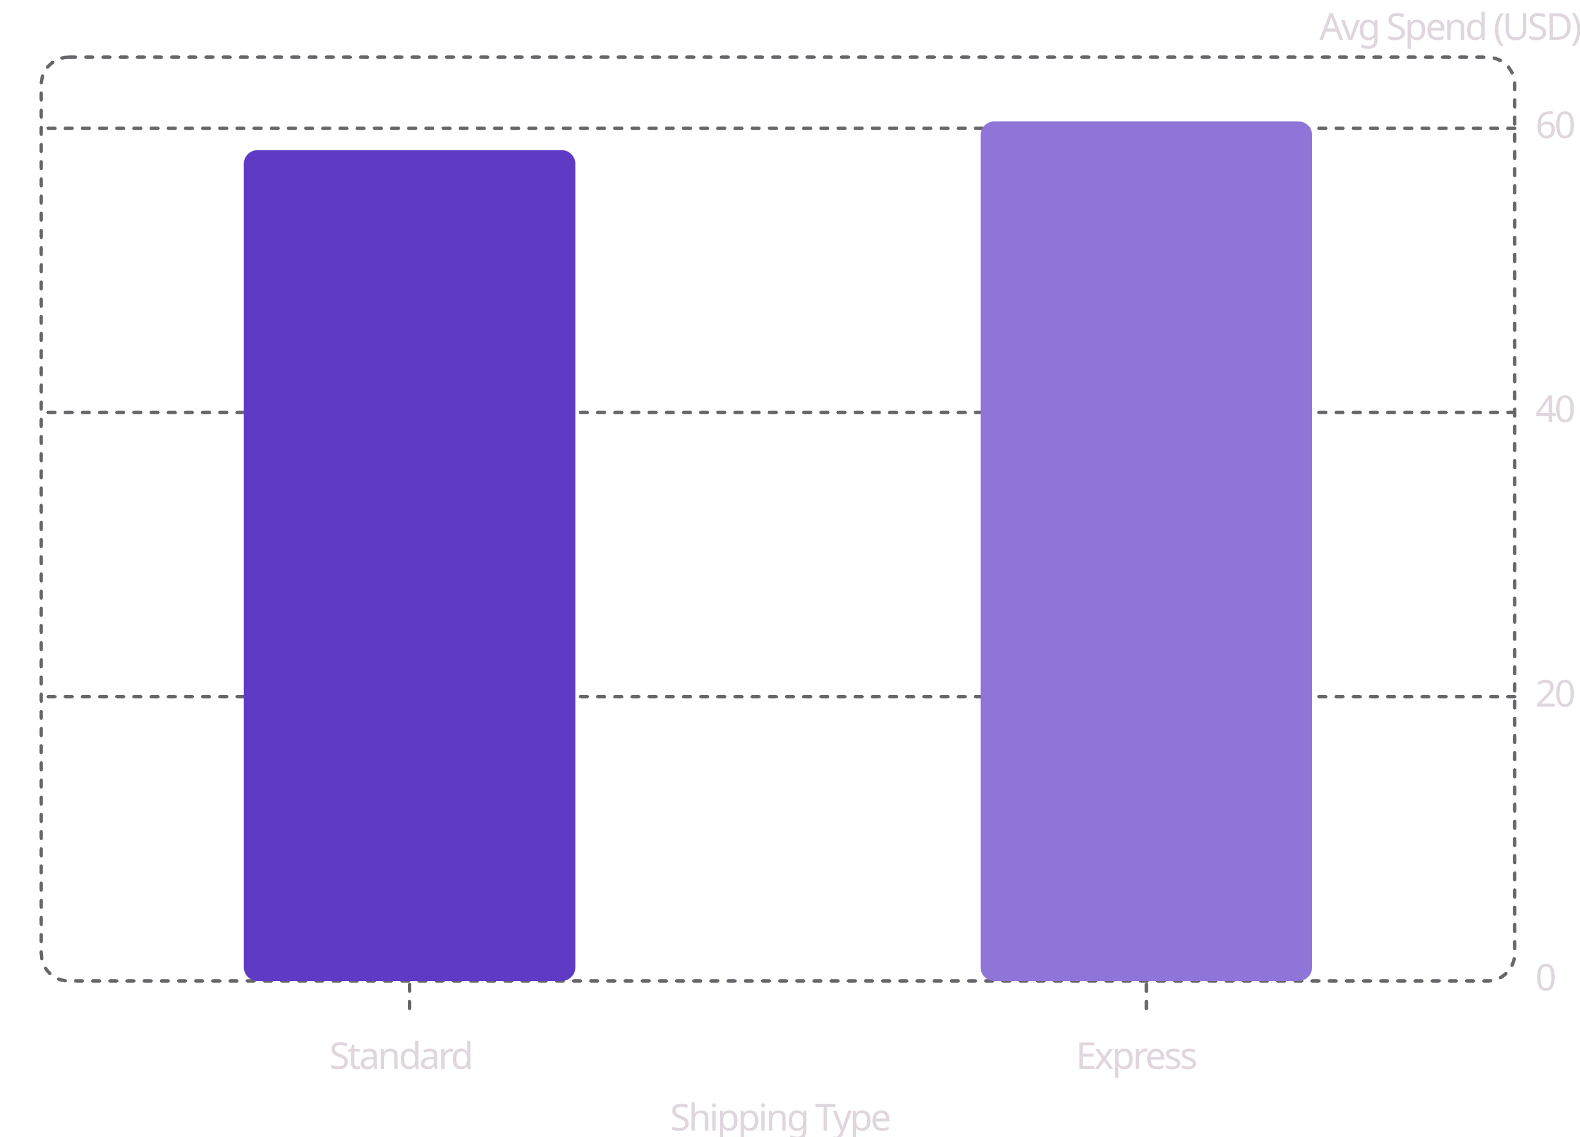
Top Products & Shipping Insights
Top 5 Products by Rating
Shipping Type vs. Avg Spend
Product | Avg Rating
Gloves | 3.86
Sandals | 3.84
Boots | 3.82
Hat | 3.80
Skirt | 3.78

Slide 7
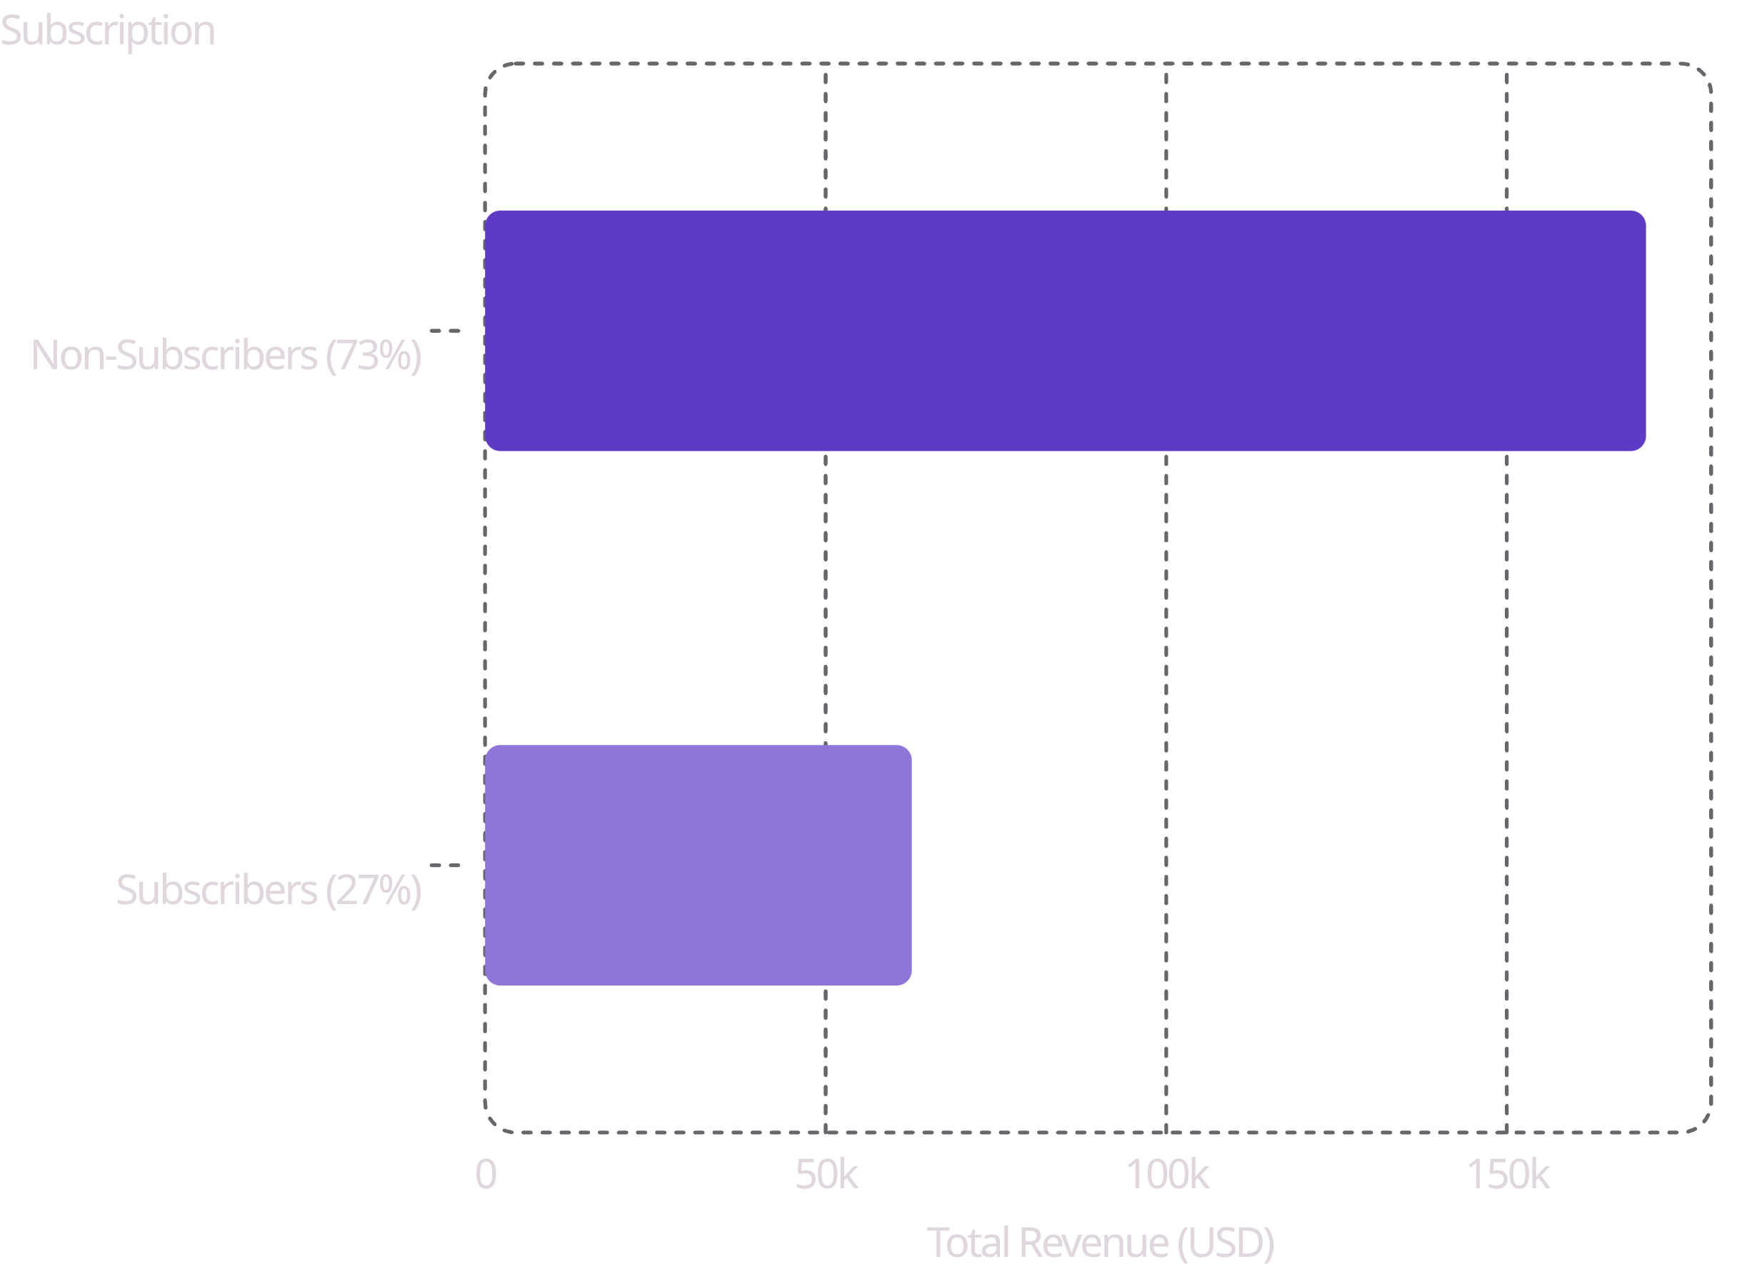

Subscribers vs. Non-Subscribers
Subscription Gap
Only 27% of customers subscribe, yet subscribers show strong repeat-buy behavior. Huge untapped potential.
958 repeat buyers (5+ purchases) are non-subscribers — prime conversion targets.

Slide 8
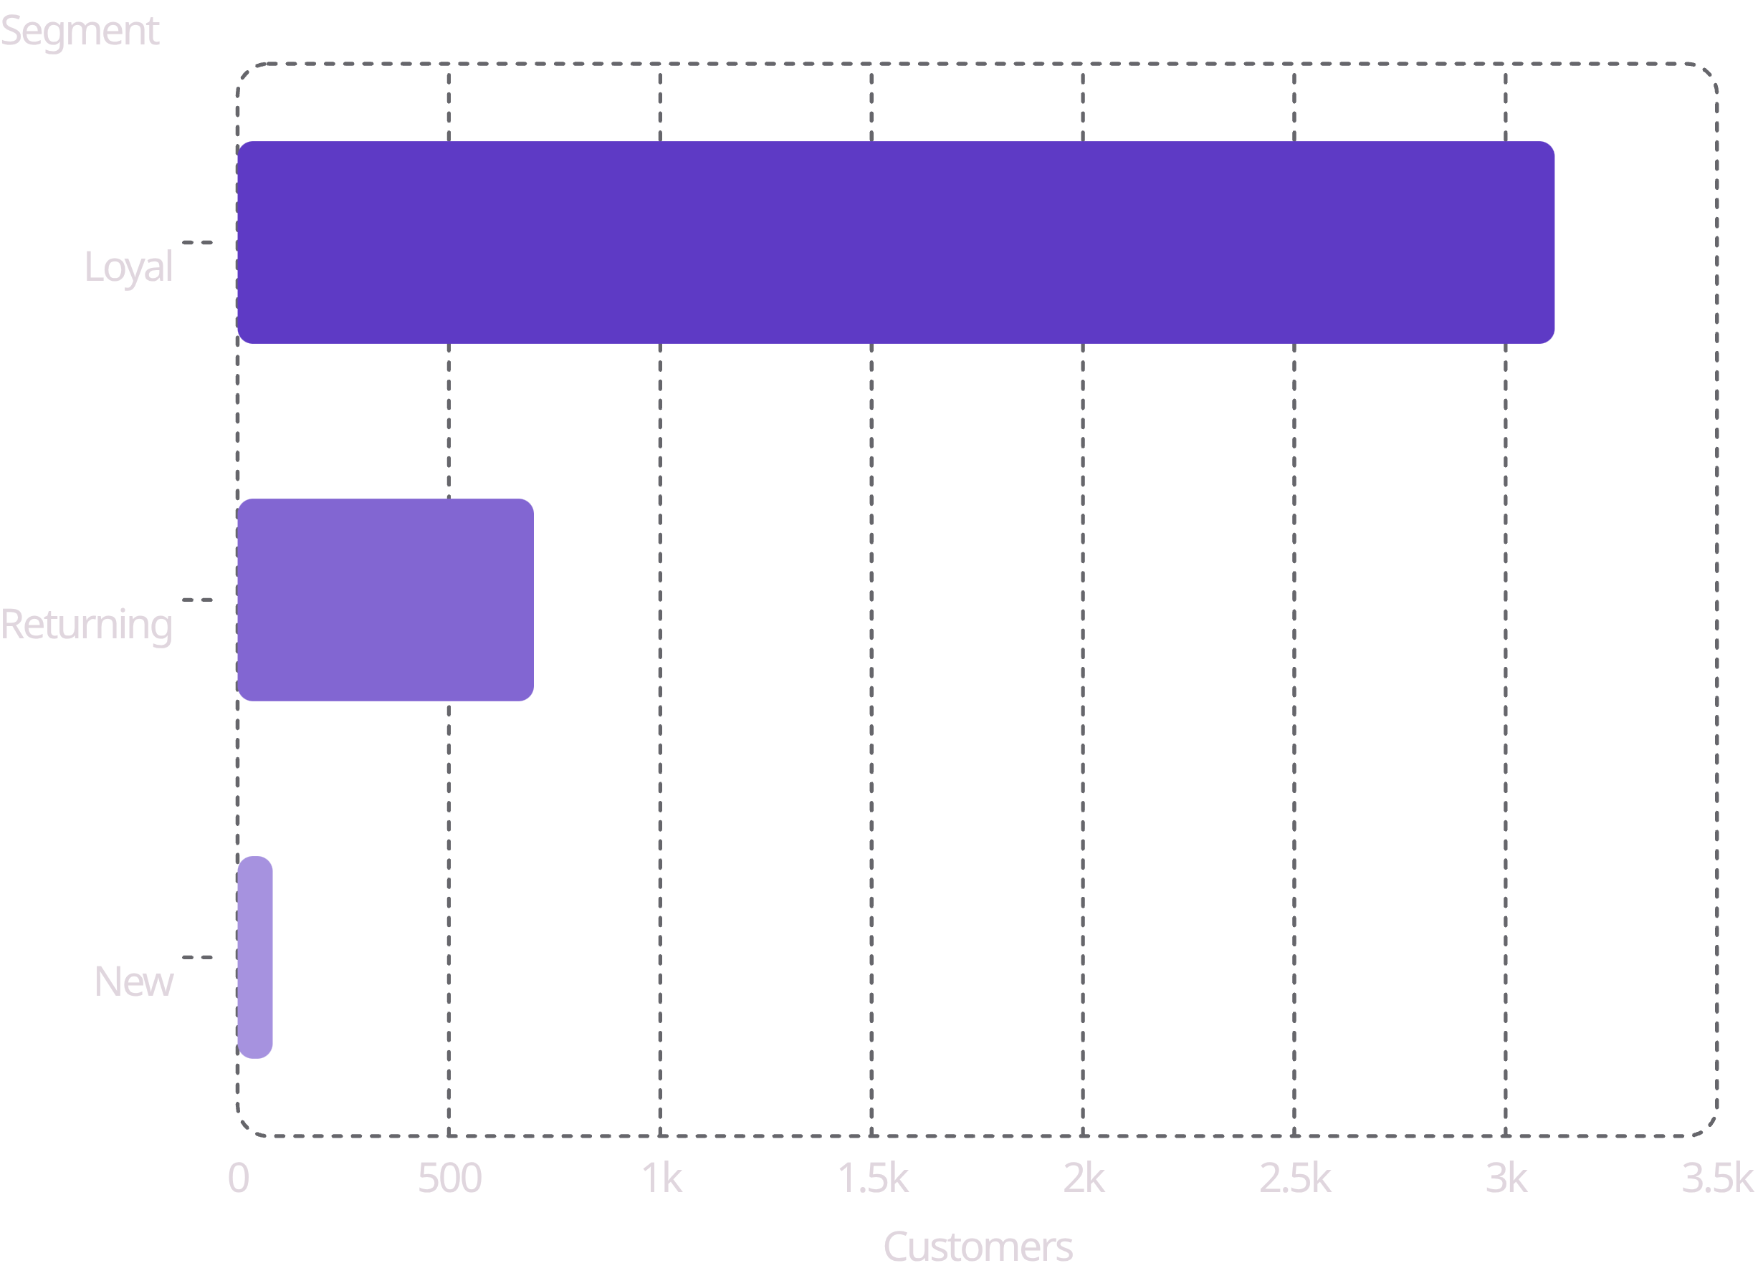
Customer Segmentation
Loyalty Pyramid
80% of customers are already Loyal. Focus: convert Returning → Loyal, and acquire New customers.

Slide 9
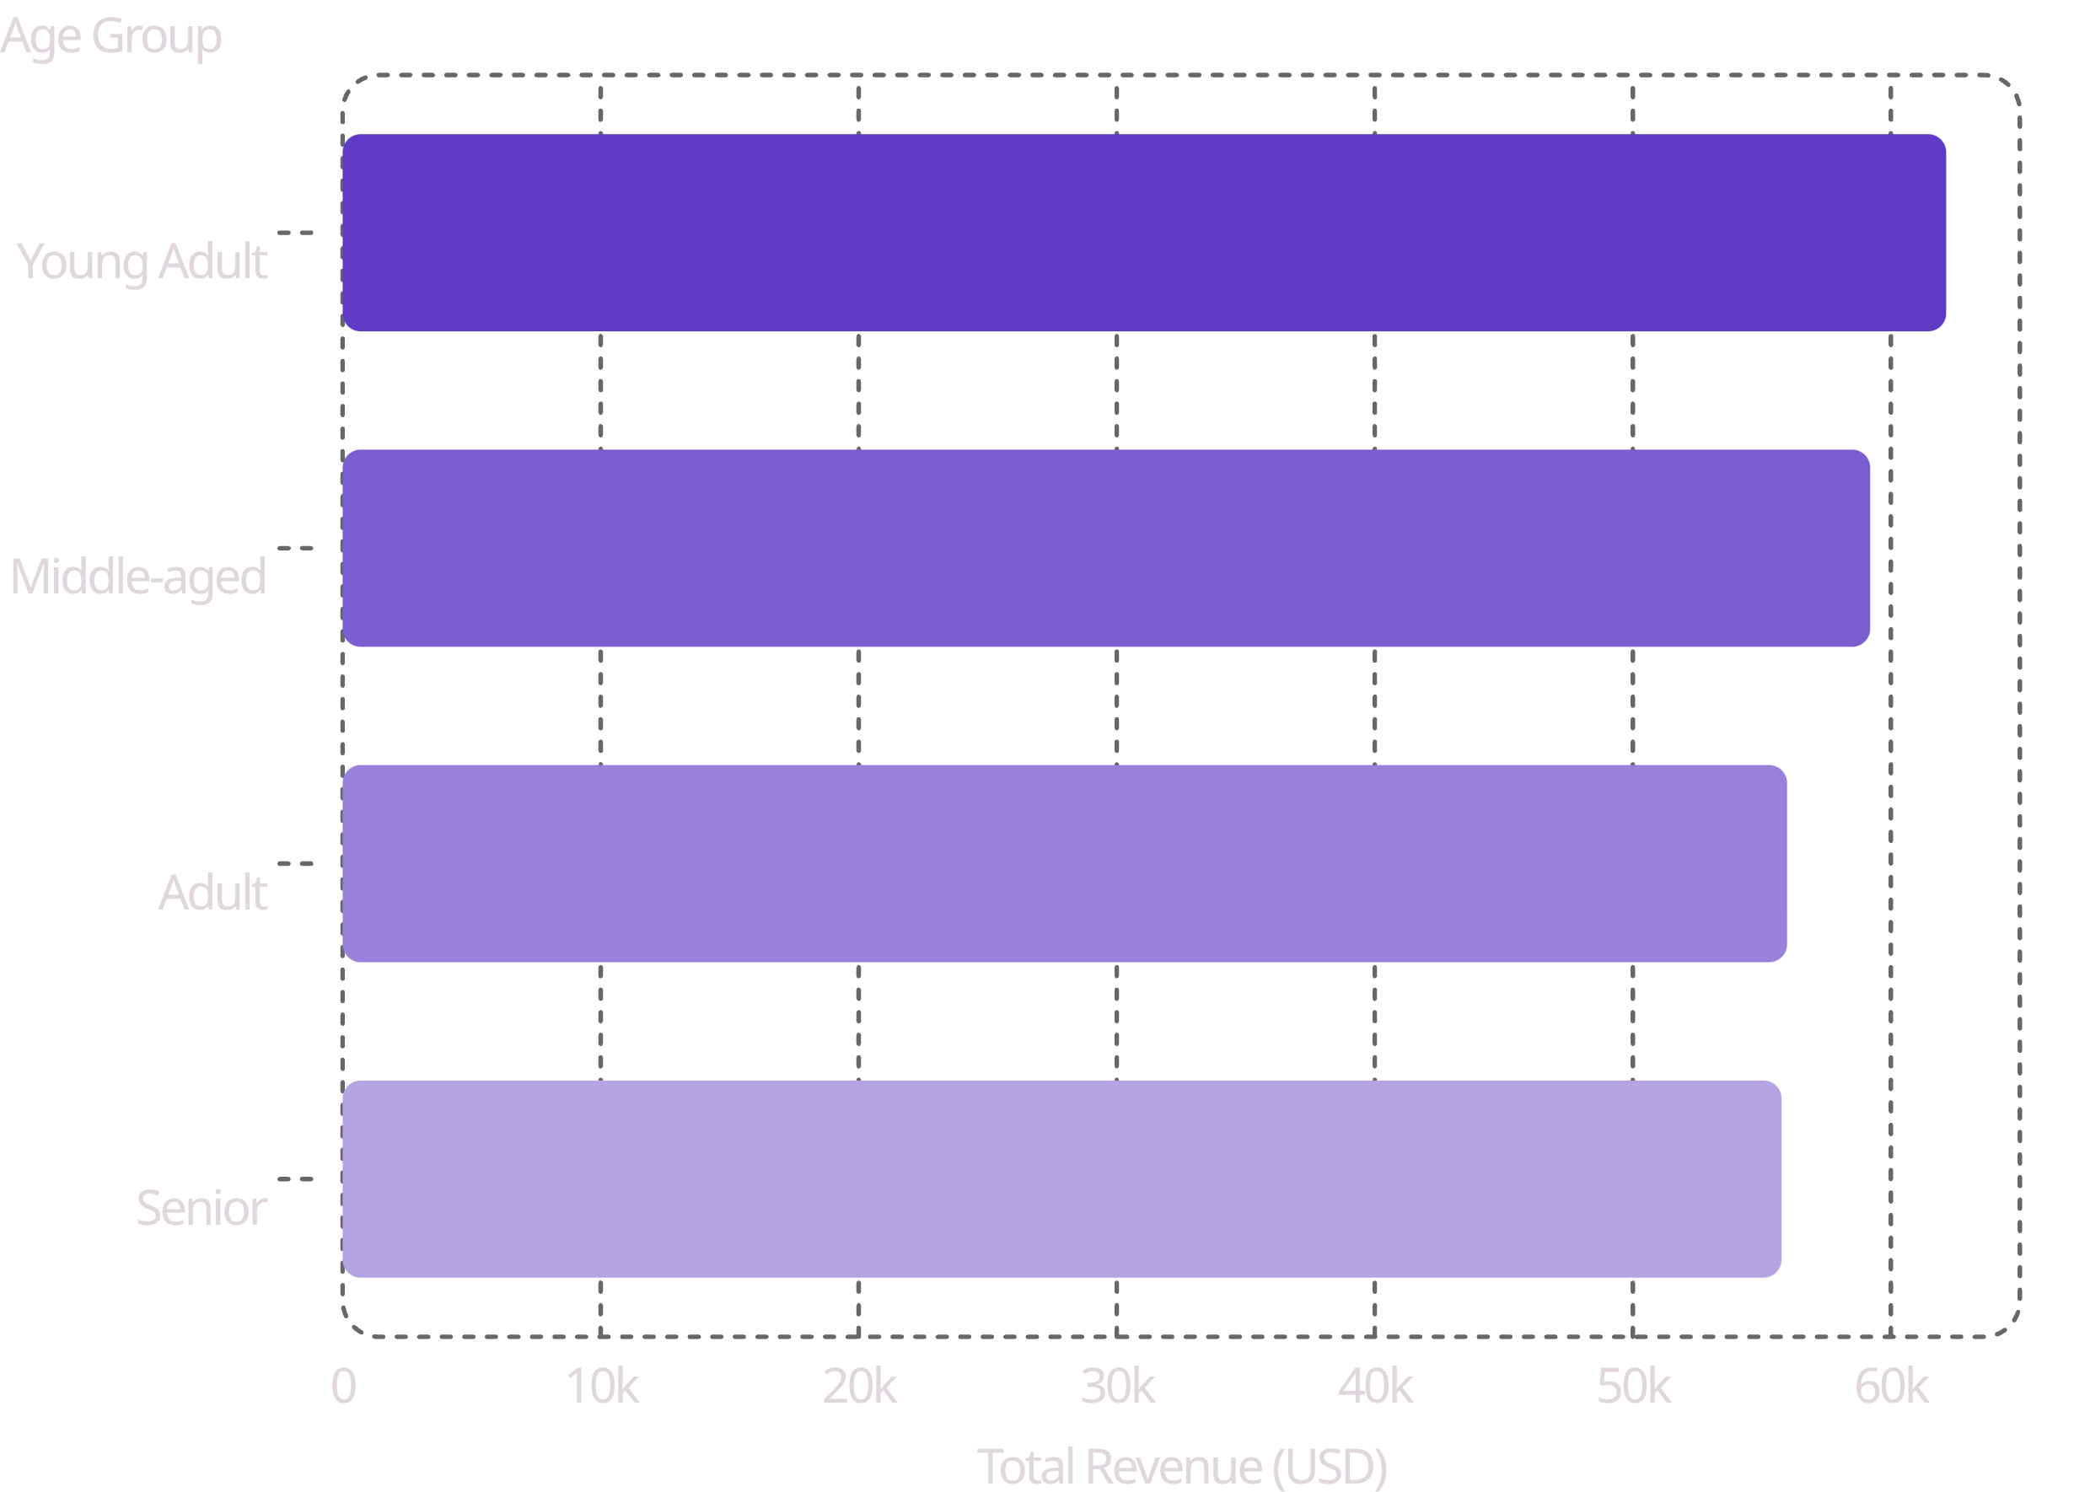
Revenue by Age Group
Top 3 Products per Category
Category | Top Products
Clothing | Blouse, Pants, Shirt
Accessories | Jewelry, Sunglasses, Belt
Footwear | Sandals, Shoes, Sneakers
Outerwear | Jacket, Coat

Slide 10
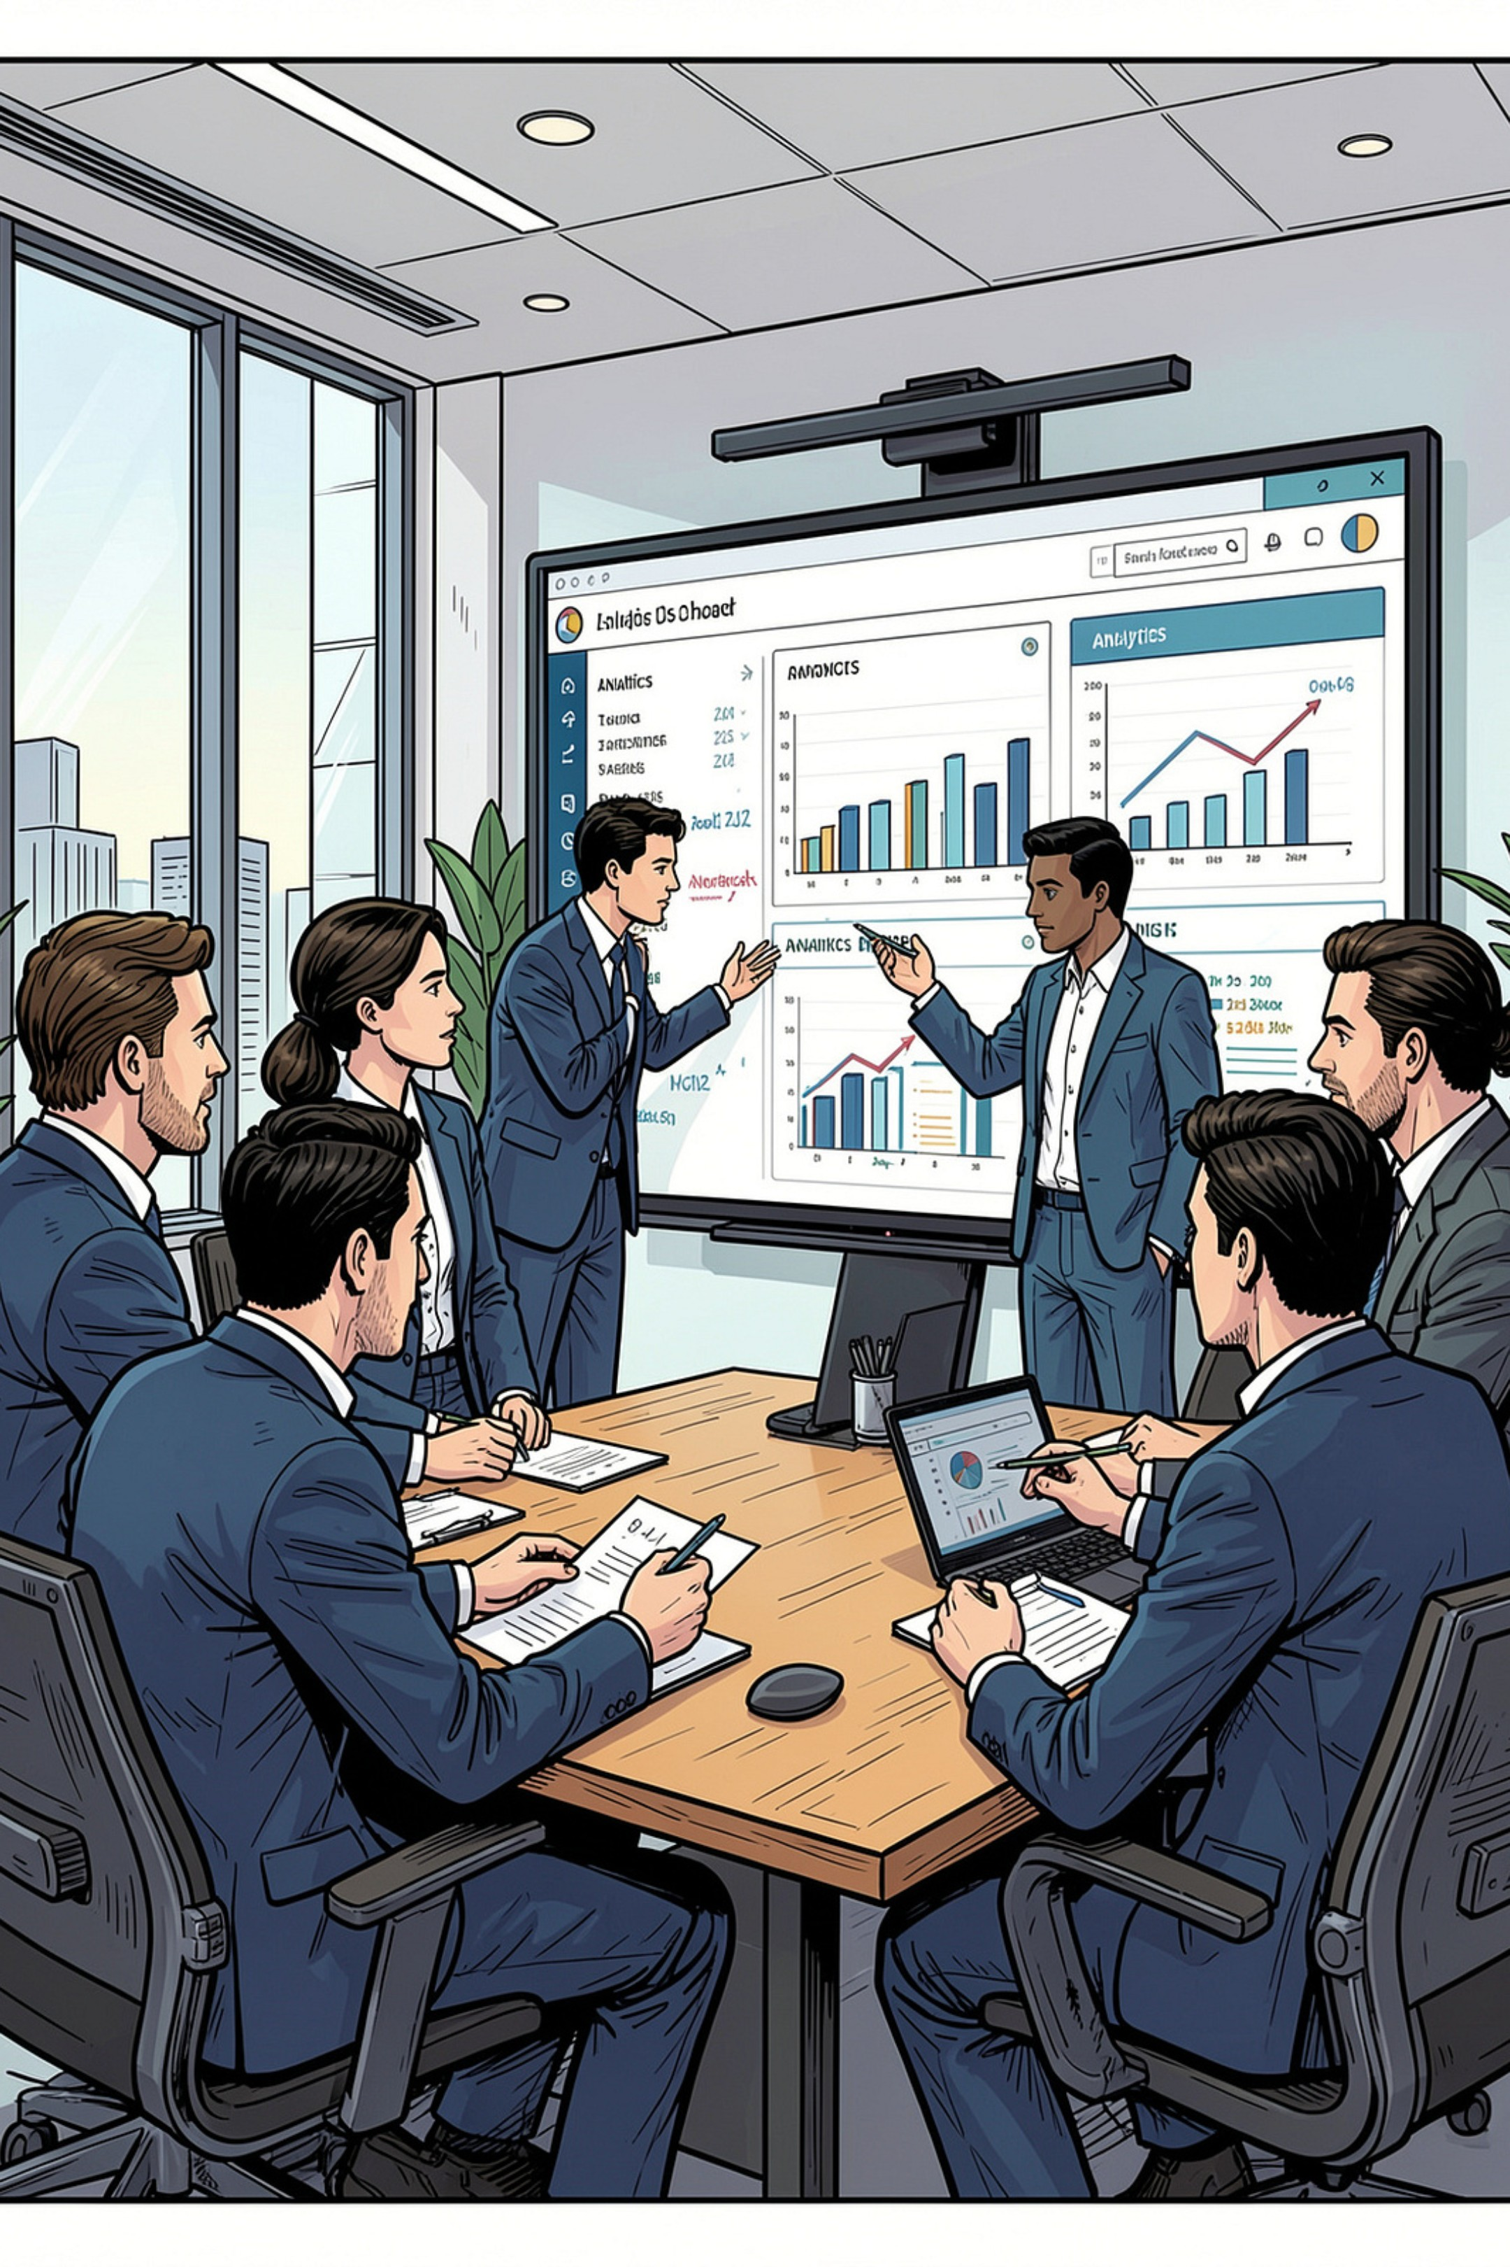




Business Recommendations
Boost Subscriptions
Promote exclusive subscriber benefits
Loyalty Programs
Reward repeat buyers → Loyal segment
Review Discount Policy
Balance sales lift with margin control
Targeted Marketing
Focus on high-revenue age groups & express shippers

