Slide 1
Global Data Insights 2023
Dashboard created using Power BI
Created by: Yash Mhatre

Slide 2
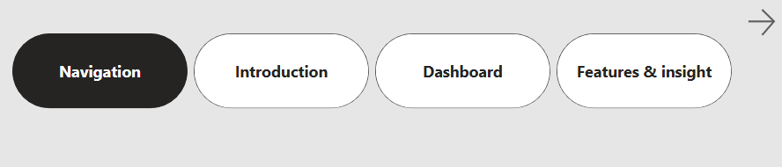
Navigation

Slide 3
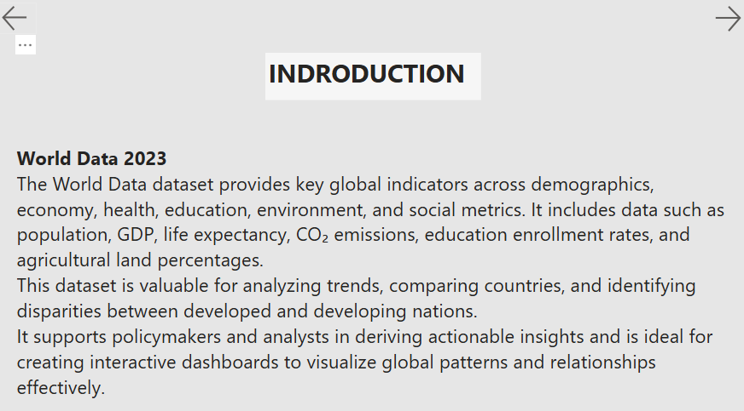
Introduction

Slide 4
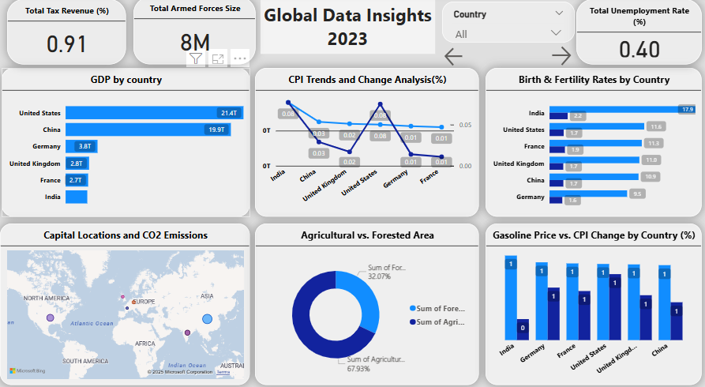
Dashboard View

Slide 5
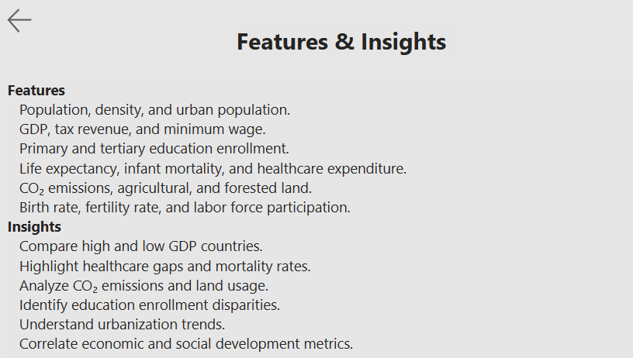
Features & Insights

