Slide 1


Bank Management System

Slide 2

Abstract:-
The Bank Management System simplifies and organizes bank operations by handling customer accounts, transactions, loans, and credit cards. It helps banks keep track of their branches and employees, making banking tasks faster and more accurate. This system improves overall efficiency and customer service.

Slide 3
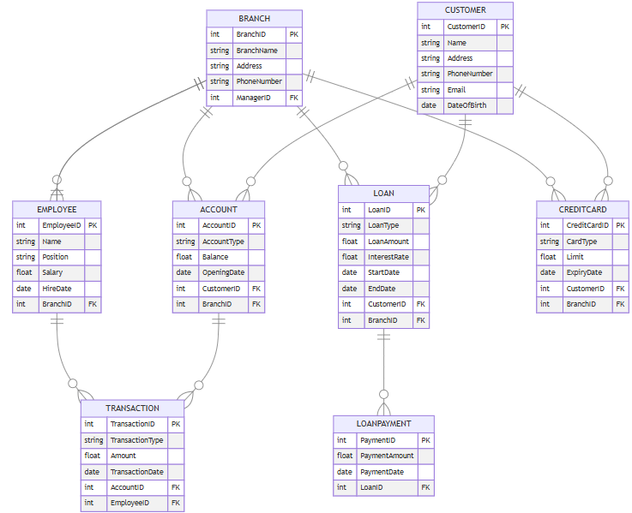
ER-Diagram

Slide 4
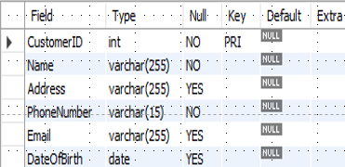
STRUCTURE OF TABLE
1. Customer Table
This Table Contains Details About Customers, Including Their Unique Identifier, Name, Address, And Contact Information.
Syntax: - DESC Customer;

Slide 5
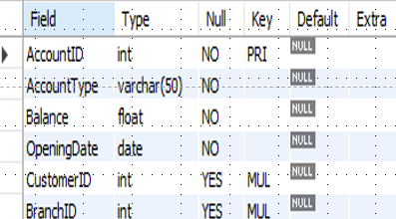
STRUCTURE OF TABLE
2. Account Table
This Table Records Details About Bank Accounts, Including Account ID, Type, Balance, Opening Date, And Links To The Customer And Branch Managing The Account.
Syntax: - DESC Account;

Slide 6
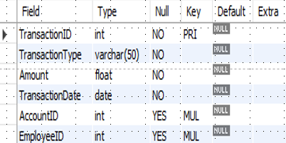
STRUCTURE OF TABLE
3. Transaction Table
This Table Details Transactions, Including Transaction ID, Type, Amount, Date, And Links To The Account And Employee Involved.
Syntax: - DESC Transaction;

Slide 7
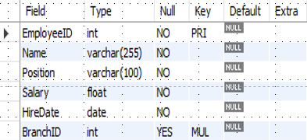
STRUCTURE OF TABLE
4. Employee Table
This Table Contains Information About Bank Employees, Including Their ID, Name, Position, Salary, Hiring Date, And Branch Affiliation.
Syntax: - DESC Employee;

Slide 8
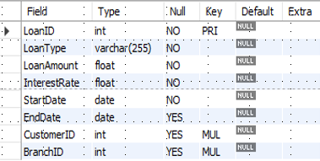
STRUCTURE OF TABLE
5. Loan Table
This Table Contains Information About Loans Issued By The Bank, Including The Loan ID, Amount, Interest Rate, Start Date, End Date, And Links To The Customer And Branch Associated With Each Loan.
Syntax: - DESC Loan;

Slide 9
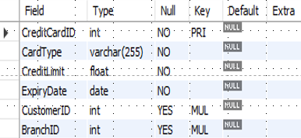
STRUCTURE OF TABLE
6. CreditCard Table
This Table Contains Information About Credit Cards Issued By The Bank, Including The Credit Card ID, Type, Limit, Expiry Date, And Links To The Customer And Branch Associated With Each Credit Card.
Syntax: - DESC CreditCard;

Slide 10
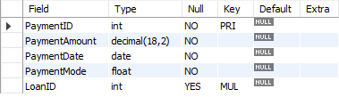
STRUCTURE OF TABLE
7. LoanPayment Table
This Table Records Loan Payments, Including Payment ID, Amount, Date, Payment Mode, And Links To The Loan Being Paid.
Syntax: -DESC LoanPayment;

Slide 11
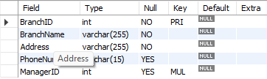
STRUCTURE OF TABLE
8. Branch Table
This Table Shows The Branches Of The Bank, Including Branch ID, Name, Address, Contact Number, And Manager Information.
Syntax: - DESC Branch;

Slide 12
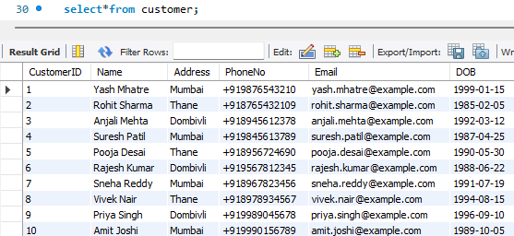
CONTENT OF TABLE

Slide 13
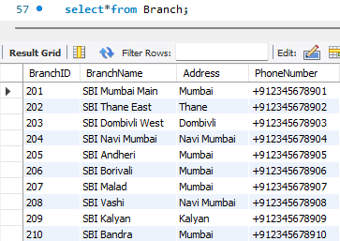
CONTENT OF TABLE

Slide 14
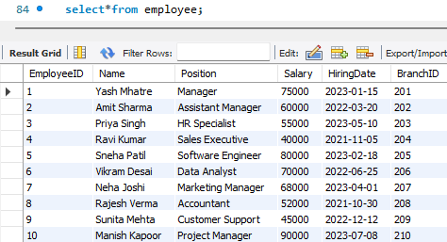
CONTENT OF TABLE

Slide 15
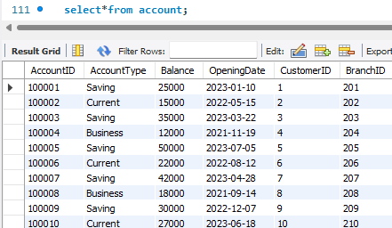
CONTENT OF TABLE

Slide 16
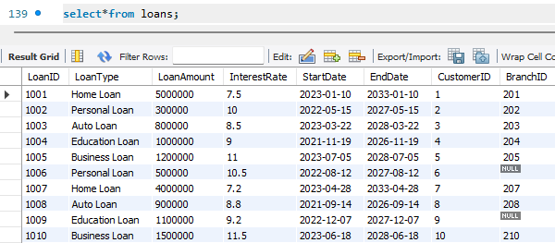
CONTENT OF TABLE

Slide 17
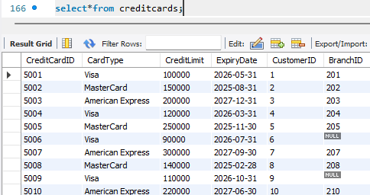
CONTENT OF TABLE

Slide 18
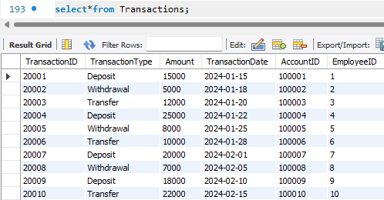
CONTENT OF TABLE

Slide 19
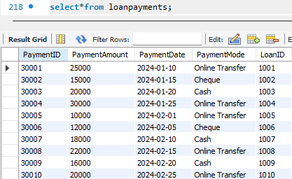
CONTENT OF TABLE

Slide 20
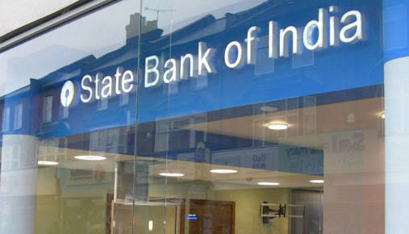
SUB-QUERIES

Slide 21

Sub-Query
This Query Finds The Employee Who Handled The Transaction With The Largest Amount.
Select E.Employeeid, E.Name, E.Positionfrom Employee Ewhere E.Employeeid = (SELECT T.Employeeid FROM Transactions T WHERE T.Amount = (SELECT Max(t2.Amount) FROM Transactions T2));

Slide 22
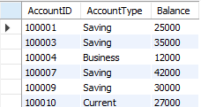
Sub-Query
Outer Query: - Retrieves AccountID, AccountType, and Balance for account with high value transaction
SubQuery: - Find account IDs where the transaction amount is greater than 10000
SELECT a.Accountid, a.Account type, a.Balance from Account a where a.AccountID IN (SELECT t.AccountID FROM Transactions t WHERE t.Amount > 10000);

Slide 23
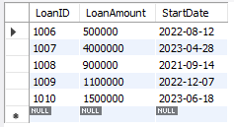
Sub-Query
Outer Query: - Retrieves LoanID, LoanAmount and Startdate for loans that have received payment after feb 1,2024
Inner Query: - loan ID with payments made up of specified date
SELECT l.LoanID, l.Loanamount, l.Startdate from Loans l where l.LoanID IN ( SELECT lp.LoanID FROM Loanpayments lp WHERE lp.Paymentdate > '2024-02-01');

Slide 24
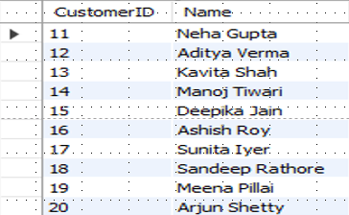
Sub-Query
List Customers Who Have Paid Off Their Loans:
SELECT c.CustomerID, c.Name from Customer c where c.CustomerID NOT IN (SELECT l.CustomerID FROM Loans l WHERE l.LoanID IN (SELECT lp.LoanID FROM Loanpayments lp WHERE lp.Paymentamount > 0 ));

Slide 25

Sub-Query
Employees Earning More Than The Average Salary Of Employees In Mumbai Branches:
SELECT e.EmployeeID, e.Name, E.Salary from Employee e where e.Salary > (SELECT Avg (e2.Salary) FROM Employee e2 WHERE e2.BranchID IN ( SELECT b.BranchID FROM Branch b WHERE Address = 'Mumbai' ));

Slide 26
JOINS

Slide 27
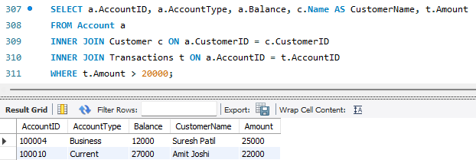
Joins
INNER JOIN: -
Explanation: This join retrieves all records where there are matching CustomerID and AccountID in Customers, BankAccounts, and Transactions, and only includes accounts with transactions above 20,000.

Slide 28
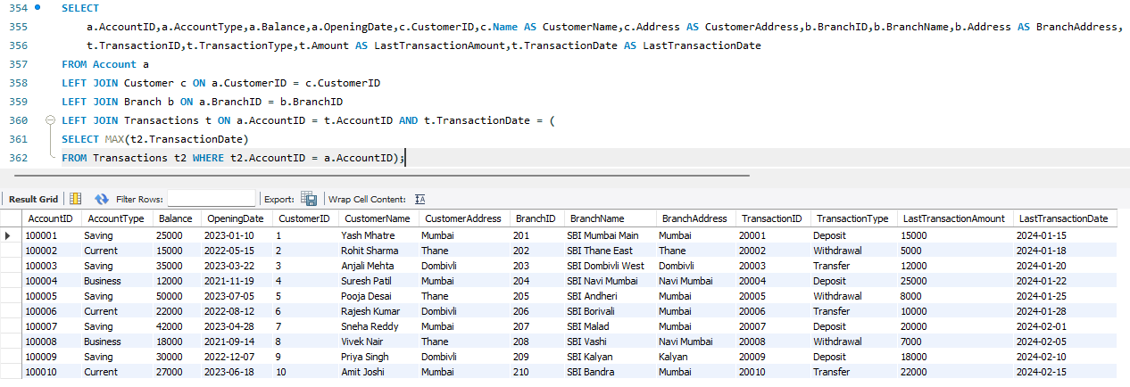
Joins
Left Join:
Explanation: List all accounts with their last transaction details, even if no transactions exist.

Slide 29
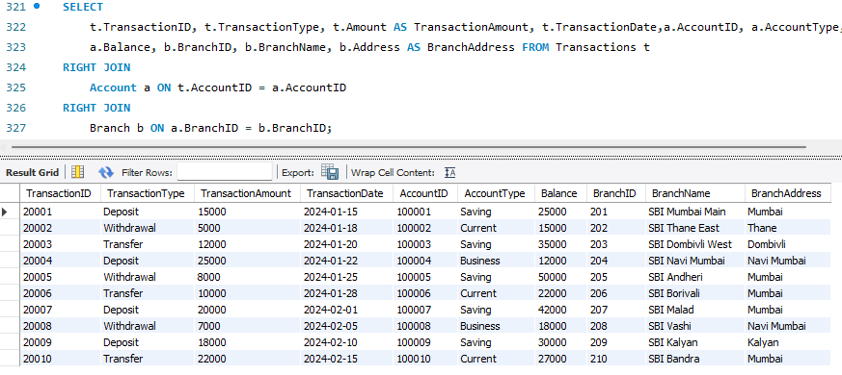
Joins
Right Join: -
Explanation: List all transactions, showing account and branch details if available

Slide 30
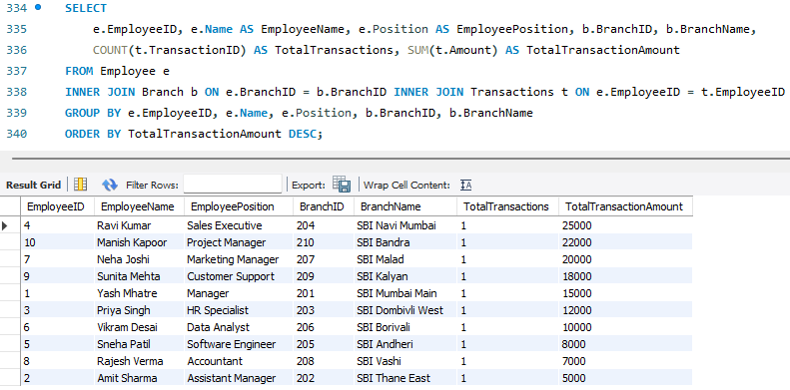
Joins
Inner Join: -
Explanation: - Find total transactions and total amount handled by each employee per branch.

Slide 31
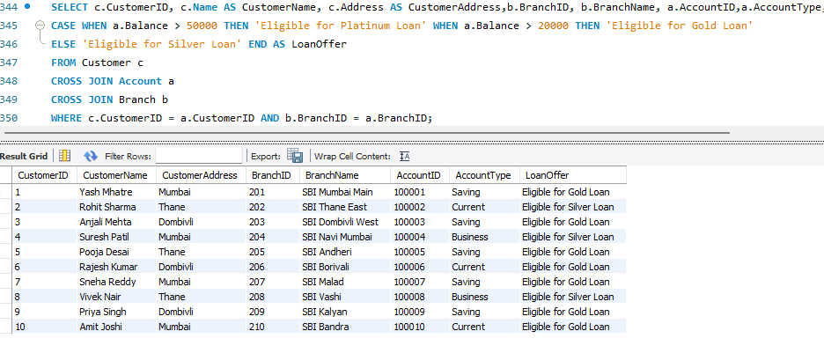
Joins
Cross Join: -
Explanation: Generate a report showing potential loan offers for customers based on their accounts and branches.

Slide 32
VIEWS

Slide 33
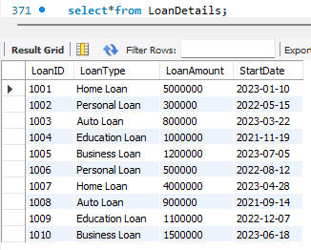
VIEWS
This View Provides A Summary Of Loans, Focusing On Their Ids, Types, Amounts, And Start Dates. It Helps In Reviewing Loan Records Without Additional Details About Customers Or Branches.
Create View LoanDetails As Select LoanID, LoanType, LoanAmount, StartDate from Loans;

Slide 34
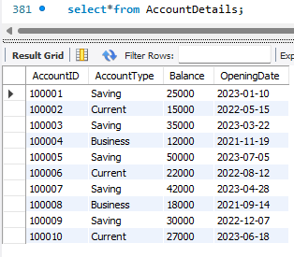
VIEWS
This View Provides A Clear Picture Of Each Account’s Details, Including The Type, Balance, And Opening Date. It Helps In Monitoring Account Statuses.
Create View Accountdetails As Select AccountID, Accounttype, Balance, Openingdate From Account;

Slide 35
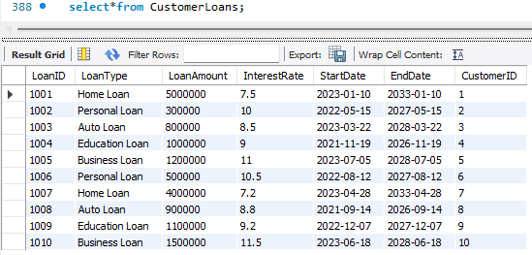
VIEWS
This View Lists All Loan Details, Including The Type, Amount, Interest Rate, Start And End Dates, And The Associated Customer ID. It Helps In Reviewing Loan Portfolios.
Create View CustomerLoans As Select LoanID, LoanType, LoanAmount, InterestRate, StartDate, EndDate, CustomerID From Loans;

Slide 36
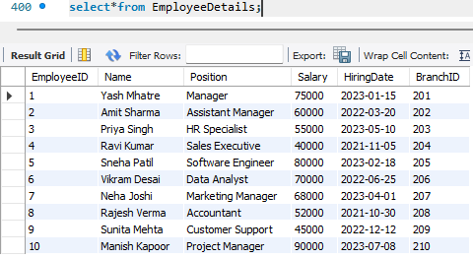
VIEWS
This View Lists Each Employee's Details, Including Their Position, Salary, Hiring Date, And Branch Association. It Helps In Managing Employee Information And Payroll.
Create View EmployeeDetails As Select EmployeeID, Name, Position, salary, HiringDate, BranchID From Employee;

Slide 37
PREPARED BY:
Yash J. Mhatre
T34/DS&DA/July 2024/1pm-3pm/R

Slide 38
THANKYOU

