Slide 1
CitiSite:Deep Learning and Computer Vision Enabled Transport Policing System
By Yashmaan Singh ,Bhanu Pratap and Ojasv Tyagi MCA 3rd Sem

Slide 2
Problem Identification
Manual monitoring of seat occupancy in public transport is inefficient and prone to errors
Reserved seats for females and special categories are often misused due to the lack of an automated detection system.
Incidents such as fights, theft, and misbehavior occur without timely detection
These safety concerns arise because there is no real-time system to alert authorities about violations.
The absence of automated monitoring compromises passenger comfort and security.

Slide 3
Objectives
To automatically detect empty and occupied seats using AI-based techniques.
To identify fights, theft, and misbehavior in real time.
To provide real-time alerts to transport authorities for quick response to incidents.
To enhance safety, comfort, and operational efficiency in public transportation
To create a scalable solution that can be implemented in various types of transport systems.

Slide 4
Abstract
The Deep Learning and Computer Vision Enabled Transport Policing System strives to contribute to improving and increasing transport safety and the behaviour and discipline of commuters while in a public transport environment through the use of knowledge of advanced artificial intelligence technologies. It uses technologies such as deep learning and computer vision that continuously finds measure where there is observed seat occupancy and or fight, violence or any kind of behaviours occurring in a transport vehicle such as a bus and a train. It uses continuous video to do an automated video processing, for automated analysis to automated finding anything that constitutes a violation and sending sending notification alerts to the transport authorities to act to the events as they unfold and in real-time.

Slide 5
Abstract (contd.)
This system has the advantage of reducing the need for human monitoring, enhancing control and efficiency of the operation of monitoring an environment, and a safer overall travelling passenger environment. Moreover, it is scalable, with options to expand to different types of transport networks. In addition, this type of system promotes responsible behaviour to commuters on public transport, while providing means for transport authorities to maintain order even control in public transport environments. Also, the system will provide automation and efficiency, reliable systems that continuously process large quantities of information without compromising efficiencies, that can offer a more comprehensive account of activities. This project has also demonstrated the potential interactive possibilities of AI-powered systems to enhance and improve safety in the public and ensures to enhance transportation management of public transport systems more efficiently with technologically advanced means and systems of activity accountability and data management and reporting to facilitate a better commuting experience overall.

Slide 6
Methodology
Data Acquisition: Public datasets such as RWF-2000, SCFD. Annotations include labels for fight scenes, passenger head locations, and seat boundaries
Preprocessing: Frame extraction from video streams. Data augmentation techniques such as flipping, rotation, and brightness adjustment to improve model robustness.
Model Used: YOLOv12 or EfficientNet-based CNN models are trained to detect human heads and seat areas from video frames.
Detection Process: Human pose landmarks are extracted from each frame using models like OpenPose or MediaPipe.

Slide 7
Model Architecture
Video Footage
Preprocessing
Seat occupancy detection
Misbehavior detection
Computing Unit
Alert System

Slide 8
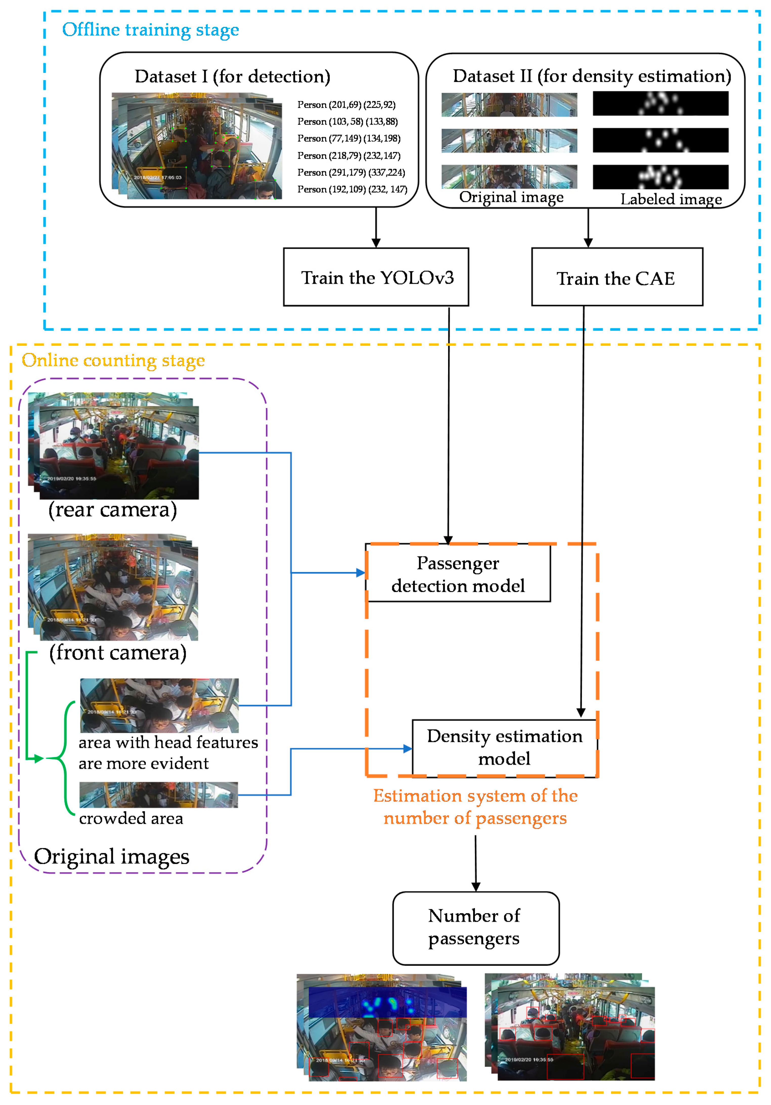
Train the CNN

Slide 9
Research papers related to violence detection
Main:- Bus Violence: An Open Benchmark for Video Violence Detection on Public Transport
Automated violence monitoring system for real-time fistfight detection using deep learning-based temporal action localization
Safety After Dark: A Privacy Compliant and Real-Time Edge Computing Intelligent Video Analytics for Safer Public Transportation

Slide 10
Research Papers related to seat occupancy
Int.2D-3D-CNN: Integrated 2D and 3D Convolutional Neural Networks for Video Violence Recognition
CUE-Net: Violence Detection Video Analytics with Spatial Cropping, Enhanced UniformerV2 and Modified Efficient Additive Attention
Estimation of the Number of Passengers in a Bus Using Deep Learning

Slide 11
Implementation
Pre-trained YOLO for person detection.
MediaPipe / YOLO-Pose for posture.
Fine-tuned CNN for gender classification.
Python + OpenCV for video processing.
Seat occupancy logic with bounding boxes & polygons.

Slide 12
Who benefits from this project?
Public Transport Authorities
Private Transport Operators
Insurance Companies
Security and Emergency Response Teams

Slide 13
Drawbacks
Limited Dataset
Privacy Concerns
Dependence on Camera Quality
High Computational Requirements

