Slide 1
Jayawant Institute of Management Studies, Tathawade
Department of MCA
Subject: Mini Project
Name := Yash Bhaskar Narkhede
Roll No. := 61291546

Slide 2
Project Name :=
E - Canteen

Slide 3
Client Name and Contact Details :=
Name := Rutik Bahir
Ekdant canteen, JSPM, Pune
Pune, Maharashtra , India
Contact No. : 7447424282

Slide 4
Introduction :=
Now a days , people don't have much time spend in Canteen by just there and waiting for the food. Sometimes they will not get food because of insufficient food. The project online canteen food ordering system helps the users to book their food earlier. As soon as they book their food the order will be sent to the chef for preparing it.
The present system consists of the manual system that involves the paper work of the billing system and maintaining the files too.

Slide 5
Introduction :=
In the proposed system the payment is online and the e-menu will be available for the user. The users will have the username and the password through which they can book.
This project will help in demonstrating the route from adapting materials to developing an online environment.

Slide 6
Need of Proposed System:=
The reason behind it is that there is lot of information to be maintained and Have to be kept in mind while running the business. For this reason we have provided a system which is automated (computerized).
With the implementation of computerized system, the task of keeping records in an organized manner will be solved. The greatest of all is the retrieval of information, which will be at the click of the mouse.
Customers can register and get the information they want, they can give feedback about the canteen .All this can be done online from home. So the proposed system helps in saving the time in different operations and making information flow easy giving valuable reports.

Slide 7
Scope of the proposed System :=
➢ Admin :=
Manage Menu
Add Gallery Images(Food)
Daily Design menu
View reports
➢ Customer :=
Sign up, Login
Add to Cart
Add Quantity
Remove from Cart
Payment Mode
Give Feedback
Technology Description :=
Java, MySQL, JDK, Netbean(8.2)

Slide 8
Hardware-Software Requirements :=
❖ Software Requirement :=
▪ OS : windows 7 or above
▪ Browser : Any
❖ Hardware Requirement :=
▪ Processor : intel i3 or above
▪ Ram : 8 GB
▪ Hard disk : 50 GB or above

Slide 9
ADVANTAGES:=
1. Security of data.
2. Ensure data accuracy’s.
3. Minimize manual data entry.
4. Minimum time needed for the various processing.
5. Greater efficiency and Better service.
6. User friendliness and interactive.
7. Minimum time required.

Slide 10
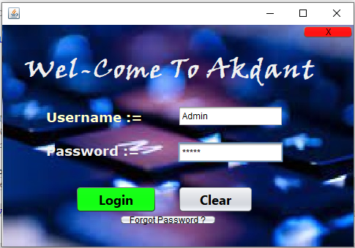
GUI := ADMIN
Login Page := Admin

Slide 11
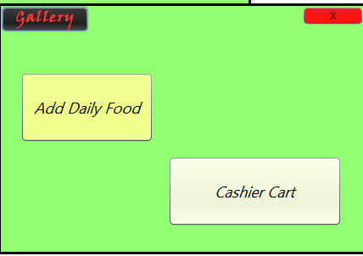
After Success Login :=
Admin Add Daily Food and Cash/ Online Payment for Food

Slide 12
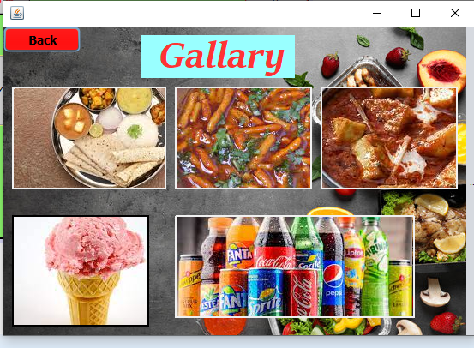
Admin :- Gallery

Slide 13
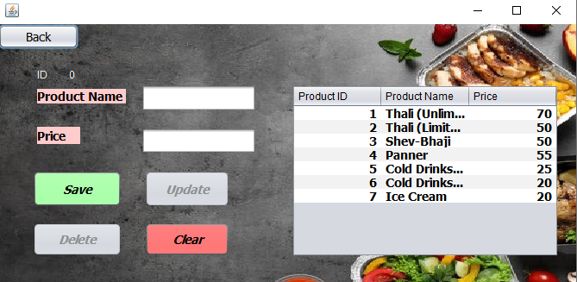
In Add Daily Food, Admin Add Daily Food.

Slide 14
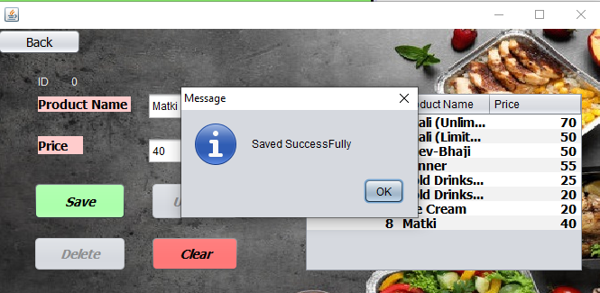
Admin :-

Slide 15
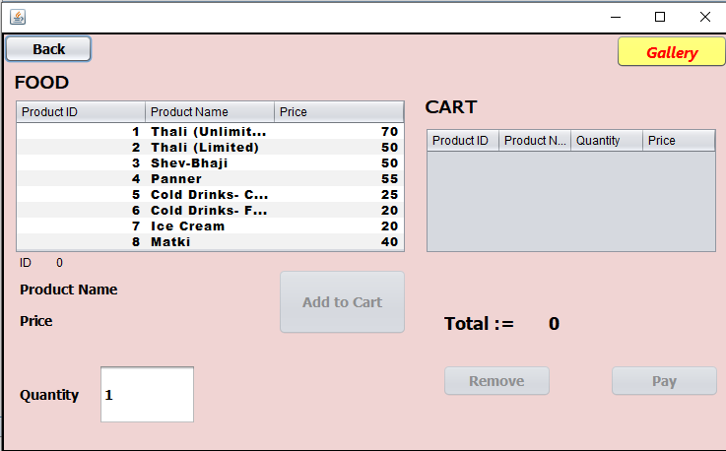
Admin placed order for Manually.

Slide 16
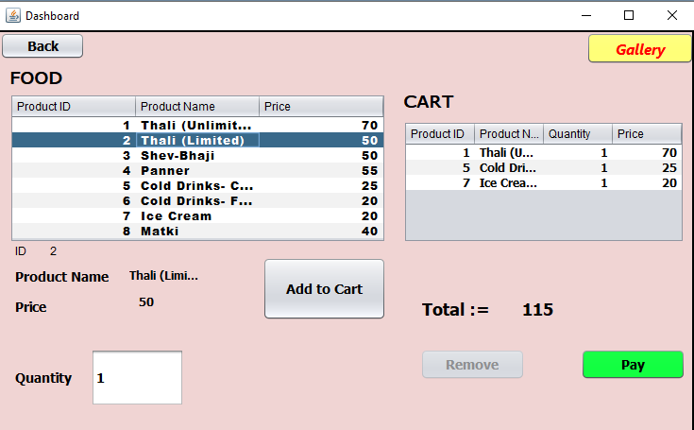
Admin :-

Slide 17
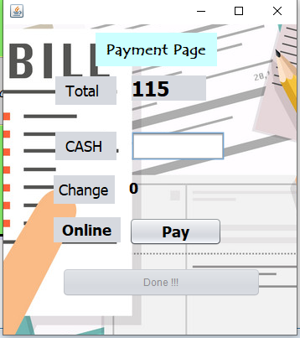
Admin :- Payment Cash / Online.

Slide 18
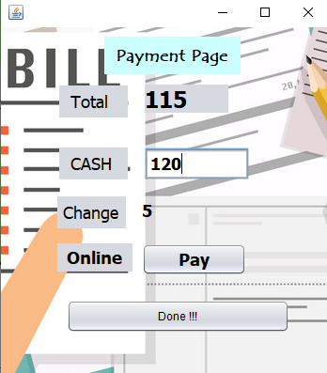

Slide 19
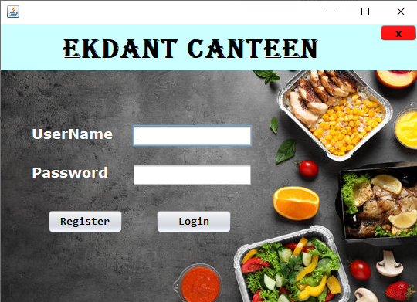
GUI := USER

Slide 20
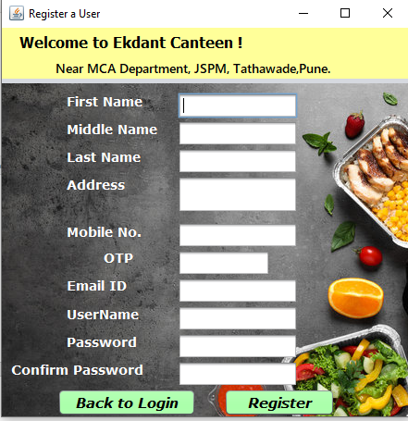
User :- First Register then Login .

Slide 21
User Add Food Items and Placed Order.

Slide 22
User :- Take payment though Online

Slide 23
REFERENCES:=
WWW.Javapoint.com
WWW.Netbean.org
Prof. Sweta Padale Mam

Slide 24
Thank You !
Any Questions ?

