Slide 1
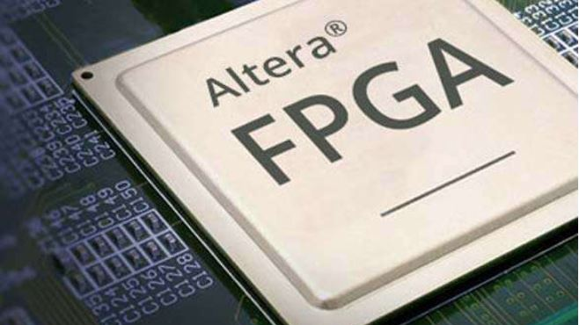
Intel Altera tools for FPGA Design
Yashodhan Vishvesh Deshpande

Slide 2
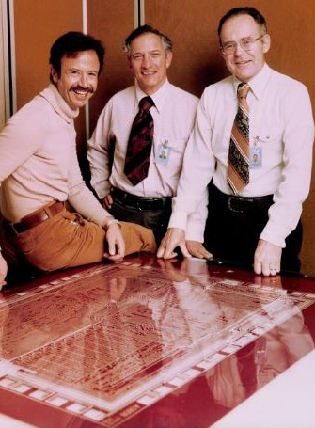
History of Intel in FPGA market
Intel semiconductor company was founded in 1968.
Altera was founded in 1983.
Altera entered in an agreement on February 2013 with Intel to use Intel's foundry services.
Intel entered the FPGA sector in 2015 when it acquired Altera as its business unit.

Slide 3
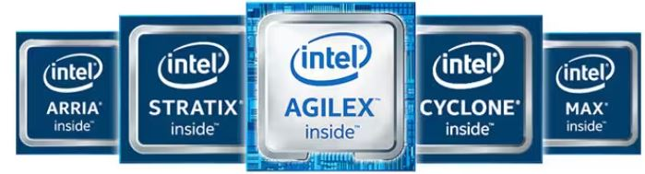
Intel Altera FPGAs
INTEL produces a wide range of FPGA products for applications based on custom logic solution.
Intel Agilex FPGA portfolio
Intel Stratix series
Intel Arria series
Intel Cyclone series
Intel Max series

Slide 4
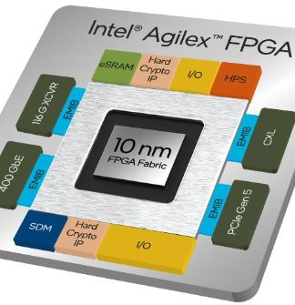
Intel Agilex FPGAs and SoCs
Intel Agilex FPGAs have application for full breath of programmable logic needs.
F series of SoC FPGAs- wide range of applications across many markets. Transceiver rates up to 58Gbps
I series of SoC FPGAs- bandwidth-intensive applications. Highest performance I/O interfaces, transceiver rates up to 116 Gbps.
M series of SoC FPGAs- optimized for computation and memory-intensive applications, Network-on-Chip (NoC) to maximize memory bandwidth.
Use cases are in industries such as communication and data centers.

Slide 5
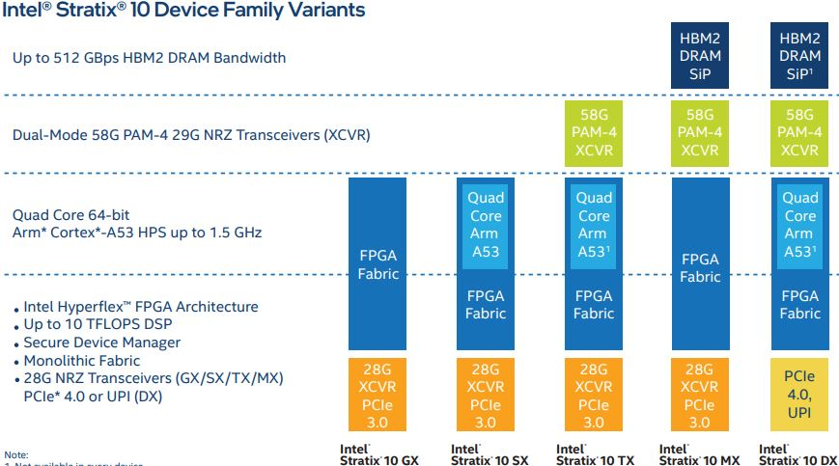
Intel Stratix 10 FPGA and SoC
Stratix 10 FPGAs are used in application which require heavy computing.
They are the highest density FPGA with up to 10.2 M logic elements.

Slide 6
Intel Arria 10 FPGA and SoC
The intel Arria 10 FPGAs are produced by TSMCs foundry on a 20nm fabric.
Arris 10 FPGA is with speeds up to 1,500 giga floating-point operations per second (GFLOPS).
Ideal use case for end market applications because of its high speeds.
Applications in :Remote radio head , Mobile back haul, Data center server acceleration, Encoder/decoder

Slide 7
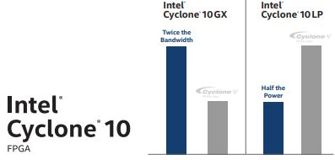
Intel Cyclone 10 FPGA and SoC
Intel Cyclone 10 FPGAs are designed for low cost and power saving applications.

Slide 8
Intel MAX 10 FPGA and SoC
Wide range of high-volume and cost-sensitive applications
TSMCs foundry on 55nm flash technology
Electric vehicle
Industry applications (IOT)
Communications system-monitoring circuitry

Slide 9
Intel Altera FPGAs Design Tools
FPGAs designing process faces many challenges
RTL code analysis
Physical synthesis for earlier timing
Parallel data processing

Slide 10

Intel Quartus Prime Design Software
Premium software from Intel used to design entry, synthesis to optimization, verification, simulation, and binary generation for Intel FPGAs
The lite versions is free to use while the pro and standard versions requires a paid license.

Slide 11
Design Flow
Platform designer - design process by automatically generating interconnect logic to connect intellectual property (IP) functions.
1
Block based design workflows- allow the user to add 3rd party IPs and pre designed blocks, allow geographically diverse teams to collaborate.
2
Partial reconfiguration- ability to reconfigure a part of the FPGA design dynamically while the rest of the FPGA design continues to function
3

Slide 12
Design Entry/Planning
Creating a design partition -optimize and lock down results for individual blocks, ability to reuse the results of individual blocks in another projects
Chip Planner-allows you to view floor-planning of the FPGA, used to modify the logic placement, connections, and routing paths after running the Fitter
Interface planner-explores the FPGA devices peripheral architecture and assigns appropriate interfaces
Logic Lock regions- logic placement and routing constraint, assign design nodes and other properties to the region, more predictable result

Slide 13
Placement and routing
Fitter (Place and Route)- process all levels of design place and route, including the Plan, Early Place, Place, Route, and re-time stages.
Register re-timing-can balance register chain by moving them into hyper registers in the routing fabric itself. Can also move the register chain across combinational logic to provide optimized solutions.

Slide 14
Timing and power
Timing Analyzer - checks the timing for design paths, evaluates the propagation delay along each path and checks for any timing constrain violations
The Design Space Explorer II tool- reports the best combination of setting and constraints, most optimal project setting for resource, performance and power consumption
Power analyzer - analyze the power consumption up to the field-programmable gate level, produce highly accurate power reports

Slide 15
Simulation and debug
Signal Tap Logic Analyzer -reads and reports real-time signal behavior in a FPGA design, gives a sight of internal signal without the requirement of any I/O pins or external devices, debug more efficiently
Transceiver Toolkit - allow designer real-time transceiver settings and reduces board bring-up time, can run link tests
Intel Advanced Link Analyzer- allow designers to evaluate high-speed serial link performance, post design debug and validation processes

Slide 16
Additional tools
Digital Signal Processing Builder for Intel FPGAs – generates HDL for DSP algorithms form Mathworks and simulink tools on Intel FPGAs. Highly synthesizable VHDL/ Verilog code.
Embedded Software and tools for Intel and SoC FPGA - development tools with utility programs, run-time software and application examples
High Level Synthesis compiler - takes in untimed C++ as input and generates production-quality register transfer level (RTL) code
Intel FPGA AI Suite - enables FPGA designers, machine learning engineers, and software developers to create optimized FPGA AI platforms.

Slide 17
Conclusion
Intel Altera FPGA
Agilex , Cyclone, Stratix, Max and Arria series
Intel Altera FPGA Design tools
Design flow, design entry/planning, placement and routing, timing and power verification, simulation and debug tools
Additional design tools

Slide 18
Q & A

